Slide 1
ARDUINO WORKSHOP 2020
FROM GOWRAV S GOKUL SAI R

Slide 2
WHAT IS AURDUINO !!!!
Arduino is an open-source prototyping platform used for building electronics projects. It consists of both a physical programmable circuit board and a software, or IDE (Integrated Development Environment) that runs on your computer, where you can write and upload the computer code to the physical board.
Arduino was born at the Ivrea Interaction Design Institute as an easy tool for fast prototyping. Initially, it was aimed at students without a background in electronics and programming, but now, it is considered to be a great tool for people of all skill levels. The Arduino hardware and software was designed for artists, designers, hobbyists, hackers, newbies, and anyone interested in creating interactive objects or environments.
The Arduino board started adapting to the new needs and challenges, differentiating it from simple 8-bit boards to products for IoT applications, wearable, 3D printing, and embedded environments. Arduino can interact with buttons, LEDs, motors, speakers, GPS units, cameras, the internet, and even your smart-phone or your TV.

Slide 3
Why Arduino ????
It can be programmed with C++ language.
Arduino Uno uses a different USB chip which makes installation of the Arduino software lot easier.
Has higher speeds of communication with the computer.
Comes equipped with the ATmega328 Microcontroller, which has more memory.
The processor can be easily replaced if damaged.
Can supply more current on its 3.3V supply.
Arduino is an open-source electronics prototyping platform.
It is flexible, easy-to-use hardware and software.
Kids can use this to make interactive objects quickly and easily for their school projects.
It will enhance their thinking and analytic skill set.
Libraries to do Everything
Low Cost

Slide 4
DIFFERENCE BETWEEN MICROPROCESSOR AND
MICROCOTROLLER

Slide 5
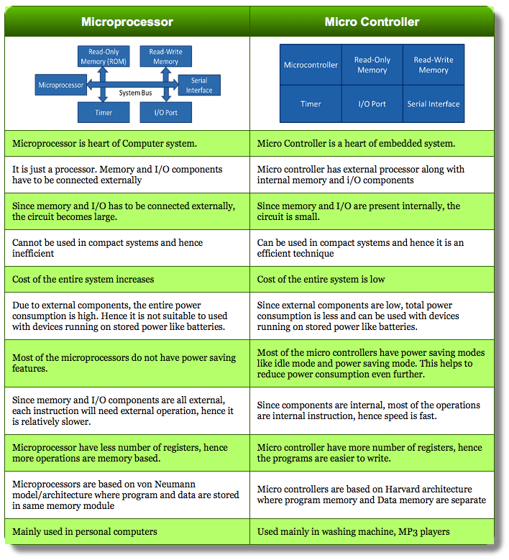

Slide 6
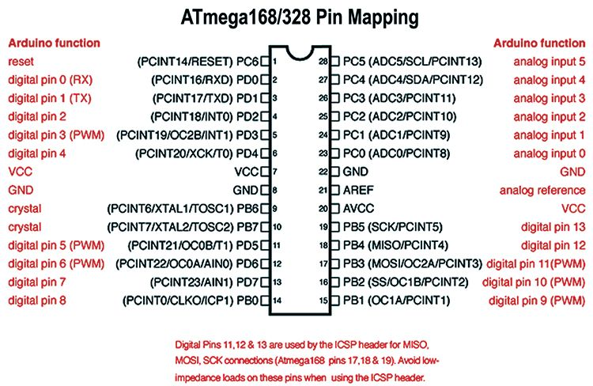
ARDUINO MICROCONTROLLER ATMEGA328P

Slide 7
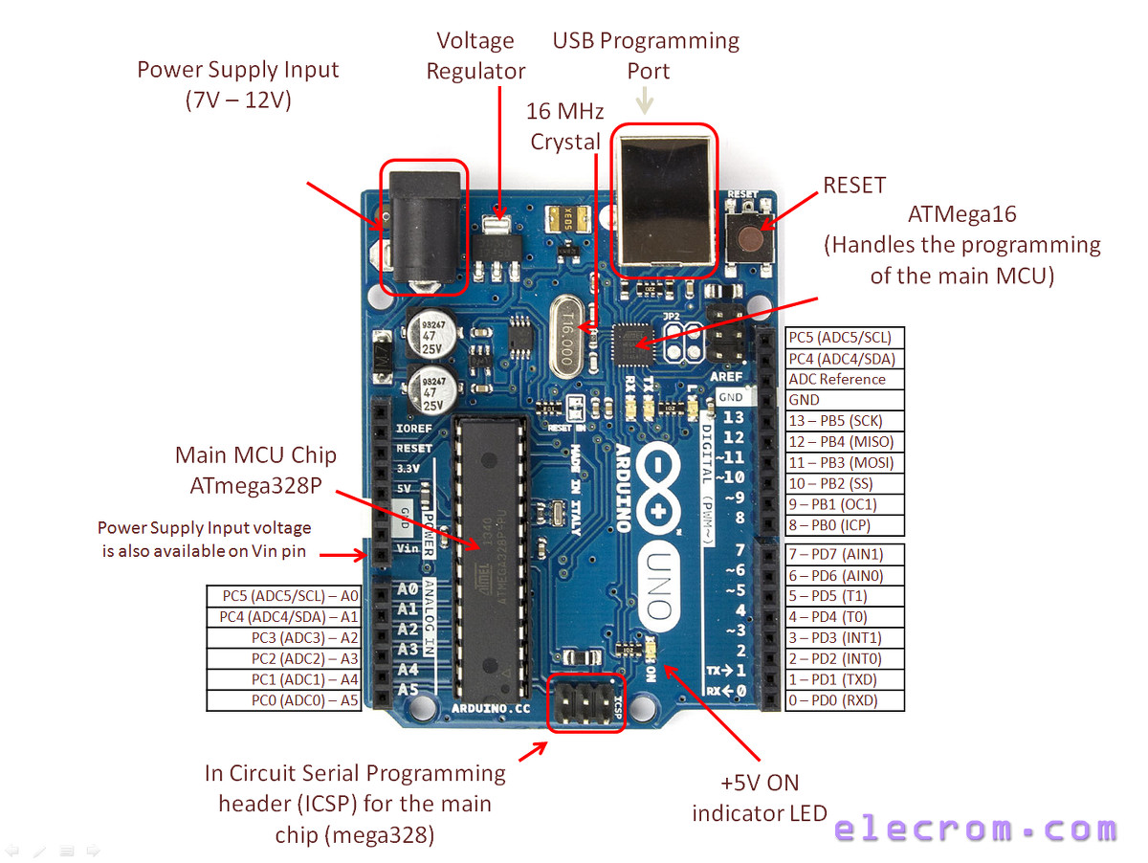
ARDUINO UNO COMPONENTS AND PINOUT

Slide 8
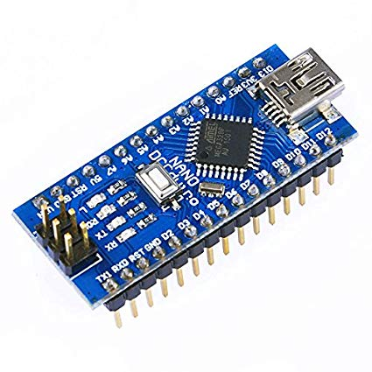
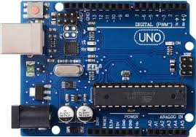
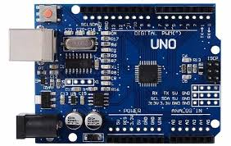
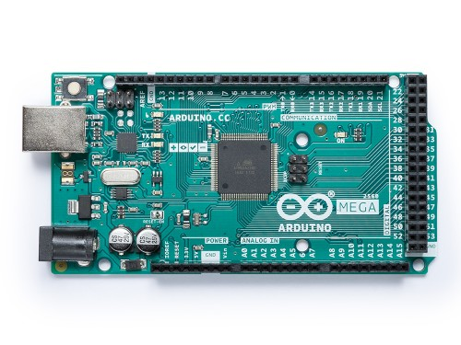
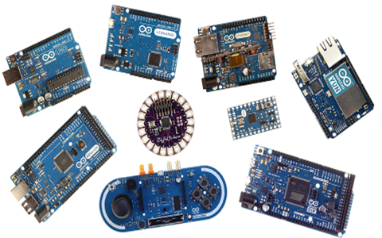
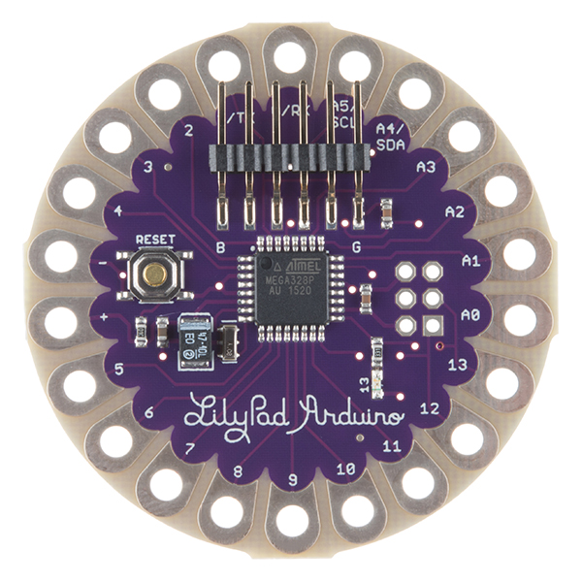
TYPES OF ARDUINO BOARDS
NANO
UNO
MEGA
OTHER BOARDS
LILYPAD

Slide 9
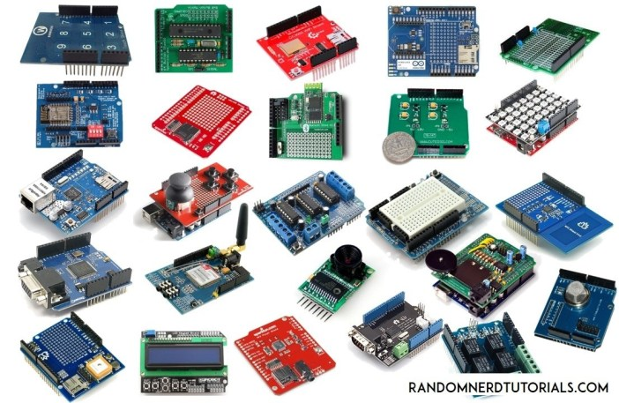

Slide 10
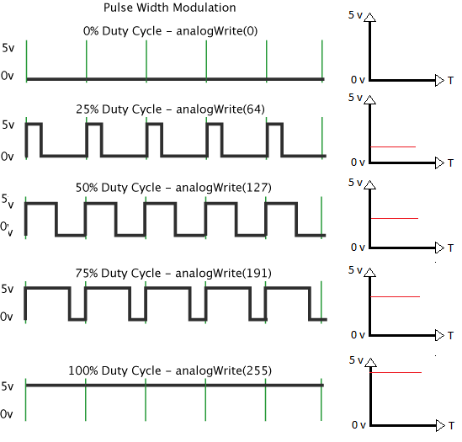
PWM GRAPHICAL ANALYSIS

