Slide 1
Jenkins
Steps for Jenkins GitHub Webhook integration
In review, the steps to configure a Jenkins GitHub webhook trigger is:
# Create a Jenkins build job that uses a GitHub URL
# Click the GitHub hook trigger for GITScm polling checkbox on the build job
# Create and copy a Jenkins API token for the Jenkins user who will run the build job
# Create a trigger in your GitHub repository’s settings page
# Set the GitHub payload URL to be your Jenkins’ IP address with /github-webhook/ appended to it
# Set the Jenkins API token as the GitHub webhook secret token
# Save the GitHub Webhook and then Jenkins builds will occur when a commit is pushed to the repo

Slide 2
JENKINS
Jenkins Email Notification
# Click the ‘Manage Jenkins’ menu option displayed at the right side of the screen. You will be redirected to the ‘Manage Jenkins’ page, where you need to select the ‘Manage Plugin’ option.
# Click the ‘Available’ tab present at the top of the ‘Manage Plugin’ page.
# Type ‘Notification’ in the ‘Filter’ field displayed at the top-right side of the ‘Manage Plugin’ page. Click the checkbox next to the ‘Email-ext plugin’ option and ‘Email-ext Template Plugin’ option. Click the ‘Install
without restart’ button.
# Go to the Jenkins home page and click the ‘Manage Jenkins’ menu option. Then, select the ‘Configure System’ option.
# Enter the SMTP server name under ‘Email Notification’. Click the ‘Advanced’ button and then click the checkbox next to the ‘Use SMTP Authentication’ option. Now, set the following fields
Check the email notification functionality by clicking the checkbox next to the ‘Test configuration by sending Test e-mail recipient’ option. Enter a valid email id and click the ‘Test configuration’ button to check
whether the email id is valid or not.
# Similarly enter the SMTP server name under ‘Extended Email Notification’. Click the ‘Advanced’ button and then click the checkbox next to the ‘Use SMTP Authentication’ option. Now, set the following fields
# Go to the home page and click on a New Item to create a Freestyle Jenkins Project.
# Then, Click the ‘Add post-build action’ drop-down and select the ‘E-mail Notification’ value. Enter the recipient email id in the ‘E-mail Notification’ box and select the checkbox next to the ‘Send e-mail for
every unstable build’ option.
# Click the ‘Add post-build action’ drop-down and select the ‘Editable Email Notification’ value. Then fill the
# Project Recipient List : email_id@gmail.com
Click the ‘Advance Settings…’ button in the ‘Editable Email Notification’ box. Click the ‘Add Trigger’ drop-down and select the ‘Always’ option and Click the ‘Save’ button.
# Go to Email-Notification Jenkins job and click on Build now.
# Check the Recipient’s mail box.
Important Settings SMTP
SMTP server name : smtp.gmail.com
User name: user_email_id@gmail.com
Password: 123456
Use SSL : Checked
SMTP Port: 465

Slide 3
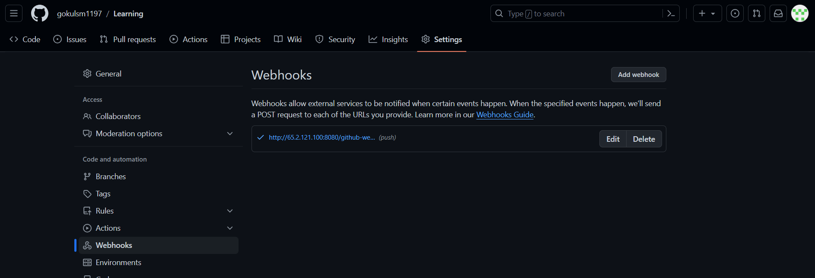
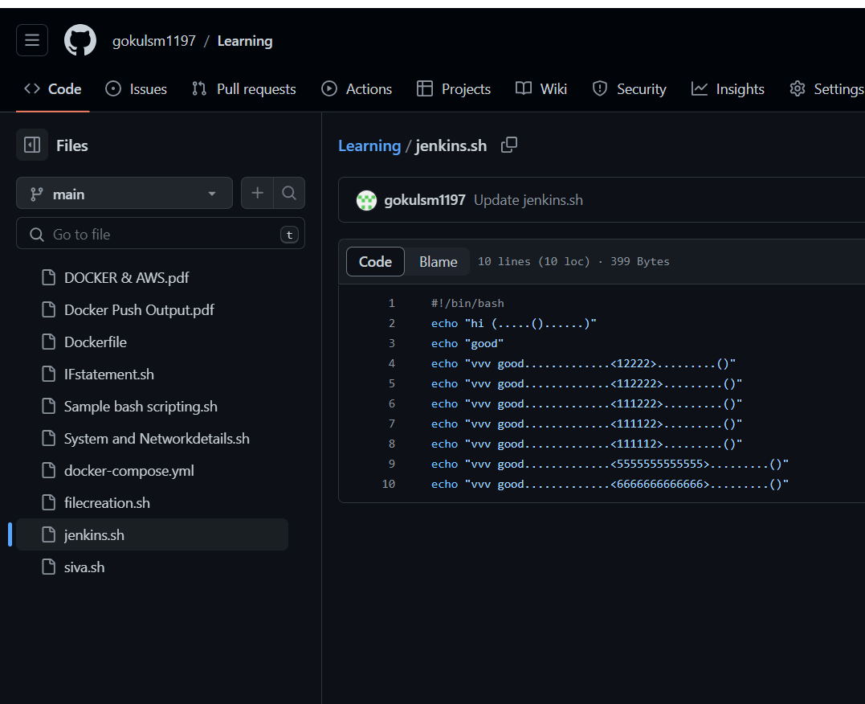
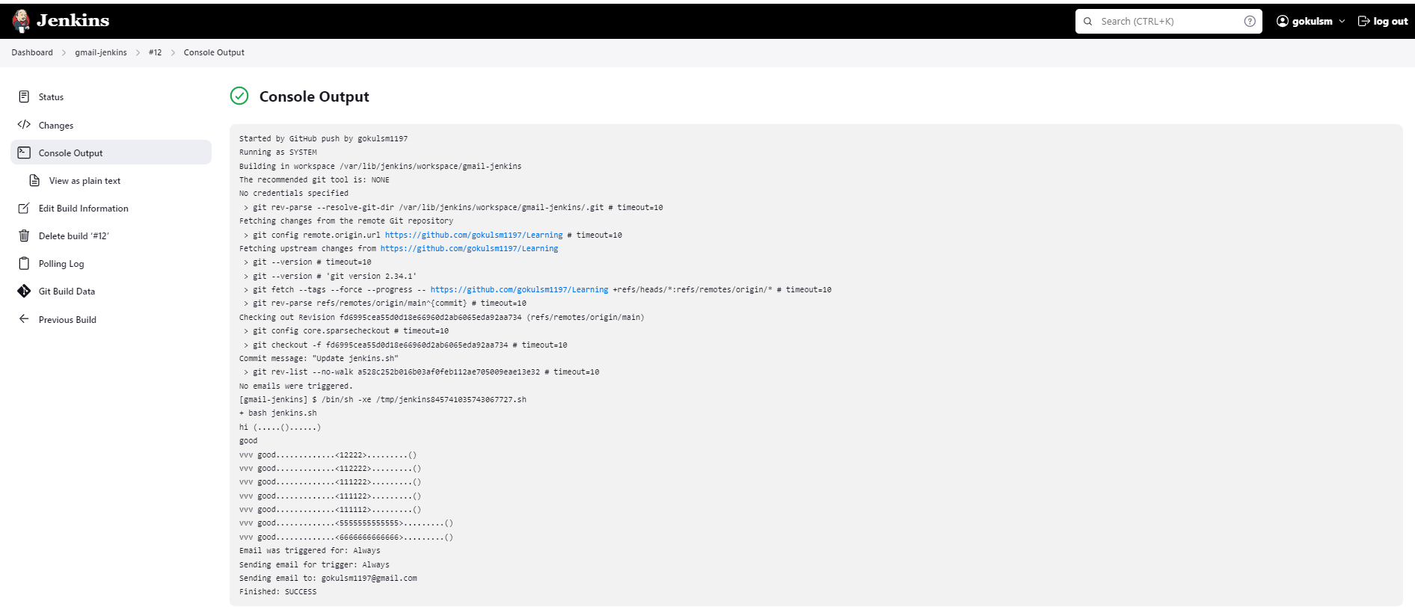
Output

Slide 4
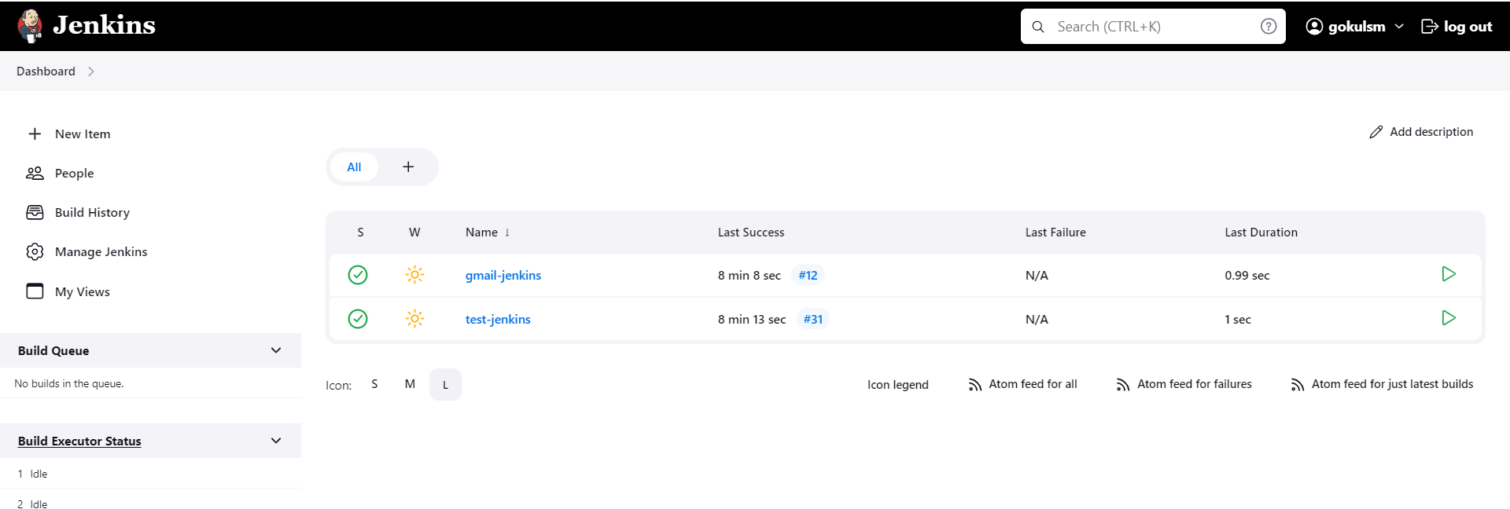
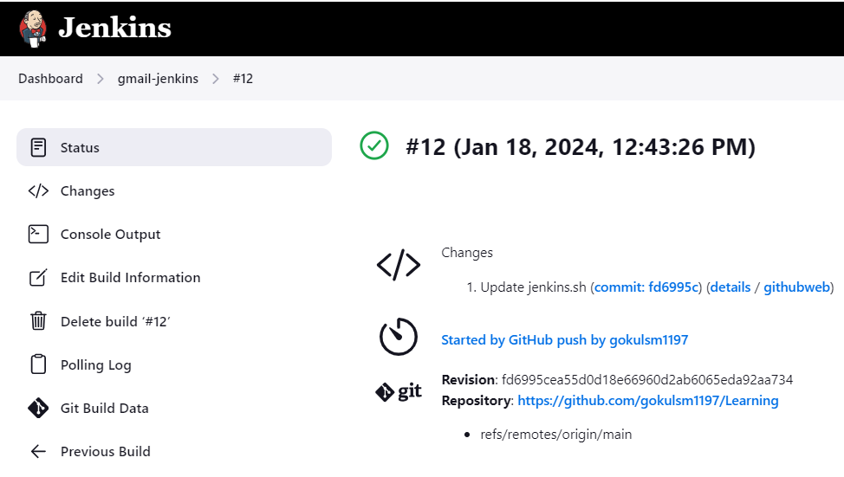
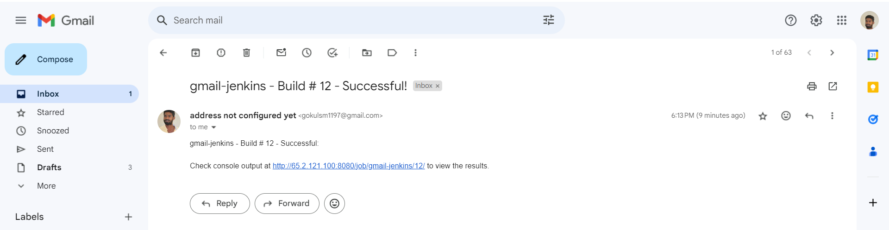
output

