Slide 1
CS 74 Project
Saksham Arora, Alex Jones, Gokul Srinivasan

Slide 2
Features
Determining correlation beforehand narrowed our focus to the following four features.
Review Text
Summary Text
Sales Rank
Price
Ascending correlation
Summary/Text sentiment

Slide 3
General Approach
Train sentiment classifier based on review & summary text.
Predict sentiment for review & summary test.
Train binary classifier using average review sentiment, average summary sentiment, price, and sales.

Slide 4
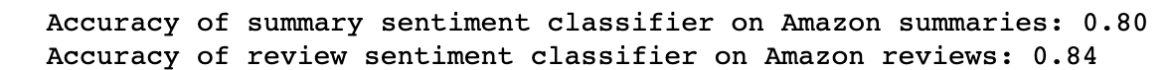
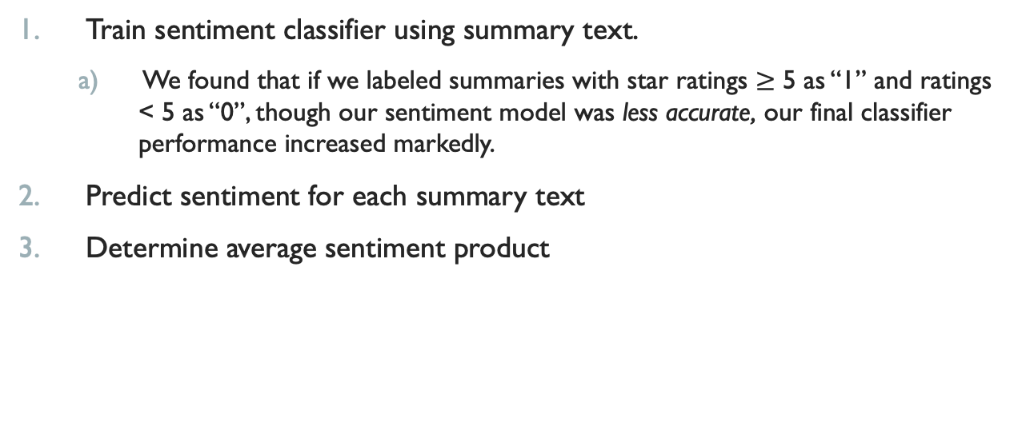
Sentiment Classifier
Train sentiment classifier using summary text.
We found that if we labeled summaries with star ratings $≥$ 5 as “1” and ratings < 5 as “0”, though our sentiment model was less accurate, our final classifier performance increased markedly.
Predict sentiment for each summary text
Determine average sentiment product
This example is limited to our classifier for summary text. We repeated this process for review text, but a separate classifier was trained
Performance

Slide 5
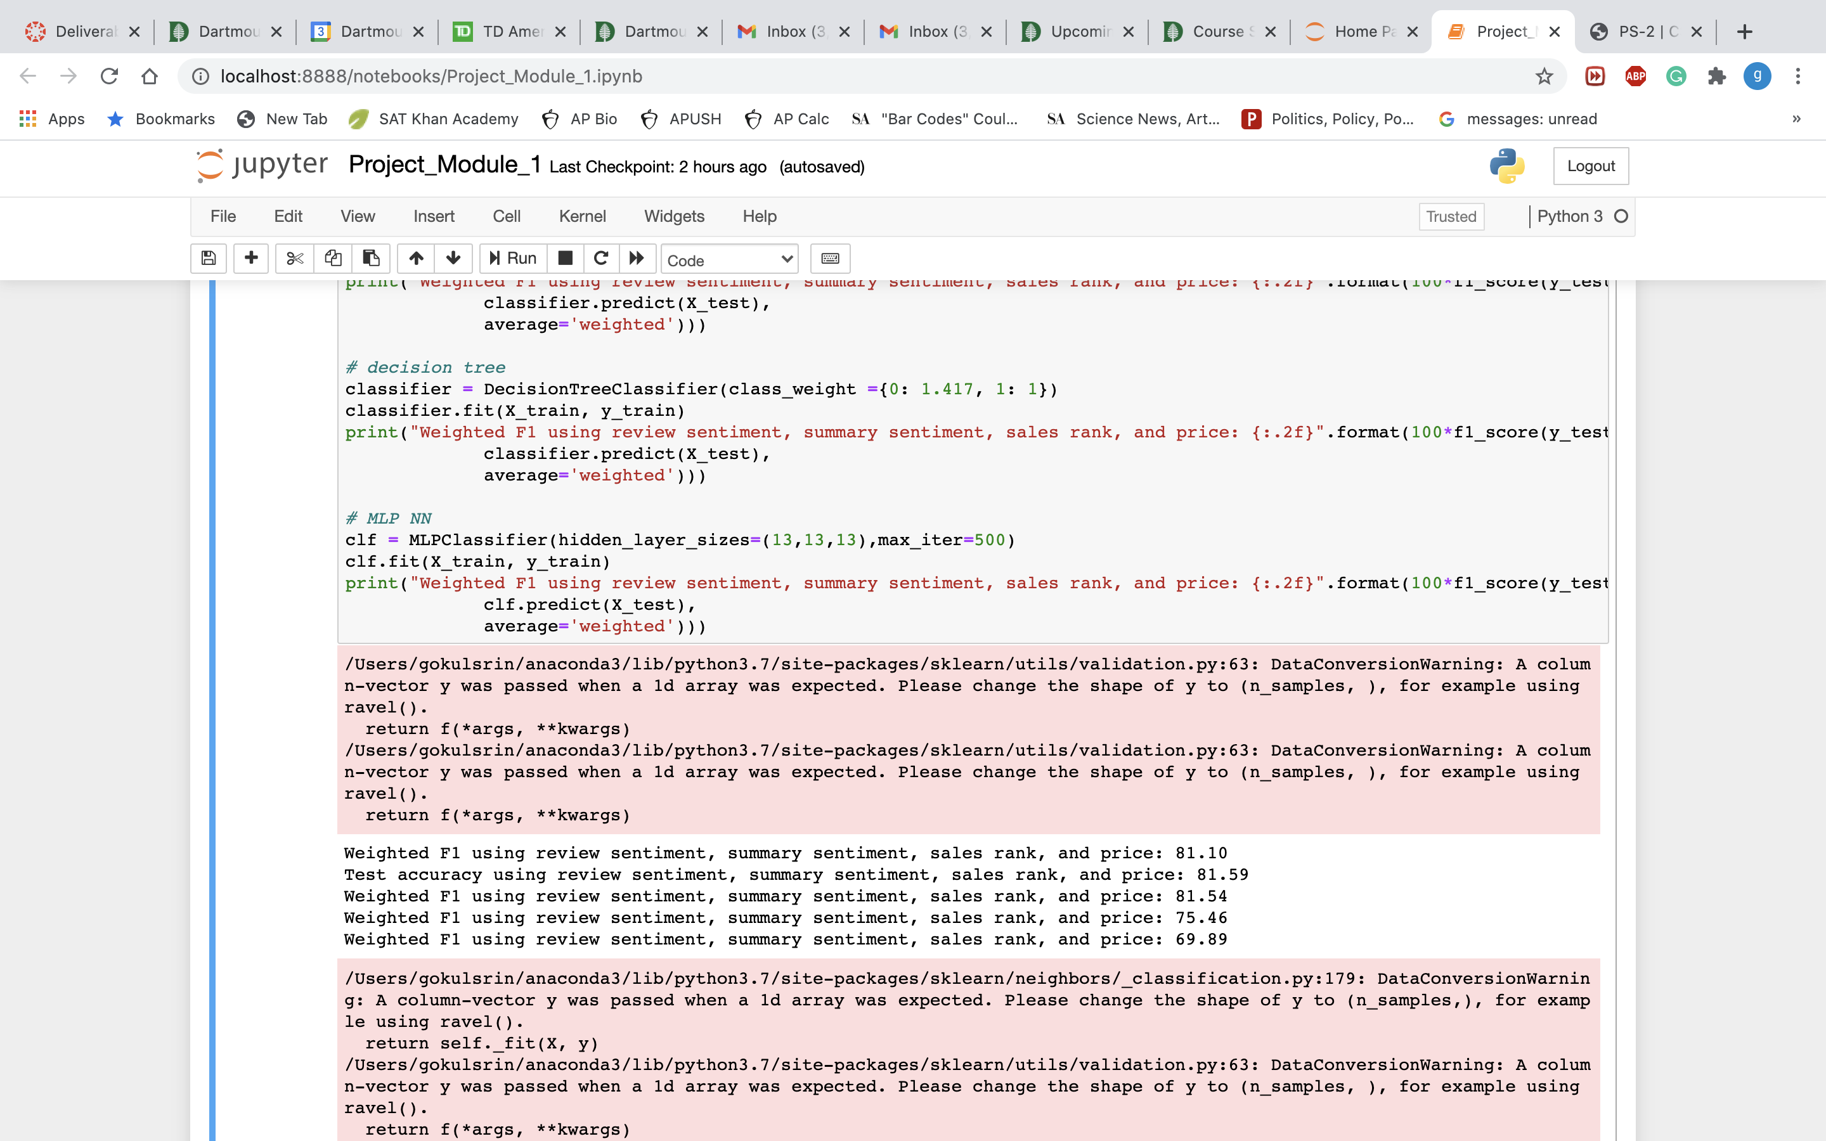
Binary Classifier
Binary classifier was trained using average review sentiment, average summary sentiment, price, and sales.
.
Logistic Regression:
Support Vector Machine:
K-Nearest Neighbors:
Throughout, k-fold cross-validation was used to evaluate model performance.
.

Slide 6
Misc. Failures/Less optimal solutions
Combinations of review sentiment, summary sentiment, price, and sales rank were tried in order to boost performance. The combination of all four yields maximal success.
Notable less optimal solutions include, but are not limited to: Naive Bayes, Decision Trees, Gradient Boost, Random Forest.
The most surprising failure by far was AdaBoost, which managed to halve our F1 score.
Training the sentiment classifier using the provided awesome/unawesome distinction leads to suboptimal performance.

Slide 7
Credits
Alex: tested countless successful and unsuccessful approaches, developed sentiment analysis structure, scaffolded project code, developed binary classifier and implemented various alternative algorithms, calculated feature correlation matrix.
Saksham: tested countless successful and unsuccessful approaches, scaffolded project code, developed binary classifier and implemented various alternative algorithms, calculated feature correlation matrix.
Gokul: tested few successful approaches but found an untold number of unsuccessful approaches, scaffolded project code and created code layout and progression, developed binary classifier and implemented alternative algorithms.

