Slide 1
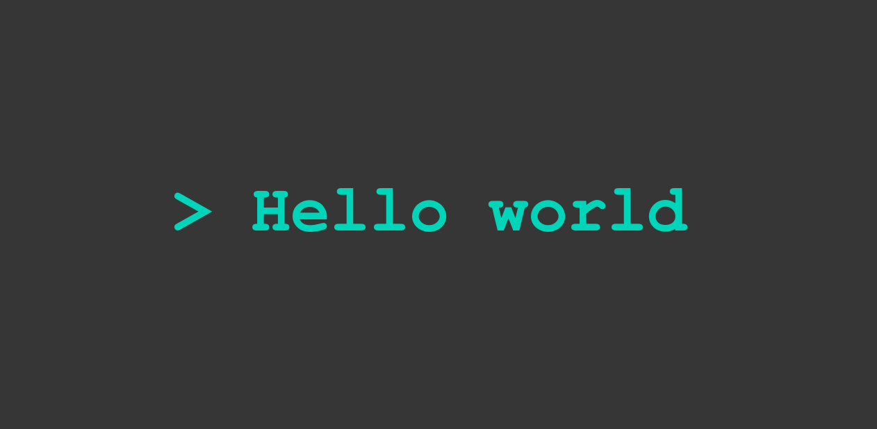

Slide 2
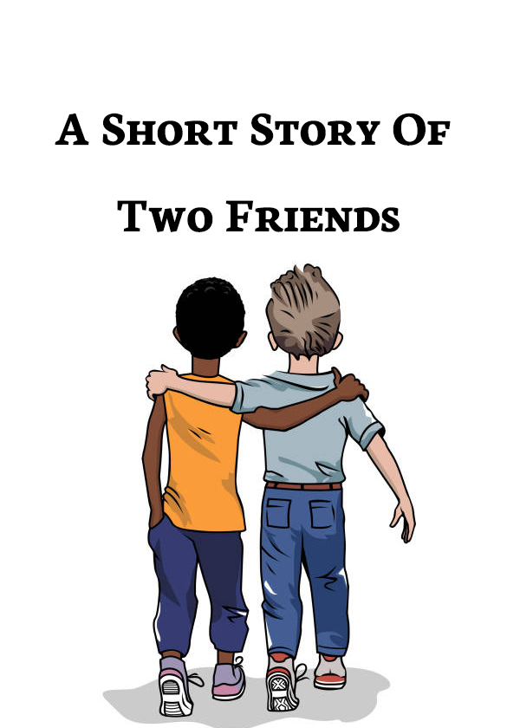
HOW TO BREAK

Slide 3

FREEMIUM

Slide 4
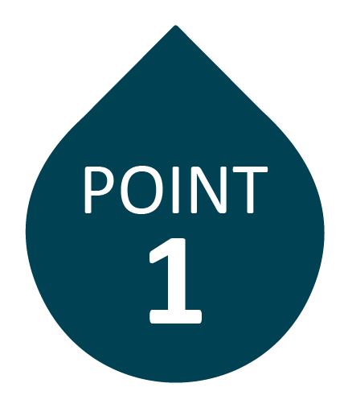
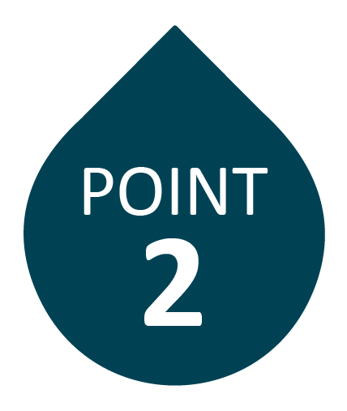
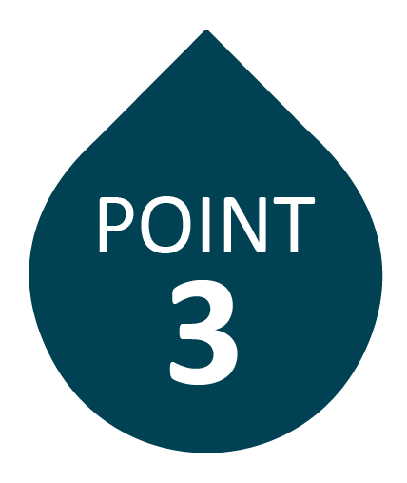
CONS
LESS FEATURES
NON CUSTOMIZABLE
SECURITY CONCERNS

Slide 5

SOLUTION

Slide 6
WE ARE GOING TO TALK ABOUT
1. HOW TO BREAK RULE 1
2. HOW TO BREAK RULE 2
3. HOW TO TALK
4. HOW TO WORK LIKE BILL GATES
5. HOW TO GET BONUS

Slide 7

1. HOW TO BREAK RULE 1
2. HOW TO BREAK RULE 2
3. HOW TO TALK
4. HOW TO WORK LIKE BILL GATES
5. HOW TO GET BONUS

Slide 8
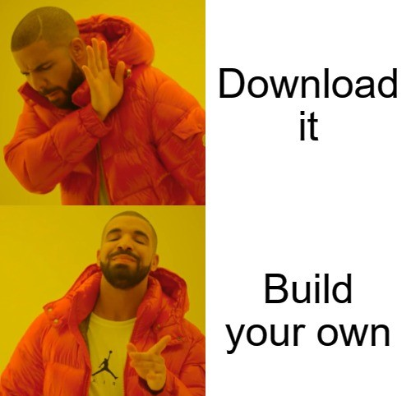
RULE 1 - IF YOU NEED SOFTWARE

Slide 9
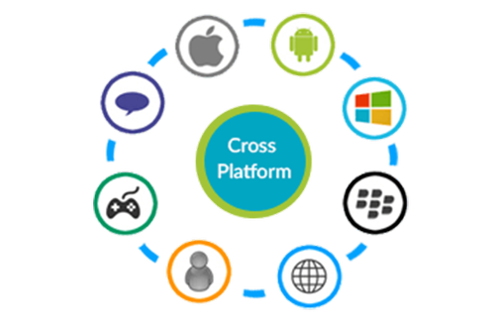
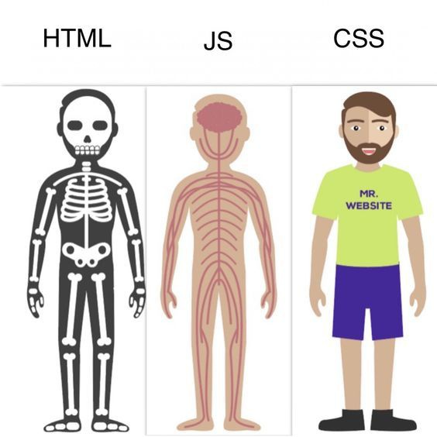
WHAT IT IS

Slide 10

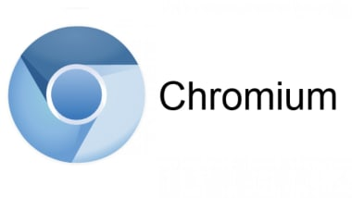
MAIN ARCHITECTURE

Slide 11
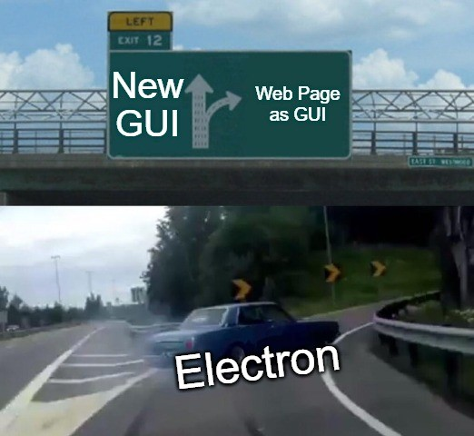
GUI

Slide 12
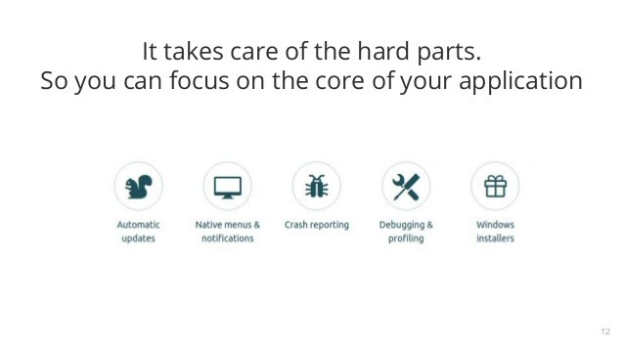
WHY

Slide 13
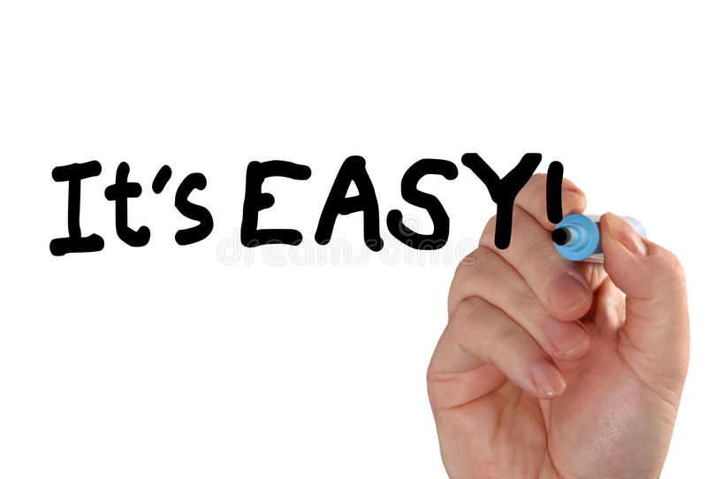
1. HOW TO BREAK RULE 1
2. HOW TO BREAK RULE 2
3. HOW TO TALK
4. HOW TO WORK LIKE BILL GATES
5. HOW TO GET BONUS

Slide 14
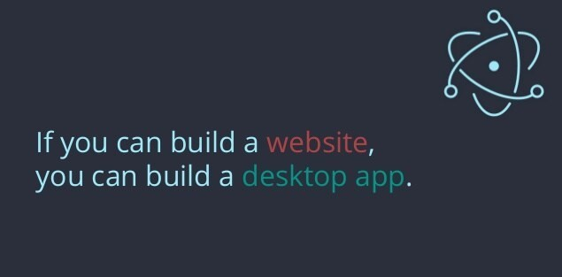
RULE 2 – YOU KNOW IT

Slide 15
CIRCLE OF LIFE
EVENT BASED
PROGRAMMING
ELECTRON STARTS
APP CLOSES APP PROCESS
DOWN CREATED
APP PROCESS READY

Slide 16
HOW IT WORKS
TWO PROCESSES
MAIN PROCESS RENDERER PROCESS
(NODE) (CHROMIUM)

Slide 17
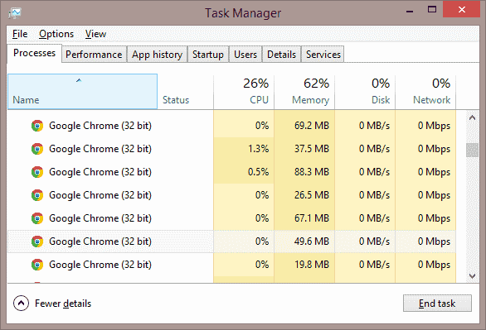
PROCESSES

Slide 18
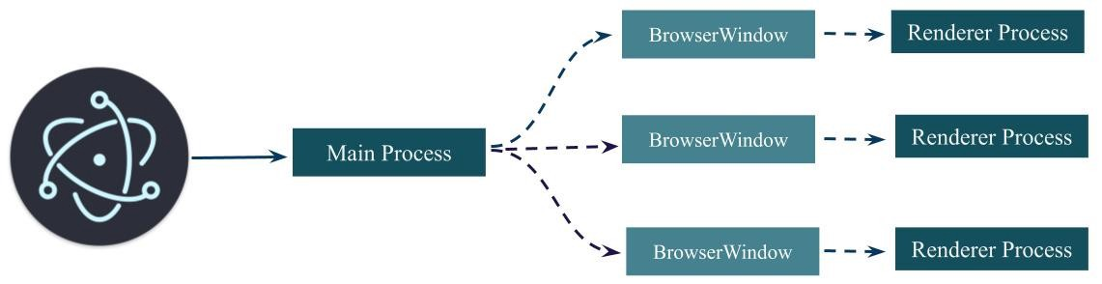
HOW IT WORKS - CONTINUED

Slide 19
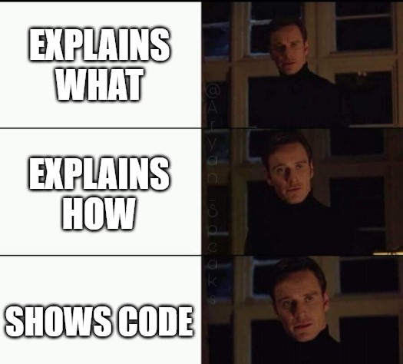
HELLO WORLD

Slide 20

1. HOW TO BREAK RULE 1
2. HOW TO BREAK RULE 2
3. HOW TO TALK
4. HOW TO WORK LIKE BILL GATES
5. HOW TO GET BONUS

Slide 21
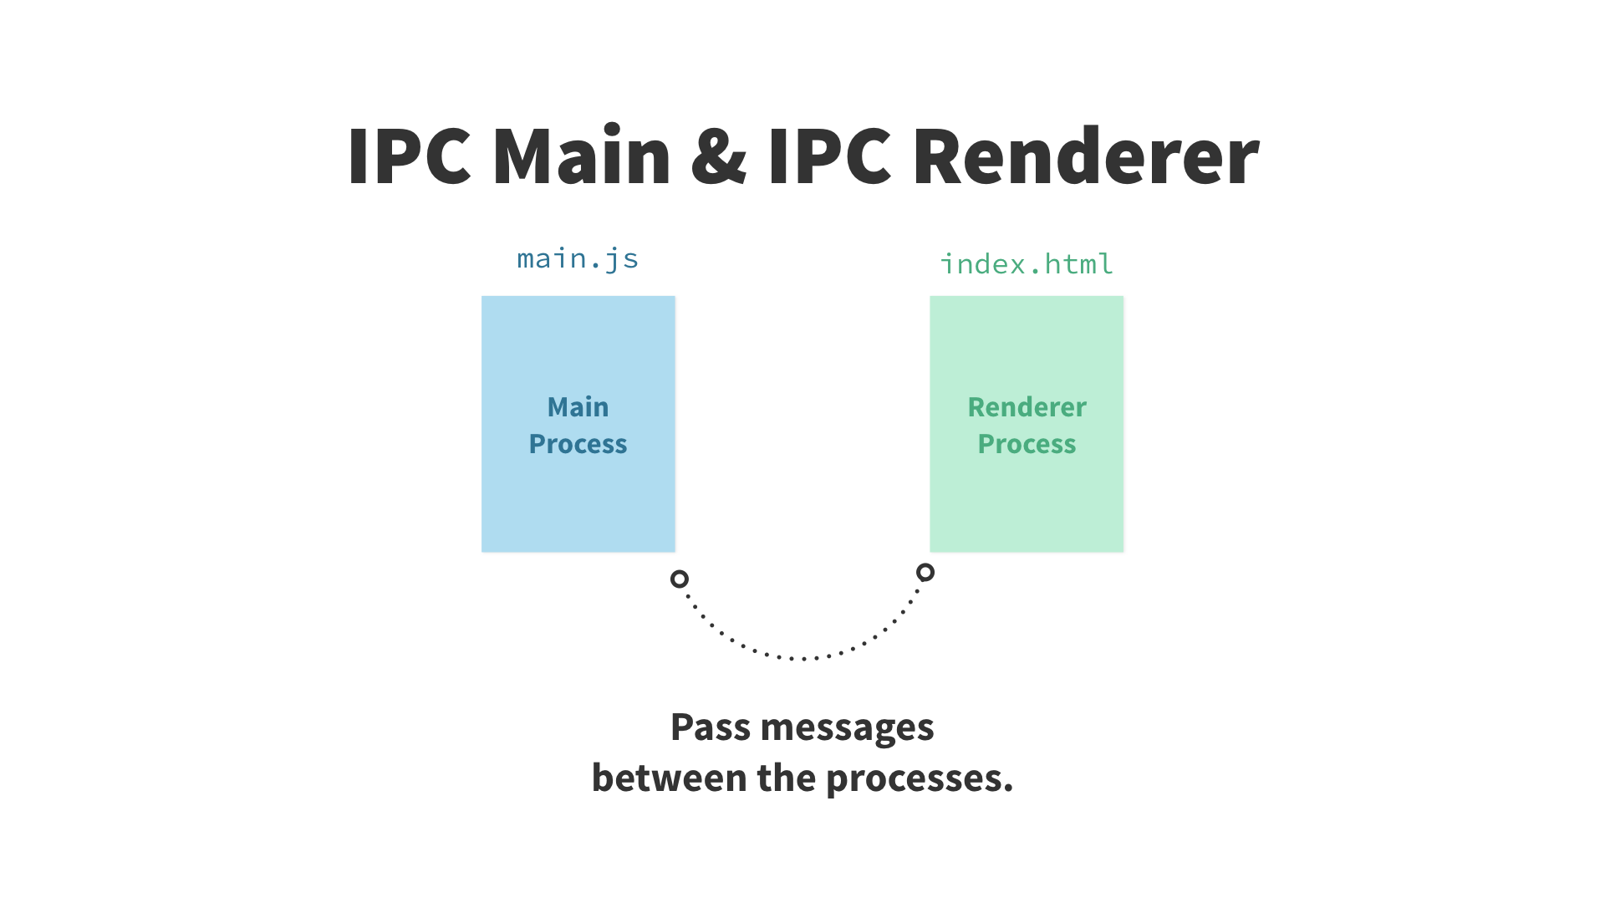
MAIN VS RENDERER

Slide 22
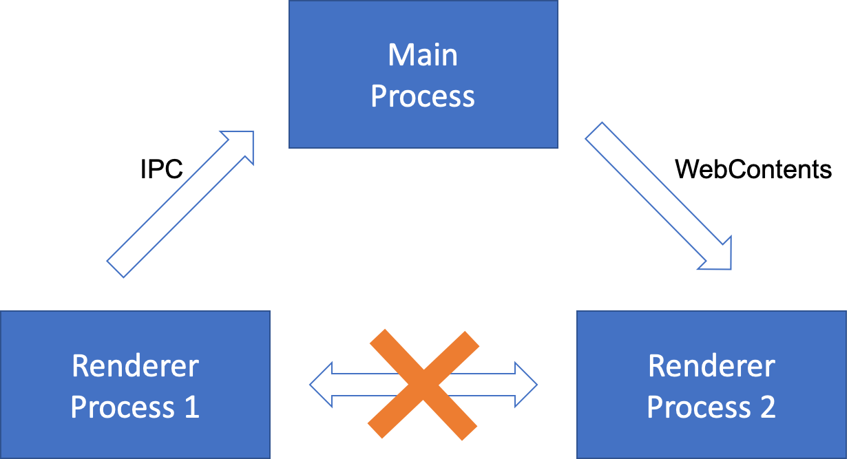
INTER PROCESS COMMUNICATION

Slide 23
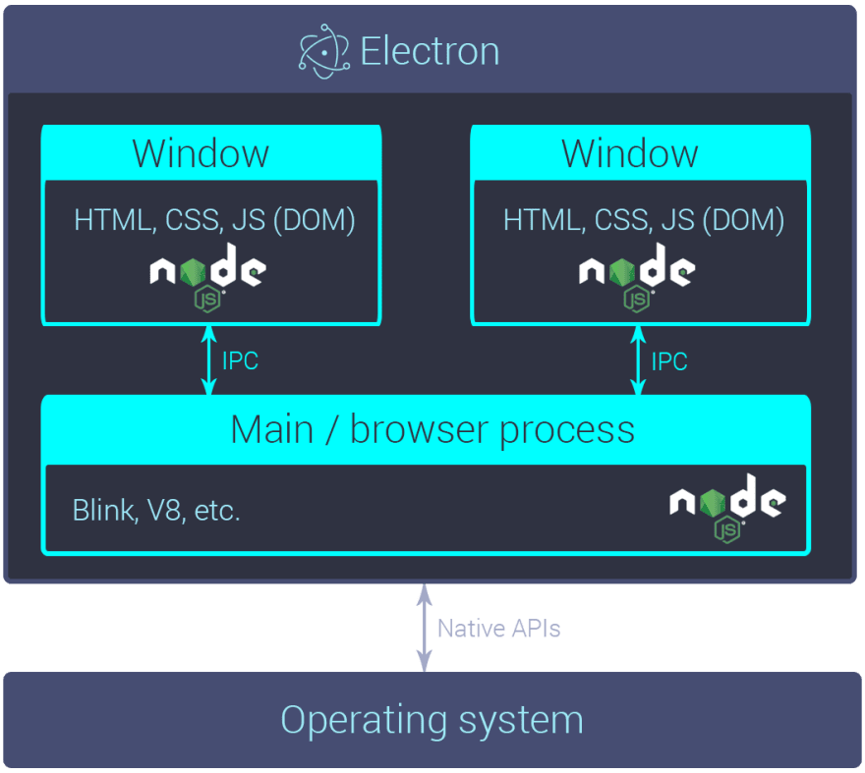
SUMMARY

Slide 24
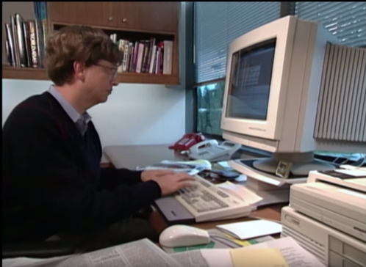
1. HOW TO BREAK RULE 1
2. HOW TO BREAK RULE 2
3. HOW TO TALK
4. HOW TO WORK LIKE BILL GATES
5. HOW TO GET BONUS

Slide 25
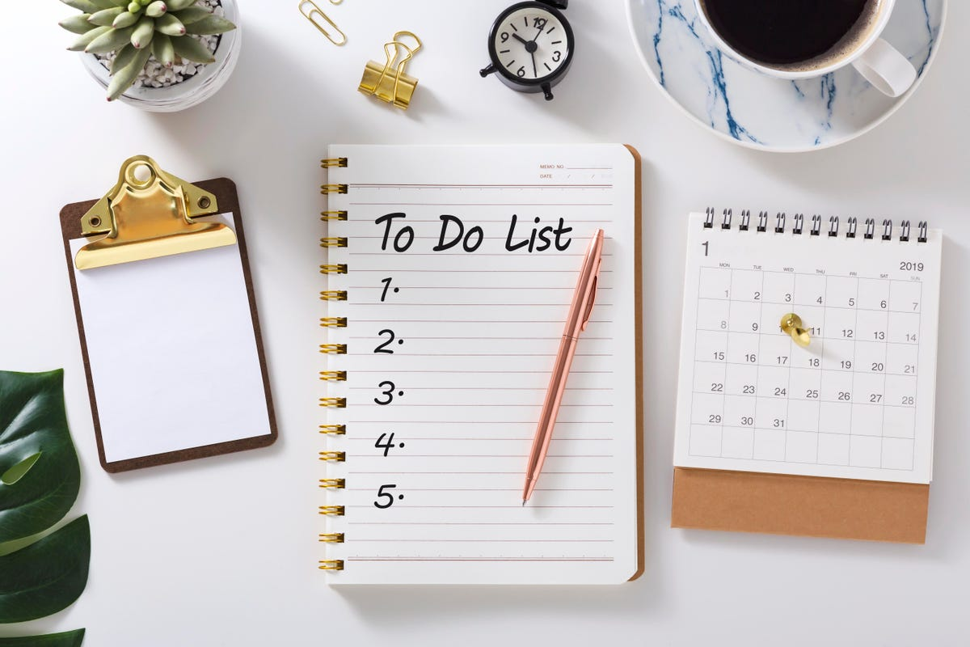
PLAN

Slide 26

1. HOW TO BREAK RULE 1
2. HOW TO BREAK RULE 2
3. HOW TO TALK
4. HOW TO WORK LIKE BILL GATES
5. HOW TO GET BONUS

Slide 27
BONUS
CHECK CHAT
( OR )
pdfhost.io/v/M781dcadr_Electron.pdf

Slide 28

TEMPLATE

