Slide 1

Backtracking: Technique & Examples
BackTrack
Yes Solution
No Solution
By,
Fahim Ferdous

Slide 2
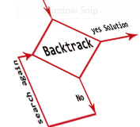
Backtracking
History
‘Backtrack’ the Word was first introduced by Dr. D.H. Lehmer in 1950s.
R.J Walker Was the First man who gave algorithmic description in 1960.
Later developed by S. Golamb and L. Baumert.

Slide 3
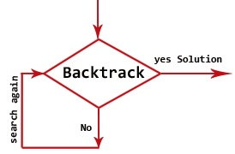
Backtracking
What is Backtracking?
----- Backtracking is nothing but the modified process of the brute force approach. where the technique systematically searches for a solution to a problem among all available options. It does so by assuming that the solutions are represented by vectors (v₁, ..., i_{n}) of values and by traversing through the domains of the vectors until the solutions is found.

Slide 4
Backtracking
The Algorithmic Approach
  Backtracking systematically try and search possibilities to find the solution. Also it is an important process for solving constraint satisfaction problem like crossword, Sudoku and many other puzzles. It can be more continent technique for parsing other combinatorial optimization problem.
  Basically the process is used when the problem has a number of option and just one solution have to be selected. After having a new option set means recursion, the procedure is repeated over and over until final stage.

Slide 5
Backtracking
Algorithm Backtrack (v1,Vi) If (V1,……., Vi) is a Solution Then Return (V1,…, Vi) For each v DO If (V1,…….,Vi) is acceptable vector THEN Sol = try (V1,…,Vi, V) If sol != () Then RETURN sol End End Return ( )

Slide 6
Backtracking
Advantages
  Comparison with the Dynamic Programming, Backtracking Approach is more effective in some cases.
  Backtracking Algorithm is the best option for solving tactical problem.
  Also Backtracking is effective for constraint satisfaction problem.
  In greedy Algorithm, getting the Global Optimal Solution is a long procedure and depends on user statements but in Backtracking It Can Easily getable.
  Backtracking technique is simple to implement and easy to code.
  Different states are stored into stack so that the data or Info can be usable anytime.
  The accuracy is granted.

Slide 7
Backtracking
Disadvantages
  Backtracking Approach is not efficient for solving strategic Problem.
  The overall runtime of Backtracking Algorithm is normally slow
  To solve Large Problem Sometime it needs to take the help of other techniques like Branch and bound.
  Need Large amount of memory space for storing different state function in the stack for big problem.
  Thrashing is one of the main problem of Backtracking.
  The Basic Approach Detects the conflicts too late.

Slide 8
Backtracking
Application of Backtracking
    Optimization and tactical problems
    Constraints Satisfaction Problem
    Electrical Engineering
    Robotics
    Artificial Intelligence
    Genetic and bioinformatics Algorithm
    Materials Engineering
    Network Communication
    Solving puzzles and path

Slide 9
Backtracking
Some Problem Solved with Backtracking Technique
  N- Queens Problem
  Sum of Subset
  Sudoku Puzzle
  Maze Generation
  Hamiltonian Cycle

Slide 10


N-Queens Problem
History:
First Introduced in 1848 which was known as 8- queens Puzzle. Surprisingly, The First Solution was created in 1950 by Franz Nauck. Nauck made an 8X8 Chessboard to find the first Feasible Solution.

Slide 11
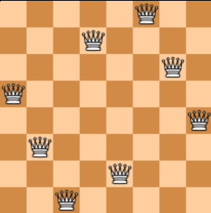
N-Queens Problem
Problem Description
In a NxN square board N – number of queens need to be placed considering three Condition ---
    No two Queens can be placed in same row.
    No two Queens Can be places in same Column
    No two queens Can be placed in same Diagonal.

Slide 12
N-Queens Problem
Backtracking approach for solution
- - The Algorithm will check each position [i , j] for each queens . If any Suitable places found , It will place a queen on that position. If not Algorithm will try same approach for next position.
Algorithm Nqueen(K,n){ For i= 1 to n { If Place(K,i){ X[k] = I; If(k = n) then Write x[1:n]; Else Nqueen(k+1, n) ; } } }
Place(k,i){ For j=1 to k-1{ If((x[j] = i) or abs(x[j] – 1 = abs(j-k))) Return false; } Return true; }

Slide 13
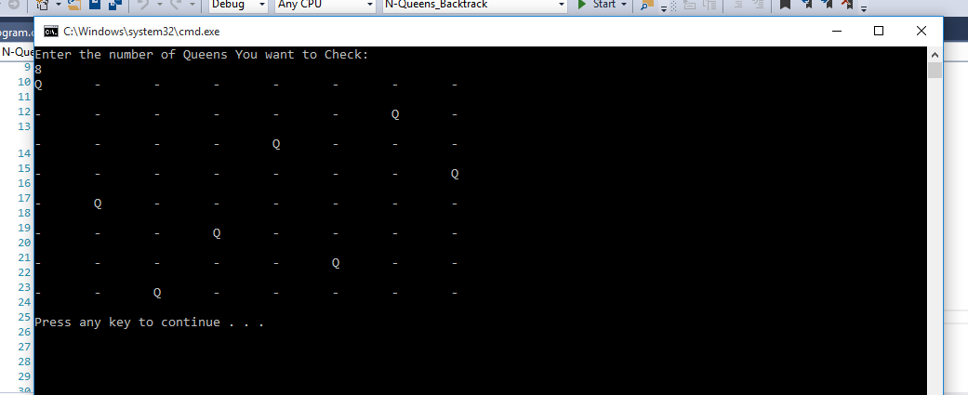
N-Queens Problem

Slide 14
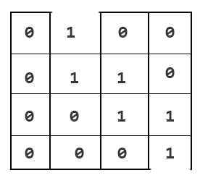
Maze Generation
Problem Description
A N X N board is made in a way So that 1 or 0 can be placed in each box where 1 is for valid path for moving towards exit and 0 is the Closed path. Now, by using Backtracking Algorithm The path to the exit need to be find.

Slide 15
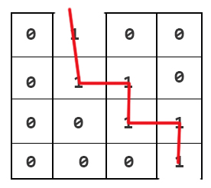
Maze Generation
-- Algorithm will try to follow the box which has the value 1 and generate a path. Again, it will check for 1 at the next box. If not found it will go through next box. If entire row is complete, then it will move to the next row and look for 1.

Slide 16
Maze Generation
Solution Using Backtracking Technique
Algorithm Maze_Gen(graph){ If(Maze_operator(graph, x,y, canvas) == false) Write (“No result”); Return false; Print_Result(canvas); Return true; }
Algorithm Maze_operator(graph, x,y, canvas){ If(x ==N-1 && y == N-1){ Canvas[x][y] = 1; Return true; } If(IsSafe(graph, x,y) == true){ Canvas[x][y] = 1; If(Maze_operator(graph, x+1,y, canvas)) Return true; If(Maze_operator(graph, x,y+1, canvas)) Return true; Canvas [x][y] = 0; Return true; } Return false; }

Slide 17
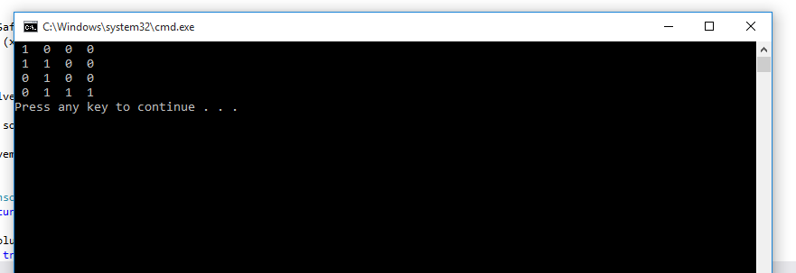
Maze Generation

Slide 18
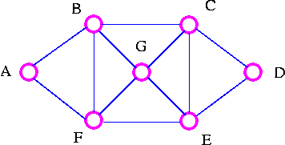
Hamiltonian Cycle
Hamiltonian Cycle is a graph theory problem where the graph cycle through a graph can visit each node only once. The puzzle was first devised by Sir William Rowan Hamilton and the Problem is named after Him.
Condition: The Cycle Started with a Starting Node, and visit all the Nodes in the Graph (Not necessary to visit in sequential Order and not creating edge that is not given) And Stop at The Starting Point/Node.

Slide 19
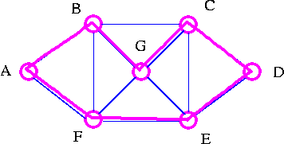
Hamiltonian Cycle
The Backtracking Approach
The Algorithm First Check the Starting Node, if there is any edge to the next node. If yes, then the Algorithm will check that node for the edge to the next Node. It will Also Check If any Node is visited twice by the previous Node. If there is any then the Algorithm Will Ignore One and Choose the Optimal One for the Solution.
The Important thing is the tour must finish at the starting point.

Slide 20
Hamiltonian Cycle
Algorithm Hamilton_Cycle(k){ Repeat{ NextVal(k); If(x[k]==0) then Return; If (k ==n) then Write (x[1:n]); Else Hamilton_Cycle(k+1); } Until (false); }
AlgortihmNextVal(k){ Repeat{ X[k] = (x[k]+1) mod (n+1); If(x[k]=0) then return; If (G[x[k-1],x[k]] != 0 ) then{ For j = 1 to k-1 do If(x[j]=x[k]) then Break; If(j = k) then If ((k<n or k=n) && G[x[n],x[1]] != 0) Then return; } } Until (false); }

Slide 21
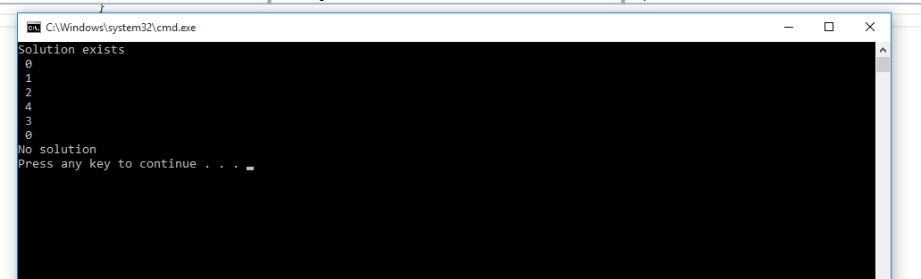
Hamiltonian Cycle

Slide 22
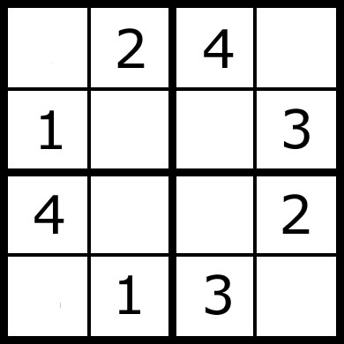
Sudoku Puzzle
The Word ‘Sudoku’ is a Japanese Word. But The Sudoku Puzzle Was First Invented in Switzerland
In a N X N Square Board, The Numbers 1 to N to be Placed in a way that:
  All the Number from 1 to N can be Placed in each row.
  All the Number from 1 to N can be Placed in each Column.
  All The Number from 1 to N Can be Placed in Sub Square boxes of the given box.

Slide 23
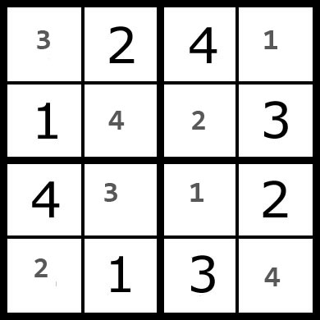
Sudoku Puzzle
Backtracking Approach
The Algorithm Will Check Each Box’s value if the value is in the same row, or same column or same sub-square box. If not,then it placed the value in the box. And go to the next box for the next value, and check the Above Condition. If there is any duplicate value, then The Algorithm check for the next value.

Slide 24
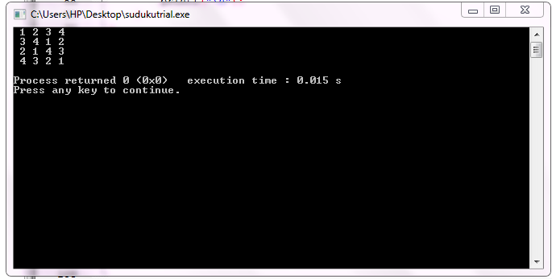
Sudoku Puzzle
Algorithm Sudoku_Solver(canvas, row, col){ If(anyEmptyLocation(canvas, row, col)) Return true; For I = 1 to n do, { If (find_location(canvas, row,col, i)){ Canvas[row][col] = i; If (Sudoku_Solver(canvas)) Return true; Canvas [row][col] = -1; } } Return false; }

Slide 25
Sum of Subset
The Sum of Subset Problem is, there will be a set of distinct positive Numbers X and a given Number N. Now, we have to find all the combination of numbers from X that sum up to N. Make a Set of those Number.
W = {4,5,6,3}
M = 13

Slide 26
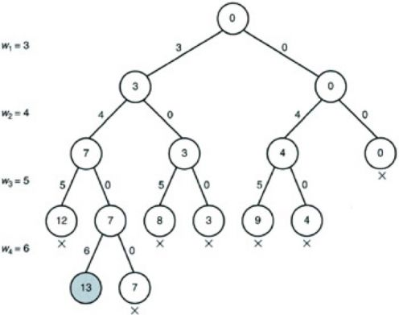
Sum of Subset

Slide 27
Sum of Subset
Backtracking Approach
First, organize the numbers in non decreasing order. Then generating a tree, we can find the solution by adding the weight of the nodes. Note that, here more than necessary nodes can be generated. The algorithm will search for the weighted amount of the nodes. If it goes beyond given Number N, then it stops generating nodes and move to other parent nodes for finding solution.
Algorithm SumOfSubset(s,k,y){ X[k] = 1; If(s+w[k] = m) Write (x[1:n]); Else if((s+w[k] + w[k+1]) <= m) SumOfSubset(s+w[k], k+1, y-w[k]); If ((s+ y-w[k]>=m) &&(s =w[k+1] <=m)) { X[k] =0; SumOfSubset(s,k+1,y-w[k]); } }

Slide 28
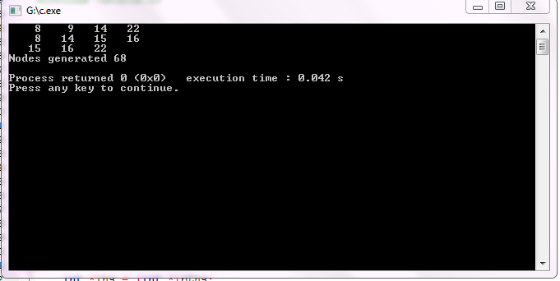
Sum of Subset
Here M = 53
W = {8,9,14,15,16,22}

Slide 29
References
Chapter 6, Backtracking, Design and Analysis of Algorithms – V.V. Muniswami
Chapter – 4, Non- Chronological Backtracking, Handbook on Constraint Programming – F. Rossi, Van Beek
web.cse.ohio-state.edu/~gurari/course/cis680/cis680Ch19.html
www.classle.net/faq/comparisons-divide-and-conquergreedy-methoddynamic-programmingbacktracking-and-branch-and-bound-
Backtracking algorithms for constraint satisfaction problems; a survey
R. Dechter, D. Frost, in Constraints, International Journal, 1998.
Bessiere C., Maestre A., Meseguer P., Distributed dynamic backtracking, in M.C. Silaghi, editor, Proceedings of the IJCAI’01 workshop on Distributed Constraint Reasoning, Seattle WA, 2001, pp. 9–16.
A First Look at Graph Theory – Jhon Clark, Allan Holton
Principles and Practice of Constraint Programming- CP 2001: 7th International Conference, CP 2001, Paphos, Cyprus, November 26 - December 1, 2001

Slide 30
Thank you!!

