Slide 1
DigiFamily
Version 1.0

Slide 2
Table Of Content
Introduction
Technologies used
Architecture
Team roles
Features
Demo
Source code review

Slide 3
Introduction
DigiFamily is the easy and simple mobile app to manage the family members details in one place.
It has the ability to upload and view certificates.
It also used to manage the contact and personal information.

Slide 4
Technologies used
Xamarin Forms
.Net Core Web API
SQL Server

Slide 5
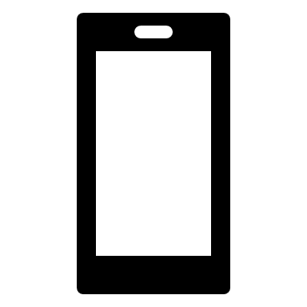
Architecture
Mobile app users
DigiFamily Web API
User 1
Request
.Net Core Web API
+
Identity Server 4
User 2
Response
DigiFamily DB
User N

Slide 6
Team Role
Mobile - Sasindran
Web API - Rajapandi, Gokul Venkatesh
Database - Rymen Issac
QA - Saranya Galla

Slide 7
Features
App available in both Android and iOS
Add/Edit/View Users
Upload and view certificates
Manage personal and contact information
Dark and Light theme
Secure Login/Logout
User registration
Forgot password
Password Remember me

Slide 8


Slide 9


