Slide 1
PRIME – PREDICTOR By Nights King
Adithya Sekar - 1637408 | AnishKumar Chouhan – 1850356 | Gokul Venugopal - 1824696
Joy Rebello – 1764719 | Naveen Subramanian - 1808626

Slide 2
introduction
A prediction game is a game which allow users to guess at the outcome of future events.
Points are awarded to players who most accurately predict the outcome of an event.
These games are very popular in the world of entertainment, sports, and finance to various world current events.

Slide 3
Game overview
A FPGA Game where user scores point by predicting the prime number generated by the board.
An authentic user can play the game. Max players: 6
Player can play to become the highest scorer within the timer limit.
Hint LEDS help user to understand his proximity to the generated value.
Highest scorer can be viewed.
Game Level increases as user score increases. Level determines the range of prime number that can be generated. Levels are:
Level 1: Prime Number can be between 0 - 25
Level 2: Prime Number can be between 0 – 50
Level 3: Prime Number can be between 0 - 75
Level 4: Prime Number can be between 0 - 99

Slide 4
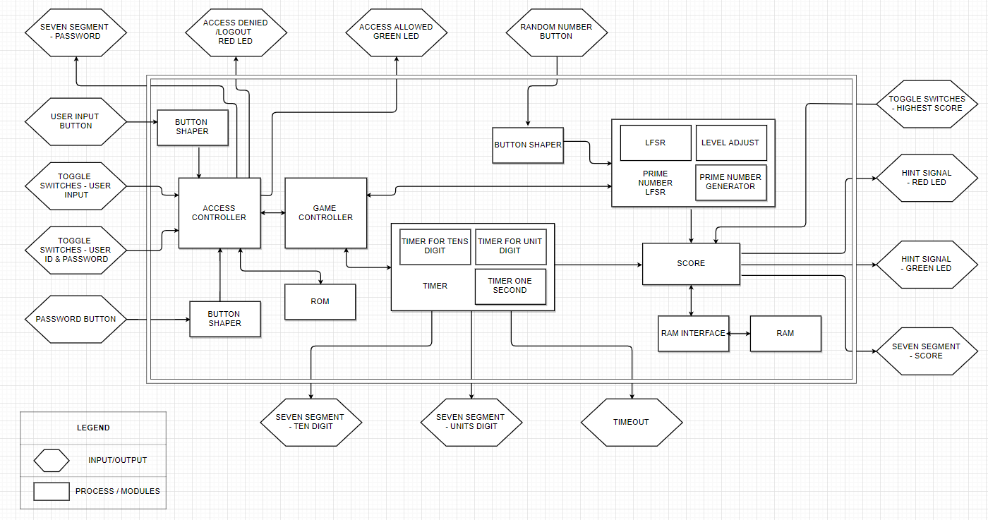
System architecture

Slide 5
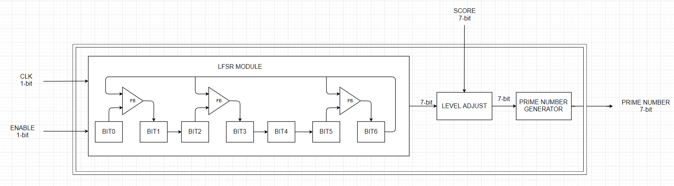
PRIME NUMBER GENERATOR
Implemented using Linear-Feedback Shift Register.
Randomly generated number is adjusted according to user game level.
Primality of the generated number is checked to obtain a prime number.

Slide 6
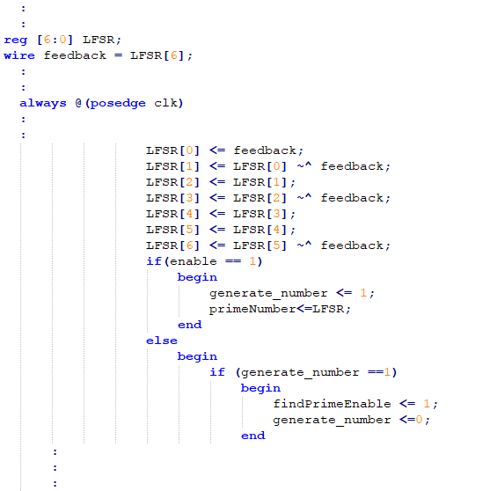
CONTD.
Code Snippet shows how LFSR is used to generate random number.
This number, along with the user score, is later used to generate prime number

Slide 7
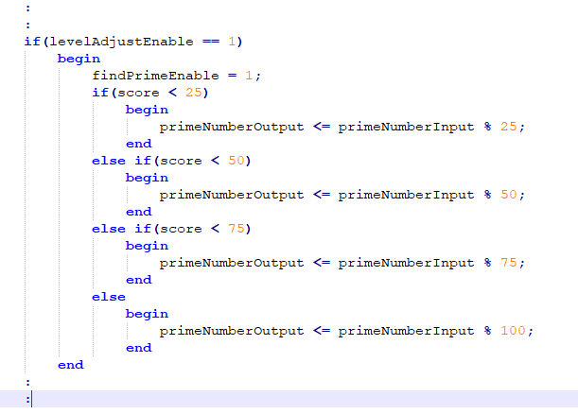
Code snippet for GAME LEVEL Adjust

Slide 8
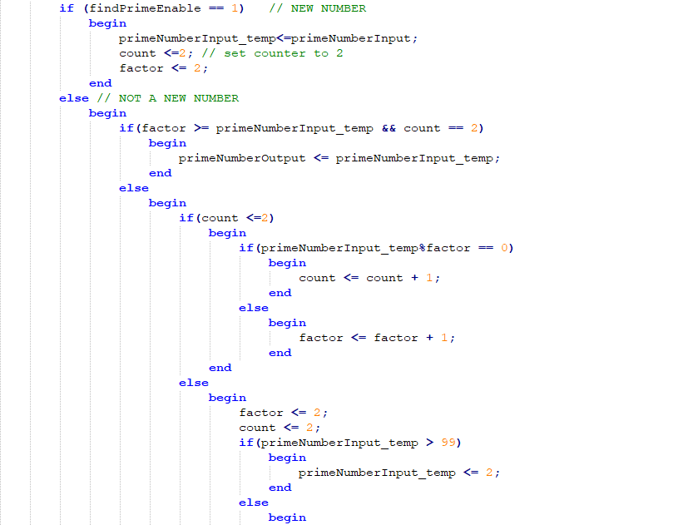
Code snippet for prime number generation

Slide 9
Access Control
Starting Point for the game that checks user authentication.
User Id and Password are accepted through toggles switches and pushbutton.
Input are checked against values stored in ROM.
This module also act as:
Bridge between user number input and game controller
Bridge between random prime number and game controller
Barrier to restrict user from accessing on wrong password and timeout

Slide 10
ACCESS CONTROL
TAKES THE INPUT FROM THE USER
STEP 1. Input the user Profile ID
STEP II. Input the password associated with that particular Profile
STEP III. Guess the Random Prime Number being generated
TECHNOLOGIES USED:
IP – CORE : 1-PORT ROM (STORE USER PROFILES)
IP – CORE : 1-PORT ROM (STORE THE PASSWORD)
Profile ID
No
Profile Present?
No
Yes
Password Match?
Yes
Play Game (Guess Prime Number)

Slide 11
GAME BOARD & Highest score
Increments score when user predicts the exact number generated by FPGA board.
Max score is 99 and is displayed using seven segment.
Score for each player is stored in RAM.
Highest score and the highest scorer’s user id is also stored in RAM
If current user score is the highest score then highest score value is changed to current user.

Slide 12
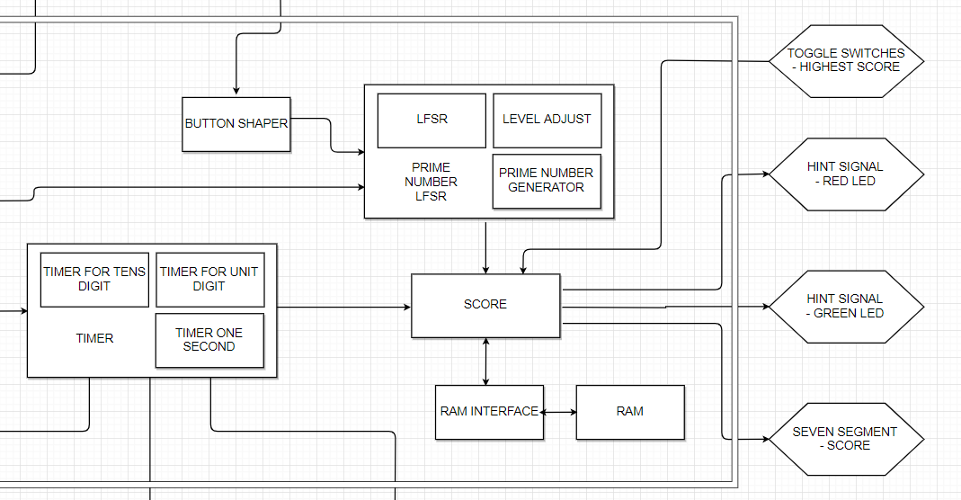
How does ram fit it in?

Slide 13
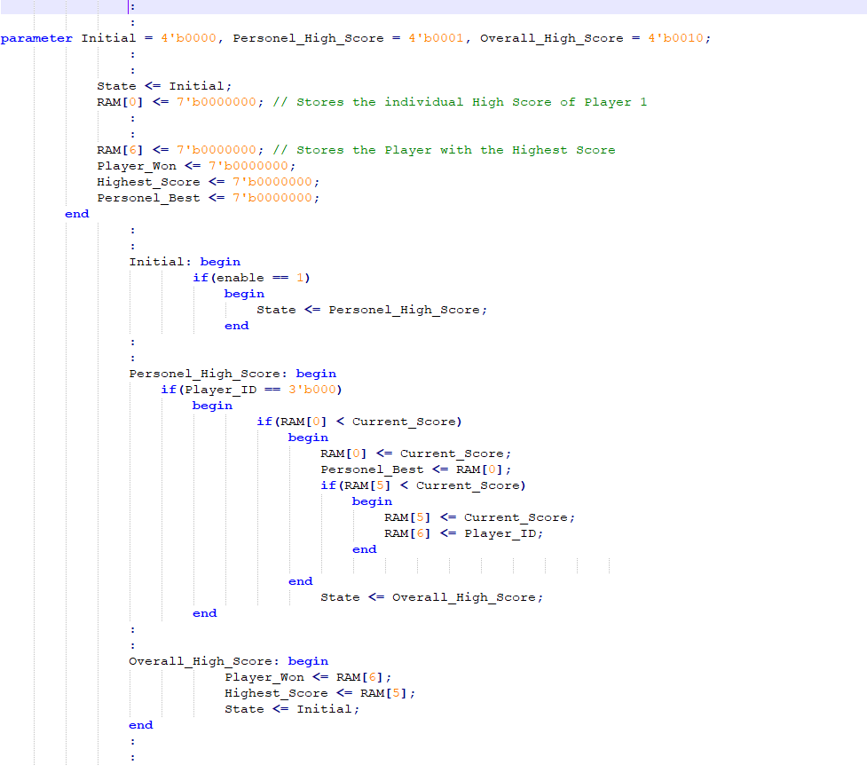
Contd.
Code snippet shows how RAM is utilized.
User id, current score is used to determine highest scorer.

Slide 14
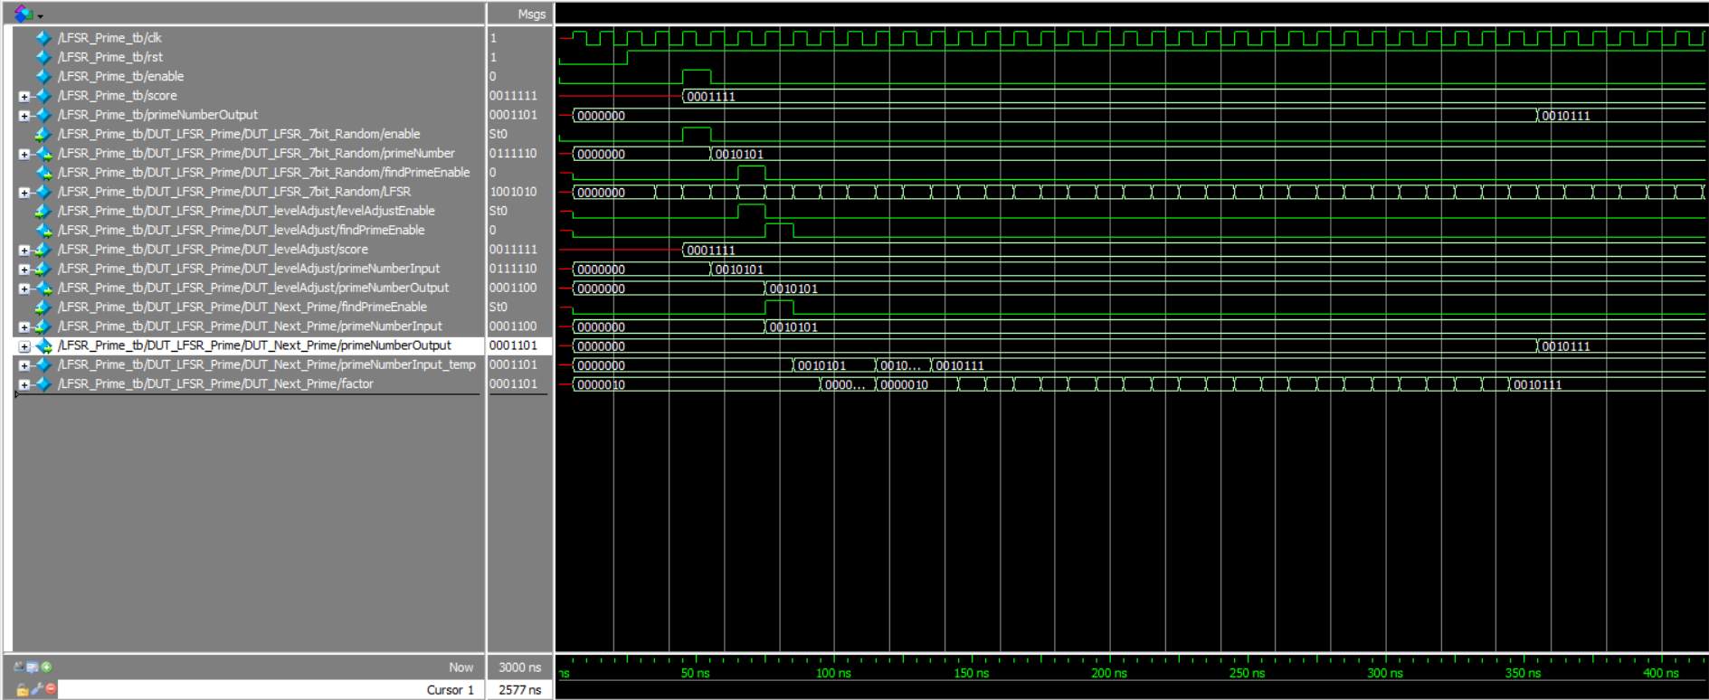
Simulation of SCOREBOARD

Slide 15
VIDEO DEMO
User Authentication
https://drive.google.com/drive/folders/1tPG7S2-q4Clli7-Deqz3iilyTYCL8IrS?usp=sharing
Random Number Generation
https://drive.google.com/drive/folders/1tPG7S2-q4Clli7-Deqz3iilyTYCL8IrS?usp=sharing
How to play game?
https://drive.google.com/drive/folders/1tPG7S2-q4Clli7-Deqz3iilyTYCL8IrS?usp=sharing

Slide 16
Future development
Game can be made more challenging by limit number of attempts a user can enter for one round.
Range of number generated can be extended to odd number, Fibonacci number, and so on.
Game board feature can be implemented to display top 5 players.

Slide 17
conclusion
Prediction Games are a great way to exercise an individual’s quantitative reasoning skills.
We were able to understand how part fit in to make a bigger picture.

Slide 18
references
[1] Wikipedia - https://en.wikipedia.org/wiki/Prediction_game
[2] INTEL - https://www.intel.com/content/www/us/en/products/programmable/fpga/new-to-fpgas/resource-center/overview.html

