Slide 1

SVM using CUDA
Final Project
Gokul Venugopal

Slide 2
Introduction
SVM is a Supervised Learning.
It is a binary classifier.
Classification is done by defining a hyperplane that is at maximum distance from all points.
Project is used to classify sample data set to classes {-1, 1}
SVM has been implemented on both CPU and GPU

Slide 3

Theory
Hyperplane is defined by
$${\overline{y}}_{i}\left({\overline{x}}_{i}⋅\overline{w}+b\right)−1=0$$
Where ${\overline{y}}_{i}$ - class of a data point
${\overline{x}}_{i}$ - input data point (features)
$\overline{w}$ - weights
$b$ - bias

Slide 4

Contd.
Hyperplane is used to classify.
If a new data point satisfies $\left({\overline{x}}_{i}⋅\overline{w}+b\right)−1<0$, then class is -1.
If it is greater than 0, then class is 1.
To train a SVM, we have to find least ||w|| and least b that satisfies
${\overline{y}}_{i}\left({\overline{x}}_{i}⋅\overline{w}+b\right)−1$ = 0.

Slide 5
CPU Implementation
Sample Input Data Points: { (1,7), (2,8), (3,8), (5,1), (7,3), (6,-1)}
Sample Output class: { -1, -1, -1, 1, 1, 1 }
Sample data to be predicted: { (0,10), (1,3), (3,4), (3,5), (5,5), (5,6), (6,-5), (5,8) }
To find minimum ||w|| and b that satisfy equation, we iterate over the maximum range at the step intervals
- (max value in input data*10) < w < (max value in input data*10)
(max value in input data*5) < b < (max value in input data* 5)
Step values: {max*0.1, max*0.01, max*0.001}

Slide 6
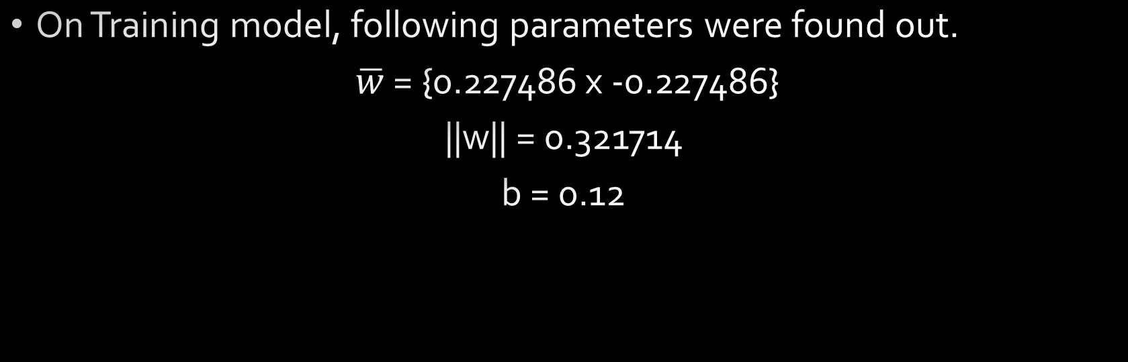
Contd.
On Training model, following parameters were found out.
$\overline{w}$ = {0.227486 x -0.227486}
||w|| = 0.321714
b = 0.12

Slide 7
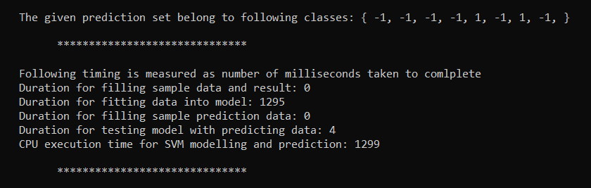
CPU Benchmark

Slide 8
GPU Implementation
To resolve the optimization problem for w, ||w|| and b, GPU implementation was divided into three kernels:
  d_getAllOptimal – used to find all possible combination of w, ||w|| and b that satisfy the hyperplane equation.
  d_findMinOptimal – uses cublasIsamin to find the index of the least ||w|| in the array of combination and returns optimal ||w||, w and b.
  d_callpredict – used to find class of the sample predict data set

Slide 9
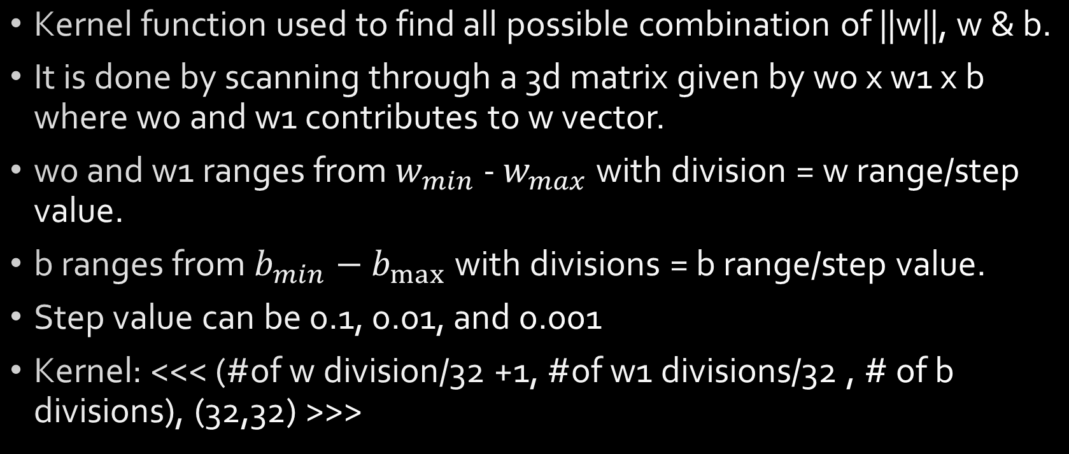
d_getAllOptimal
Kernel function used to find all possible combination of ||w||, w & b.
It is done by scanning through a 3d matrix given by w0 x w1 x b where w0 and w1 contributes to w vector.
w0 and w1 ranges from $w_{min}$ - $w_{max}$ with division = w range/step value.
b ranges from $b_{min}−b_{max}$ with divisions = b range/step value.
Step value can be 0.1, 0.01, and 0.001
Kernel: <<< (#of w division/32 +1, #of w1 divisions/32 , # of b divisions), (32,32) >>>

Slide 10
d_findMinOptimal
cublasIsamin finds the (smallest) index of the element of the minimum magnitude
This index is then used to fetch ||w||, w and b.
cublasStatus_t cublasIsamin(cublasHandle_t handle, int n, const float *x, int incx, int *result)

Slide 11
d_callpredict
Executes the hyperplane equation for data set for prediction.
Kernel:
<<< (# of data points/32 +1, size of data points/32 + 1), (32, 32)>>>
Resultant array consists of classes.

Slide 12
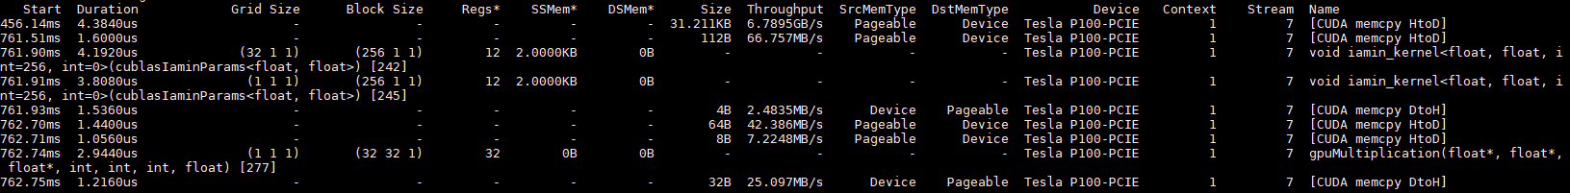
GPU Profiling Overview

Slide 13
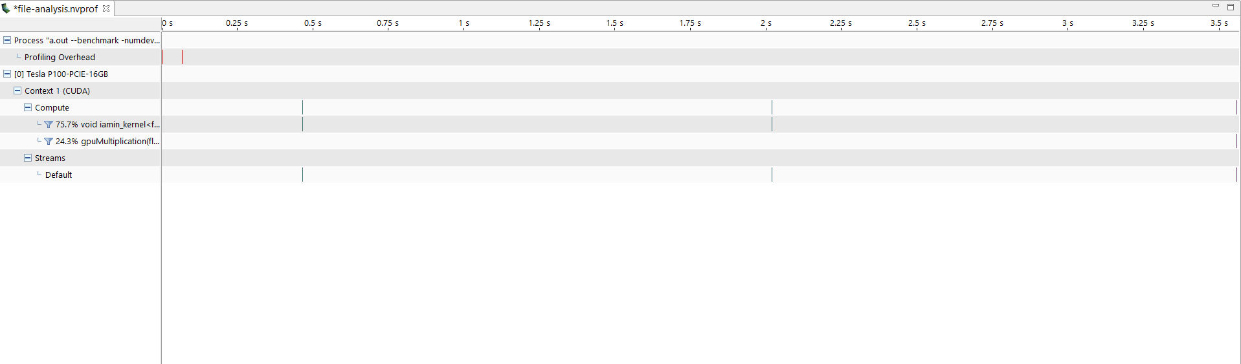
Profiling Overview

Slide 14
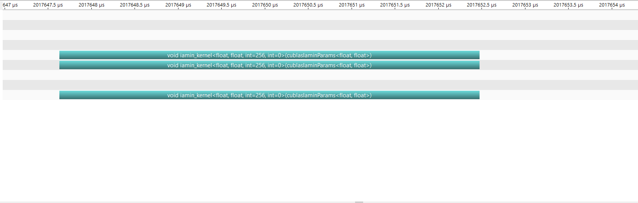
Profiling

Slide 15
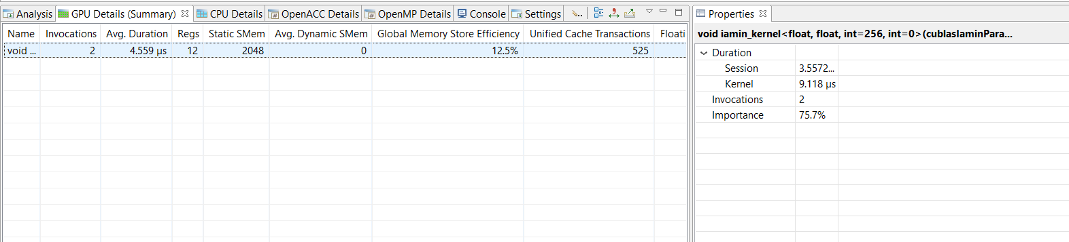
D_findMinOptimal Profiling

Slide 16
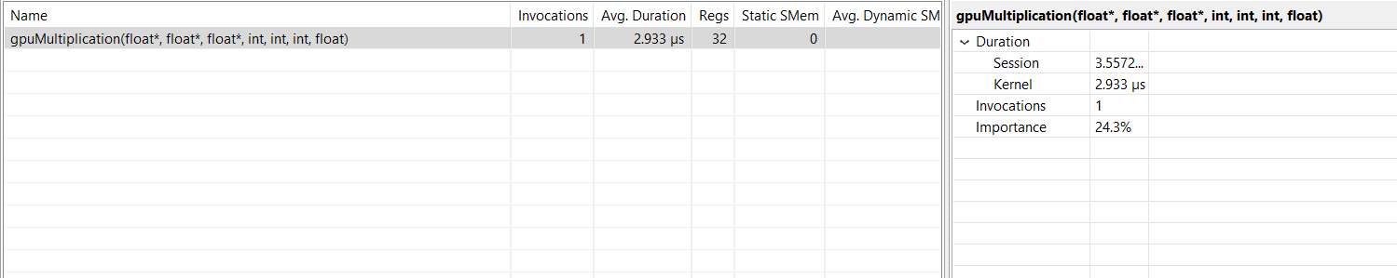
D_callpredict Profiling

Slide 17
Profiling comparison amongst kernels.

Slide 18
Contd.

Slide 19
Contd.

Slide 20
Conclusion
GPU implementation is so much faster than CPU. GPU completes simulation in micro seconds while CPU completes in milliseconds.
Profiling on kernels gave idea on how code performs and how it can be improved.

