Slide 1
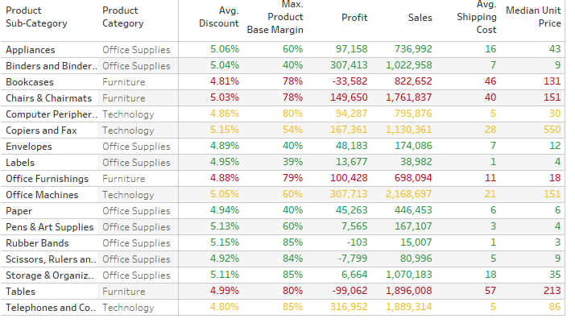
Quiz – Create following summary table
Use – Sample Superstore Sales.xls and format your numbers exactly like shown in screenshot below

Slide 2
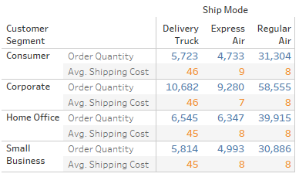
Quiz – Create following summary table
Use – Sample Superstore Sales.xls and format your numbers exactly like shown in screenshot below

Slide 3
Quiz
Import – Sample Superstore Sales.xls (Sheet – Orders) and answer the following questions:
What is the total sales of the store?
What is the total sales of product category = “Furniture”?
What is the total sales of product category = “Furniture” sold to Customer Segment = “Corporate”?
Set the default number format of Discount to percentage with 2 decimal places.
Find average discount on each order priority. Which order priority has highest average discount?

Slide 4
Quiz Answer
Import – Sample Superstore Sales.xls (Sheet – Orders) and answer the following questions:
What is the total sales of the store? (Ans – 14,915,601)
What is the total sales of product category = “Furniture”? (Ans – 5,178,591)
What is the total sales of product category = “Furniture” sold to Customer Segment = “Corporate”? (Ans – 1,862,841)
Set the number format of Discount to percentage with 2 decimal places.
What order priority has highest average discount? (Ans – Low at 5.04%)

Slide 5
Quiz – Answer in (Bracket)
Import – Sample Superstore Sales.csv and answer the following questions:
For Product Container = “Large Box” which Ship Mode has lowest average shipping cost? (Express Air)
For Product Container = “Medium Box” which Ship Mode has lowest average shipping cost? (Regular Air)
Which Ship Mode uses only “Jumbo” sized Product Containers? (Delivery Truck)
Which Ship Mode doesn’t entertain “Jumbo” sized Product Containers? (Express Air)

