Slide 1
ANALYTICS PROJECT REPORT
E-Commerce Customer & Marketing Analytics
End-to-End Analysis using SQL, Python, Excel & Power BI
Dataset: Sample Superstore Dataset — Kaggle
PYTHON
SQL
EXCEL
POWER BI
Presented By: Govind
August 2026

Slide 2
WHY THIS PROJECT
Objective
Build a complete analytics pipeline — from raw data to executive dashboards — to uncover the drivers of sales and profitability and turn them into concrete business actions.
1
Clean & Prepare Data
2
Explore the Data
3
Build an Excel Dashboard
Handle missing values, duplicates, data types and outliers in Python.
Run EDA to understand distributions and relationships between Sales, Profit, Discount & Quantity.
Deliver a fast, spreadsheet-native KPI view for business users.
4
Query with SQL
5
Design a Power BI Report
6
Synthesize Insights
Answer targeted business questions with precise, ad-hoc aggregation.
Create an interactive, filterable, executive-level dashboard.
Turn findings into prioritized, actionable recommendations.
E-Commerce Customer & Marketing Analytics
2

Slide 3
THE CHALLENGE
Business Problem
Superstore sells across Furniture, Office Supplies and Technology in four U.S. regions. Order volume and sales have grown — but profitability hasn't kept pace.
ORDERS SOLD AT A LOSS
18.73%
Management lacks a unified, data-driven view connecting sales, discounting behaviour and profitability — so decisions on discounting, regional investment and category focus are made without knowing which combinations actually erode margin.
nearly 1 in 5 orders
AVG. DISCOUNT
PROFIT MARGIN
This report identifies where profit is made and lost, quantifies the role of discounting, and translates the findings into prioritized action.
15.63%
~12.3%
Discount correlates negatively with Profit (r = -0.22) — the strongest controllable driver of loss.
E-Commerce Customer & Marketing Analytics
3

Slide 4
THE DATA
Dataset Overview
Sample Superstore Dataset (Kaggle) — multi-year U.S. retail order-line transactions.
9,977
37,820
₹22.96L
₹2.86L
Orders
Units Sold
Total Sales
Total Profit
STRUCTURE OF THE DATA
KEY FIELDS
Categories:
Furniture · Office Supplies · Technology
Sales / Profit
Numeric — revenue & margin
Regions:
Central · East · South · West
Discount
Numeric — 0% to 80%
Segments:
Consumer · Corporate · Home Office
Quantity
Numeric — units per line
Ship Modes:
Standard · Second · First Class · Same Day
Order / Ship Date
Date fields
Category / Sub-Category
Product classification
E-Commerce Customer & Marketing Analytics
4

Slide 5
HOW IT WAS BUILT
Project Workflow
A four-stage pipeline turns raw transactions into decisions.
1
2
3
4
5
Python
SQL
Excel
Power BI
Insights
➜
➜
➜
➜
Clean data &
run EDA
Query business
questions
Build KPI
dashboard
Interactive exec.
dashboard
Recommend &
act
Each stage cross-validates the last: Python's EDA findings reappear in SQL aggregates, and both are visualized identically across the Excel and Power BI dashboards — giving high confidence in the final recommendations.
E-Commerce Customer & Marketing Analytics
5

Slide 6
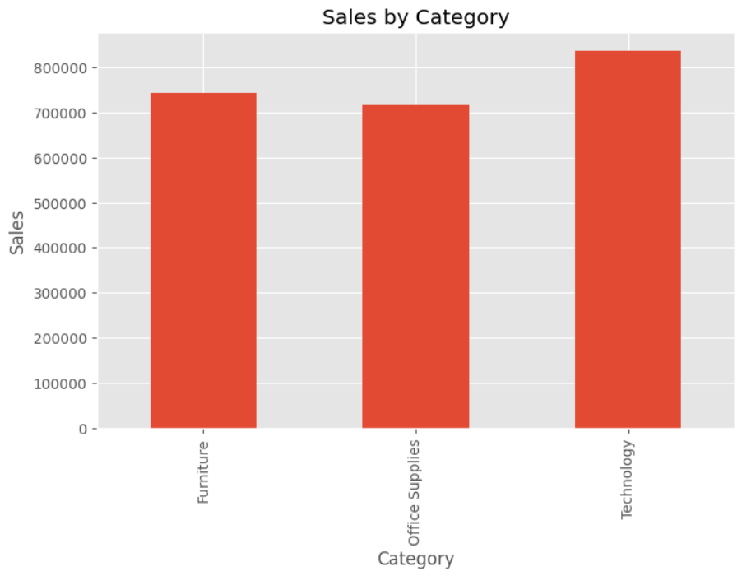
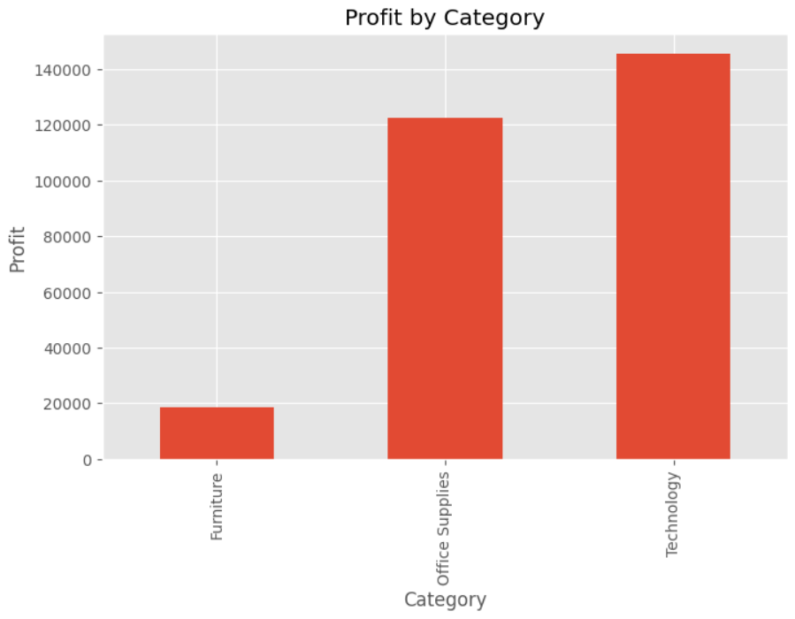
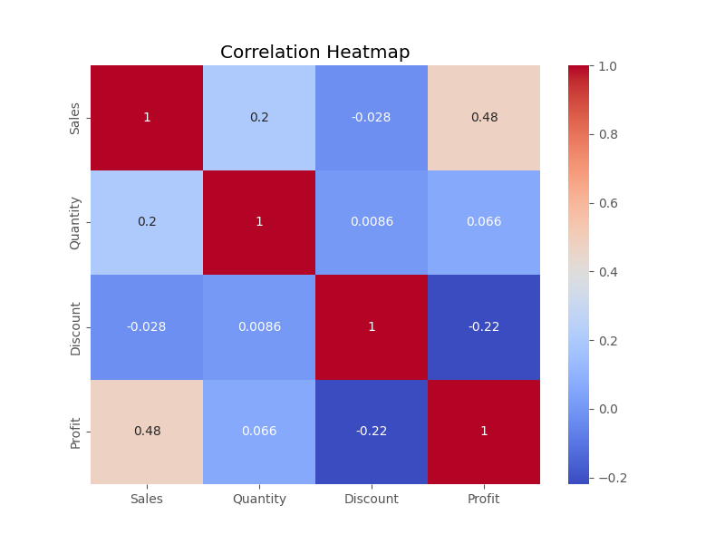
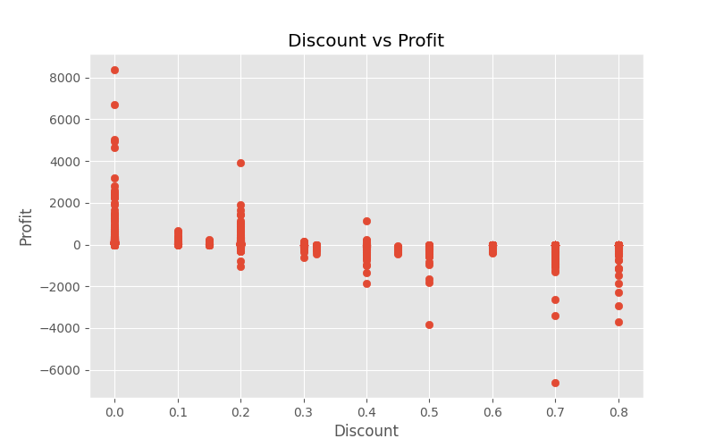
PREPARATION & EXPLORATION
Python Cleaning & EDA
Cleaning & Key Findings
✓
Removed duplicates, fixed dtypes, converted dates
✓
Validated Discount range & handled Profit outliers
✓
Sales & Profit are right-skewed — small orders dominate volume
✓
Discount ↔ Profit correlation: -0.22 (negative)
✓
Sales ↔ Profit correlation: +0.48 (positive)
E-Commerce Customer & Marketing Analytics
6

Slide 7
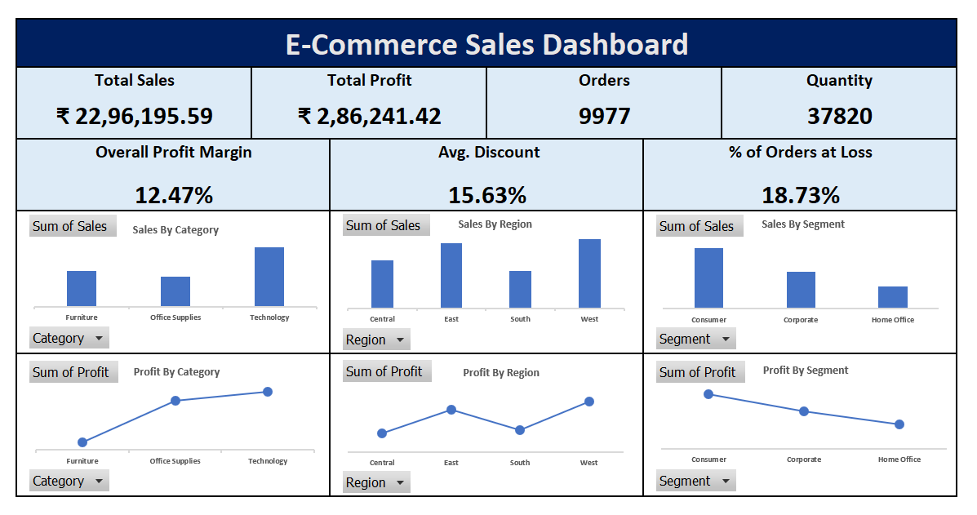
SPREADSHEET REPORTING
Excel Dashboard
PivotTable / PivotChart based KPI dashboard, filterable by Category, Region & Segment.
Total Sales
₹22,96,195.59
Total Profit
₹2,86,241.42
Overall Margin
12.47%
Avg. Discount
15.63%
% Orders at Loss
18.73%
E-Commerce Customer & Marketing Analytics
7

Slide 8
QUERYING THE DATA
SQL Analysis
Precise, ad-hoc aggregation used to answer targeted business questions.
Loss-Making Sub-Categories
QUERIES ANSWERED
SELECT Sub_Category,
SUM(Sales) AS Total_Sales,
SUM(Profit) AS Total_Profit
FROM superstore
GROUP BY Sub_Category
HAVING SUM(Profit) < 0
ORDER BY Total_Profit ASC
LIMIT 10;
Category profit & margin
Technology leads on profit & margin
Top loss sub-categories
Binders, Tables, Machines
Regional performance
West & East outperform
Discount impact
Finding: Binders (-31K), Tables (-21K) and Machines (-19K) are the largest loss contributors — despite strong sales volume.
Avg. profit turns negative past ~20–30% discount
Loss-order rate
18.73% of orders unprofitable
E-Commerce Customer & Marketing Analytics
8

Slide 9
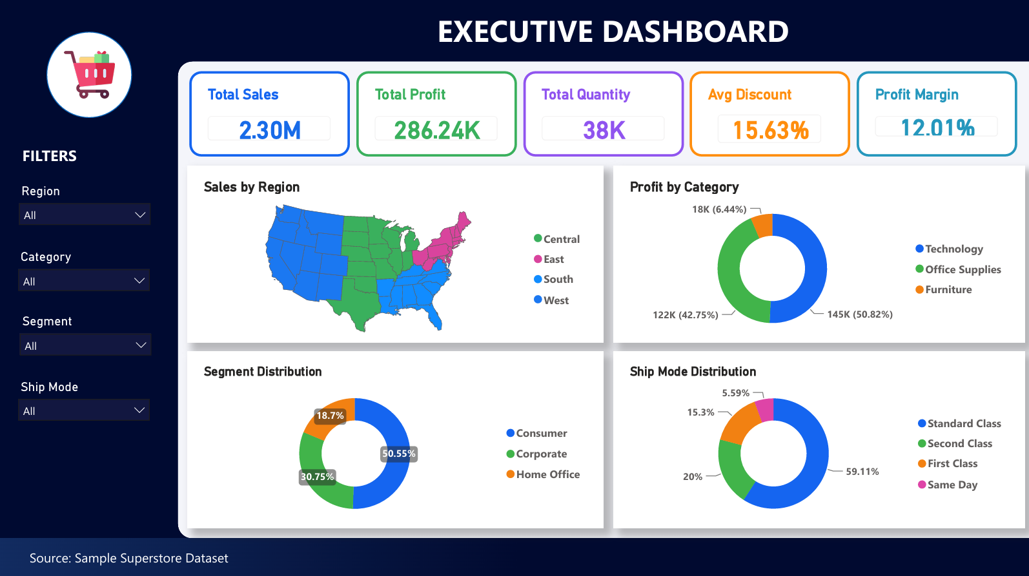
EXECUTIVE REPORTING
PAGE 1 / 5
Power BI Dashboard
Executive Dashboard
Top-Line KPIs
Total Sales 2.30M, Total Profit 286.24K, 38K units, Avg. Discount 15.63%, Profit Margin 12.01%.
Regional Sales Map
Filled U.S. map showing sales concentration by Region.
Category & Segment Mix
Profit by Category donut: Technology 50.8%, Office Supplies 42.8%, Furniture 6.4%; Segment split led by Consumer at 50.6%.
Ship Mode Distribution
Standard Class dominates fulfillment at 59.1% of shipments.
E-Commerce Customer & Marketing Analytics
9

Slide 10
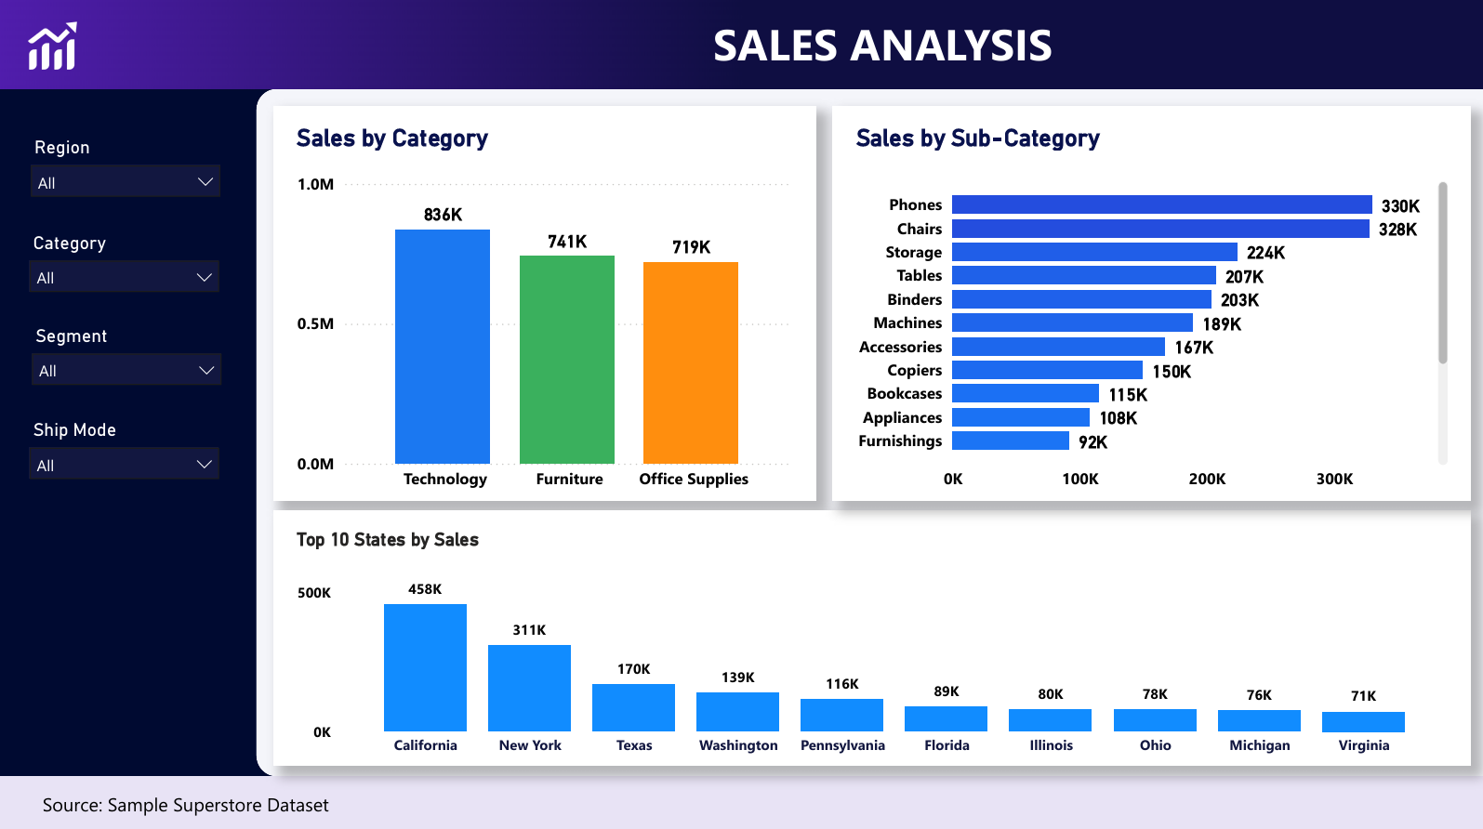
EXECUTIVE REPORTING
PAGE 2 / 5
Power BI Dashboard
Sales Analysis
Sales by Category
Technology leads (836K), ahead of Furniture (741K) and Office Supplies (719K).
Sales by Sub-Category
Phones (330K) and Chairs (328K) are the top two sub-categories, down to Furnishings (92K).
Top 10 States
California (458K) and New York (311K) are by far the largest state markets, ahead of Texas, Washington & Pennsylvania.
E-Commerce Customer & Marketing Analytics
10

Slide 11
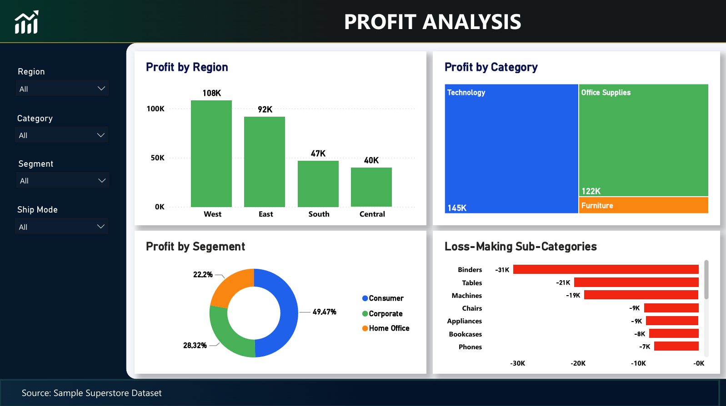
EXECUTIVE REPORTING
PAGE 3 / 5
Power BI Dashboard
Profit Analysis
Profit by Region
West (108K) and East (92K) rank well ahead of South (47K) and Central (40K).
Profit by Category
Technology (145K) and Office Supplies (122K) dominate; Furniture contributes only a sliver.
Profit by Segment
Consumer 49.5%, Corporate 28.3%, Home Office 22.2%.
Loss-Making Sub-Categories
Binders (-31K), Tables (-21K) and Machines (-19K) are the largest loss contributors.
E-Commerce Customer & Marketing Analytics
11

Slide 12
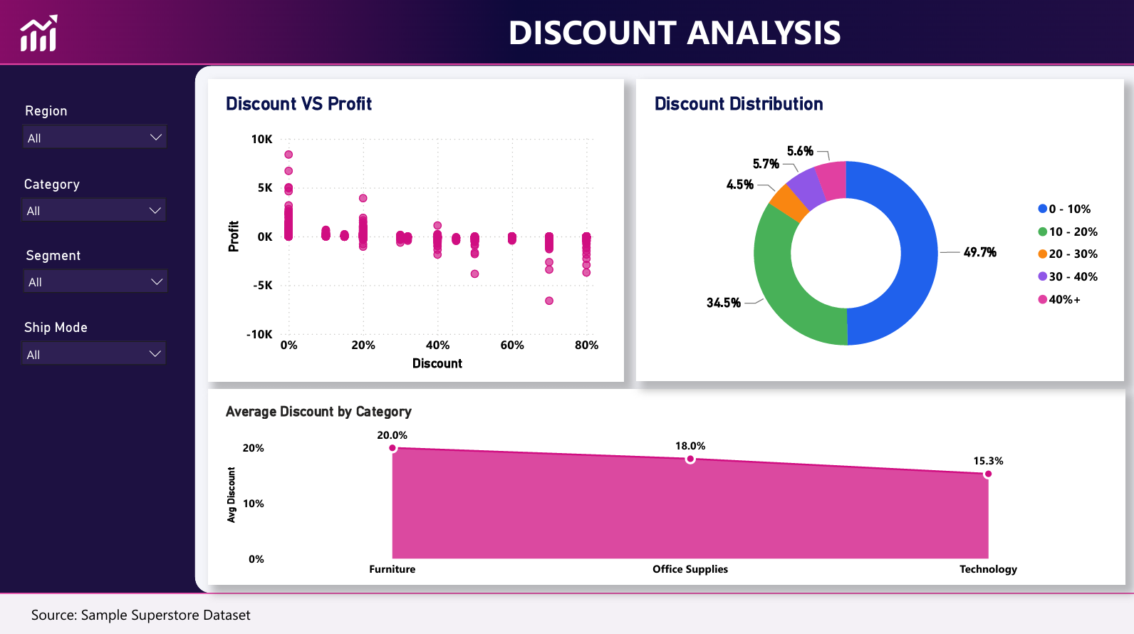
EXECUTIVE REPORTING
PAGE 4 / 5
Power BI Dashboard
Discount Analysis
Discount vs Profit
Profit clusters positive near 0% discount and trends toward loss as discount rises, especially past 60-70%.
Discount Distribution
49.7% of orders carry 0-10% discount; 34.5% carry 10-20%; a combined 15.8% receive 20%+.
Avg. Discount by Category
Furniture receives the steepest average discount (20.0%), ahead of Office Supplies (18.0%) and Technology (15.3%).
E-Commerce Customer & Marketing Analytics
12

Slide 13
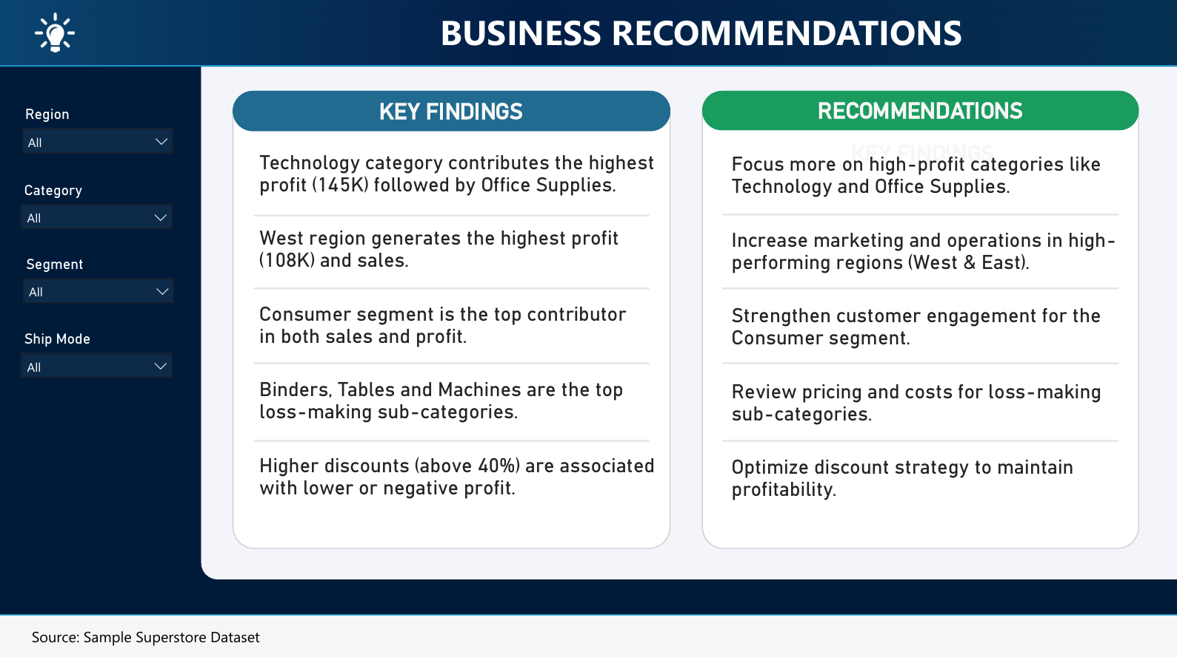
EXECUTIVE REPORTING
PAGE 5 / 5
Power BI Dashboard
Business Recommendations Page
Findings ↔ Actions
Two-column layout pairs each key finding directly with its recommended action.
Built for Stakeholders
Lets business users see not just what the data shows, but what it implies.
Closes the Loop
Mirrors the structure this presentation itself follows — insights, then recommendations.
E-Commerce Customer & Marketing Analytics
13

Slide 14
WHAT THE DATA TELLS US
Key Insights
Technology drives profit
Furniture underperforms
🡑
🡓
50.8% of total profit; lowest average discount of the 3 categories.
Nearly matches Technology on sales but earns only ~6% of profit.
West & East lead regions
Consumer segment dominates
🌐
👥
Together contribute 60%+ of sales and ~200K of total profit.
49.5% of total profit — nearly half — vs. Corporate & Home Office.
Discounting erodes margin
18.73% of orders lose money
％
⚠
Correlation of -0.22; profit turns negative past ~20–30% discount.
A quantifiable, addressable drag on overall profitability.
3 sub-categories bleed profit
Standard Class dominates
📦
🚚
Binders, Tables & Machines are chronic loss-makers.
59.1% of shipments — concentrated logistics cost structure.
E-Commerce Customer & Marketing Analytics
14

Slide 15
WHAT TO DO NEXT
Recommendations
1
Tighten discount governance
5
Sustain West & East investment
Cap/require approval above 20–30% discount.
Investigate Central & South underperformance first.
2
Review loss-making sub-categories
6
Deepen Consumer engagement
Re-price Binders, Tables, Machines & others.
Loyalty & retention programs for the top segment.
3
Re-balance Furniture discounting
7
Track the loss-order rate
Reduce blanket discounts; use bundling instead.
Make 18.73% a recurring KPI on both dashboards.
4
Double down on Technology & Office Supplies
Weight marketing & inventory investment here.
E-Commerce Customer & Marketing Analytics
15

Slide 16
WHY IT MATTERS
Business Impact
Implementing the recommendations targets the two biggest controllable levers on profit: discount policy and loss-making sub-categories.
REDUCE
PROTECT
RECOVER
GROW
Loss-Order Rate
Margin on Furniture
Sub-Category Losses
High-Margin Categories
from 18.73% via discount caps & pricing review
by cutting its 20% avg. discount toward category norms
from Binders, Tables & Machines through re-pricing
by shifting investment toward Technology & Office Supplies
E-Commerce Customer & Marketing Analytics
16

Slide 17
BRINGING IT TOGETHER
Conclusion
Superstore's revenue base is healthy and diversified — but profitability is being materially eroded by uncontrolled discounting and a small set of chronically loss-making sub-categories, particularly within Furniture.
Technology, Office Supplies, the West & East regions, and the Consumer segment are Superstore's core strengths and should anchor future growth — while tightening discount policy and re-pricing loss-makers represents a concrete, sizable opportunity to lift margin without needing any increase in sales volume.
Four analytical layers — Python, SQL, Excel and Power BI — cross-validated one another at every step, giving high confidence in these findings.
E-Commerce Customer & Marketing Analytics
17

Slide 18
WHAT'S NEXT
Future Enhancements
📈
🧩
💲
Sales & profit forecasting
Customer segmentation
Discount optimization
Time-series models (Prophet/ARIMA) by category & region.
RFM analysis / clustering for high-value customer targeting.
Price-elasticity model for sub-category-level discount caps.
⚙
🔍
🌐
Automated ETL pipeline
Drill-through reporting
External data enrichment
Scheduled refresh from Python → SQL → Power BI.
Region/category drill-down to product & customer level.
Marketing spend, competitor pricing & macro indicators.
E-Commerce Customer & Marketing Analytics
18

Slide 19
THANK YOU
Questions & Discussion
E-Commerce Customer & Marketing Analytics — SQL · Python · Excel · Power BI
PYTHON
SQL
EXCEL
POWER BI

