Slide 1


BANGLADESH ARMY UNIVERSITY OF ENGINEERING & TECHNOLOGY(BAUET)
DEPARTMENT OF COMPUTER SCIENCE AND ENGINEERING
COURSE CODE: CSE-4106
COURSE TITLE: SOFTWARE DEVELOPMENT FOR WEB APPS SESSIONAL
PROJECT TITLE: A CAR TRADING PORTAL USING DJANGO WEB FRAMEWORK
PRESENTED BY:
GOLAM RABBI HASAN
ID:18204042
ISHAAT RAHMAN DIPU
ID:18204048
ABDULLAH AL MAMUN
ID:18204050
KAZI SAD-AL SAKIB
ID:18104040
SABBIR AHMED PREOM
ID:17204080
PRESENTED TO
MD. OMAR FARUQ,
LECTURER, DEPT OF CSE,BAUET
MD. NAZMUS SALEHIN,
LECTURER, DEPT OF CSE,BAUET
MST. IRIN SULTANA,
LECTURER, DEPT OF CSE,BAUET
SESSION:2018-19
DEPT :CSE
BATCH: 8TH

Slide 2
A Car Trading Portal Using Django Web Framework

Slide 3
Outlines
Introduction
Goals And Objectives
How will the system benefit the companies?
Existing System
Proposed System
Methodology
Flow Chart
Use Case Diagram
Class Diagram
Used Technology
Features
Future Work
Conclusion
Date: 4/21/2022 A Car Trading Portal Using Django Web Framework Page-3

Slide 4
INTRODUCTION
Car Trading means buying/selling used cars including budget,
model, prices, company etc.
Our project is meant to give people a better and
a trustworthy platform where they can sell and buy cars of
their own choice and obviously on their own terms and
condition.
With the help of internet and computer systems a man
from remote area can buy/sell his car from anywhere the
country
Date: 4/21/2022 A Car Trading Portal Using Django Web Framework Page-4

Slide 5
GOALS AND OBJECTIVES
The main purpose of “car trading portal” is sell/buy used/second-hand cars online. Using this project anyone can buy/sell used cars online including by price, city, model, company etc. This project would become the best market place and information source on old cars bought and sold in Bangladesh. This project will provide facility to all buyer, seller and dealers for buy/sell cars.
If anyone want to buy used cars online, then first he will register in this website and then he can see all the details about the sell used cars including prices, model and cities.
Date: 4/21/2022 A Car Trading Portal Using Django Web Framework Page-5

Slide 6
GOALS AND OBJECTIVES (CONT.)
It provides the best used cars for the cheapest prices,
creating more value for customers visiting.
This Web Application is based on the buyer budget, seller budget
for the buying/selling used cars. The main goal is to
provide easy way for buying and selling used cars
online
Date: 4/21/2022 A Car Trading Portal Using Django Web Framework Page-6

Slide 7
How will the System benefit the Companies?
This web application is built to eliminate and in some cases reduce the hardships faced by the existing system.
Moreover, this system is designed for particular need of the company to carry out its operations in a smooth and effective manner. This web application is reduced as much as possible to avoid errors while entering data. It also provides error message while entering invalid data. It is user-friendly as no formal knowledge is required to use the system.
Date: 4/21/2022 A Car Trading Portal Using Django Web Framework Page-7

Slide 8
Existing System
In the existing system, it is difficult to maintain the car information individually and to supply it for the customers who are eager to buy them. A customer has to face difficulty in order to know the information of car-like manufacturing year, car model and other valuable information in a single domain.
h
Date: 4/21/2022 A Car Trading Portal Using Django Web Framework Page-8

Slide 9
PROPOSED SYSTEM
This project will provide facilities to all buyers, car business owners for selling cars. If anyone want to buy used cars online, then first he will register on this website and then he can see all the details about the sell used cars including prices, model and cities. The website can maintain car details like manufacturer, year of manufacturing, price, model, etc. We can also view all the car details which are kept for sale effectively and wecan search for our desired car. With this Customer can get the information quickly like cardetails which have been entered clearly.
Date: 4/21/2022 A Car Trading Portal Using Django Web Framework Page-9

Slide 10
Methodology
Step 1: At first you have to enter the website.
Step 2: For Buy you have to log in/register on the website.
Step 3: For completing our registration, you have to go registration page and fill the
boxes with the required information.
Step 4: For searching the desired car you can use the search icon from the dashboard or
the advanced filter section from the home page.
Step5: Then the website shows a single-car page. This page shows you particular car
details on the left side and there is a send message button. If the customer wants to send a
message to the car owner then the customer can send a message with the help of that
button.
Step 6: To Contract with the car dealer, the customer can use the contract menu from the
dashboard
Step 7: To Return Home, the customer can click the home menu from the dashboard
Step 8: To Exit the website, the customer can click the log out from the dashboard and exit
The website.
Date: 4/21/2022 A Car Trading Portal Using Django Web Framework Page-10

Slide 11
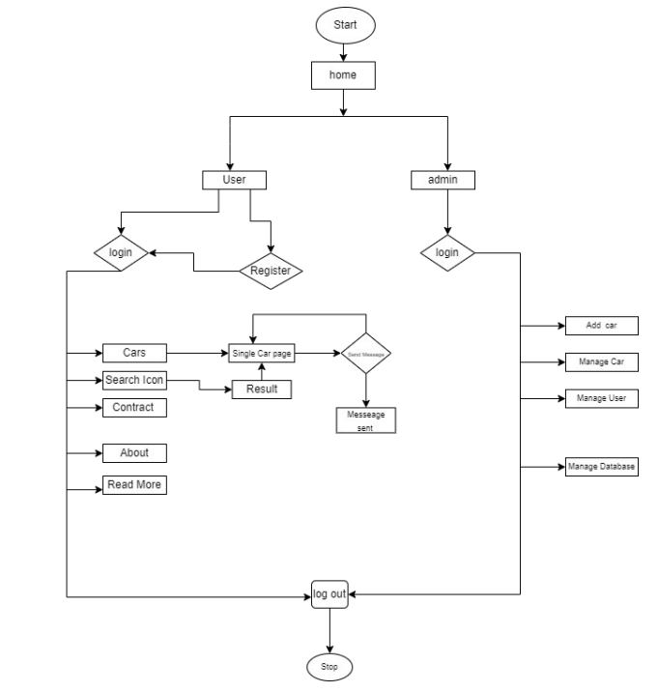
Flow Chart
Figure-1:Flow chart of Employee Car Web Portal Web Application
Date: 4/21/2022 A Car Trading Portal Using Django Web Framework Page-11

Slide 12
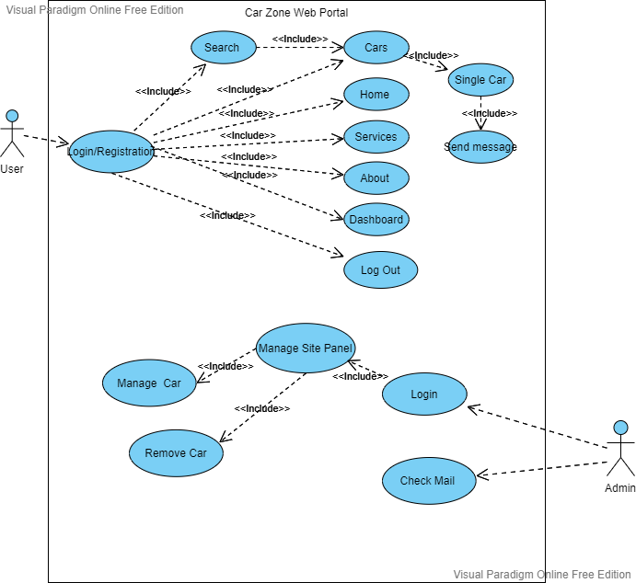
Use Case Diagram
Figure-2:Use Case Diagram of Car Trading Web Application
Date: 4/21/2022 A Car Trading Portal Using Django Web Framework Page-12

Slide 13
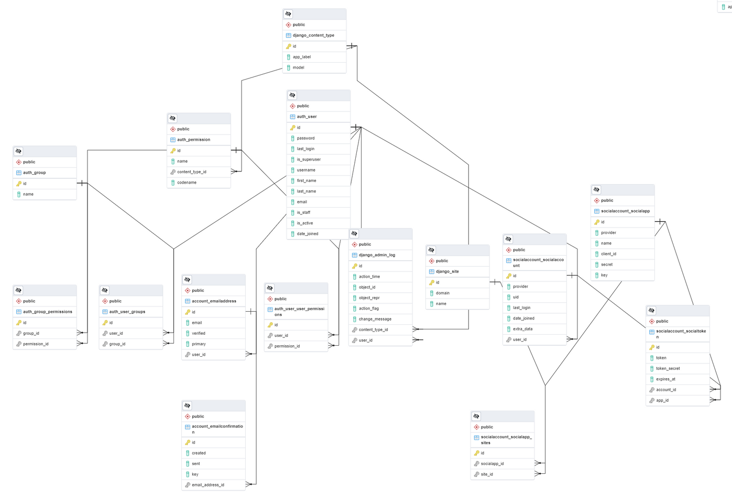
Class Diagram
Figure-2:Use Case Diagram of Car Trading Web Application
Date: 4/21/2022 A Car Trading Portal Using Django Web Framework Page-13

Slide 14
Used Technology
SOFTWARE
HARDWARE
PROGRAMING
LANGUAGE
Frameworks
Atom
Git
pgAdmin
Google Chrome
Notepad++
PERSONAL COMPUTER
HTML
CSS
JavaScript
Python
Django
Bootstrap
Jqurey
Date: 4/21/2022 A Car Trading Portal Using Django Web Framework Page-14

Slide 15
Features
Easy to use.
It is completely secure.
It is controlled by the admin.
This system is easily compatible with most of the web browsers.
Admin can view all the records whenever necessary with ease.
Free of cost registration in the website
Commision is not required in buying/selling used car
Date: 4/21/2022 A Car Trading Portal Using Django Web Framework Page-15

Slide 16
Future Work
The option to print the records in future.
We intend to add a payment getaway structure in the future.
We would like to implement a regular backup mechanism to back up thewebsite database to avoid disasters.
The system can be developed in such a way that its existin can be modified to better versions
An unregistered person may only see common pages with all buyer and seller’s information.
Date: 4/21/2022 A Car Trading Portal Using Django Web Framework Page-16

Slide 17
Conclusion
With vehicle ownership shifting towards leasing, the importance of the used-car
website will keep rising in the coming years. In the meantime, the used-car market
will be completely reshaped by online sales. It is a very powerful trend, providing
a step change in terms of customer journey, while optimizing business efficiency.
Online sales will shake up the competitive landscape, with the emergence of new players, and an overall consolidation of the competition. We hope that our project will deliver the most of its requirements.
Date: 4/21/2022 A Car Trading Portal Using Django Web Framework Page-17

Slide 18
THANK YOU

