Slide 1
Advanced Java and Android Programming
Day 2: Swing and Graphics

Slide 2
What We’ll Cover
File Choosers and Color Choosers
Menus
More about Text Components: Text Areas and Fonts
Sliders
Look and Feel
Drawing Text
Basic Graphics

Slide 3
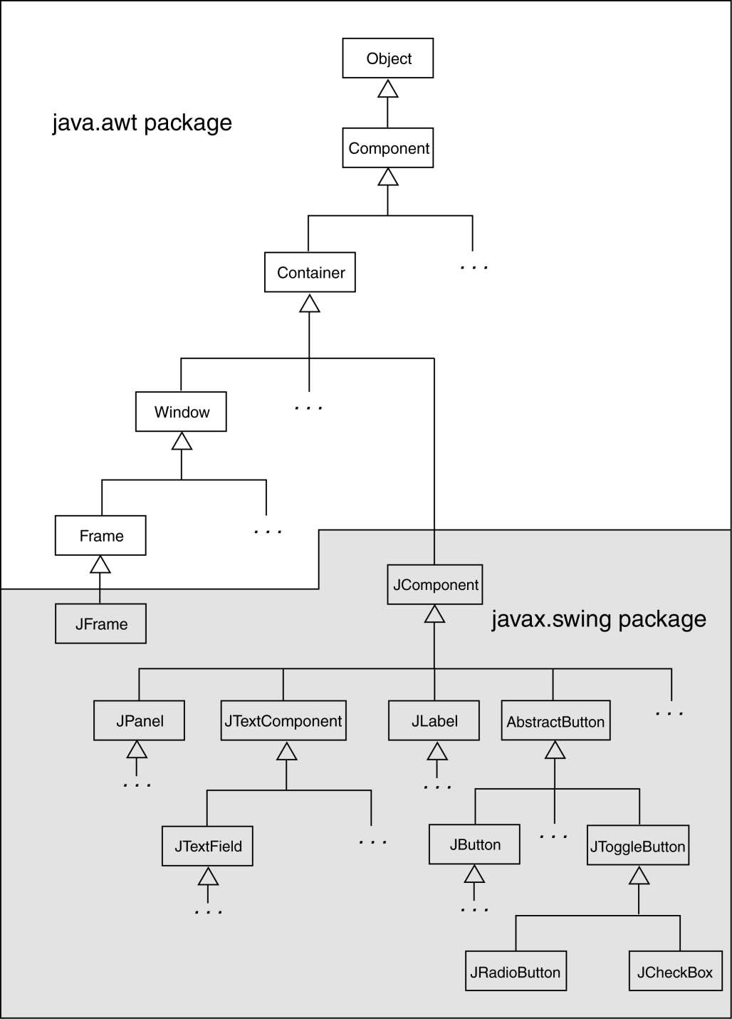
AWT and Swing Class Hierarchy

Slide 4
Lists
A list is a component that displays a list of items and allows the user to select items from the list.
The JList component is used for creating lists.
When an instance of the JList class is created, an array of objects is passed to the constructor.
JList (Object[] array)
The JList component uses the array to create the list of items.
String[] names = { "Bill", "Geri", "Greg", "Jean", "Kirk", "Phillip", "Susan" };
JList nameList = new JList(names);

Slide 5
List Selection Modes
The JList component can operate in any of the following selection modes:
Single Selection Mode - Only one item can be selected at a time.
Single Interval Selection Mode - Multiple items can be selected, but they must be in a single interval. An interval is a set of contiguous items.
Multiple Interval Selection Mode - In this mode multiple items may be selected with no restrictions.
This is the default selection mode.

Slide 6
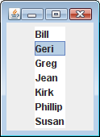
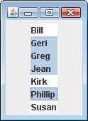
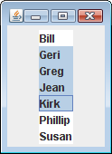
List Selection Modes
Single selection mode allows
only one item to be selected
at a time.
Multiple interval selection mode allows multiple items to be selected with no restrictions.
Single interval selection mode allows
a single interval of contiguous items
to be selected.

Slide 7
List Selection Modes
You change a JList component’s selection mode with the setSelectionMode method.
The method accepts an int argument that determines the selection mode:
ListSelectionModel.SINGLE_SELECTION
ListSelectionModel.SINGLE_INTERVAL_SELECTION
ListSelectionModel.MULTIPLE_INTERVAL_SELECTION
Example:
nameList.setSelectionMode(
ListSelectionModel.SINGLE_SELECTION);

Slide 8
List Events
When an item in a JList object is selected it generates a list selection event.
The event is handled by an instance of a list selection listener class, which must meet the following requirements:
It must implement the ListSelectionListener interface.
It must have a method named valueChanged. This method must take an argument of the ListSelectionEvent type.
Use the addListSelectionListener method of the JList class to register the instance of the list selection listener class with the list object.

Slide 9
List Events
When the JList component generates an event:
it automatically executes the valueChanged method of the list selection listener object
It passes the event object as an argument.

Slide 10
Retrieving Selected Items
You may use:
getSelectedValue or
getSelectedIndex
to determine which item in a list is currently selected.
getSelectedValue returns a reference to the item that is currently selected.
String selectedName;
selectedName = (String)nameList.getSelectedValue();
The return value must be cast to String is required in order to store it in the selectedName variable.
If no item in the list is selected, the method returns null.

Slide 11
Retrieving Selected Items
The getSelectedIndex method returns the index of the selected item, or –1 if no item is selected.
Internally, the items that are stored in a list are numbered (similar to an array).
Each item’s number is called its index.
The first item has the index 0.
You can use the index of the selected item to retrieve the item from an array.
String[] names = { "Bill", "Geri", "Greg", "Jean", "Kirk", "Phillip", "Susan" };
JList nameList = new JList(names);

Slide 12
Retrieving Selected Items
This code could be used to determine the selected item:
int index;
String selectedName;
index = nameList.getSelectedIndex();
if (index != -1)
selectedName = names[index];
Example: ListWindow.java

Slide 13
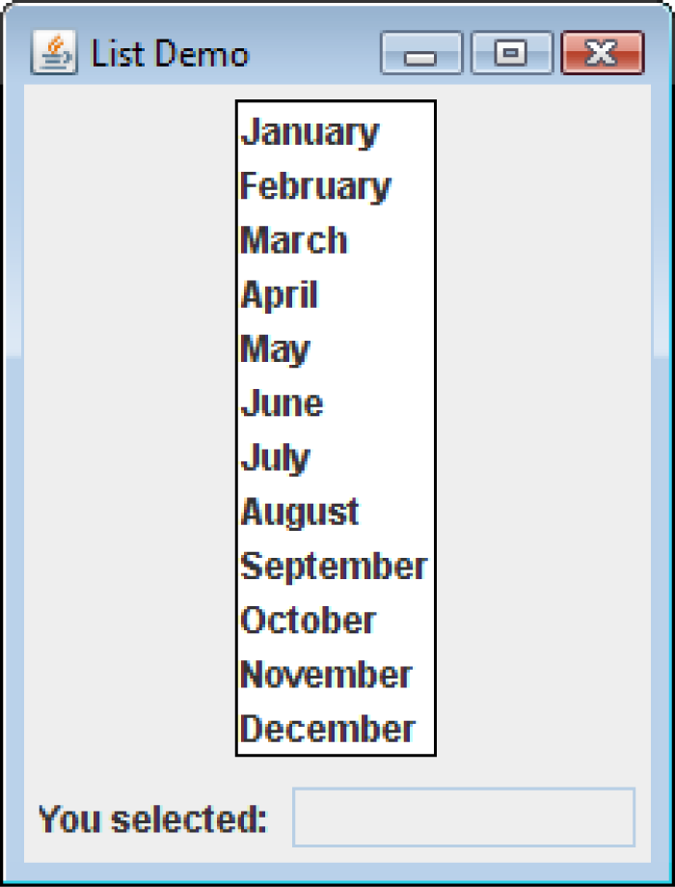
Bordered Lists
The setBorder method can be used to draw a border around a JList.
monthList.setBorder(
BorderFactory.createLineBorder(Color.black,1));

Slide 14
Adding A Scroll Bar To a List
By default, a list component is large enough to display all of the items it contains.
Sometimes a list component contains too many items to be displayed at once.
Most GUI applications display a scroll bar on list components that contain a large number of items.
List components do not automatically display a scroll bar.

Slide 15
Adding A Scroll Bar To a List
To display a scroll bar on a list component, follow these general steps.
Set the number of visible rows for the list component.
Create a scroll pane object and add the list component to it.
Add the scroll pane object to any other containers, such as panels.
For this list:
String[] names = { "Bill", "Geri", "Greg", "Jean", "Kirk", "Phillip", "Susan" };
JList nameList = new JList(names);

Slide 16
Adding A Scroll Bar To a List
Establish the size of the list component.
nameList.setVisibleRowCount(3);
Create a scroll pane object and add the list component to it.
A scroll pane object is a container that displays scroll bars on any component it contains.
The JScrollPane class to create a scroll pane object.
We pass the object that we wish to add to the scroll pane as an argument to the JScrollPane constructor.
JScrollPane scrollPane = new
JScrollPane(nameList);

Slide 17
Adding A Scroll Bar To a List
Add the scroll pane object to any other containers that are necessary for our GUI.
JPanel panel = new JPanel();
panel.add(scrollPane);
add(panel);
When the list component is displayed, it will appear with:
Three items showing at a time and
scroll bars:

Slide 18
Adding A Scroll Bar To a List
By default, JList components added to a JScrollPane object only display a scroll bar if there are more items in the list than there are visible rows.
When a JList component is added to a JScrollPane object, a border will automatically appear around the list.
Example: ListWindowWithScroll.java

Slide 19
Adding Items to an Existing List
The setListData method allows the adding of items in an existing JList component.
void setListData(Object[] data)
This replaces any items that are currently displayed in the component.
This can be used to add items to an empty list.

Slide 20
Adding Items to an Existing List
You can create an empty list by using the JList component’s no-parameter constructor:
JList nameList = new JList();
Items can be added to the list:
String[] names = { "Bill", "Geri", "Greg", "Jean", "Kirk", "Phillip", "Susan" };
nameList.setListData(names);

Slide 21
Adding Items to an Existing List
To add a single item to a list:
JList nameList = new JList();
private Vector<String> nameData;
private String[] nameList = { “John", “Susy", “Bill};
for (int ix=0; ix<nameList.length; ix++)
{
months.add(mlist[ix]);
}

Slide 22
Single Interval Selection Mode
A list is set to single interval selection mode by passing the constant
ListSelectionModel.SINGLE_INTERVAL_SELECTION
to the component’s setSelectionMode method.
An interval is a set of contiguous items.
The user selects:
the first item in the interval by clicking on it
the last item by holding the Shift key while clicking on it.
All of the items that appear in the list from the first item through the last item are selected.

Slide 23
Single Interval Selection Mode
The getSelectedValue method returns the first item in the selected interval.
The getSelectedIndex method returns the index of the first item in the selected interval.
To get the entire selected interval, use the getSelectedValues method.
This method returns an array of objects, which are the items in the selected interval.
The getSelectedIndices method returns an array of int values that are the indices of all the selected items in the list.

Slide 24
Multiple Interval Selection Mode
Set multiple interval selection mode by passing the constant
ListSelectionModel.MULTIPLE_INTERVAL_SELECTION
to the component’s setSelectionMode method.
In multiple interval selection mode:
multiple items can be selected
the items do not have to be in the same interval.
In multiple interval selection mode the user can select single items or intervals.

Slide 25
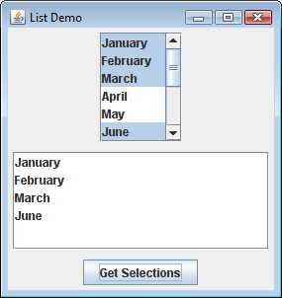
Multiple Interval Selection Mode
Example: MultipleIntervalSelection.java

Slide 26

Combo Boxes
A combo box presents a drop-down list of items that the user may select from.
The JComboBox class is used to create a combo box.
Pass an array of objects that are to be displayed as the items in the drop-down list to the constructor.
String[] names = { "Bill", "Geri", "Greg", "Jean", "Kirk", "Phillip", "Susan" };
JComboBox nameBox = new JComboBox(names);
When displayed, the combo box created by this code will initially appear as the button:

Slide 27
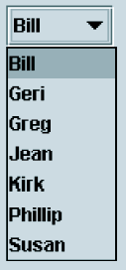
Combo Boxes
The button displays the item that is currently selected.
The first item in the list is automatically selected when the combo box is displayed.
When the user clicks on the button, the drop-down list appears and the user may select another item.

Slide 28
Combo Box Events
When an item in a JComboBox object is selected, it generates an action event.
Handle action events with an action event listener class, which must have an actionPerformed method.
When the user selects an item in a combo box, the combo box executes its action event listener’s actionPerformed method, passing an ActionEvent object as an argument.

Slide 29
Retrieving Selected Items
There are two methods in the JComboBox class that can be used to determine which item in a list is currently selected:
getSelectedItem
getSelectedIndex
The getSelectedItem method returns a reference to the item that is currently selected.
String selectedName;
selectedName = (String) nameBox.getSelectedItem();
getSelectedItem returns an Object reference so we cast the return value to a String.

Slide 30
Retrieving Selected Items
The getSelectedIndex method returns the index of the selected item.
String[] names = { "Bill", "Geri", "Greg", "Jean", "Kirk", "Phillip", "Susan" };
JComboBox nameBox = new JComboBox(names);
Get the selected item from the names array:
int index;
String selectedName;
index = nameBox.getSelectedIndex();
selectedName = names[index];

Slide 31
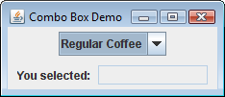
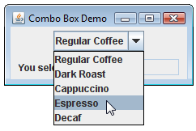
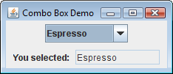
Retrieving Selected Items
Example:
ComboBoxWindow.java

Slide 32
Editable Combo Boxes
There are two types of combo boxes:
uneditable – allows the user to only select items from its list.
editable – combines a text field and a list.
It allows the selection of items from the list
allows the user to type input into the text field
The setEditable method sets the edit mode for the component.
String[] names = { "Bill", "Geri", "Greg", "Jean", "Kirk", "Phillip", "Susan" };
JComboBox nameBox = new JComboBox(names);
nameBox.setEditable(true);

Slide 33
Editable Combo Boxes
An editable combo box appears as a text field with a small button displaying an arrow joining it.
When the user clicks on the button, the drop-down list appears as shown in the center of the figure.
The user may:
select an item from the list.
type a value into the text field.
The user is not restricted to the values that appear in the list, and may type any input into the text field.

Slide 34

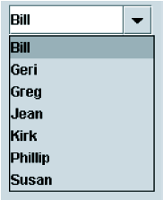

Editable Combo Boxes
Note that Sharon is not in the list.

Slide 35
Displaying Images in Labels and Buttons
Labels can display text, an image, or both.
To display an image, create an instance of the ImageIcon class, which reads the image file.
The constructor accepts the name of an image file.
The supported file types are JPEG, GIF, and PNG.
The name can also contain path information.
ImageIcon image = new ImageIcon("Smiley.gif");
or
ImageIcon image = new ImageIcon(
"C:\\Workshop\\Images\\Smiley.gif");

Slide 36
Displaying Images in Labels and Buttons
Display the image in a label by passing the ImageIcon object as an argument to the JLabel constructor.
JLabel(Icon image)
The argument passed can be an ImageIcon object or any object that implements the Icon interface.
ImageIcon image = new ImageIcon("Smiley.gif");
JLabel label = new JLabel(image);
or
JLabel label = new JLabel("Have a nice day!");
label.setIcon(image);

Slide 37
Displaying Images in Labels and Buttons
Text is displayed to the right of images by default.
Text alignment can be modified by passing one of the following to an overloaded constructor:
SwingConstants.LEFT
SwingConstants.CENTER
SwingConstants.RIGHT
Example:
ImageIcon image = new ImageIcon("Smiley.gif");
JLabel label = new JLabel("Have a nice day!",
image,
SwingConstants.RIGHT);

Slide 38
Displaying Images in Labels and Buttons
Creating a button with an image is similar to that of creating a label with an image.
ImageIcon image = new ImageIcon("Smiley.gif");
JButton button = new JButton(image);
To create a button with an image and text:
ImageIcon image = new ImageIcon("Smiley.gif");
JButton button = new JButton(
"Have a nice day!", image);
button.setIcon(image);

Slide 39
Displaying Images in Labels and Buttons
To add an image to an existing button:
JButton button = new JButton(
"Have a nice day!");
ImageIcon image = new ImageIcon("Smiley.gif");
button.setIcon(image);
You are not limited to small graphical icons when placing images in labels or buttons.
Example: MyCatImage.java

Slide 40
Mnemonics
A mnemonic is a key that you press in combination with the Alt key to quickly access a component. (The term is from the Greek word for memory.)
These are sometimes referred to as hot keys.
A hot key is assigned to a component through the component’s setMnemonic method
The argument passed to the method is an integer code that represents the key you wish to assign.

Slide 41
Mnemonics
The key codes are predefined constants in the KeyEvent class (java.awt.event package).
These constants take the form:
KeyEvent.VK_x, where x is a key on the keyboard.
The letters VK in the constants stand for “virtual key”.
To assign the A key as a mnemonic, use KeyEvent.VK_A.
Example:
JButton exitButton = new JButton("Exit");
exitButton.setMnemonic(KeyEvent.VK_X);

Slide 42
Mnemonics
If the letter is in the component’s text, the first occurrence of that letter will appear underlined.
If the letter does not appear in the component’s text, then no letter will appear underlined.

Slide 43
Mnemonics
You can also assign mnemonics to radio buttons and check boxes:
JRadioButton rb1 = new
JRadioButton("Breakfast");
rb1.setMnemonic(KeyEvent.VK_B);
JRadioButton rb2 = new JRadioButton("Lunch");
rb2.setMnemonic(KeyEvent.VK_L);
JCheckBox cb1 = new JCheckBox("Monday");
cb1.setMnemonic(KeyEvent.VK_M);
JCheckBox cb2 = new JCheckBox("Wednesday");
cb2.setMnemonic(KeyEvent.VK_W);

Slide 44
Tool Tips
A tool tip is text that is displayed in a small box when the mouse is held over a component.
The box usually gives a short description of what the component does.
Most GUI applications use tool tips as concise help to the user.

Slide 45
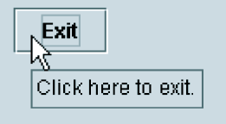

Tool Tips
Assign a tool tip to a component with the setToolTipText method.
JButton exitButton = new JButton("Exit");
exitButton.setMnemonic(KeyEvent.VK_X);
exitButton.setToolTipText(
"Click here to exit.");
Note the mnemonic x.
Tool tip

Slide 46
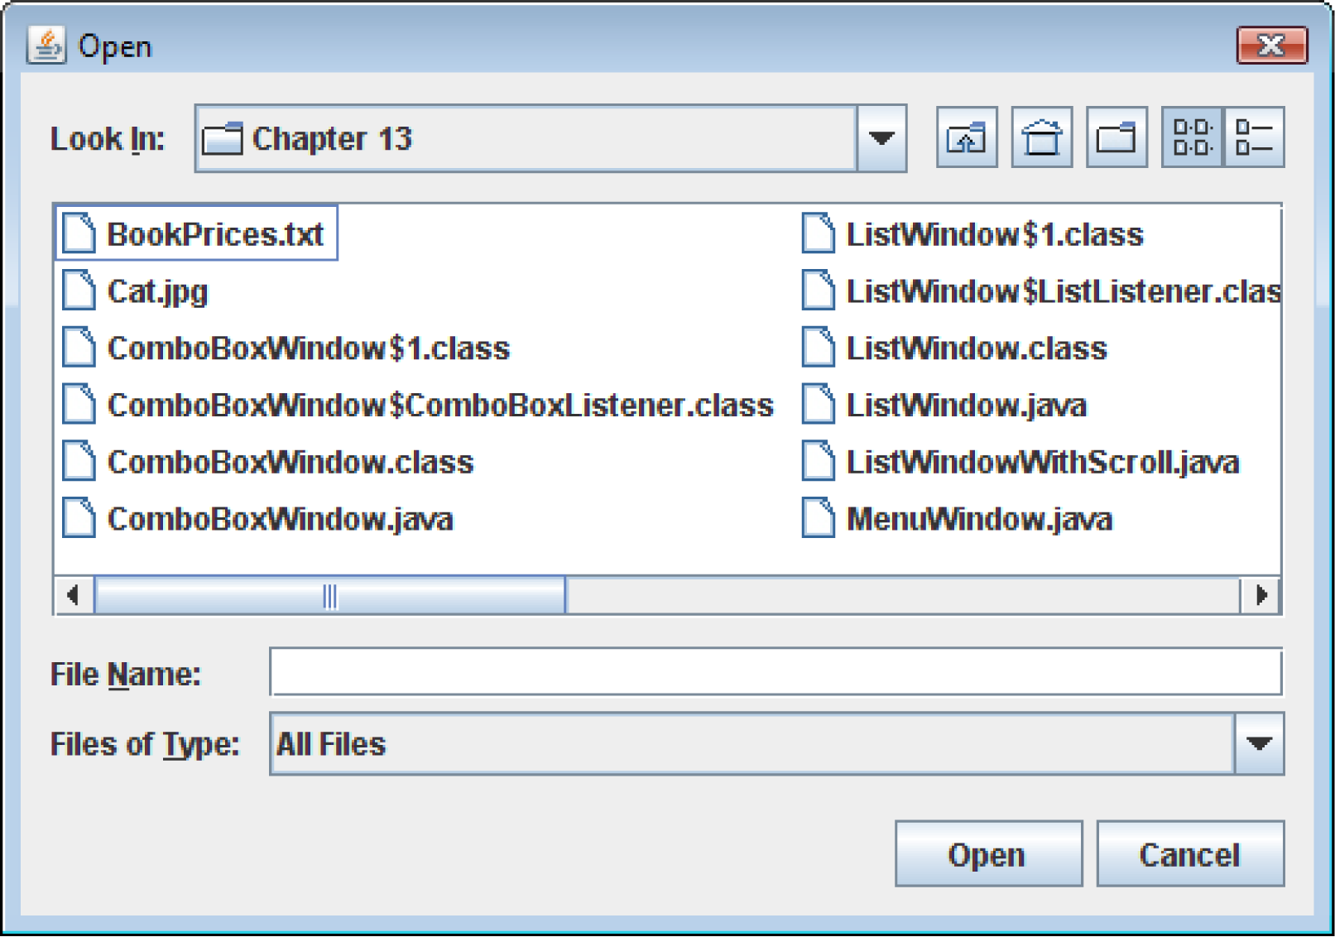
File Choosers
A file chooser is a specialized dialog box that allows the user to browse for a file and select it.

Slide 47
File Choosers
Create an instance of the JFileChooser class to display a file chooser dialog box.
Two of the constructors have the form:
JFileChooser()
JFileChooser(String path)
The first constructor shown takes no arguments and uses the default directory as the starting point for all of its dialog boxes.
The second constructor takes a String argument containing a valid path. This path will be the starting point for the object’s dialog boxes.

Slide 48
File Choosers
A JFileChooser object can display two types of predefined dialog boxes:
open file dialog box – lets the user browse for an existing file to open.
a save file dialog box – lest the user browse to a location to save a file.

Slide 49
File Choosers
To display an open file dialog box, use the showOpenDialog method.
General format:
int showOpenDialog(Component parent)
The argument can be null or a reference to a component.
If null is passed, the dialog box is normally centered in the screen.
If you pass a reference to a component the dialog box is displayed over the component.

Slide 50
File Choosers
To display a save file dialog box, use the showSaveDialog method.
General format:
int showSaveDialog(Component parent)
The argument can be either null or a reference to a component.
Both methods return an integer that indicates the action taken by the user to close the dialog box.

Slide 51
File Choosers
You can compare the return value to one of the following constants:
JFileChooser.CANCEL_OPTION – indicates that the user clicked on the Cancel button.
JFileChooser.APPROVE_OPTION – indicates that the user clicked on the OK button.
JFileChooser.ERROR_OPTION – indicates that an error occurred, or the user clicked on the standard close button on the window to dismiss it.
If the user selected a file, use the getSelectedFile method to determine the file that was selected.
The getSelectedFile method returns a File object, which contains data about the selected file.

Slide 52
File Choosers
Use the File object’s getPath method to get the path and file name as a String.
JFileChooser fileChooser = new JFileChooser();
int status = fileChooser.showOpenDialog(null);
if (status == JFileChooser.APPROVE_OPTION)
{
File selectedFile =
fileChooser.getSelectedFile();
String filename = selectedFile.getPath();
JOptionPane.showMessageDialog(null,
"You selected " + filename);
}

Slide 53
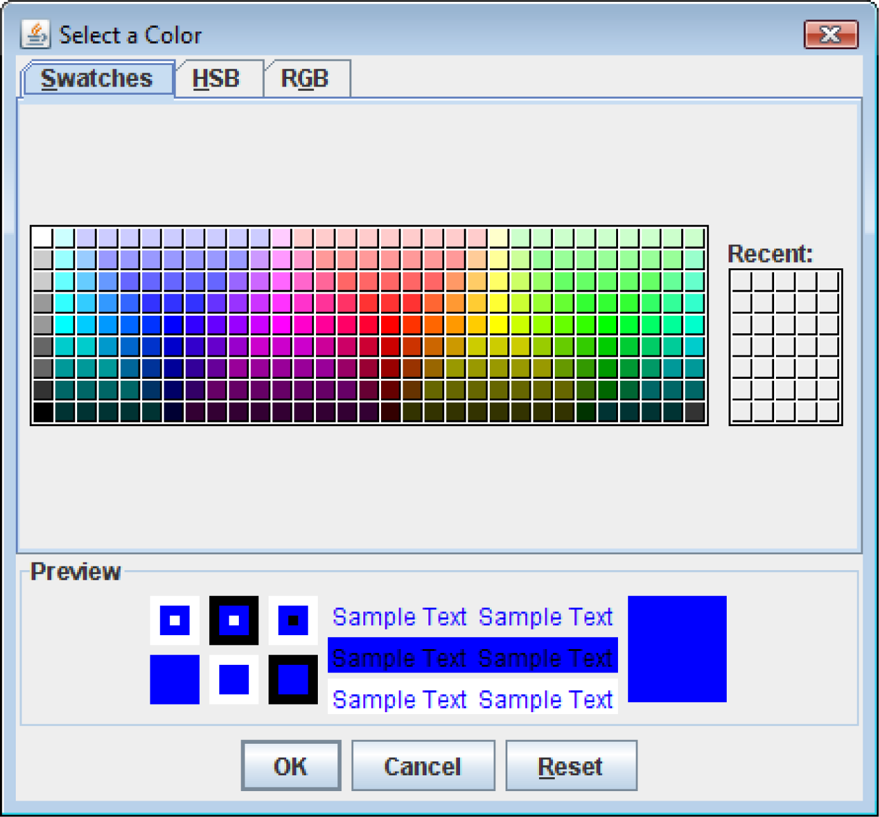
Color Choosers
A color chooser is a specialized dialog box that allows the user to select a color from a predefined palette of colors.

Slide 54
Color Choosers
By clicking the HSB tab you can select a color by specifying its hue, saturation, and brightness.
By clicking the RGB tab you can select a color by specifying its red, green, and blue components.
The JColorChooser class has a static method named showDialog, with the following general format:
Color showDialog(Component parent,
String title, Color initial)

Slide 55
Color Choosers
If the first argument is null, the dialog box is normally centered in the screen.
If it is a reference to a component the dialog box is displayed over the component.
The second argument is the dialog title.
The third argument indicates the color that appears initially selected in the dialog box.
This method returns the color selected by the user.

Slide 56
Color Choosers
Example:
JPanel panel = new JPanel();
Color selectedColor =
JColorChooser.showDialog(null,
"Select a Background Color",
Color.BLUE);
panel.setBackground(selectedColor);

Slide 57
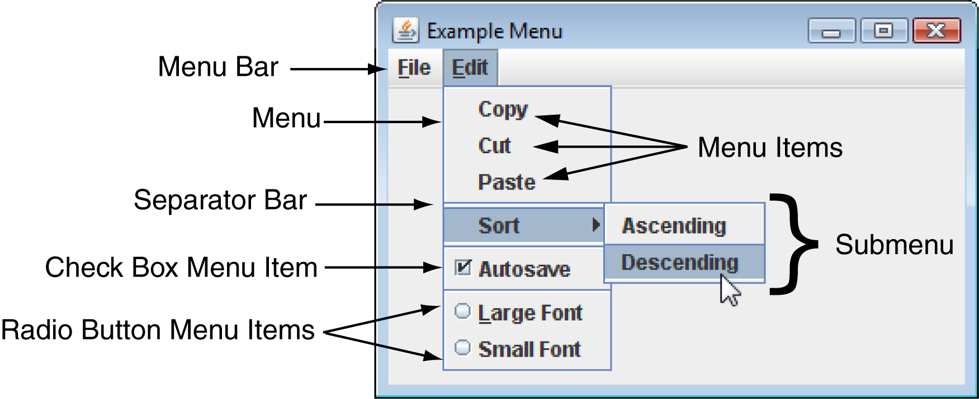
Menus
A menu system is a collection of commands organized in one or more drop-down menus.

Slide 58
Components of A Menu System
A menu system commonly consists of:
Menu Bar – A menu bar lists the names of one or menus.
Menu – A menu is a drop-down list of menu items.
Menu Item – A menu item can be selected by the user.
Check box menu item – A check box menu item appears with a small box beside it.
The item may be selected or deselected.
Radio button menu item – A radio button menu item may be selected or deselected.
Submenu – A menu within a menu is called a submenu.
Separator bar – A separator bar is a horizontal bar used to separate groups of items on a menu.

Slide 59
Menu Classes
A menu system is constructed with the following classes:
JMenuBar – Used to create a menu bar.
A JMenuBar object can contain JMenu components.
JMenu – Used to create a menu. A JMenu component can contain:
JMenuItem, JCheckBoxMenuItem, and JRadioButtonMenuItem components,
as well as other JMenu components.
A submenu is a JMenu component that is inside another JMenu component.
JMenuItem – Used to create a regular menu item.
A JMenuItem component generates an action event when selected.

Slide 60
Menu Classes
JCheckBoxMenuItem – Used to create a check box menu item.
The class’s isSelected method returns true if the item is selected, or false otherwise.
A JCheckBoxMenuItem component generates an action event when selected.
JRadioButtonMenuItem – Used to create a radio button menu item.
JRadioButtonMenuItem components can be grouped together in a ButtonGroup object so that only one of them can be selected at a time.
The class’s isSelected method returns true if the item is selected, or false otherwise.
A JRadioButtonMenuItem component generates an action event when selected.

Slide 61
Menu Example
Menu Example: MenuWindow.java

Slide 62
Text Areas
The JTextField class is used to create text fields.
A text field is a component that allows the user to enter a single line of text.
A text area is like a text field that can accept multiple lines of input.
You use the JTextArea class to create a text area.
The general format of two of the class’s constructors:
JTextArea(int rows, int columns)
JTextArea(String text, int rows, int columns)

Slide 63
Text Areas
The JTextArea class provides the getText and setText methods for getting and setting the text.
String userText = textInput.getText();
textInput.setText("Modified: " + userText);
JTextArea components do not automatically display scroll bars.
You must add a text area to a scroll pane.
JTextArea textInput = JTextArea(20, 40);
JScrollPane scrollPane = new
JScrollPane(textInput);

Slide 64
Text Areas
The JScrollPane object displays both vertical and horizontal scroll bars on a text area.
By default, the scroll bars are not displayed until they are needed.
This behavior can be altered:
scrollPane.setHorizontalScrollBarPolicy(
JScrollPane.HORIZONTAL_SCROLLBAR_NEVER);
scrollPane.setVerticalScrollBarPolicy(
JScrollPane.VERTICAL_SCROLLBAR_ALWAYS);

Slide 65
Text Areas
You can pass one of the following constants as an argument:
setHorizontalScrollBarPolicy
JScrollPane.HORIZONTAL_SCROLLBAR_AS_NEEDED.
JScrollPane.HORIZONTAL_SCROLLBAR_NEVER
JScrollPane.HORIZONTAL_SCROLLBAR_ALWAYS
setVericalScrollBarPolicy
JScrollPane.VERTICAL_SCROLLBAR_AS_NEEDED
JScrollPane.VERTICAL_SCROLLBAR_NEVER
JScrollPane.VERTICAL_SCROLLBAR_ALWAYS

Slide 66
Text Areas
By default, JTextArea components do not perform line wrapping.
To enable line wrapping:
textInput.setLineWrap(true);
There are two different styles of line wrapping:
word wrapping – the line breaks always occur between words.
textInput.setWrapStyleWord(true);
character wrapping – lines are broken between characters (default mode).

Slide 67
Fonts
Components display according to their font characteristics:
font – the name of the typeface
style – can be plain, bold, and/or italic
size – size of the text in points.
A component’s setFont method will change the appearance of the text in the component:
setFont (Font appearance)
A Font constructor takes three parameters:
Font(String fontName, int style, int size)

Slide 68
Fonts
Java guarantees that you will have the fonts:
Dialog, DialogInput, Monospaced, SansSerif, and Serif.
There are three font styles:
Font.PLAIN, Font.BOLD, and Font.ITALIC.
Example:
label.setFont(new Font(
"Serif", Font.BOLD, 24));
Font styles can be combined adding them.
label.setFont(new Font(
"Serif", Font.BOLD + Font.ITALIC, 24));

Slide 69
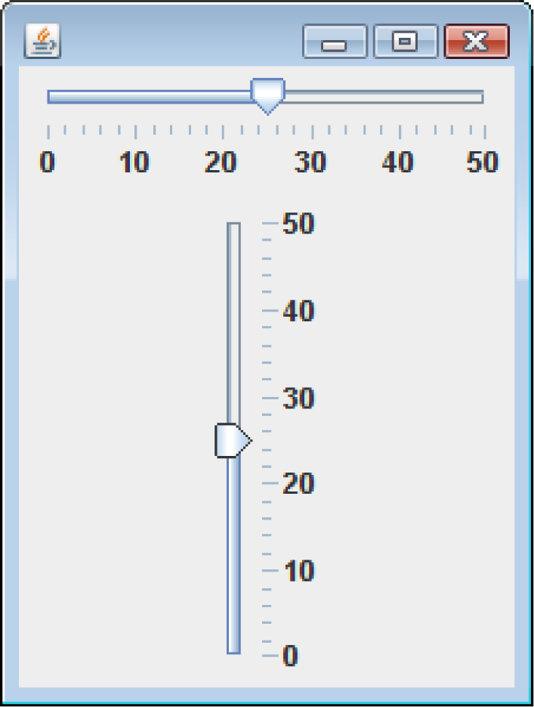
Sliders
A slider is a component that allows the user to graphically adjust a number within a range.
Sliders are created from the JSlider class.
They display an image of a “slider knob” that can be dragged along a track.

Slide 70
Sliders
A slider is designed to represent a range of numeric values.
As the user moves the knob along the track, the numeric value is adjusted accordingly.
Between the minimum and maximum values, major tick marks are displayed with a label indicating the value at that tick mark.
Between the major tick marks are minor tick marks.

Slide 71
Sliders
The JSlider constructor has the general format:
JSlider(int orientation, int minValue,
int maxValue, int initialValue)
For orientation, one of these constants should be used:
JSlider.HORIZONTAL
JSlider.VERTICAL

Slide 72
Sliders
Example:
JSlider slider1 = new JSlider(JSlider.HORIZONTAL, 0, 50, 25);
JSlider slider2 = new JSlider(JSlider.VERTICAL, 0, 50, 25);
Set the major and minor tick mark spacing with:
setMajorTickSpacing
setMinorTickSpacing
Example:
slider1.setMajorTickSpacing(10);
slider1.setMinorTickSpacing(2);

Slide 73
Sliders
Display tick marks by calling:
setPaintTickMarks
slider1.setPaintTickMarks(true);
Display numeric labels on the slider by calling:
setPaintLabels
slider1.setPaintLabels(true);
When the knob’s position is moved, the slider component generates a change event.
To handle the change event, write a change listener class.

Slide 74
Sliders
A change listener class must meet the following requirements:
It must implement the ChangeListener interface.
It must have a method named stateChanged.
This method must take an argument of the ChangeEvent type.
To retrieve the current value stored in a JSlider, use the getValue method.
currentValue = slider1.getValue();
Example: TempConverter.java

Slide 75
Look and Feel
The appearance of a particular system’s GUI is known as its look and feel.
Java allows you to select the look and feel of a GUI application.
On most systems, Java’s default look and feel is called Metal.
There are also Motif and Windows look and feel classes for Java.
Motif is similar to a UNIX look and feel
Windows is the look and feel of the Windows operating system.

Slide 76
Look and Feel
To change an application’s look and feel, call the UIManager class’s static setLookAndFeel method.
Java has a class for each look and feel.
The setLookAndFeel method takes the fully qualified class name for the desired look and feel as its argument.
The class name must be passed as a string.

Slide 77
Look and Feel
Metal look and feel:
"javax.swing.plaf.metal.MetalLookAndFeel"
Motif look and feel:
"com.sun.java.swing.plaf.motif.MotifLookAndFeel"
Windows look and feel:
"com.sun.java.swing.plaf.windows.WindowsLookAndFeel

Slide 78
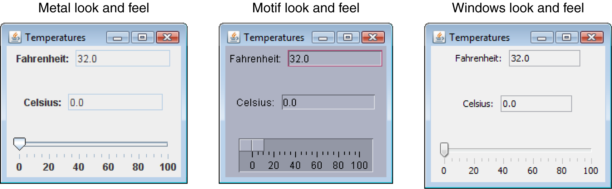
Look and Feel

Slide 79
Look and Feel
Any components that have already been created need to be updated.
SwingUtilities.updateComponentTreeUI(…);
This method takes a reference to the component that you want to update as an argument.
The UIManager.setLookAndFeel method throws a number of exceptions:
ClassNotFoundException
InstantiationException
IllegalAccessException
UnsupportedLookAndFeelException

Slide 80
Look and Feel
Example (Motif):
try
{
UIManager.setLookAndFeel(
"com.sun.java.swing.plaf.motif.MotifLookAndFeel");
SwingUtilities.updateComponentTreeUI(this);
}
catch (Exception e)
{
JOptionPane.showMessageDialog(null,
"Error setting the look and feel.");
System.exit(0);
}

Slide 81
Look and Feel
Example (Windows):
try
{
UIManager.setLookAndFeel(
"com.sun.java.swing.plaf.windows.WindowsLookAndFeel");
SwingUtilities.updateComponentTreeUI(this);
}
catch (Exception e)
{
JOptionPane.showMessageDialog(null,
"Error setting the look and feel.");
System.exit(0);
}

Slide 82
Introduction to Graphics
How to Draw

Slide 83
Drawing Shapes
Components have an associated Graphics object that may be used to draw lines and shapes.
Java allows drawing of lines and graphical shapes such as rectangles, ovals, and arcs.
Frame or panels can become a canvas for your drawings.
What I’m about to show you works pretty much the same in Swing and Android

Slide 84
XY Coordinates
The location of each pixel in a component is identified with an X coordinate and a Y coordinate.
The coordinates are usually written in the form (X, Y).
Unlike Cartesian coordinates, the upper-left corner of a drawing area (0, 0).
The X coordinates increase from left to right, and the Y coordinates increase from top to bottom.
When drawing a line or shape on a component, you must indicate its position using X and Y coordinates.

Slide 85
Graphics Objects
Each component has an internal object that is derived from the Graphics class, which is part of the java.awt package.
This object has numerous methods for drawing graphical shapes on the surface of the component.

Slide 86
Graphics Objects
Some of the methods of the Graphics class:
setColor(Color c) – Sets the drawing color for this object.
getColor() – Returns the current drawing color for this object.
drawLine(int x1, int y1, int x2, int y2) – Draws a line on the component
drawRect(int x, int y, int width, int height) – Draws the outline of a rectangle on the component.
fillOval(int x, int y, int width, int height) – Draws a filled oval.
drawString(String str, int x, int y) – Draws the string passed into str using the current font.

Slide 87
Graphics Objects
In order to call these methods, you must get a reference to a component’s Graphics object.
One way to do this is to override the paint method.
You can override the paint method in any class that is derived from:
JApplet
JFrame
Any AWT class
The paint method is responsible for displaying, or “painting,” a component on the screen.

Slide 88
Graphics Objects
The paint method is automatically called
when the component is first displayed and
any time the component needs to be redisplayed.
The header for the paint method is:
public void paint(Graphics g)
The method’s argument is a Graphics object, which is automatically passed by the calling component.
Overriding the paint method, allows drawing of graphics on the Graphics object argument. Example: LineDemo.java, LineDemo.html

Slide 89
Graphics Objects
The Graphics object argument is responsible for drawing the entire applet window.
It is advisable to call the base class paint method passing the Graphics object, g, as an argument:
super.paint(g);
g.setColor(Color.red);
g.drawLine(20, 20, 280, 280);
This is a red diagonal line drawn from the top-left area of the applet window to the bottom-right area.

Slide 90
Rectangles
Rectangles can be drawn or filled.
g.drawRect(10, 10, 50, 50);
g.fillRect(10, 10, 50, 50);
The fillRect and drawRect take four integers as parameters:
drawRect(int x, int y, int width, int height)
Example:
RectangleDemo.java
RectangleDemo.html

Slide 91
Ovals and Bounding Rectangles
Ovals are created by drawing the oval inside of a “bounding rectangle”.
This rectangle is invisible to the viewer of the Graphics object.
g.fillOval(x, y, width, height);
Width
Example: OvalDemo.java OvalDemo.html
(x,y)
Height

Slide 92
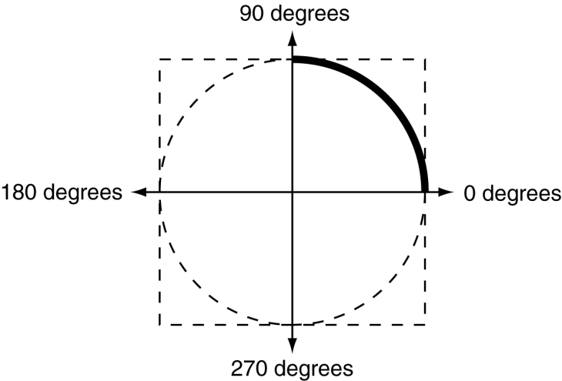
Arcs
Arcs are drawn from the 90 degree position counterclockwise and can be filled or unfilled
g.drawArc(0, 20, 120, 120, 0, 90);
g.fillArc(0, 20, 120, 120, 0, 90);
The fillArc and drawArc take six integers as parameters:
drawArc(int x, int y, int width, int height, int start, int end)
Example:
ArcDemo.java
ArcDemo.html

Slide 93
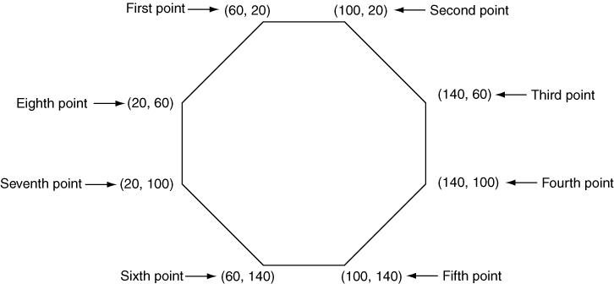
Polygons
Polygons are drawn using arrays of integers representing x, y coordinates
int[]xCoords={60,100,140,140,100,60,20,20};
int[]yCoords={20,20,60,100,140,140,100,60};

Slide 94
Polygons
The fillPolygon and drawPolygon use the arrays as parameters:
Example:
PolygonDemo.java
PolygonDemo.html

Slide 95
Drawing Text
With the Graphics object, you can change the font:
Font f = new Font("Serif", Font.PLAIN, 18);
g.setFont(f);
g.drawString("test", 0, 18);

Slide 96
Using the FontMetrics Class
FontMetrics is an abstract class, but you can get a concrete implementation for any font. This then provides you with methods for that font. For example:
FontMetrics fm = getFontMetrics(f);
int width = fm.stringWidth("Test");
Gets the width of the string “Test” in pixels. This can be used to right-justify or center text.

Slide 97
Using the FontMetrics Class
Similarly, this gets the height of the font, which can be useful for vertical centering, etc.
int height = fm.getHeight();

Slide 98
The repaint Method
We do not call a component’s paint method.
It is automatically called when the component must be redisplayed.
We can force the application or applet to call the paint method.
repaint();
in Android, this is invalidate();
The repaint method clears the surface of the component and then calls the paint method.

Slide 99
Drawing on Panels
To draw on a panel, get a reference to the panel’s Graphics object and use that object’s methods.
The resulting graphics are drawn only on the panel.
Getting a reference to a JPanel component’s Graphics object is similar to previous examples.
Instead of overriding the JPanel object’s paint method, override its paintComponent method.
This is true for all Swing components except JApplet and JFrame.

Slide 100
Drawing on Panels
The paintComponent method serves the same purpose as the paint method.
When it is called, the component’s Graphics object is passed as an argument.
public void paintComponent(Graphics g)
When overriding this method, first call the base class’s paintComponent method.
super.paintComponent(g);

Slide 101
Drawing on Panels
After this you can call any of the Graphics object’s methods to draw on the component.
Example:
GraphicsWindow.java,
DrawingPanel.java,
GraphicsWindow.html

Slide 102
Handling Mouse Events
The mouse generates two types of events:
mouse events and mouse motion events.
Any component derived from the Component class can handle events generated by the mouse.
To handle mouse events you create:
a mouse listener class and/or
a mouse motion listener class.

Slide 103
Handling Mouse Events
A mouse listener class can respond to any of the follow events:
The mouse button is pressed.
The mouse button is released.
The mouse button is clicked on (pressed, then released without moving the mouse).
The mouse cursor enters a component’s screen space.
The mouse cursor exits a component’s screen space.
A mouse listener class must implement the MouseListener interface.

Slide 104
Mouse Events
The MouseEvent object contains data about the mouse event.
getX and getY are two common methods of the MouseEvent class.
They return the X and Y coordinates of the mouse cursor when the event occurs.
Once a mouse listener class is created, it can be registered with a component using the addMouseListener method

Slide 105
Mouse Listener Methods
public void mousePressed(MouseEvent e)
called if the mouse button is pressed over the component.
public void mouseClicked(MouseEvent e)
called if the mouse is pressed and released over the component without moving the mouse.
public void mouseReleased(MouseEvent e)
called when the mouse button is released.
public void mouseEntered(MouseEvent e)
called when the mouse cursor enters the screen area of the component.
public void mouseExited(MouseEvent e)
This method is called when the mouse cursor leaves the screen area of the component.

Slide 106
Mouse Events
The MouseEvent object contains data about the mouse event.
getX and getY are two common methods of the MouseEvent class.
They return the X and Y coordinates of the mouse cursor when the event occurs.
Once a mouse listener class is created, it can be registered with a component using the addMouseListener method

Slide 107
Mouse Motion Events
The appropriate methods in the mouse listener class are automatically called when their corresponding mouse events occur.
A mouse motion listener class can respond to the following events:
The mouse is dragged
The mouse moved.
A mouse motion listener class must implement the MouseMotionListener interface and it’s methods.

Slide 108
Mouse Motion Listener Methods
public void mouseDragged(MouseEvent e)
called when a dragging operation begins over the component.
The mousePressed method is always called just before this method.
public void mouseMoved(MouseEvent e)
called when the mouse cursor is over the component and it is moved.
Example:
MouseEvents.java
MouseEvents.html

Slide 109
Using Adapter Classes
The mouse listener class must implement all of the methods required by the interfaces they implement.
If any of the methods are omitted, a compiler error results.
The MouseAdapter and MouseMotionAdapter classes provide empty implementations of the methods.
They can serve as base classes for mouse listener and mouse motion listener classes.
Examples: DrawBoxes.java, DrawBoxes.html, DrawBoxes2.java, DrawBoxes2.html

Slide 110
Timer Objects
Timer objects automatically generate action events at regular time intervals.
This is useful when you want a program to:
perform an operation at certain times or
after an amount of time has passed.
Timer objects are created from the Timer class.
The general format of the Timer class’s constructor:
Timer(int delay, ActionListener listener)

Slide 111
Timer Objects
The delay parameter is the amount of time between action events in milliseconds.
The the listener parameter is a reference to an action listener to be registered with the Timer object.
Passing null will cause no action listener to be registered.
the Timer object’s addActionListener method can register an action listener after the object’s creation.

Slide 112
Timer Object Methods
void addActionListener (ActionListener listener)
Registers the object referenced by listener as an action listener.
int getDelay()
Returns the current time delay in milliseconds.
boolean isRunning()
Returns true if the Timer object is running.
void setDelay(int delay)
Sets the time delay in milliseconds.
void start()
Starts the Timer object.
void stop()
Stops the Timer object.

Slide 113
Timer Object Methods
An application can use a Timer object to automatically execute code at regular time intervals.
Example:
BouncingBall.java
BouncingBall.html

Slide 114
Playing Audio
Java programs can play audio that is stored in a variety sound file formats.
.aif or .aiff (Macintosh Audio File)
.au (Sun Audio File)
.mid or .rmi (MIDI File)
.wav (Windows Wave File)
One way to play an audio file is to use the Applet class’s play method.
One version of this method is:
void play(URL baseLocation, String fileName)

Slide 115
Playing Audio
The argument passed to baseLocation is a URL object that specifies the location of the file.
The argument passed to fileName is and name of the file.
The sound that is recorded in the file is played one time.
The getDocumentBase or getCodeBase methods can get a URL object for the first argument.

Slide 116
Playing Audio
The getDocumentBase method returns a URL object containing the location of the HTML file that invoked the applet.
play(getDocumentBase(), "mysound.wav");
The getCodeBase method returns a URL object containing the location of the applet’s .class file.
play(getCodeBase(), "mysound.wav");
If the sound file specified by the arguments to the play method cannot be found, no sound will be played.

Slide 117
Using an AudioClip Object
The Applet class’s play method:
loads a sound file,
plays it one time, and
releases it for garbage collection.
If you need to load a sound file to be played multiple times, use an AudioClip object.
An AudioClip object is an object that implements the AuidoClip interface.

Slide 118
Using an AudioClip Object
The AudioClip interface specifies the following three methods:
play – plays a sound one time.
loop – repeatedly plays a sound.
stop – causes a sound to stop playing.
The Applet class’s getAudioClip method can be used to create an AudioClip object:
AudioClip getAudioClip(URL baseLocation,
String fileName)
The method returns an AudioClip object that can be used to play the sound file.
Example: AudioDemo2.java, AudioDemo2.html

Slide 119
Playing Audio in an Application
Playing audio in from a JFrame is slightly different than playing audio from an applet.
// Create a file object for the step.wav file.
File file = new File("step.wav");
// Get a URI object for the audio file.
URI uri = file.toURI();
// Get a URL for the audio file.
URL url = uri.toURL();
// Get an AudioClip object for the sound
// file using the Applet class's static
// newAudioClip method.
sound = Applet.newAudioClip(url);
Example: AudioFrame.java

