Slide 1
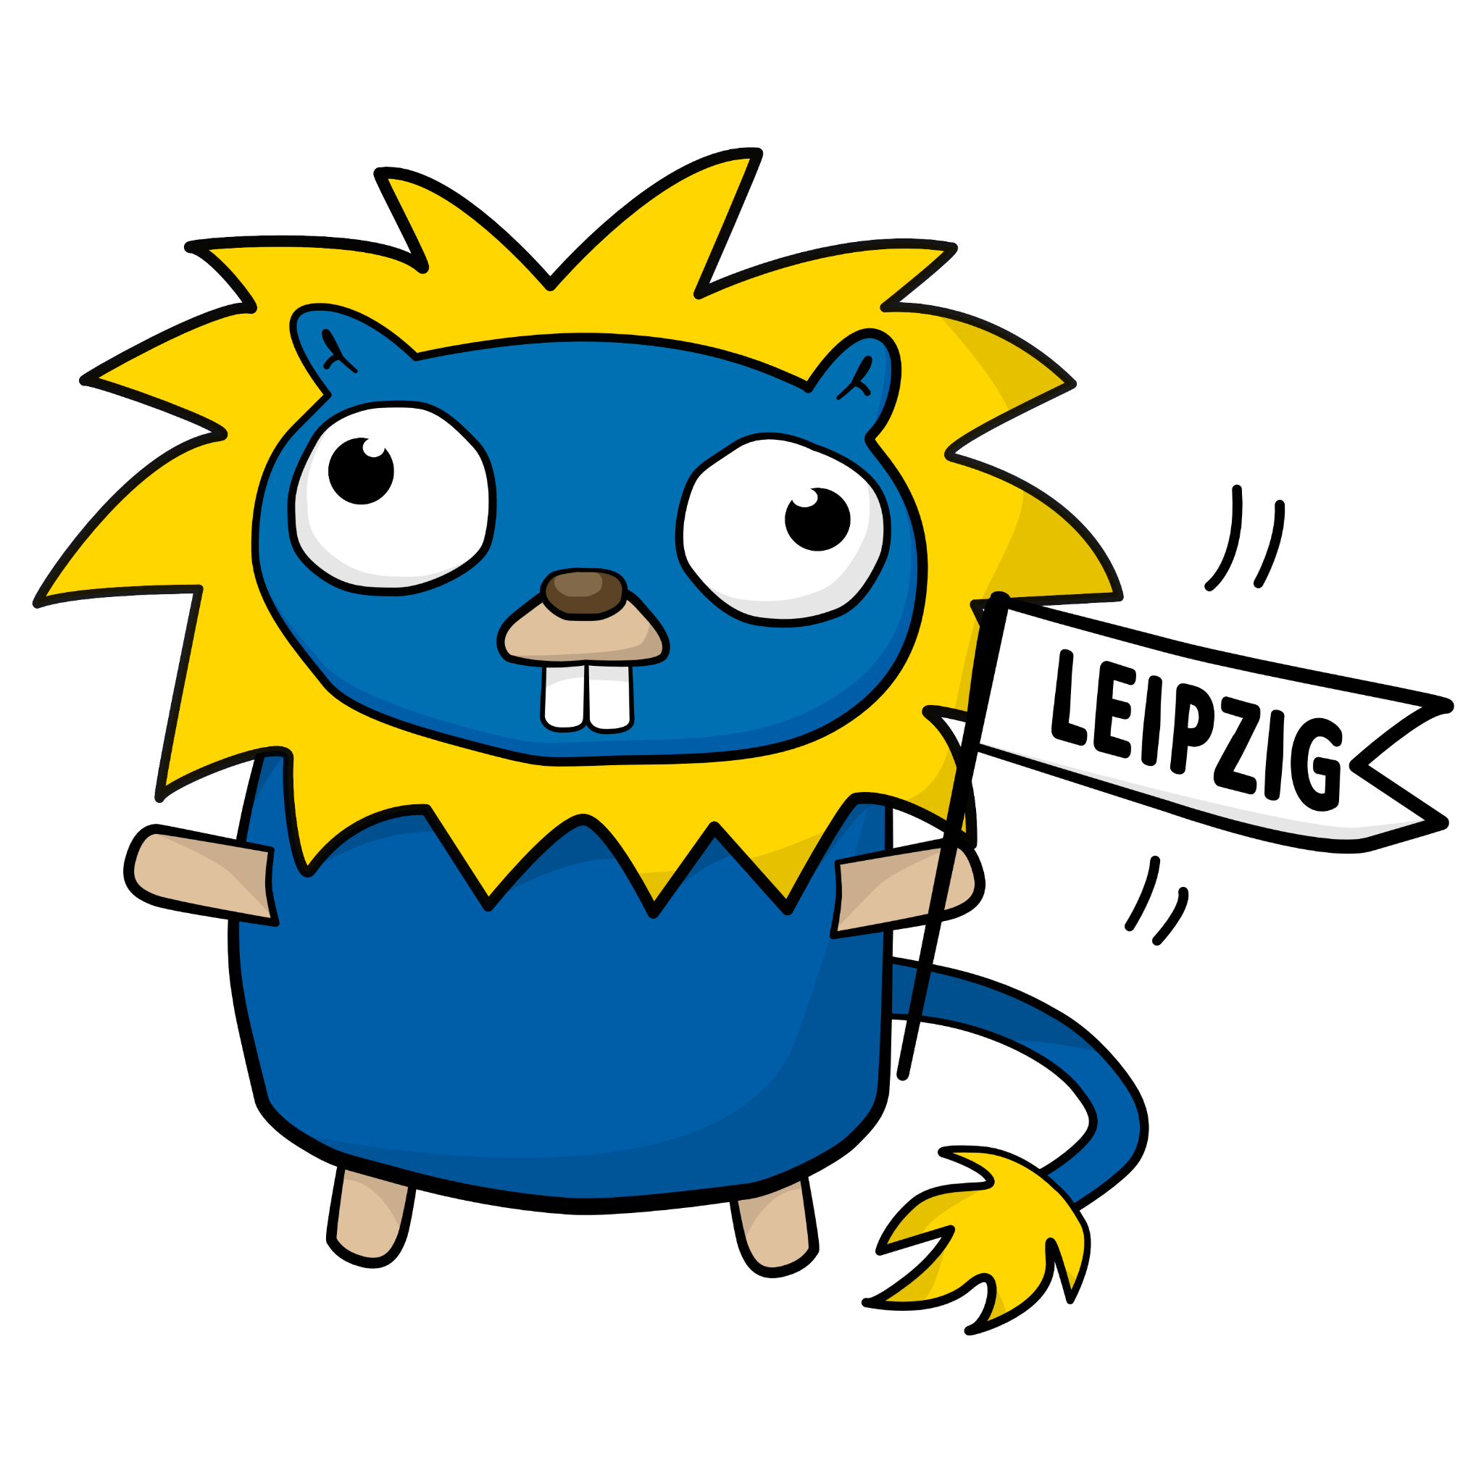
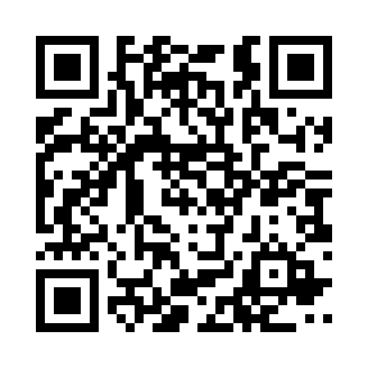
Leipzig Gophers
Meetup
regular Go (golang) and Cloud (Native) discourse
hybrid events, global audience
collaboration with startups
cool sponsors
500+ members
Come and share your experiences, show off you project or company.
See you! 👋
https://golangleipzig.space
est. 2019, 30+ events

