Slide 1
Only Office NLP Solver

Slide 3

Content
karlbreuer.com
Introducing OnlyOffice and showing the Solver
Overview architecture, flow of data
Getting formulas and user input in JS
Preparing Go for WASM, connect to JS
Dynamic Equations with Tokenizer and Parser -> Eval func
Finally the Solver. Custom Downhill Simplex
State of the project and next steps

Slide 4
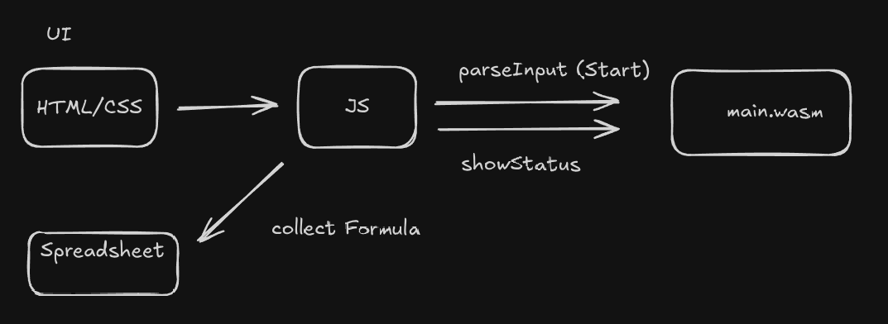
Overview architecture, flow of data
karlbreuer.com

Slide 5
Getting formulas and user input in JS
karlbreuer.com
1.Collect Formula (Show in spreadsheet)
2. Parse Input
"((B28*0.08)+(B29*0.06)+(B30*0.42)+(B31*0.22))"
And the start params!
type StartParamsT struct {
Cell string `json:"cell"`
MinValue float64 `json:"min_value"`
MaxValue float64 `json:"max_value"`
LimitMin bool `json:"limit_min"`
LimitMax bool `json:"limit_max"`
}

Slide 6
Preparing Go for WASM, connect to JS
karlbreuer.com
//go:build js && wasm
// +build js,wasm
package main
func main() {
// Keep the program running
c := make(chan struct{})
// Register the addOne function to be callable from JavaScript
js.Global().Set("goAddOne", js.FuncOf(addOneJS))
js.Global().Set("goGetResult", js.FuncOf(getResultJS))
js.Global().Set("goParseInput", js.FuncOf(parseInputJS))
js.Global().Set("goCheckStatus", js.FuncOf(checkStatusJS))
// Block forever
<-c
}
//go:build !wasm
// +build !wasm
package main
$GOOS=js GOARCH=wasm go build -o main.wasm .

Slide 7
Preparing Go for WASM, connect to JS
karlbreuer.com
<script src="scripts/wasm_exec.js"></script>
<script src="scripts/go-script.js"></script>
//go-script.js
(function () {
"use strict";
let wasmReady = false;
// Load Go WASM
async function loadWasm() {
try {
const go = new Go();
const result = await WebAssembly.instantiateStreaming(
fetch("go/main.wasm"),
go.importObject
);
// Run the Go program
go.run(result.instance);
wasmReady = true;
} catch (err) {
console.error("WASM load error:", err);
}
}
// Initialize WASM when plugin is ready
window.addEventListener("DOMContentLoaded", function () {
// Wait a bit for Asc.plugin to be available
setTimeout(loadWasm, 100);
});
// Also expose loadWasm for manual initialization if needed
window.loadGoWasm = loadWasm;
})();
window.goParseInput(
res.targetFormula,
paramsJSON,
iterations.toString(),
sideConditionsJSON
);

Slide 8
Dynamic Equations with Tokenizer and Parser -> Eval func
karlbreuer.com
The Problem: We get a string, and have no chance to know the equation at compile time.
We have to build the evaluation function for the equation dynamically at runtime instead
Input = "(4-B10*112^2)"
BinaryOp(-)
/ \
/ \
Num(4) BinaryOp(*)
/ \
/ \
Var(B10) BinaryOp(^)
/ \
/ \
Num(112) Num(2)
First step tokenize!
"(4-B10*112^2)" → [(, 4, -, B10, *, 112, ^, 2, )]
Second step is building the node tree structure,
higher index gets evaluated first!

Slide 9
The Solver
karlbreuer.com
The solver itself is nothing more than trying out a lot of possible values for all parameters in a smart way!
I used a custom variation of the nelder mead downhill simplex, so that we can theoretically fit any function that we can calculate
There are 2 important things left:.
The algorithm itself, and a good starting simplex.

Slide 10
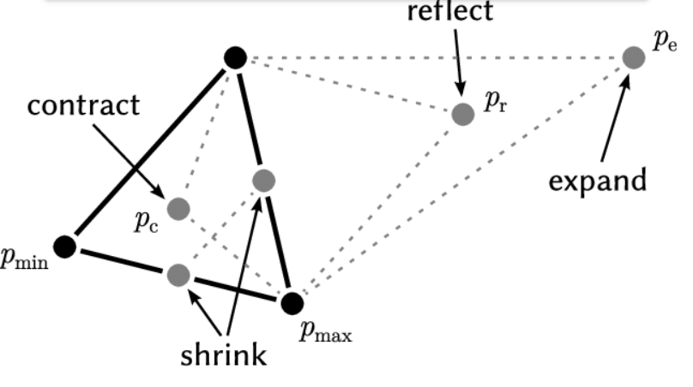
The Solver – The algorithm
karlbreuer.com
https://en.wikipedia.org/wiki/Nelder%E2%80%93Mead_method

Slide 11

The Solver – The algorithm
karlbreuer.com
Question for Golang audience how to imrove this?
https://en.wikipedia.org/wiki/Nelder%E2%80%93Mead_method

Slide 12
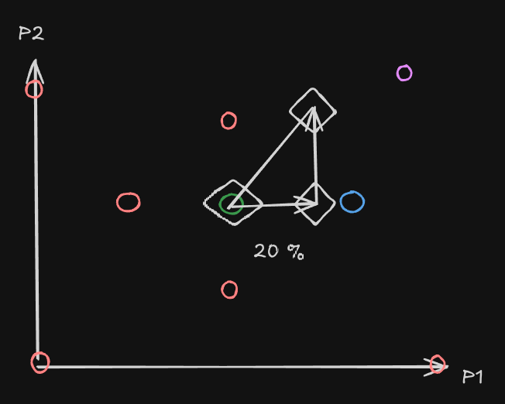
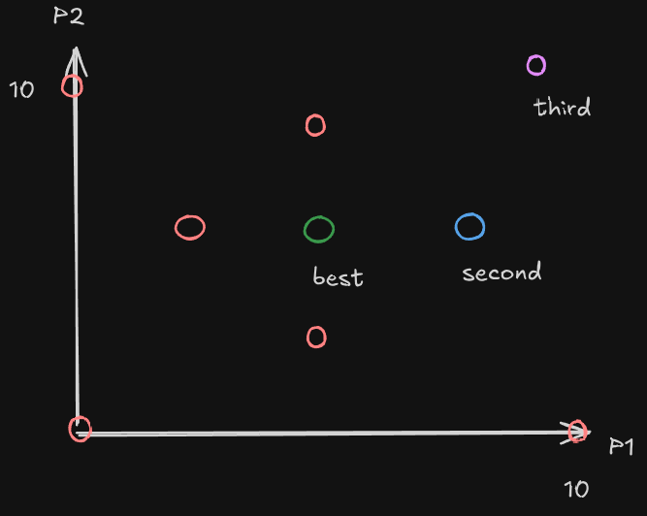
The Solver – The starting simplex
karlbreuer.com
We use the starting value from the user to specify the range of the starting simplex
https://en.wikipedia.org/wiki/Nelder%E2%80%93Mead_method

Slide 13
Next steps
karlbreuer.com
Add an addition linear solver, that works better with linear problems and side condition!
Listen for actual user input. Bugs and use-cases!

