Slide 1
Golang Meetup 32
25.11.2022

Slide 2




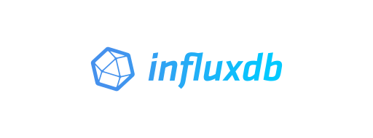

Architecture
Connectors

Slide 3
Technologies
NATS (https://nats.io/)
Telegraf (https://www.influxdata.com/time-series-platform/telegraf/)
InfluxDB 2.x (https://www.influxdata.com/products/influxdb-overview/)
All written in golang
Backend written in golang
Frontend written in typescript (remix)

Slide 4
Problem
We have events like this
Subject: “platform.asset.43”
Platform is a namespace
Asset is a kind of entity
42 is the primary key for this asset
Payload:
Nats Consumer cannot utilize subjects, only the payload
Use Mqtt instead?
We change it and contribute!
https://github.com/influxdata/telegraf/pull/12274
{
"id": "37d8094b-1ccb-40a9-af0a-5e049dbb3c84",
"value": 3.14,
"quality": 1,
"timestamp": "2022-01-01T00:00:00Z"
}

