Slide 1
Running your own VPN (RYO VPN)
2025-03-25 Lightning Talk at Leipzig Gophers #49
Martin Czygan

Slide 2
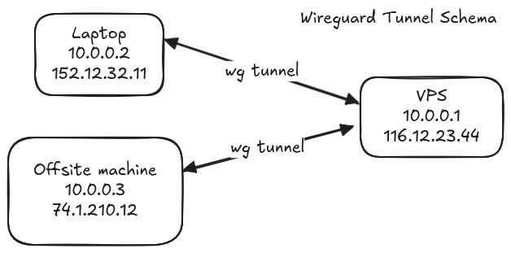
Goal
To connect machines across locations (home, mobile, other, …).
Tailscale (2019) builds on WireGuard (2015) to offer VPN
solutions, and most of the components
are open source, e.g. the tailscale client.
PS. WireGuard is included
in Linux 5.6 (2020)

Slide 3
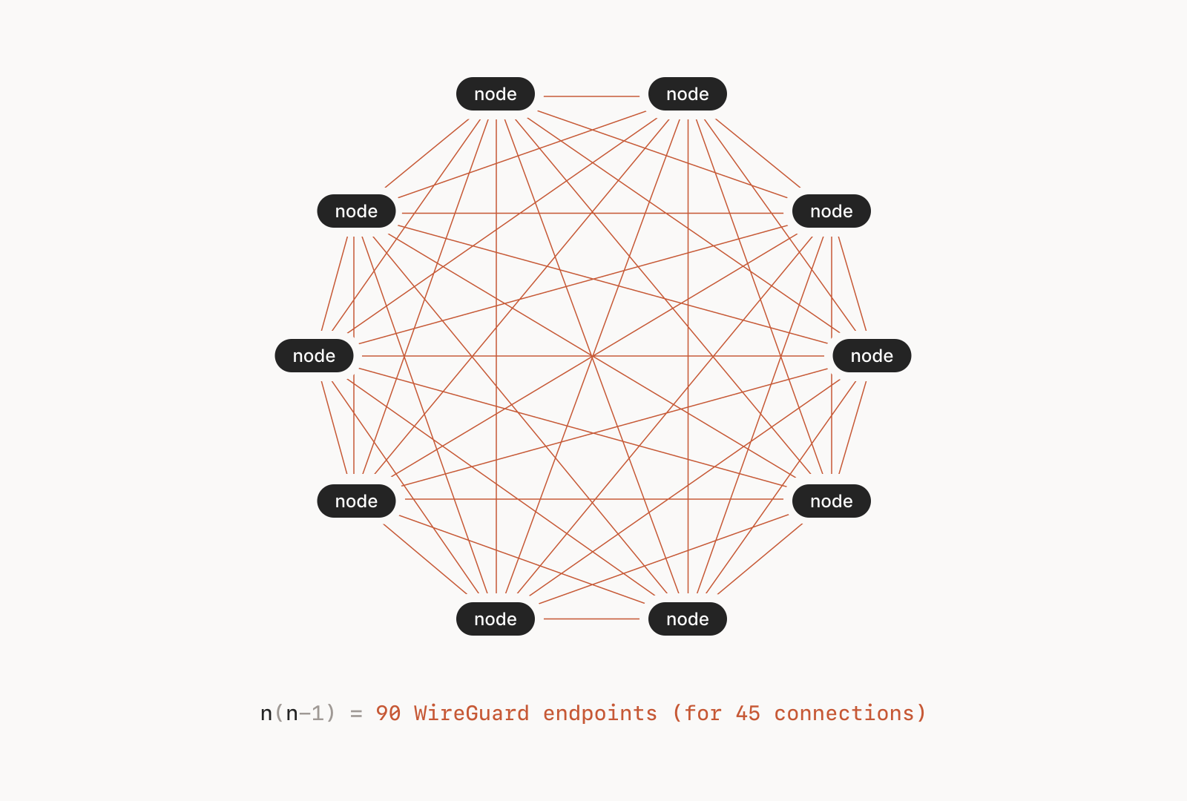
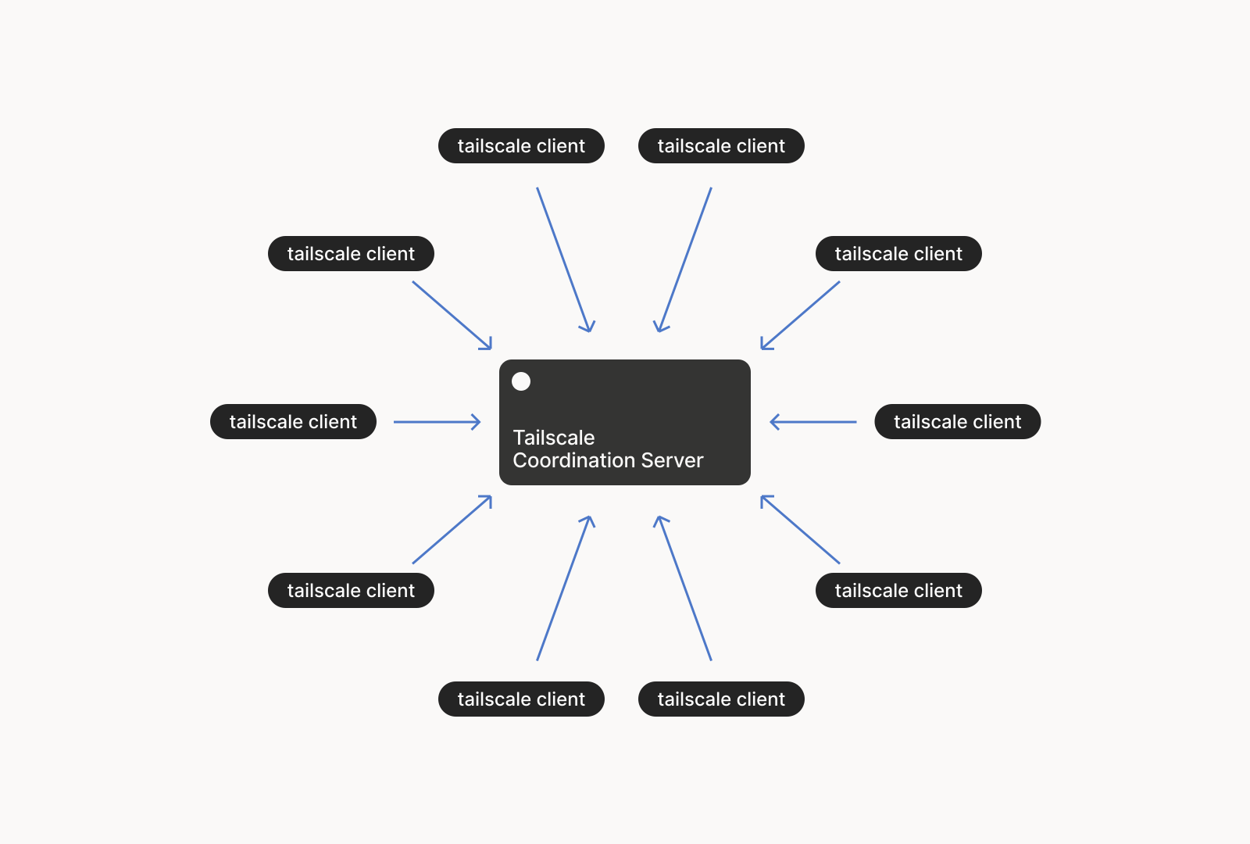
WireGuard / tailscale
(mostly) point-to-point tunnel exposed as a virtual network device “wg0”
two endpoints use public-key crypto to setup encrypted connection
Easy, fast secure.
Tailscale adds another management layer on top of wireguard, using a control server that manages key exchange, visibility, DNS and more.

Slide 4
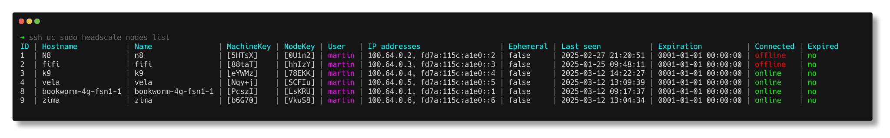
Headscale
headscale is an open source implementation of the tailscale control server
You can run headscale on your own, on a VPS for example and have all your machines connected in a single mesh overlay.
headscale allows a client to “tailscale login --login-server my.vps” and then you register the node on the headscale server, and done.

Slide 5
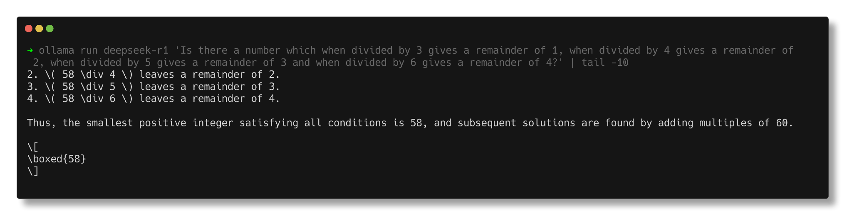
Use cases / limits
I run ollama (local LLM tool) on a desktop machine (behind NAT) and can connect to it from my laptop from anywhere (behind NAT)
offsite backup, testing private projects on mobile devices, …
limits: cannot run multiple tailnets at the same time with headscale

Slide 6
RYO Cloud?
could you build and run your own cloud provider with a fleet of machines that are part of a tailnet?
If you are curious, let’s hack together on that!
Thanks!

