Slide 1
Climbing the Testing Pyramid: From Real
Service to Interface Mocks in Go
Naveen Ramanathan
Software Engineer @ JPMorgan
Founder of golangbot.com, gojobs.run

Slide 2
Opinions expressed are solely my own and do not express the views of my employer.

Slide 3
This talk is about...
Challenges when testing code with external (cloud) dependencies
Different strategies to test code with cloud dependencies

Slide 4
Why is testing code with cloud dependencies hard?
Notes:
Ask whether anyone has any idea on why testing cloud dependencies is hard

Slide 5
Why is testing code with cloud dependencies hard?
Testing failures is hard
Access restrictions
High costs (failure to teardown resources after test)
Notes:
Now that we have discussed the issues when testing code with cloud dependencies, let’s look at some of the possible solutions.

Slide 6
Testing Pyramid
Level 4
Testing with
interface mocks
Level 3
Testing with http mocks
Level 2
Testing with a service emulator
Level 1
Testing against the real service
Notes:
This is what I would like to call a testing pyramid

Slide 7
Level 1: Testing against the real service
Level 4
Testing with
interface mocks
Level 3
Testing with http mocks
Level 2
Testing with a service emulator
Level 1
Testing against the real service

Slide 8
Function under test
Function to create a S3 bucket

Slide 9
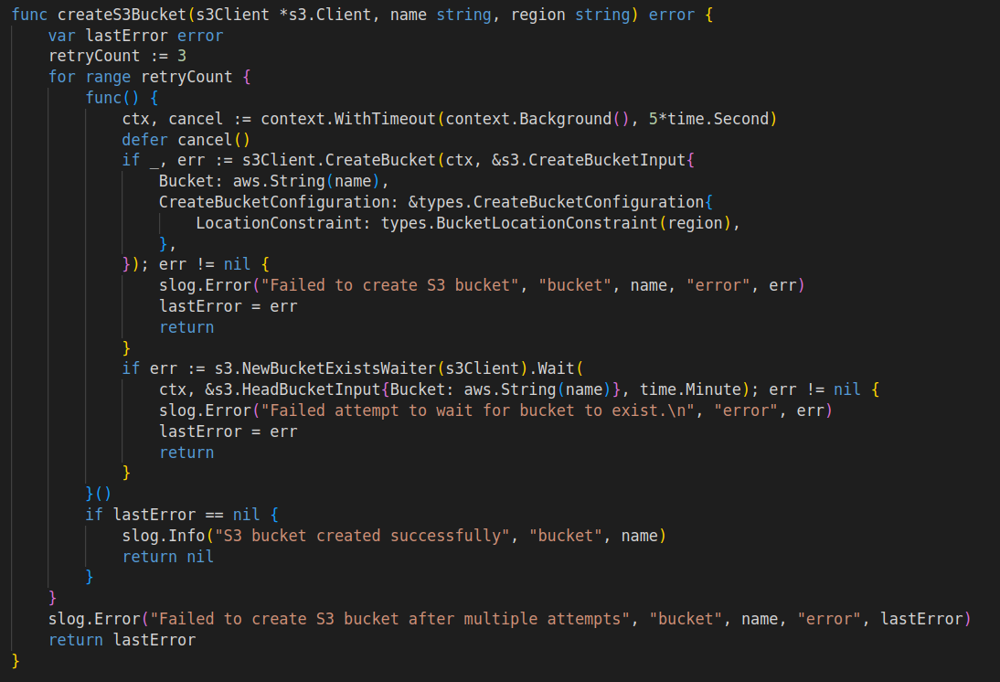
Create S3 bucket Function
Notes:
Tell that a simple retry logic which retry
I am using a closer here so that the context can be cancelled in all code branches using defer

Slide 10
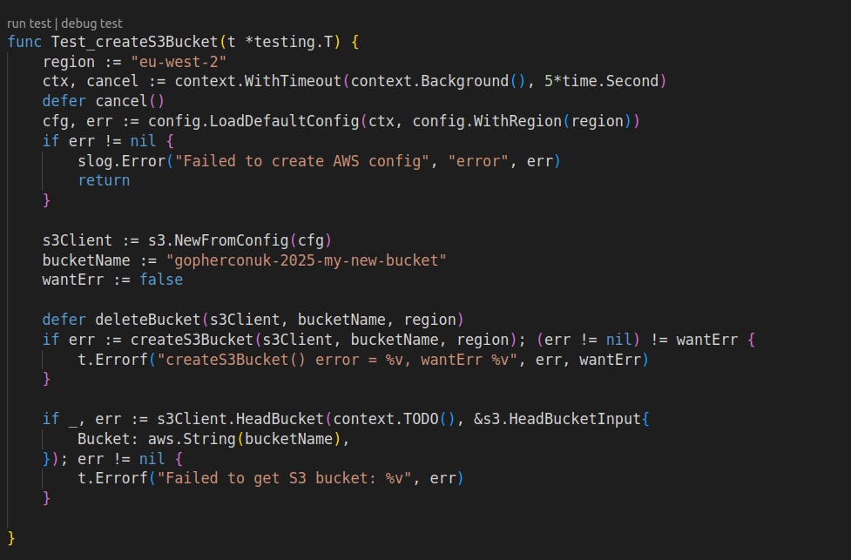
Test happy path

Slide 11
How to test the unhappy path?
Any guesses?

Slide 12
Testing unhappy path
Go function to create S3 Bucket
Proxy
AWS
Proxy creates network partition

Slide 13
Toxiproxy
TCP proxy written in Go for simulating network conditions
Runs as a container
Can be configured using REST APIs
Different network conditions can be simulated using toxics

Slide 14
Toxiproxy – A TCP proxy for simulating network conditions
Go function to create S3 Bucket
Toxiproxy
AWS S3 Endpoint
Listening port
:8443
Rest End Point
:8474
Configure upstream
and toxic
Go Test

Slide 15
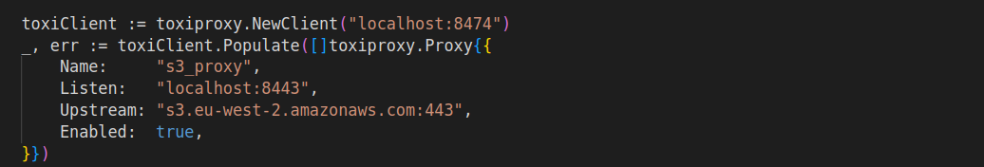
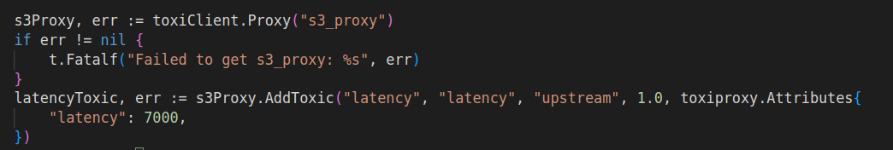
Configure Toxiproxy

Slide 16
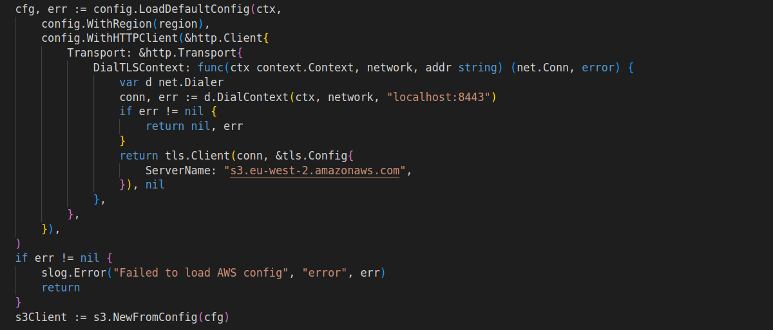
Configure AWS client to use Toxiproxy

Slide 17
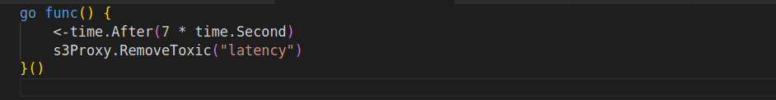
Remove Toxic to simulate successful retry

Slide 18
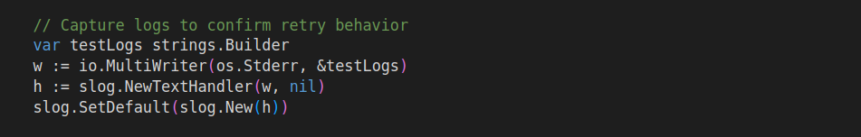
How to validate retry ?
Monitoring logs

Slide 19
Why testing againt the real cloud service is not possible always?

Slide 20
Why testing againt the real cloud service is not possible always?
Access control (lack of permissions), quite common in regulated environments
Cost

Slide 21
Level 2: Testing with a service emulator
Level 4
Testing with
interface mocks
Level 3
Testing with http mocks
Level 2
Testing with a service emulator
Level 1
Testing against the real service

Slide 22
Emulators
Provides stubbed/mocked web services which emulate the external dependency
Runs in a container

Slide 23
LocalStack
AWS cloud service emulator that runs in a single container
Supports a number of AWS services like AWS Lambda, S3, DynamoDB,…
Works with AWS CLI
Runs in port no :4566

Slide 24
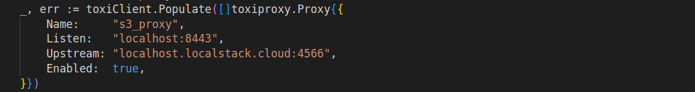
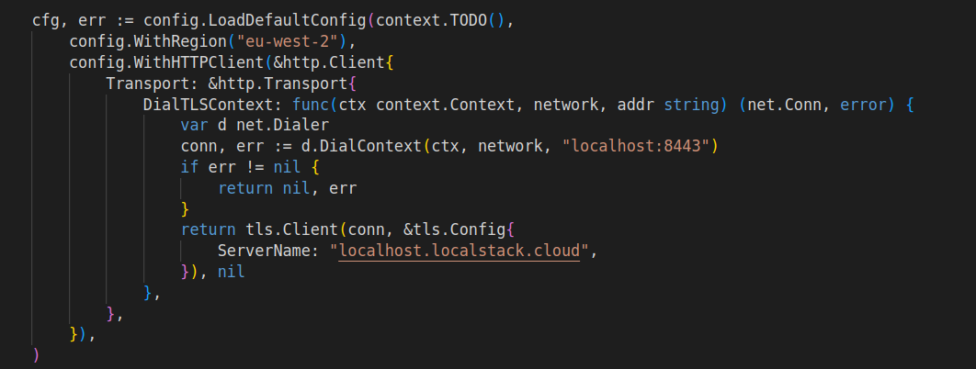
LocalStack Configuration

Slide 25
LocalStack DNS
Can be accessed using the domain name localhost.localstack.cloud
Offers a valid SSL cert(not self signed)
Can anyone guess how LocalStack has a valid SSL cert even though the container runs locally?

Slide 26
The barriers to testing with emulators
Not 100% parity with AWS
Emulators are not available for all dependencies

Slide 27
Level 3: Testing with http mocks
Level 4
Testing using
interfaces
Level 3
Testing with http mocks
Level 2
Testing with a service emulator
Level 1
Testing against the real service

Slide 28
HTTP Mocks
Creating mock http services that match the real dependency
Can be thought of as writing our own emulator
httptest standard library has support to write mock http services

Slide 29
httptest standary library
Has helper functions to create test TLS server
Has methods to return the host name, port and CA certs of the http test TLS server
This host name, port can be used as upstream in Toxiproxy

Slide 30
Testing happy path using http test

Slide 31
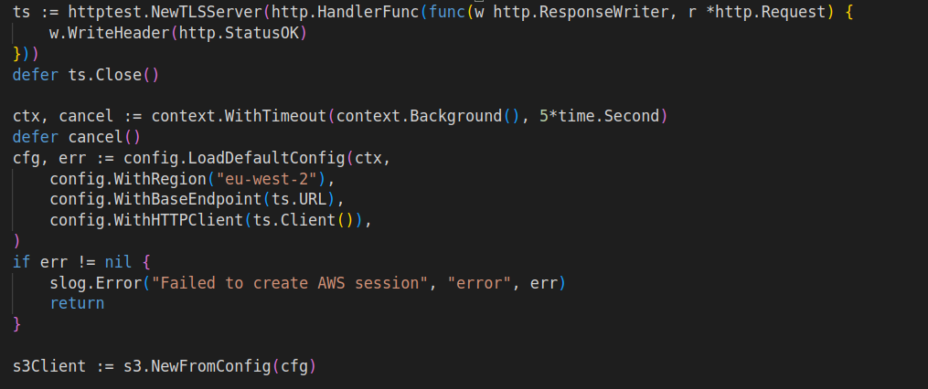
Configuring s3 client using http test server
Test URL
Test client

Slide 32
Testing unhappy path

Slide 33
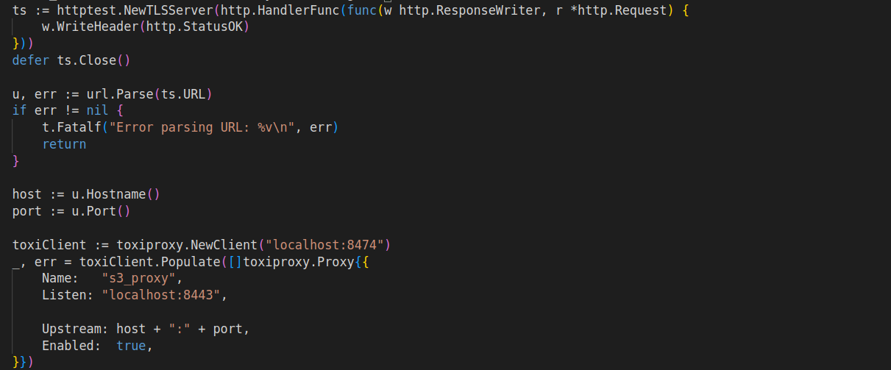
Configuring Toxiproxy to use http test server as upstream

Slide 34
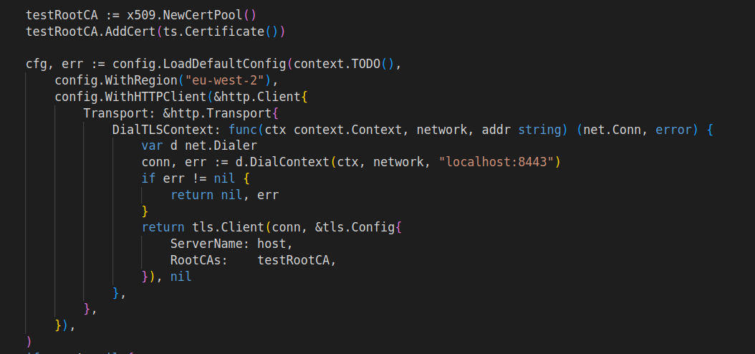
Configuring CA cert for the S3 client

Slide 35
Why testing using a http mock is not possible always?

Slide 36
Why testing using a http mock is not possible always?
Closed source dependencies where the SDK doesn’t provide a way to set the http client/transport
Complex logic involved in the external service and writing a mock proves to be difficult to maintain

Slide 37
Level 4: Testing using interface mocks
Level 4
Testing with
interface mocks
Level 3
Testing with http mocks
Level 2
Testing with a service emulator
Level 1
Testing against the real service

Slide 38
Test happy path with interfaces

Slide 39
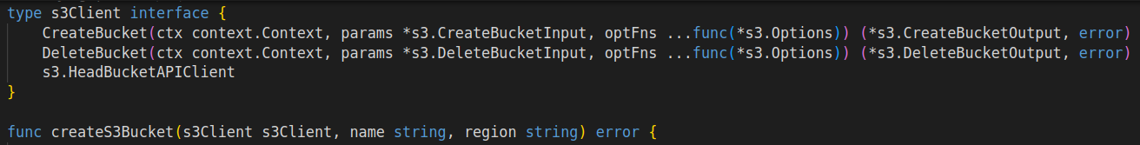
Refactor code to accept interfaces
Notes:
Go proverb – Accept interfaces return structs

Slide 40
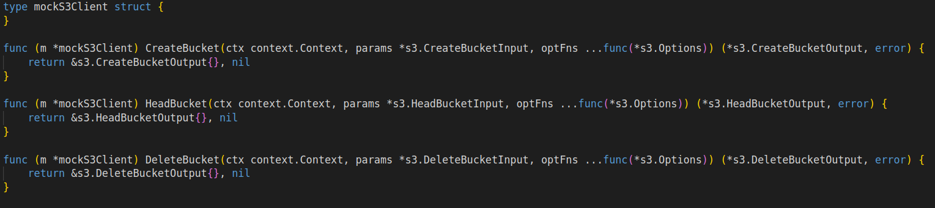
Create struct which implements the interface

Slide 41
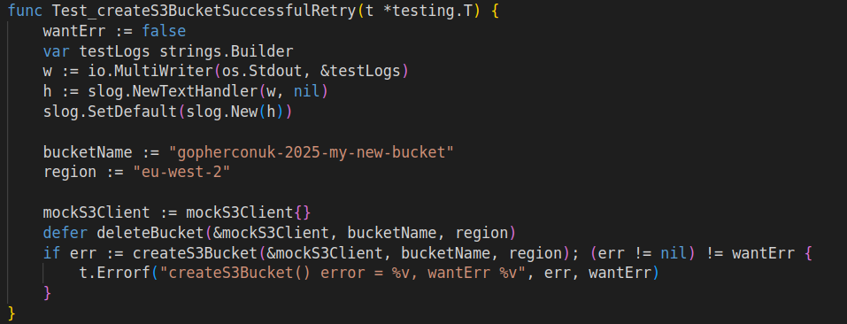
Use mock struct for test
Mock struct

Slide 42
Test unhappy path with interfaces

Slide 43
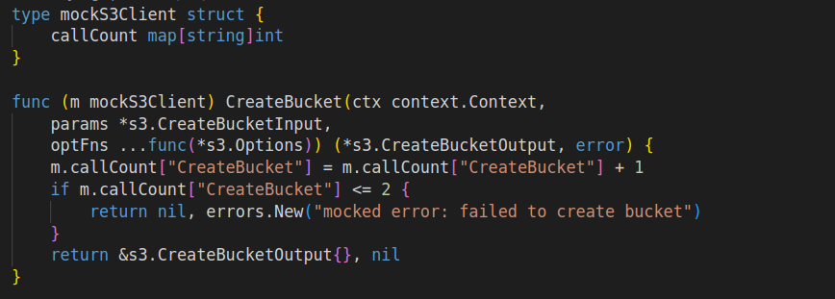
Return error from mock implementation

Slide 44
Problems with writing mocks manually
Tedious to maintain mocks
Mock has to be updated everytime the interface changes

Slide 45
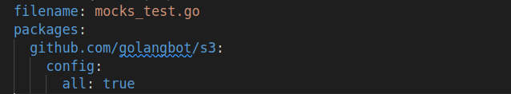
Automatic mock generation using mockery
.mockery.yaml
Notes:
Delete mocks_test.go and generate the mocks by running the command `mockery`

Slide 46
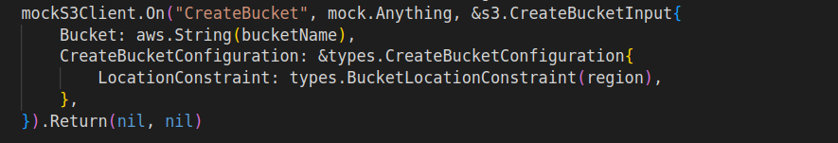
Using the generated mock in the happy path
Notes:
The on method is the expected call from the bucket creation code. And the return, returns the values when the method call is made

Slide 47
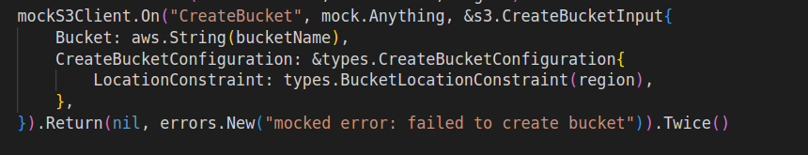
Returning errors using the mock

Slide 48
Conclusion
There is no one size fits all solution
Climb the pyramid as needed
Start with real, fallback when you must
Level 4
Testing with
interface mocks
Level 3
Testing with http mocks
Level 2
Testing with a service emulator
Level 1
Testing against the real service

Slide 49
Thank you

