Slide 1

Building High-Performance Data Pipelines with Go and Kubernetes
A Developer’s Practical Approach
Rahul S. Patil
EPAM Winter Data Meetup 2025
Pune, India

Slide 2
Why High-Performance Data Pipelines?
Data volumes are growing exponentially
Real-time analytics & responsive systems demand scalable pipelines
Traditional stack limitations → need for modern tooling

Slide 3
Tech Stack Overview
Go → Fast, lightweight, concurrency-friendly
Kafka → Distributed, durable event streaming
MongoDB → Flexible document database
Kubernetes → Autoscaling and orchestration

Slide 4
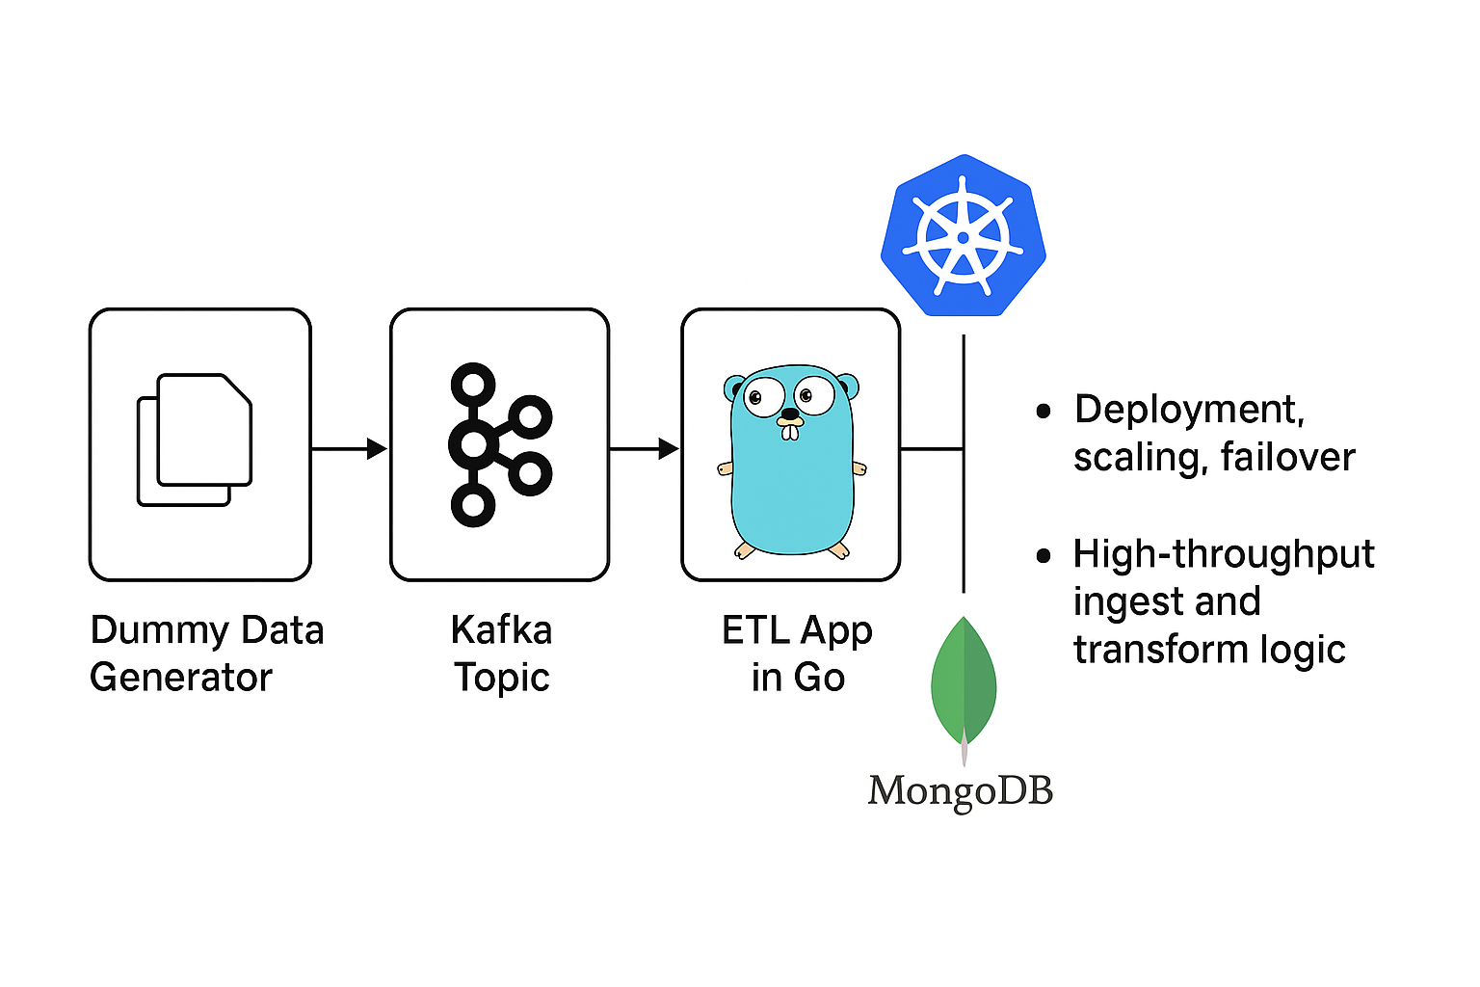
Pipeline Architecture

Slide 5
Step-by-Step Plan (Overview)
1. Minikube Setup
2. Kafka Cluster Deployment
3. Data Generator (Kafka Producer)
4. ETL Application (Go Kafka Consumer + MongoDB Upsert)
5. MongoDB Deployment
6. HPA Autoscaler
7. Benchmarking

Slide 6
Setting Up Minikube (K8s)
Install & start Minikube
Basic kubectl commands
Cluster up and running locally

Slide 7
Modern Kafka (KRaft Mode) on Kubernetes
Using Bitnami Helm chart with kraft.enabled=true
Simpler, faster, and production-ready deployment
helm install kafka bitnami/kafka --set kraft.enabled=true

Slide 8
Dummy Data Generator (Go)
Kafka producer in Go
Sends JSON messages to dummy-data topic
Tunable message rate (via sleep interval)

Slide 9
ETL Application in Go
Kafka consumer
Transforms message into MongoDB bson.M
Inserts into MongoDB etl_db.data collection
Production-ready concurrency possible

Slide 10

MongoDB Deployment
Single pod setup
YAML deployment
Exposed service for internal cluster access

Slide 11

Autoscaling ETL App
Kubernetes HPA
kubectl autoscale based on CPU usage
Minimum 1, maximum 10 pods
Responsive to workload spikes

Slide 12
Benchmarking and Monitoring
Load simulation using k6
Metrics: Kafka lag, MongoDB throughput
Optional tools: Prometheus, Grafana

Slide 13
Live Demo (5 mins)
Show running pipeline in Minikube
Kafka producing/consuming messages
MongoDB insert verification
HPA in action with kubectl top pods

Slide 14
Key Takeaways
✅ Fully working data pipeline
✅ Simple, scalable Go components
✅ Real-time ingestion and autoscaling
✅ Extensible for real-world systems

Slide 15
What's Next?
Add observability and alerting
Cloud-native version (GKE/EKS/Azure AKS)
Integrate with real data sources
GitHub repo and Docker images (coming soon)

Slide 16
Thank You
Contact: golangda@gmail.com
www.linkedin.com/in/rahulsidpatil
Questions?

