Slide 1

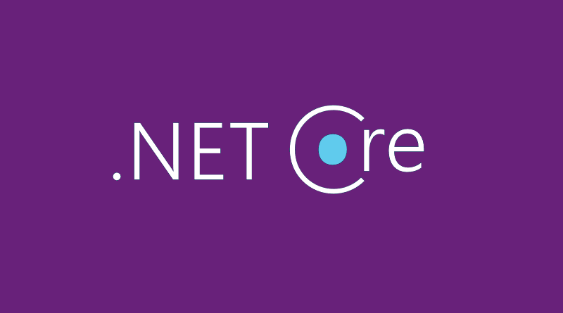
Migrating to ASP.net core
Ali Khalili

Slide 2
AGENDA
Agenda
Why ASP.NET CORE?
Differences between MVC Core and MVC
OWIN
DEMO

Slide 3
WHY
ASP.NET CORE ?

Slide 4
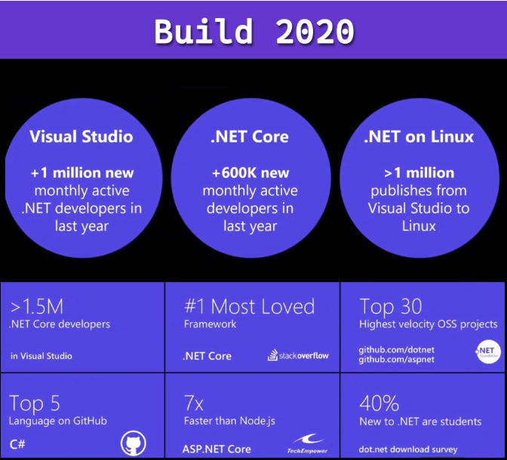

Slide 5
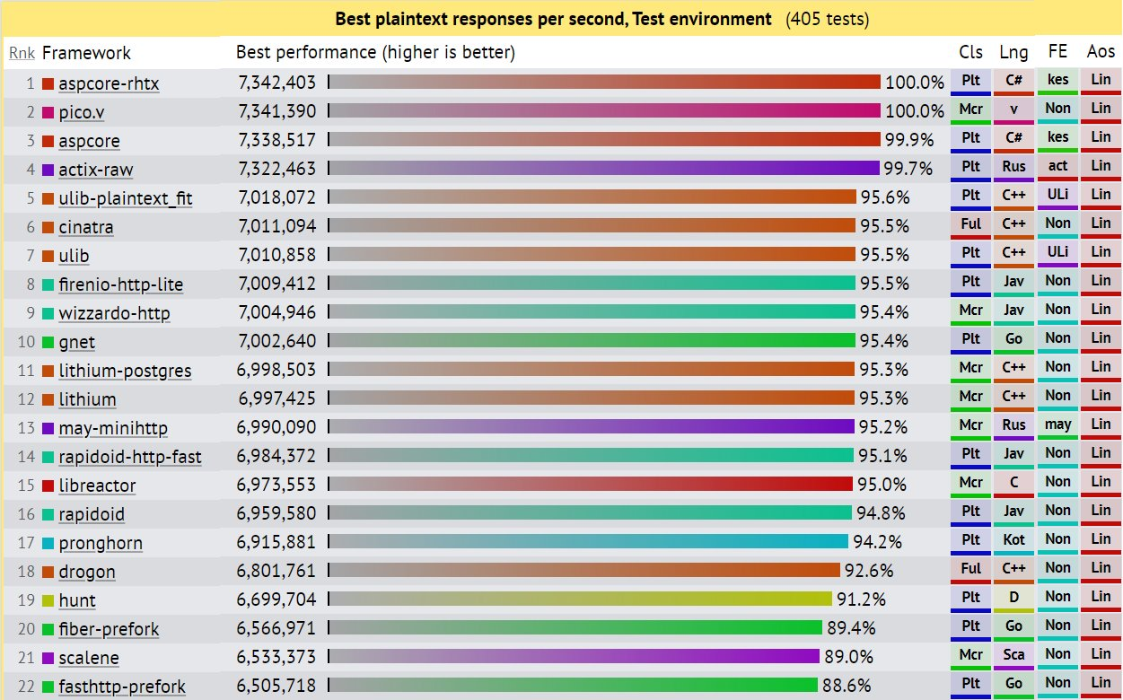

Slide 6
ASP.NET CORE
FAST
RELIABLE
RUNS EVERYWHERE (LINUX/MAC/WIN) - RasberyPI
Resilient
Modern and ready for latest requirements
Easier Maintenance
Cloud-Based Web Application

Slide 7
What else?
Business is happy
Developers are happy
Customers are happy

Slide 8
Differences between MVC Core and Old MVC

Slide 9

How does it work?

Slide 10
HTTP MODULE/HTTP HANDLER

Slide 11


Kestrel
Kestrel used as an edge (Internet-facing) web server:
Kestrel used in a reverse proxy configuration:

Slide 12
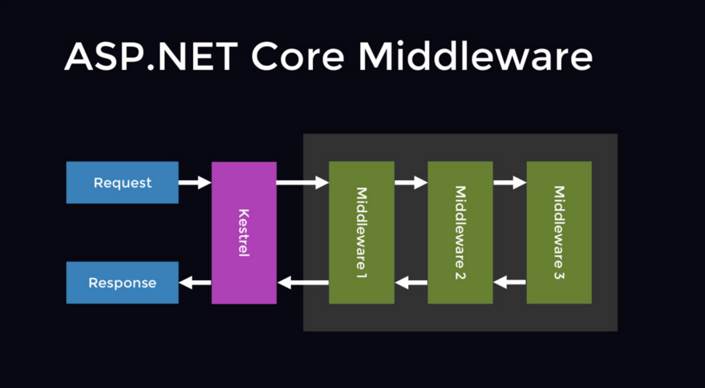
Middleware

Slide 13
Cloud based app

Slide 14
OWIN

Slide 15
Decouple from IIS, self-Isolation

Slide 16
Integration Test
CI/CD friendly

Slide 17
Middleware

Slide 18
ASP.NET Core was inspired by OWIN

Slide 19
OWIN implementation in ASP.NET Core

Slide 20
DEMO

Slide 21
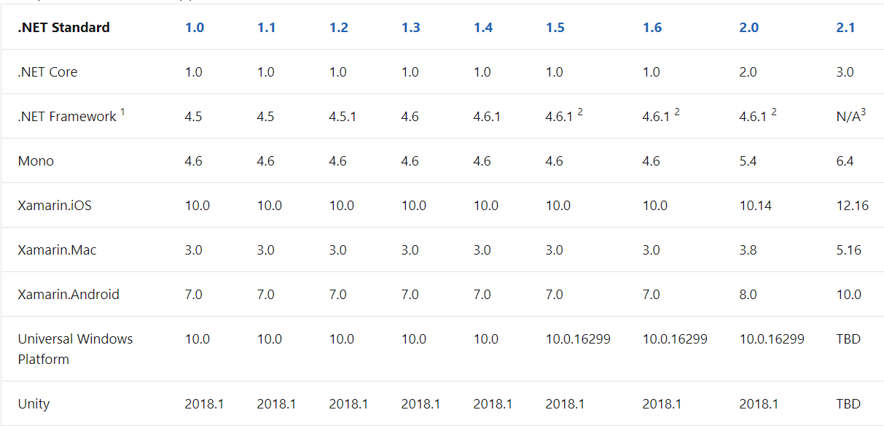
.NET STANDARD 2.0

Slide 22
Summarization
Migration process
Add OWIN
Write everything with middlewares
Unit / Integration / Regression tests
Update class libraries to .NET Standard 2.0
Update to ASP.NET Core with OWIN
Get rid of OWIN and keep with Pure ASP Core
Keep update ;)

Slide 23
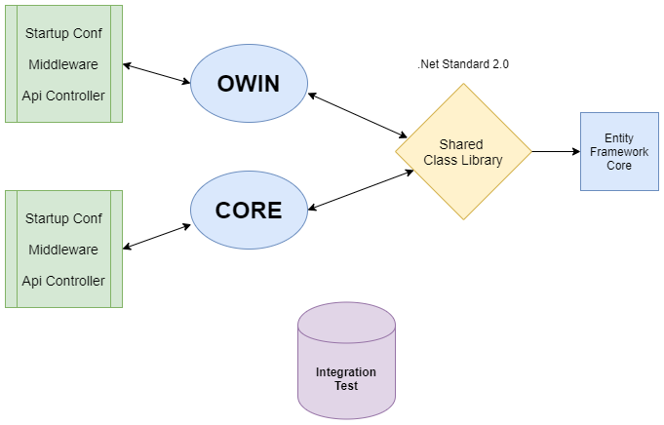

Slide 24
THANK YOU
Ali Khalili

