Slide 1
Differentially Private Accelerated Optimization for Federated Learning
Roman Vakhrushev
Rensselaer Polytechnic Institute
2022

Slide 2
Introduction
Motivation:
Federated learning is capable of significantly preserving clients’ private data from being exposed to external adversaries
At the same time, the privacy of clients’ data is still in danger
Think of Adversarial server scenario, Honest-but-curios server scenario, Man-in-the-Middle attack scenarios
In some way, federated learning (Distributed Learning in general) is probably even more sensible to these attacks compared to regular ML
One way to overcome this issue is by replacing optimizer algorithms with their DP versions, where possible
Related Work:
Federated Learning:
FedOpt algorithm (Reddi et al., 2021)
Differentially-Private Optimizers:
SGD (Abadi et. al., 2016)
Nesterov’s method (Gylberth et al., 2017 and Kuru et al., 2020)
Federated Learning with DP-SGD:
DP-FedAvg and DP-FedSGD (McMahan et al., 2018)
Advanced Algorithms (Kairouz et. al., 2021)
Notes:
Law: fairness includes protecting individuals and groups from discrimination or mistreatment with a focus on prohibiting behaviors, biases and basing decisions on certain protected factors or social group categories.
Social science: “often considers fairness in light of social relationships, power dynamics, institutions and markets.” Members of certain groups (or identities) that tend to experience advantages.
Quantitative fields (i.e. math, computer science, statistics, economics): questions of fairness are seen as mathematical problems. Fairness tends to match to some sort of criteria, such as equal or equitable allocation, representation, or error rates, for a particular task or problem.
Philosophy: ideas of fairness “rest on a sense that what is fair is also what is morally right.” Political philosophy connects fairness to notions of justice and equity

Slide 3
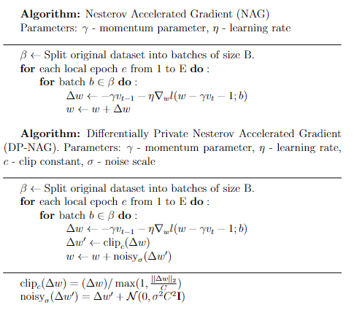
DP-Nesterov Accelerated Gradient (DP-NAG)
Intuition: Move as you would according to regular gradient descent, then go a little bit more from that point using the gradient from the new place
Similar to Momentum-Based optimizer
NAG has convergence rate of O(1/t^2), whereas SGD only has O(1/t)
For the Differentially Private version also clip the objective and add noise to the gradients
Noise is added according to Gaussian mechanism
Data can also be sampled according to Poisson sampling

Slide 4
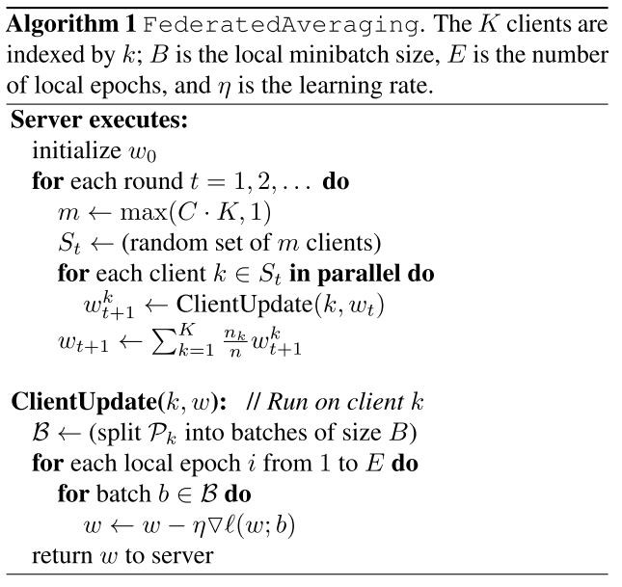
Aggregation
Each client trains its model separately, the training is performed as if it was done in a regular scenario.
ClientUpdate(k,w) can theoretically be any optimization method, including SGD, DP-SGD, NAG, DP-NAG, etc.
Communication is expensive, so we want to do as little communication rounds as needed.
We select m clients every communication round.
After each round we update the global weights and replace each clients’ model with the updated one.

Slide 5

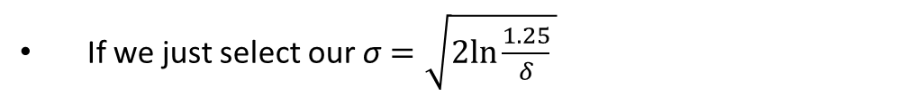
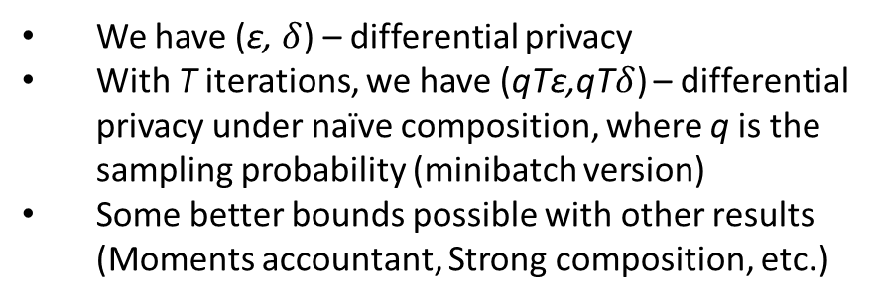
Differential Privacy
For DP-NAG:
Analysis is similar to DP-SGD, if DP-NAG is implemented as above
Consider Gaussian Mechanism:
For Federated Learning:
Differential Privacy is ill-defined
Who do we want to defend against?
What is the dataset?
Many different notions exist, depends on your application
For example:
Aggregated model against server or any client
(Malekzadeh et. al., 2021)
Strong/weak federated f-differential privacy
(Zheng et. al., 2021)
Global Differential Privacy
(Wei et. al., 2019)
i-th client against j-th client
If we just select our $\text{σ}=\sqrt{2ln\frac{1.25}{δ}⁡}$
/ε
We have (ε, $δ$) – differential privacy
With T iterations, we have (qTε,qT$δ$) – differential privacy under naïve composition, where q is the sampling probability (minibatch version)
Some better bounds possible with other results
(Moments accountant, Strong composition, etc.)

Slide 6
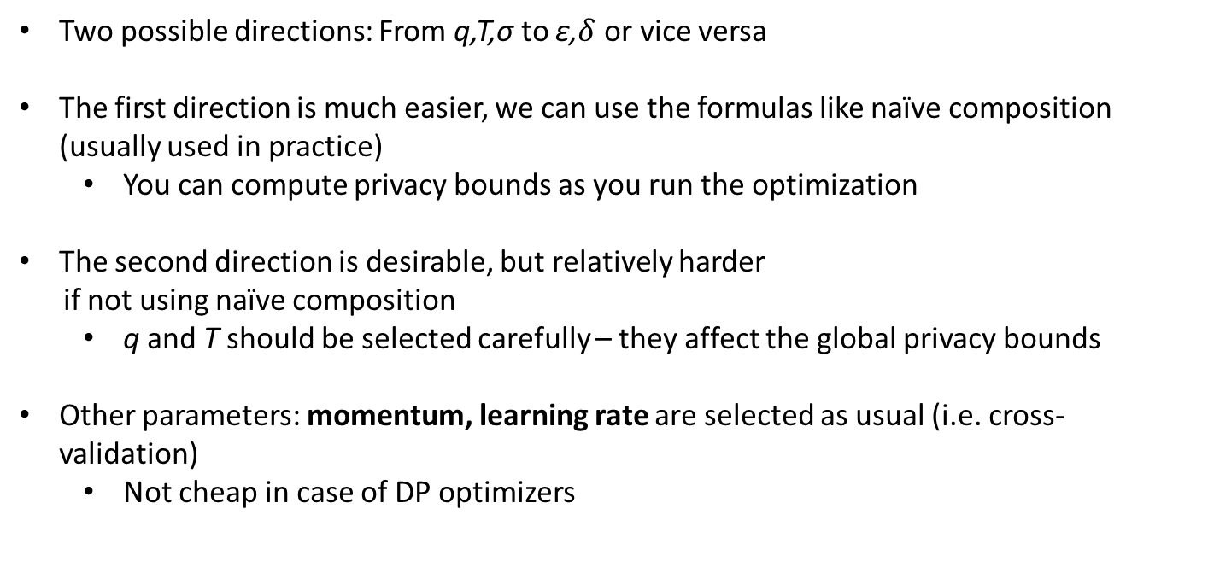
Parameters
Two possible directions: From q,T,$\text{σ}$ to ε,$δ$ or vice versa
The first direction is much easier, we can use the formulas like naïve composition (usually used in practice)
You can compute privacy bounds as you run the optimization
The second direction is desirable, but relatively harder
if not using naïve composition
q and T should be selected carefully – they affect the global privacy bounds
Other parameters: momentum, learning rate are selected as usual (i.e. cross-validation)
Not cheap in case of DP optimizers

Slide 7
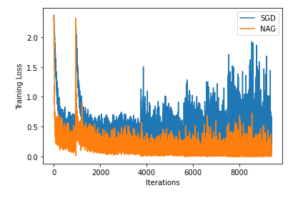
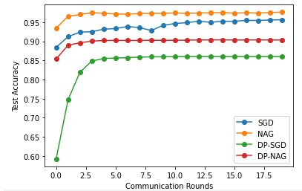
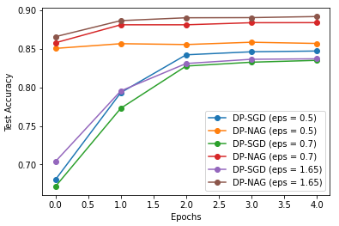
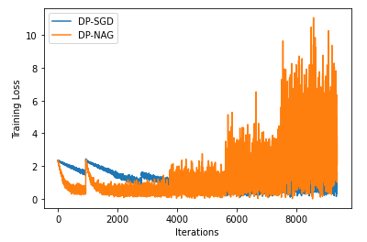
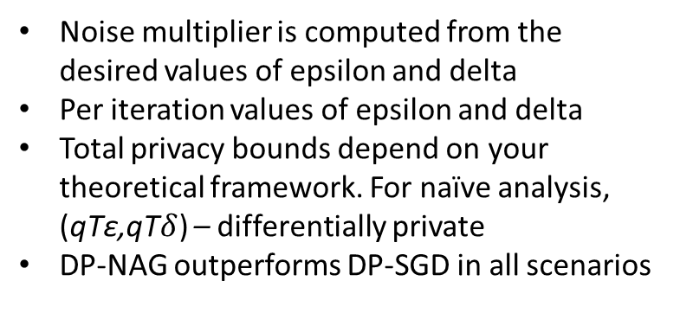
Results
Federated Learning Results
Local Learning Results
Aggregation (Communication) is done after each epoch
For DP: noise multiplier = 0.4, clip constant = 1.0
2 Workers
Noise multiplier is computed from the desired values of epsilon and delta
Per iteration values of epsilon and delta
Total privacy bounds depend on your theoretical framework. For naïve analysis, (qTε,qT$δ$) – differentially private
DP-NAG outperforms DP-SGD in all scenarios
Server Results (Aggregation)
Local Learning (Delta is constant = 0.5)
Single Worker in FL

Slide 8
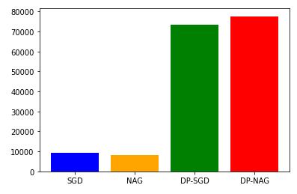
Running Time
Average Running time per epoch (ms)
DP Optimization has another huge disadvantage – running time
The noise added scales with the size of the model
Unoptimized DP optimization results in unacceptable running times (up to 50 times longer compared to non-DP optimization)
Optimized DP can be done through the use of different libraries: Pytorch Opacus, Tensorflow Privacy, JAX
Still not very good; the best we can get is about 2x slower
DP Optimization with ImageNet on JAX
DP-SGD and DP-NAG here are implemented using Opacus

Slide 9
Conclusion
The idea of DP-SGD can easily be extended to other optimization methods (First-Order only)
DP optimizers can be used in the Federated Learning setting, replacing the non-DP optimizers
DP optimizers not only have the issue with utility, but they are also much slower (can be more than twice as slow even with good optimization) than non-DP optimizers
The use of accelerated optimizers partially compensates for the issue with utility as they generally converge more quickly (not in all scenarios)

Slide 10
References
Reddi, S., Charles, Z., Zaheer, M., Garrett, Z., Rush, K., Konečný, J., Kumar, S., & McMahan, H. B. (2021, September 8). Adaptive Federated Optimization. arXiv.org. Retrieved March 14, 2022, from https://arxiv.org/abs/2003.00295
R. Gylberth, R. Adnan, S. Yazid and T. Basaruddin, "Differentially private optimization algorithms for deep neural networks," 2017 International Conference on Advanced Computer Science and Information Systems (ICACSIS), 2017, pp. 387-394, doi: 10.1109/ICACSIS.2017.8355063.
Kuru, N., Birbil, Ş. İ., Gurbuzbalaban, M., & Yildirim, S. (2020, August 5). Differentially private accelerated optimization algorithms. arXiv.org. Retrieved March 14, 2022, from https://arxiv.org/abs/2008.01989
McMahan, H. B., Ramage, D., Talwar, K., & Zhang, L. (2018, February 24). Learning differentially private recurrent language models. arXiv.org. Retrieved March 14, 2022, from https://arxiv.org/abs/1710.06963
Kairouz, P., McMahan, B., Song, S., Thakkar, O., Thakurta, A., & Xu, Z. (2021, December 10). Practical and private (deep) learning without sampling or shuffling. arXiv.org. Retrieved March 14, 2022, from https://arxiv.org/abs/2103.00039
Malekzadeh, M., Hasircioglu, B., Mital, N., Katarya, K., Ozfatura, M. E., & Gündüz, D. (2021). Dopamine: Differentially private federated learning on medical data. arXiv preprint arXiv:2101.11693.
Zheng, Q., Chen, S., Long, Q., & Su, W. (2021, March). Federated f-differential privacy. In International Conference on Artificial Intelligence and Statistics (pp. 2251-2259). PMLR.
Wei, K., Li, J., Ding, M., Ma, C., Yang, H. H., Farokhi, F., ... & Poor, H. V. (2019). Federated learning with differential privacy: Algorithms and performance analysis. IEEE Transactions on Information Forensics and Security, 15, 3454-3469.

