Slide 1
Covid Effect on Air Travel
By Aaron Gold

Slide 2
Goals of Study
Determine which reporting factors of Covid-19 had the biggest effect on air travel throughput.
2 data sources:
  TSA Travelor Data 2019 and 2020 tsa.gov/coronavirus/passenger-throughput
  The Covid Tracking project CSV https://covidtracking.com/data/download
Data analysis and charts done with python/ Jupyter notebook

Slide 3
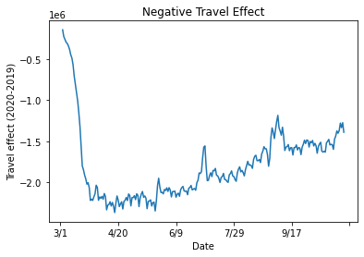
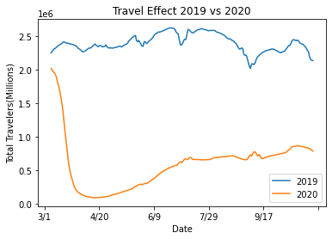
Traveler Throughput 2019 vs 2020

Slide 4
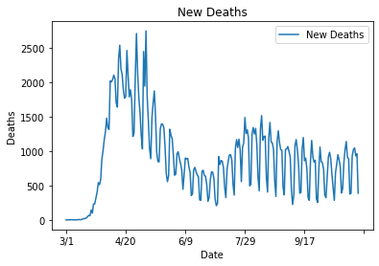
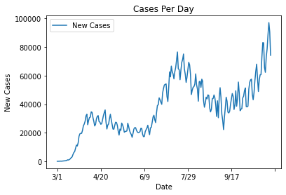
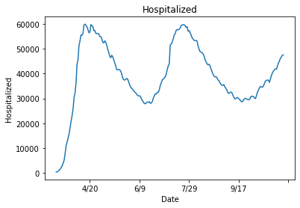
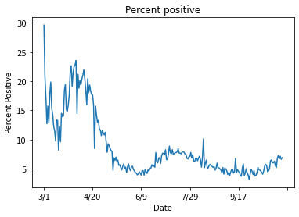
Covid Reporting Charts

Slide 5
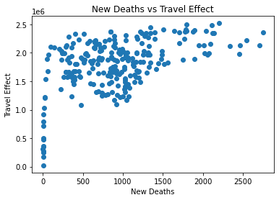
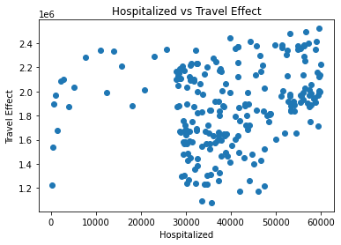
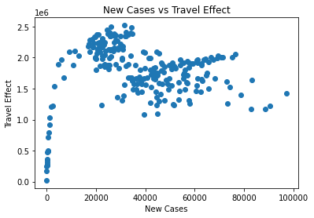
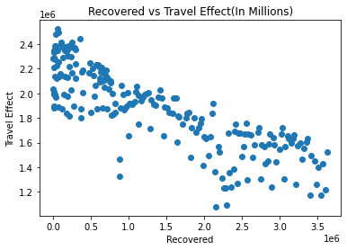
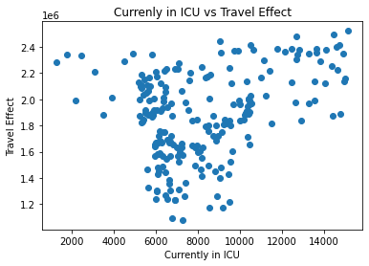
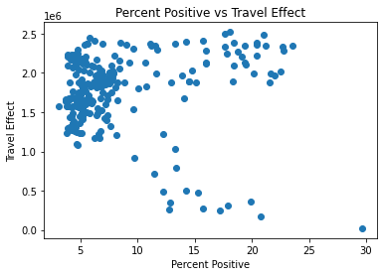
Travel throughput vs Covid - Correlations
Corr: 0.20
Corr: 0.53
Corr: 0.07
Corr: -0.84
Corr: 0.02
Corr: 0.33

Slide 6
Other factors to consider…
We may want to find more Travelor/ TSA Data such as number from different airpots to see the effect on various cities at a given time.
Flights per day and flight prices, time of year/ days of week
More data such as comparing 2020 to an average of more years. Also more data before march.
Look at correlations varying month intervals. Scrape web for more updated info
The End

