Slide 1
Cross-City Urban Heat
Hotspot Prediction
Two ways to evaluate hotspot prediction
Max Clements | Nicholas Machado
STAT 5630 Final Project | April 2026

Slide 2
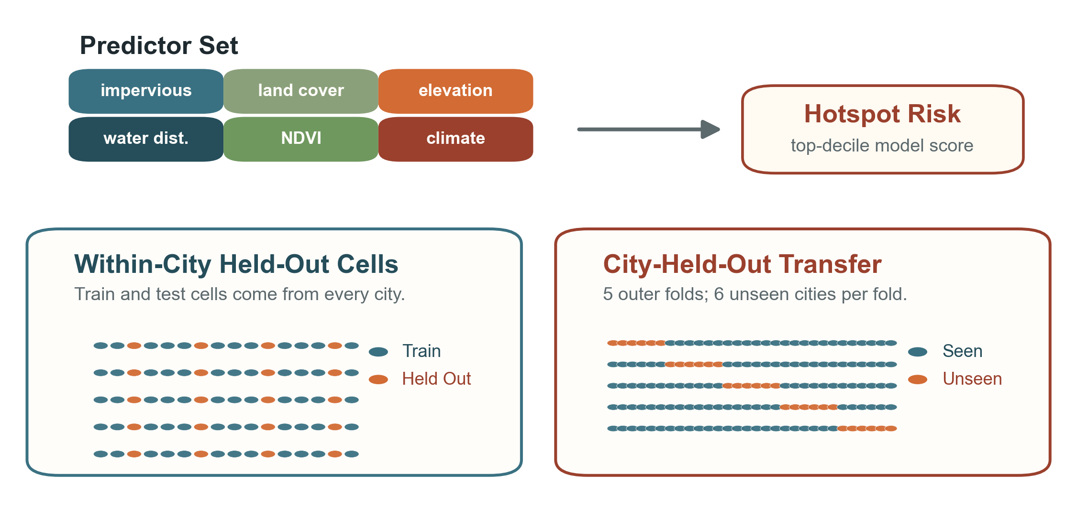
Research Question + Validation Design

Slide 3
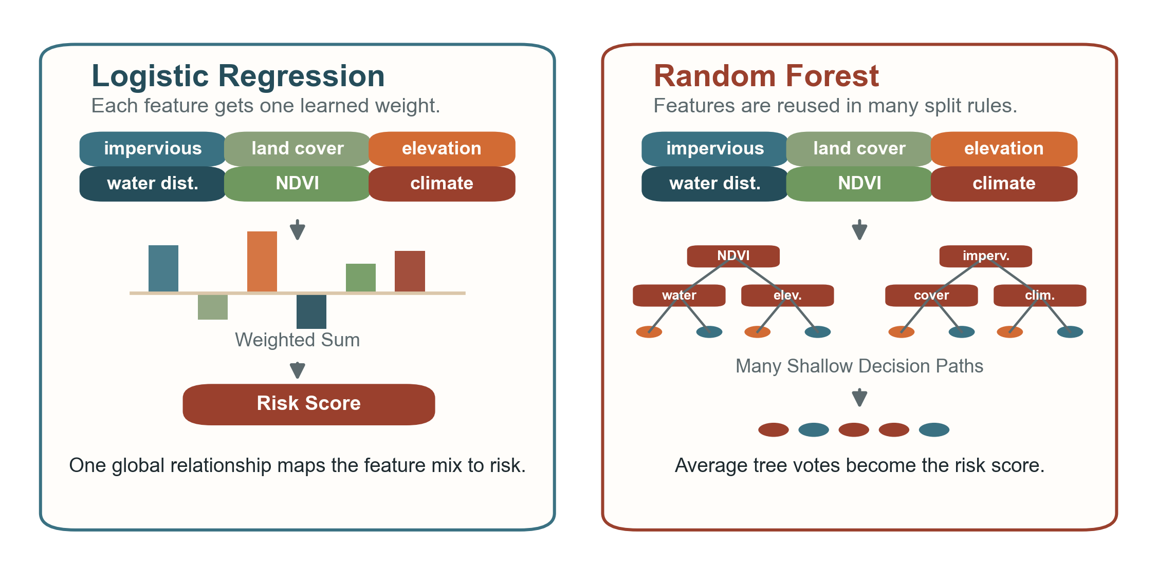
Modeling Section: Logistic vs Random Forest

Slide 4
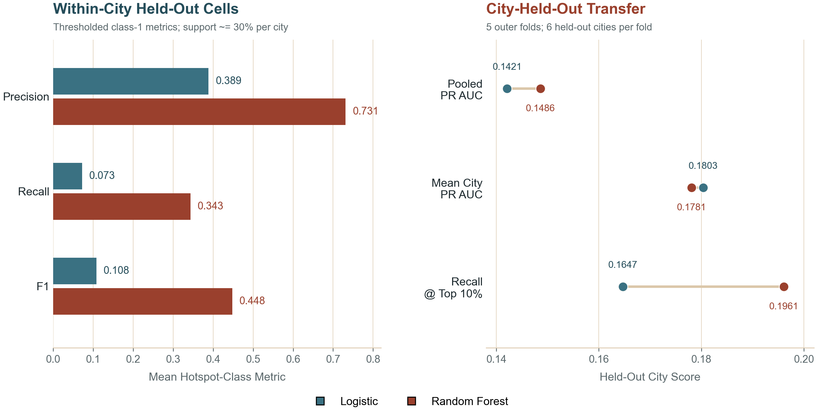
Results Side by Side

Slide 5
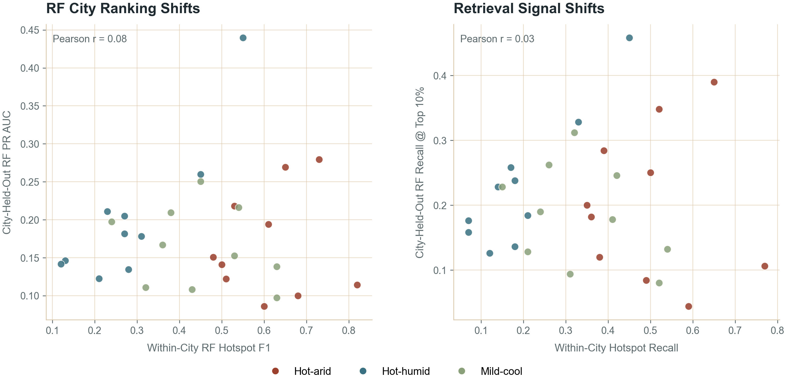
City-Level Signal Shifts Across Evaluation Designs

Slide 6
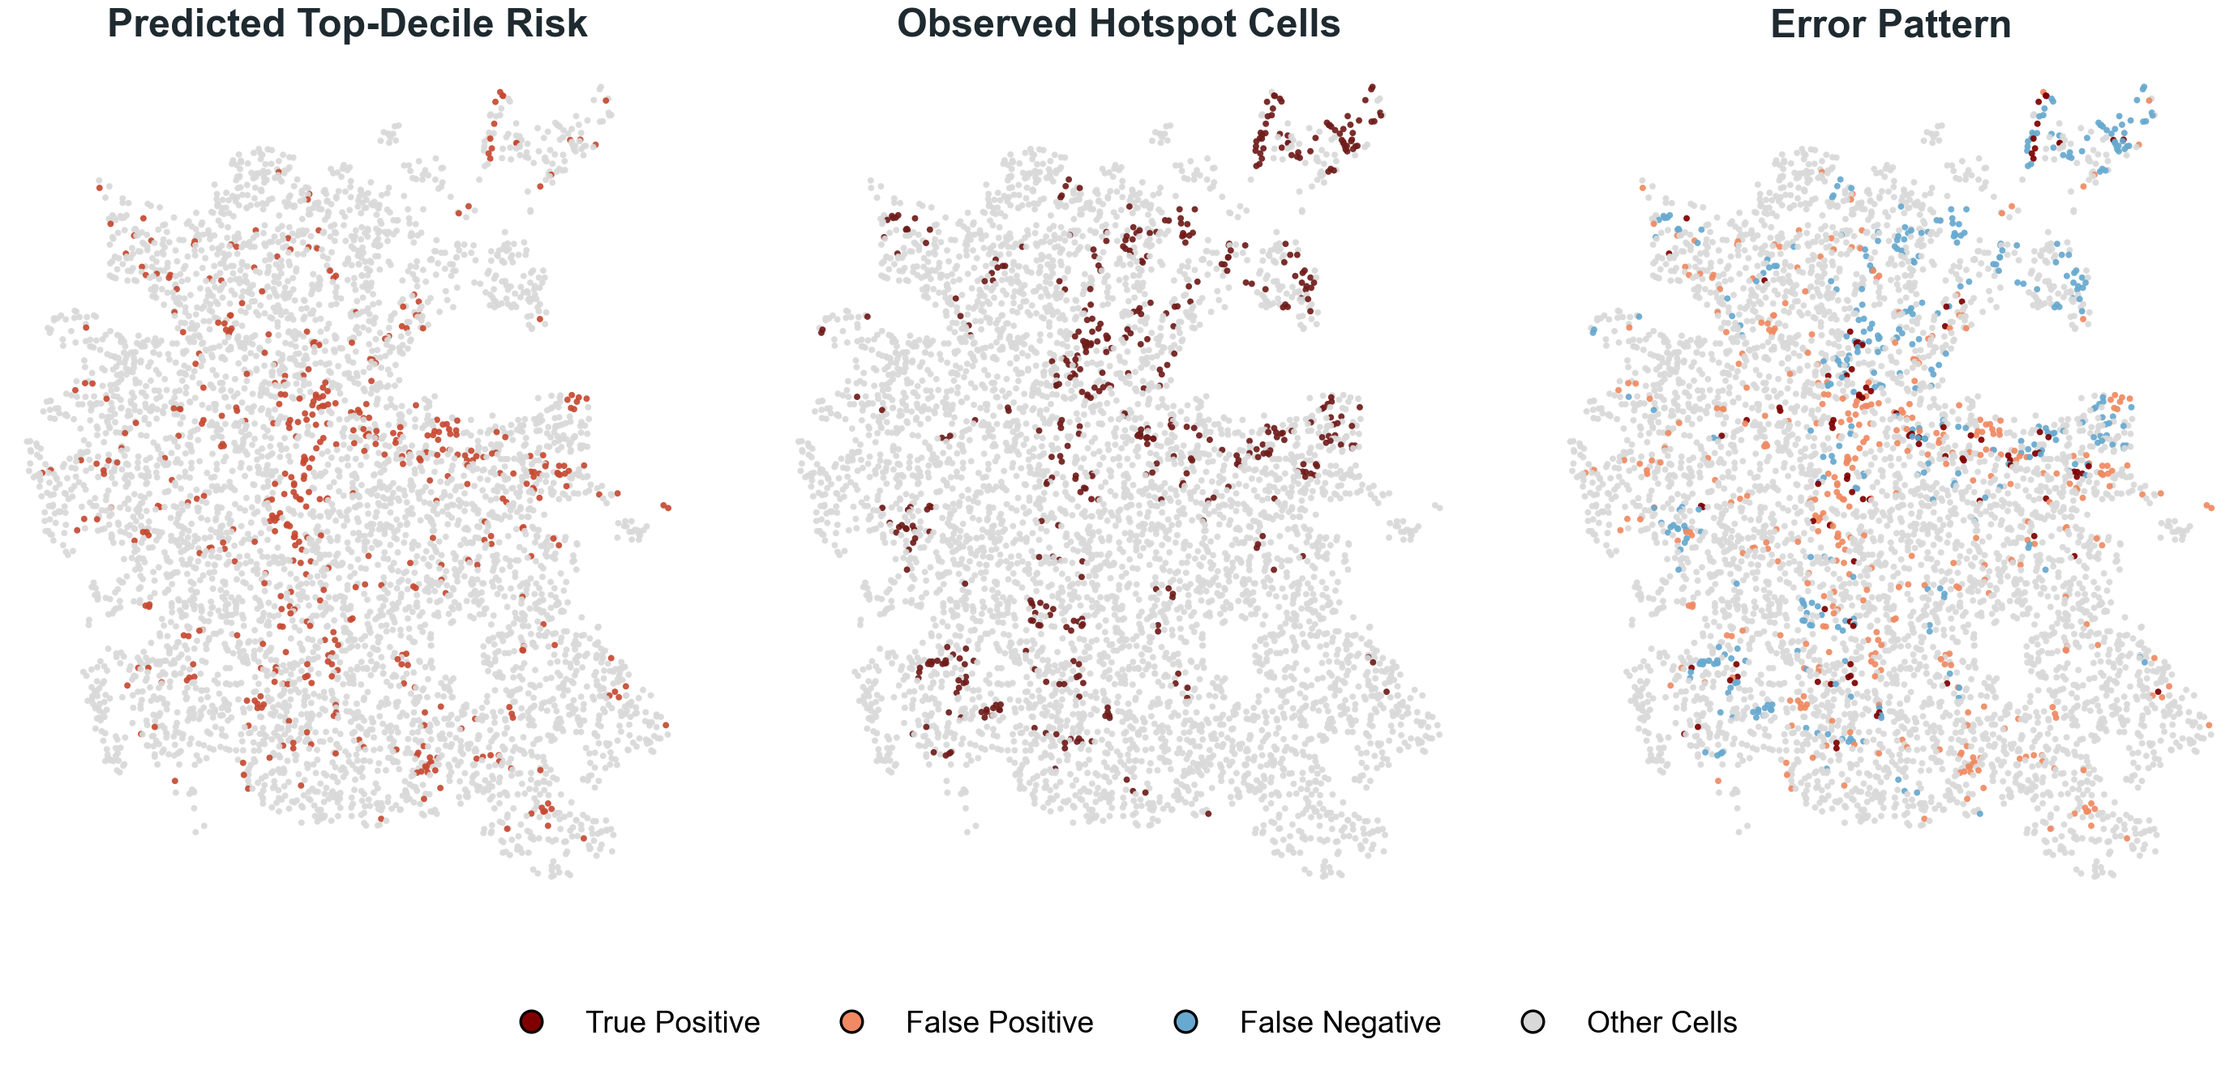
Held-Out Denver Map Example

Slide 7
Questions?

