Slide 1

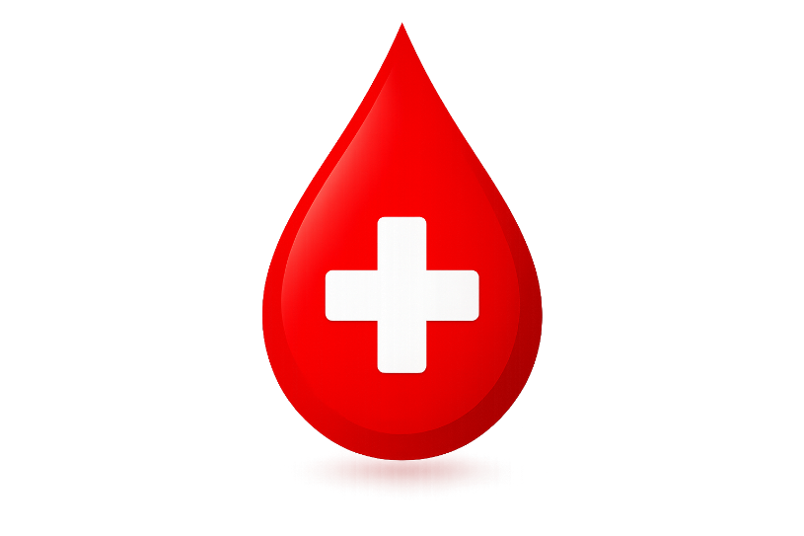

ShareLife
A Blood Donor Management System
Presented By:
Satyam Sharma 2505112120182
Nency D. Rana 2505112120189
Vaibhav Kumar 2505112120189

Slide 2

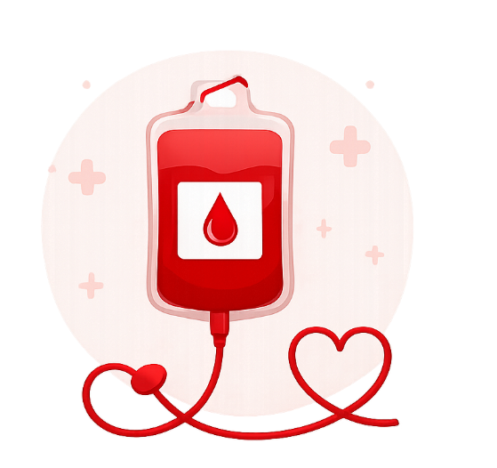
Introduction
ShareLife is a web-based Blood Donor Management System developed to connect blood donors with people in need.
The system enables donor registration, blood group search, and centralized donor record management, making blood availability faster during emergencies.

Slide 3
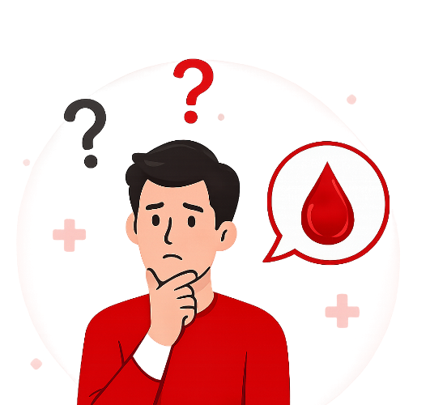
Problem Statement
Difficulty in finding blood donors during emergencies.
Donor information is often stored manually.
Searching for the required blood group takes time.
Lack of a centralized donor database.
Communication between donors and beneficiaries is inefficient.

Slide 4

Solution
ShareLife provides a simple online platform to:
Register blood donors.
Store donor information securely.
Search donors by blood group.
Display available donors instantly.
Manage donor records efficiently.

Slide 5

Objectives
Register blood donors online.
Maintain a centralized donor database.
Enable quick blood group search.
Improve emergency blood availability.
Provide an easy-to-use system for users.

Slide 6
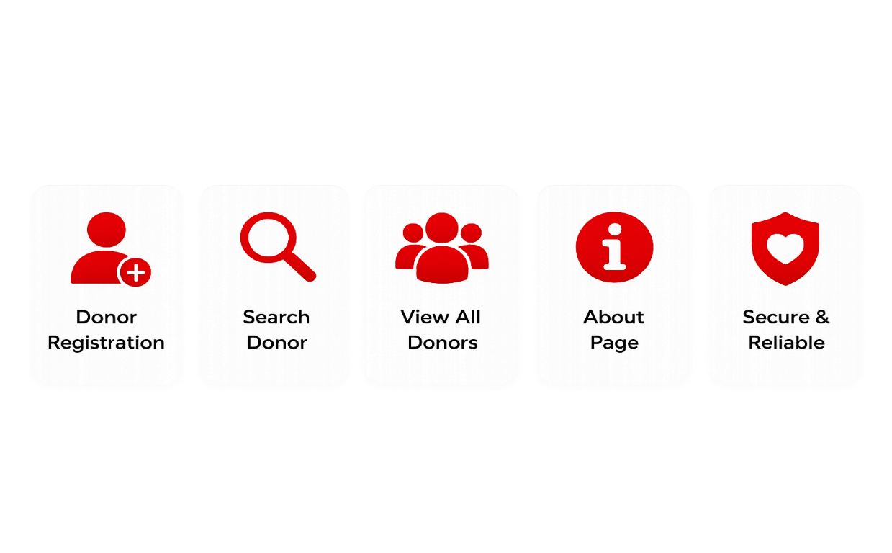
Features

Slide 7
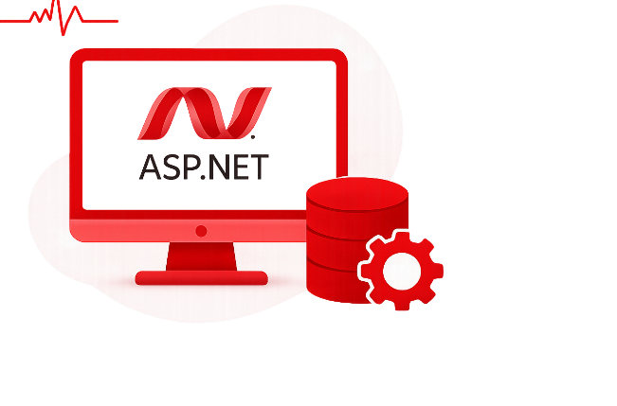
Technology Used
Technology | Purpose
ASP.NET Web Forms | Frontend & Backend
C# | Server-side Programming
SQL Server (LocalDB) | Database
ADO.NET | Database Connectivity
HTML & CSS | User Interface
Visual Studio | Development Environment

Slide 8

Database
Database Name
BloodDonorDB
Table Name
Donor
Column | Data Type
DonorID | INT (PK)
Name | VARCHAR(50)
Age | INT
BloodGroup | VARCHAR(5)
Mobile | VARCHAR(15)
City | VARCHAR(50)

Slide 9
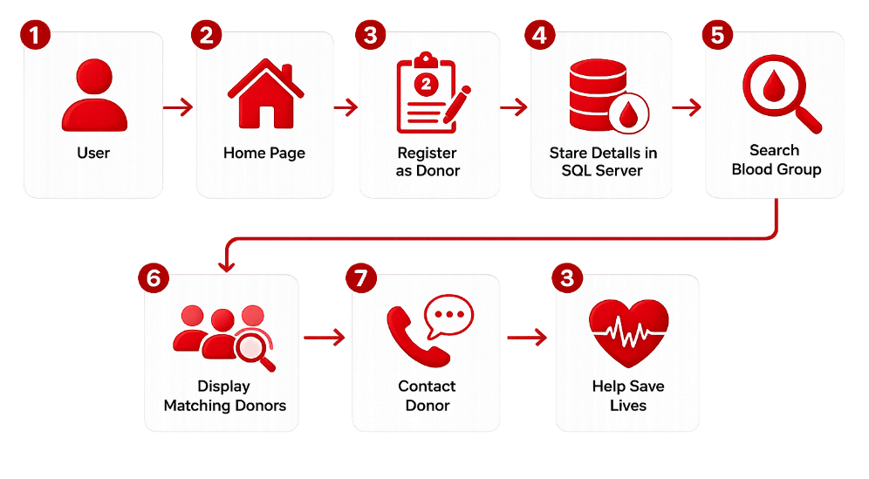
System Workflow

Slide 10

Advantages
Easy donor registration.
Fast blood group search.
Centralized donor management.
User-friendly interface.
Saves time during emergencies.
Reliable donor information.

Slide 11
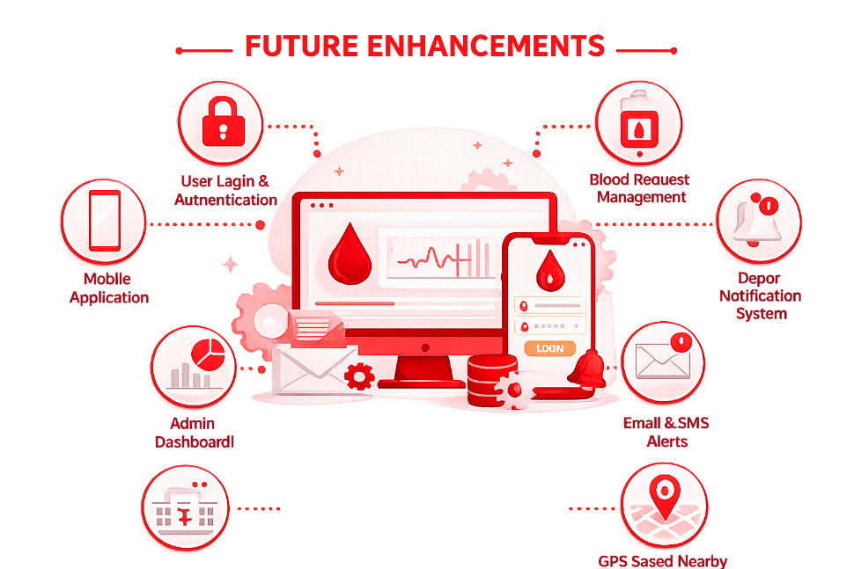

Slide 12
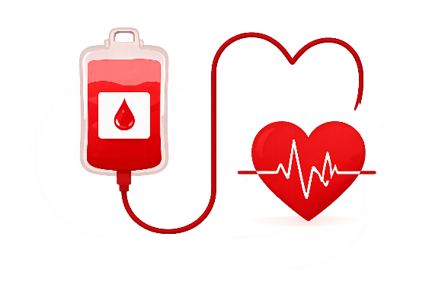
Conclusion
ShareLife is a simple and efficient Blood Donor Management System developed using ASP.NET Web Forms, C#, SQL Server, and ADO.NET.
The application helps users register donors, search donors by blood group, and manage donor information efficiently, making blood donation faster and more organized during emergencies.

Slide 13
Thankyou

