Slide 1
Music Market Analysis
YouTube Engagement Visualization
Initial Findings
Combining iTunes metadata with YouTube engagement metrics to analyze music performance across platforms.

Slide 2
Data Source Progress
• iTunes — metadata baseline (track, artist, genre, duration)
• Spotify — track metadata; popularity field not in Search response
• YouTube — views, likes, and comments
All data fetched via public APIs with no scraping.

Slide 3
YouTube Metrics
• Views — exposure indicator
• Likes — audience response indicator
• Comments — additional engagement indicator
• Engagement Rate — (likes + comments) / views
Sample: 10 lofi study music videos via search.list + videos.list.

Slide 4
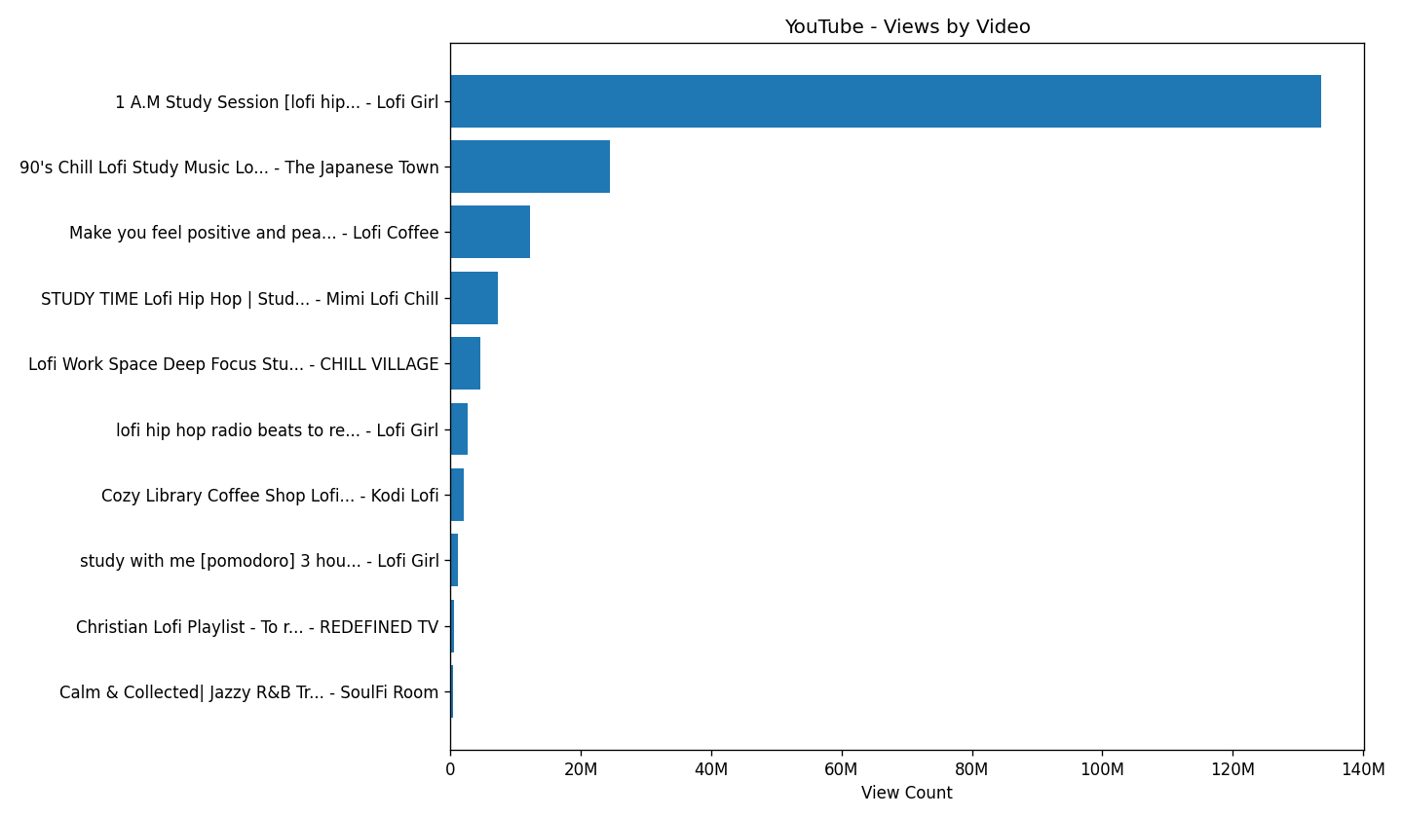
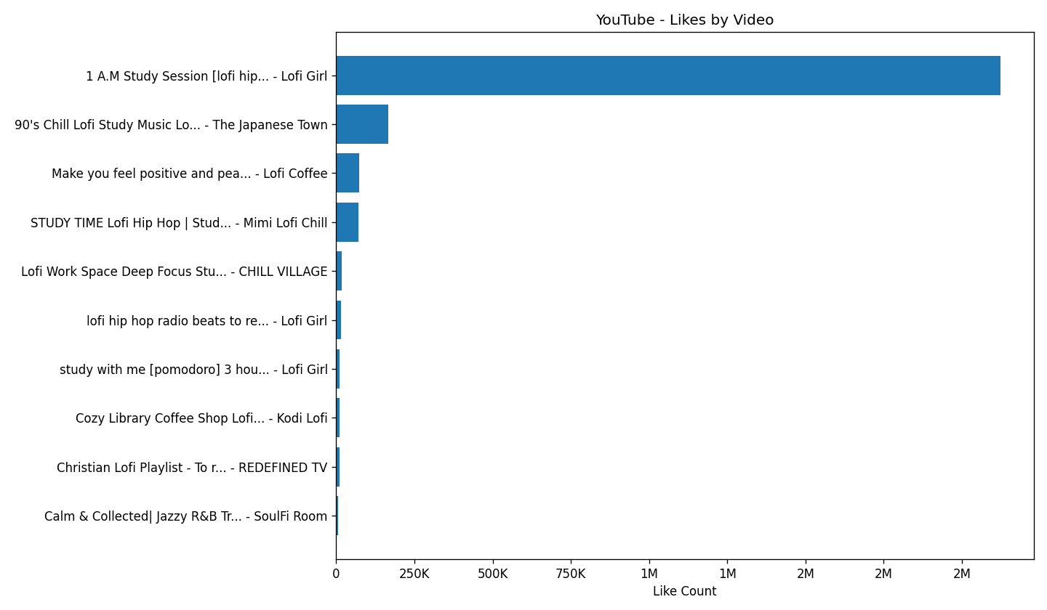
Views and Likes by Video
Takeaway: Views and likes are generally aligned, with one video dominating both.

Slide 5
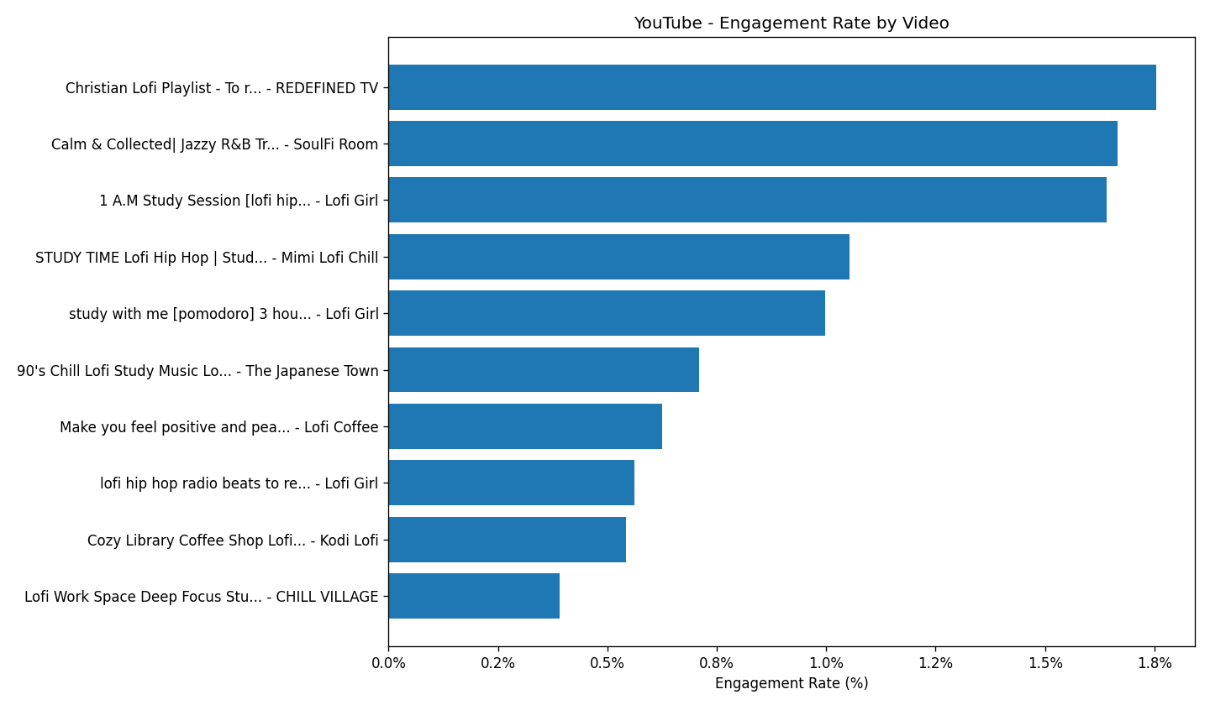
Engagement Rate by Video
Takeaway: Engagement rate shows a different ranking after normalizing by view volume.

Slide 6
Summary and Next Steps
Findings
Next Steps
• YouTube adds public engagement signals to the iTunes baseline.
• Views and likes are generally aligned in the current sample; one video dominates both.
• Engagement rate reveals a different ranking after normalizing.
• Expand sample beyond the lofi genre.
• Link YouTube engagement back to iTunes track metadata.

