Slide 1
Biomarker-Phenotypic Association model to predict disease progression
Ekansh Sharma
Anna Goldenberg

Slide 2
Background and Problem Statement
Need to understand the phenotypic progression patterns of a disease
Given initial observations identify the most probable trajectory for the disease:
Doctors can prescribe more aggressive treatment based on the progression
Utilize all the data that is collected and build biologically relevant models
Model the association between genetic causes
Model/understand the response to a drug

Slide 3
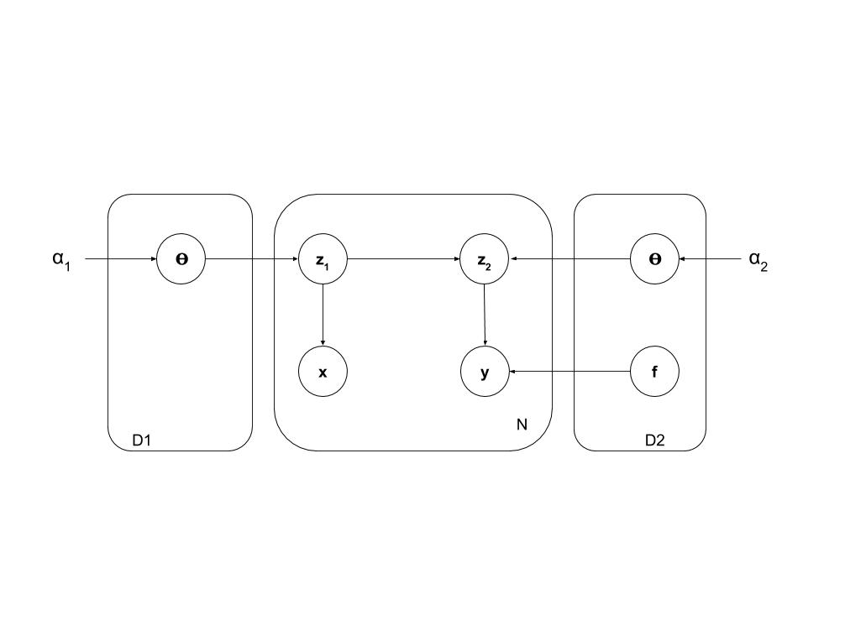
Graphical Model
X variables: N x K biomarker data
Z1 latent variables: specify the cluster index for X
Y variables: N x t biomarker data where T are the number of times of observation
(Note: We also need N x t time matrix which contains the time of observation)
Z2 latent variables: Specify the cluster index for Y
Key idea: Joint probability models Z2 as conditionally dependent on Z1 and the stick lengths (or weights of each cluster)

Slide 4
Conditioned Dirichlet Process
Intuition: People belonging in the same cluster for the Biomarker data should be related and show similar disease progression behavior
Generative Process:
Identify the Z1 clusters using the traditional Chinese Restaurant Process
Z2|Z1 ~ mult(w1,w2,…, wk, w_new) (note: w_new probability of creating new cluster)
Traditionally weights are proportional to the the number of people in the cluster
We make the weights dependent on Z1 by double counting the people belonging in the same Z1 cluster

Slide 5



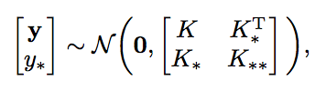

Gaussian Process Likelihood: P(Y|Z2=k)
Here k(t,t’) is the kernel. I am using the RBF kernel for now but can change the kernel depending on the data.
Covariance matrix is N.t x N.t
To compute the likelihood for a new person:
We can compute the likelihood of y* by using the pdf of the gaussian with mean and covariance matrix given on the right

Slide 6
Gibbs Inference
Initialize the clustering assignments
For each pairs of Z1 and Z2 clusters:
Remove their cluster assignment
Sample z1 ~ mult(w1* L1,w2*L2,…, wk*Lk, w_new*L_new) – w1, w2, ... are the traditional crp weights
Sample z2|z1 ~ mult(w1* L1,w2*L2,…, wk*Lk, w_new*L_new) - Here weights are the conditional weights we discussed earlier
NOTE: L1,L2,... is the likelihood for z1, likelihood is P(x|z1=k). For z2, the likelihood is P(y|z2=k) = GP likelihood

Slide 7
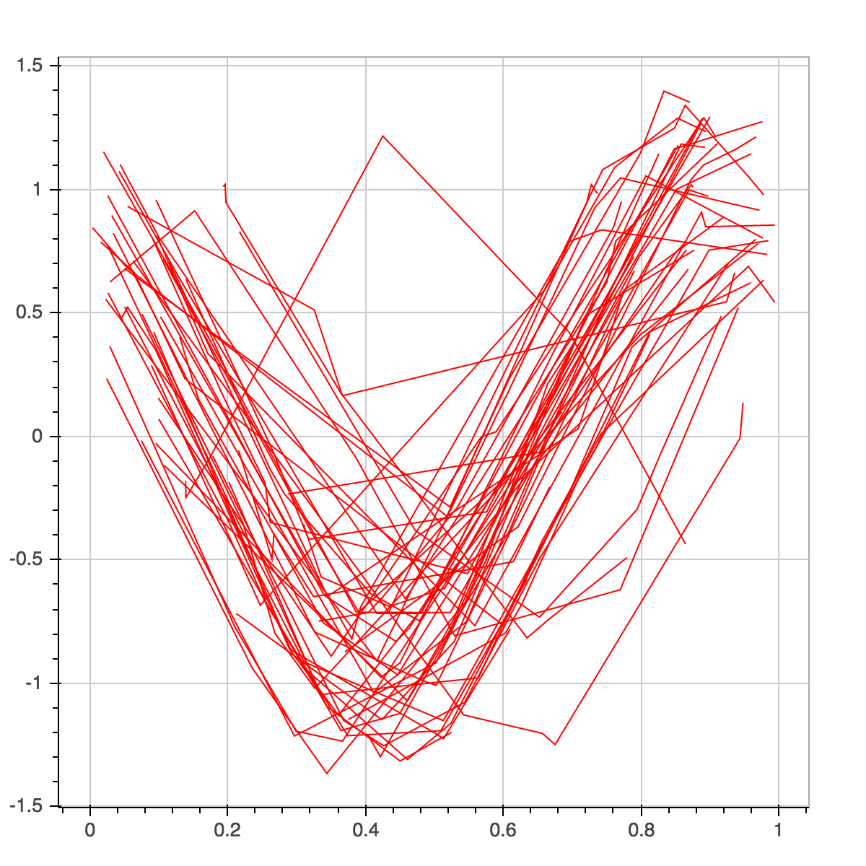
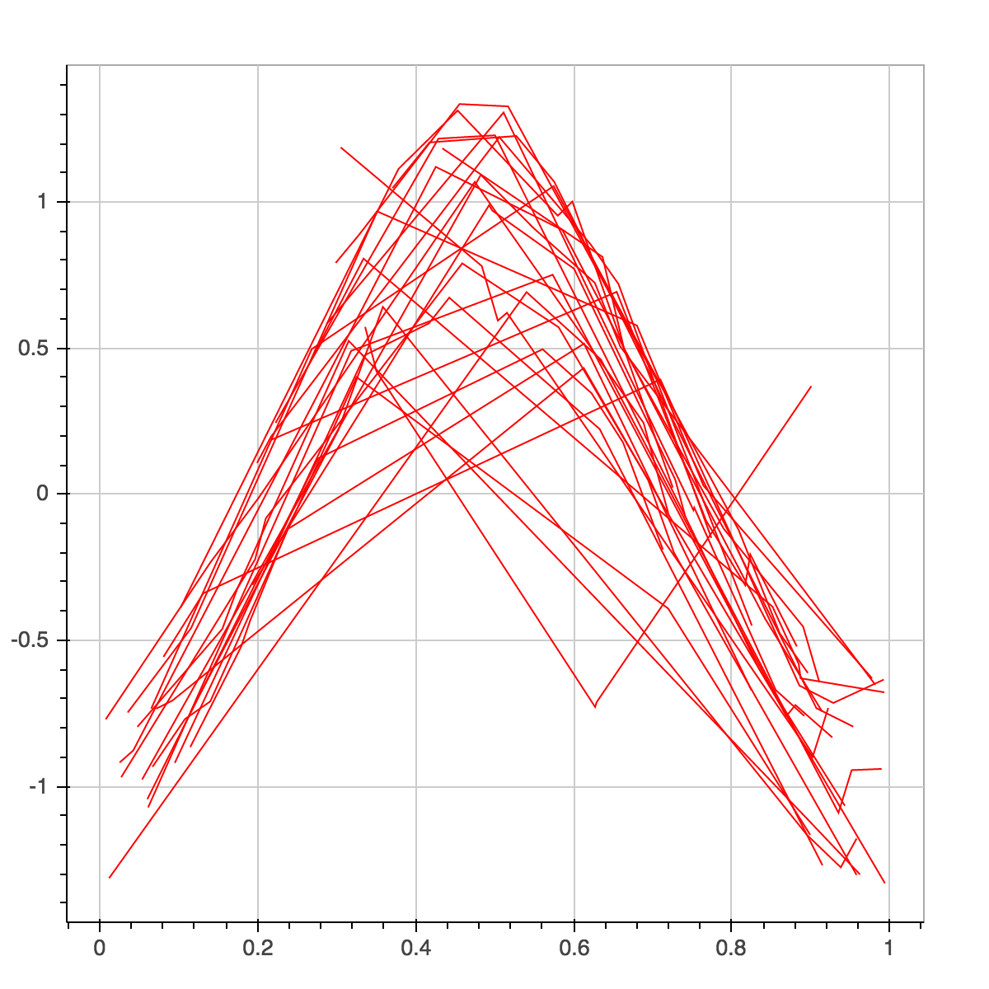
Simulation Data – Phase shifted sinusoids

Slide 8
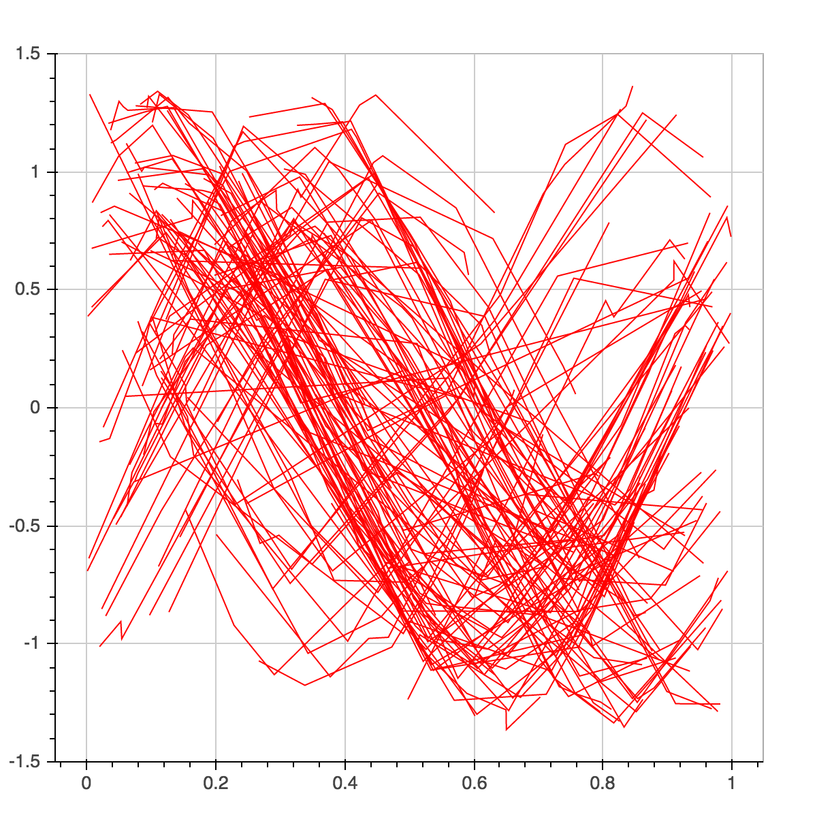
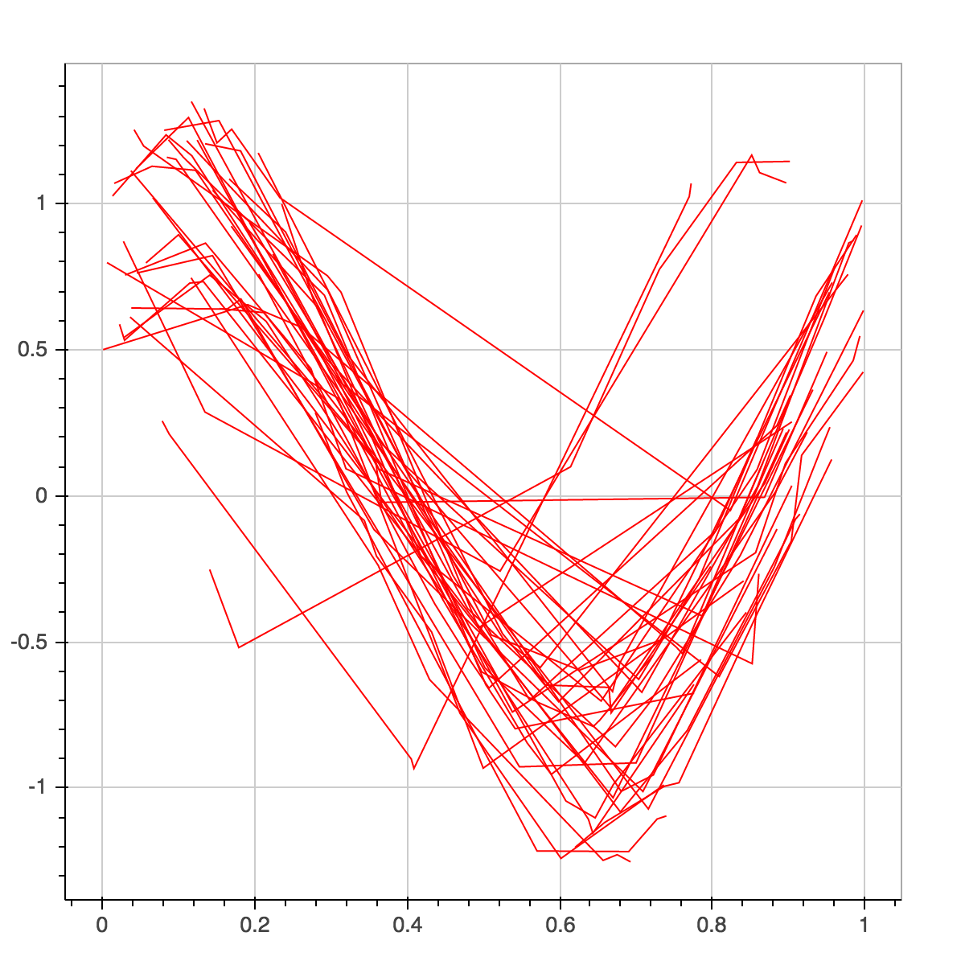
Simulation Data – Phase shifted sinusoids

Slide 9
Final Remarks and Future Work
Gibbs Sampling is pretty slow for a large dataset – Probably should switch to Variational Bayes – For this we would need to change the representation of the DP to stick breaking representation so we can compute gradients
Difficult to choose the right set of hyper-parameters since gibbs sampling is slow

