Slide 1
Data Scientist salary analysis
Chase Golden
DSE5002: R Project

Slide 2
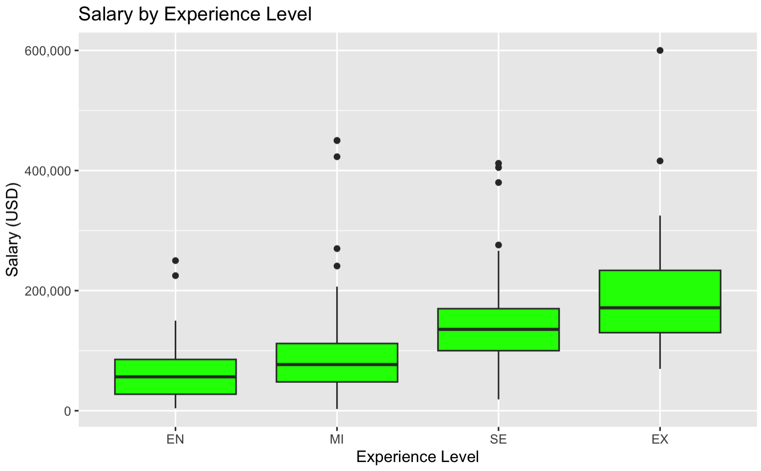
Experience level
SALARY IN USD

Slide 3
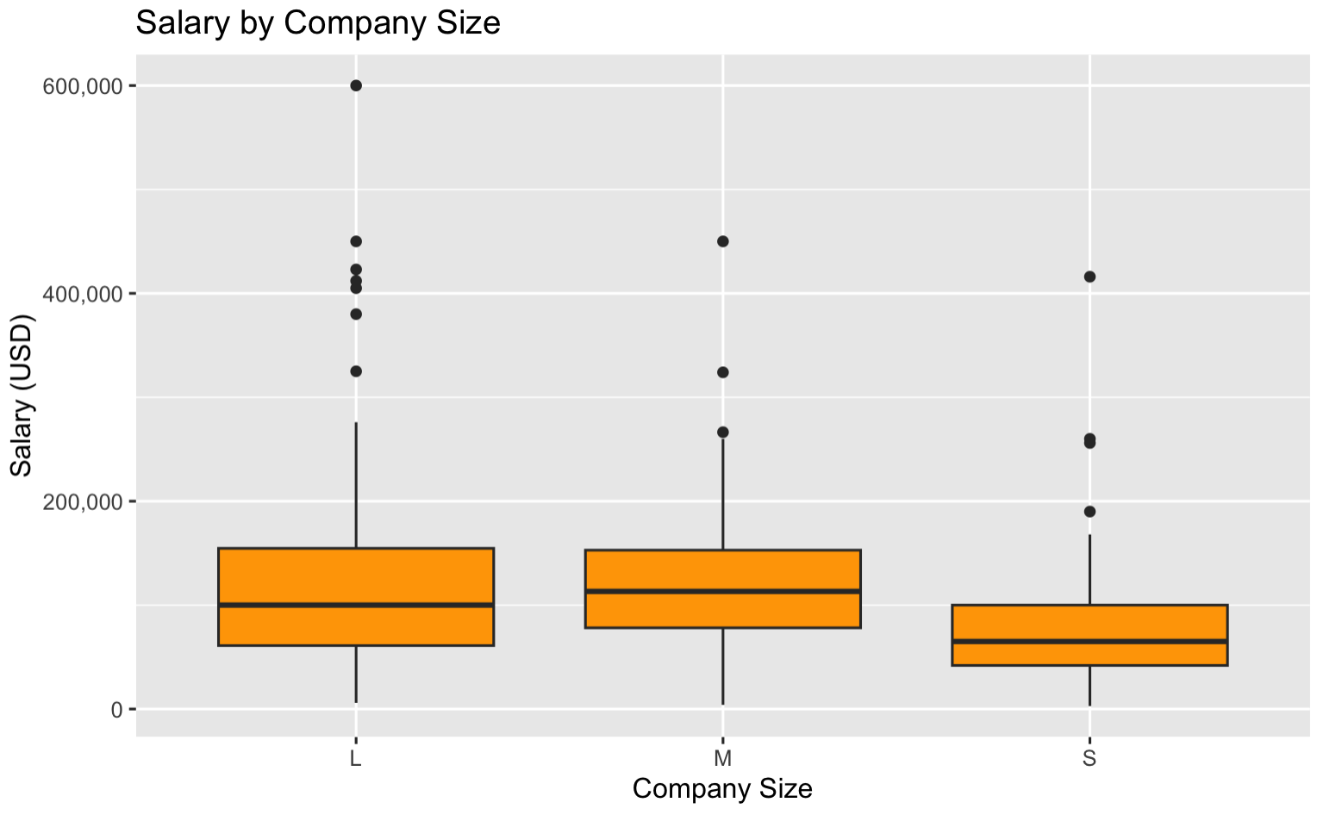
COMPANY SIZE
SALARY IN USD

Slide 4
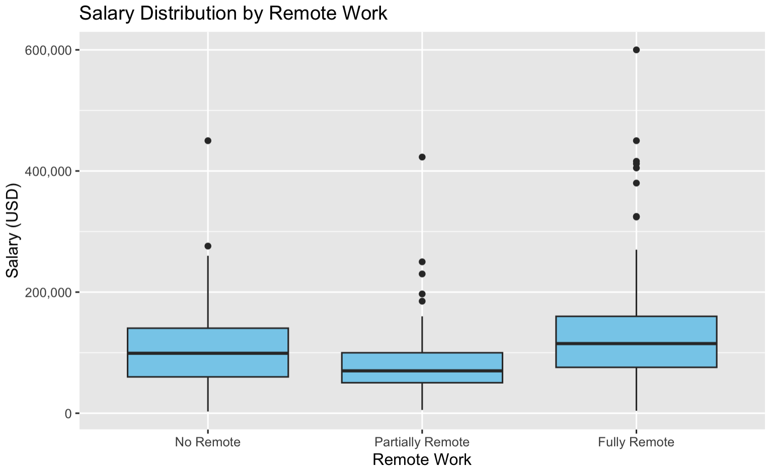
REMOTE WORK RATIO
SALARY IN USD

Slide 5
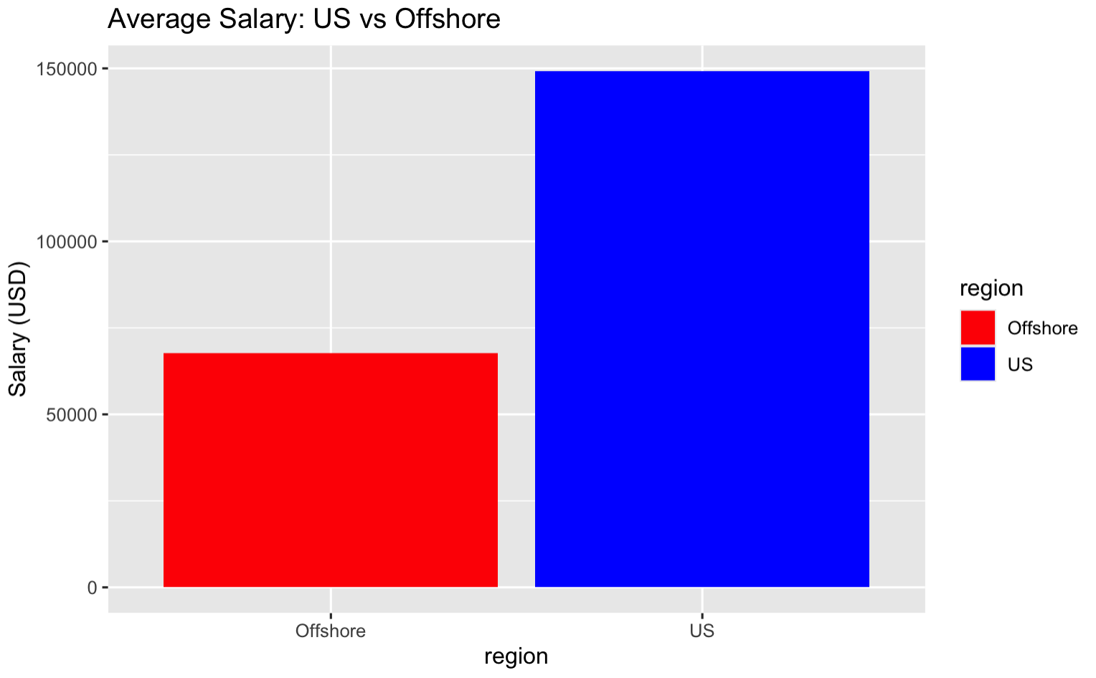
U.s. vs offshore
SALARY IN USD

Slide 6
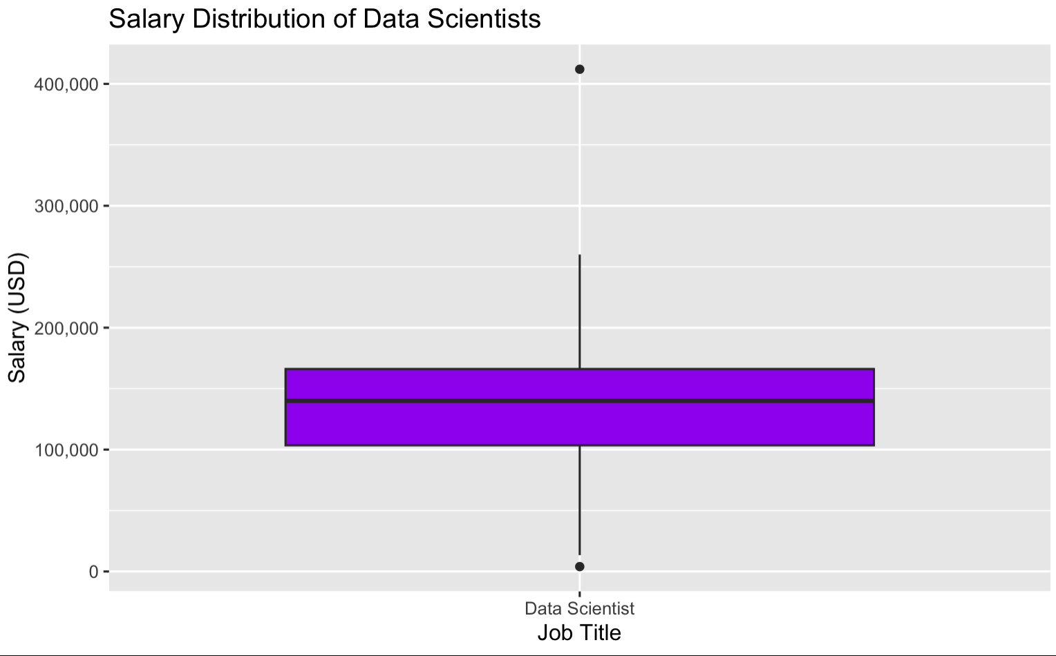
DATA SCIENTIST SEARCH CONCLUSION
Senior Level Data Scientist+
U.S. Based (Especially for Lead Possibilities)
Partially Remote
Based on Small-Medium Company Size

Slide 7
DATA SCIENTIST SEARCH CONCLUSION
Based on the previous data analysis, I would recommend offering the salary range of $140,000-$190,000
This range would give the company a strongly competitive standing while attracting top talent
The higher end of the range is certainly enough to bring in a high-level data scientist that is more than capable of leading a team right away

