Slide 1


SMART INDIA HACKATHON 2025
EDGE FLEET
TITLE PAGE
If the control room dies, the aisle should not.
Edge-AI Based Distributed Fleet Coordination for Autonomous Mobile Robots in Smart Warehouses
Problem Statement ID – SIH26123
Problem Statement Title – Edge-AI Based Distributed Fleet Coordination for Autonomous Mobile Robots in Smart Warehouses
Theme – Robotics and Drones
PS Category – Software
Team ID – «Team ID from portal»
Team Name (Registered on portal) – «Team Name»
• 3 AMRs · no dispatcher · peer-to-peer radio only. The dashboard is a spectator, never a controller.
• Measured at a 800-tick limit: stop-and-wait never completes an experiment; UBPA finishes E1 in 72 ticks, 6/6 tasks, 0 deadlocks.
• Python 3.10+ standard library only — no pip install, no build step, no GPU, no cloud.
Notes:
Title page. Two fields are intentionally left as placeholders: Team ID and Team Name come from the team's own SIH portal registration. Problem statement SIH26123 - Edge-AI Based Distributed Fleet Coordination for Autonomous Mobile Robots in Smart Warehouses. Theme: Robotics and Drones. PS Category: Software. Ministry/Organisation: Bharat Electronics Limited. Read from the official problem-statement table. The template header still reads 'SMART INDIA HACKATHON 2025' because that is the supplied template.

Slide 2
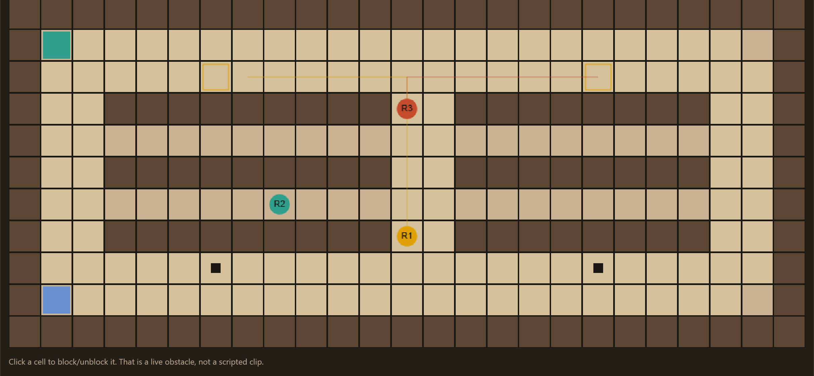
IDEA TITLE
EDGE FLEET — robots that negotiate the aisle instead of waiting for a scheduler
«Team Name»
If the control room dies, the aisle should not. Three warehouse AMRs with no central dispatcher: each robot broadcasts its own state, bids for work, detects conflict on a peer's plan and yields by an explainable rule — so the fleet keeps moving when one robot, or the radio, misbehaves.
Proposed Solution (Describe your Idea/Solution/Prototype)
A Python 3.10+ standard-library prototype: 3+ autonomous AMRs on a Hyderabad 3PL warehouse grid, each running its own space-time A* planner and its own auction. One terminal is the clock (8 Hz); the browser dashboard is a spectator, never a controller.
Detailed explanation of the proposed solution
• Every tick each robot broadcasts PeerState — robot_id, position, velocity, current_task, planned_path, battery, priority, timestamp, status. That packet is the only channel between robots.
• Work is allocated by auction, not assignment: cost = distance + battery penalty + congestion + workload, and the lowest valid bid wins by each robot's own argmin. Tie-break on robot_id, so no referee exists.
• Conflict is detected from a peer's *broadcast* planned_path — never a central occupancy oracle — then settled locally with YIELD_QUERY / YIELD_ACK / YIELD_NACK.
• UBPA right-of-way picks who keeps the aisle; the loser reverse-plans to the nearest turnout, waits, and resumes.
• Block a cell live and the sensing robot broadcasts OBSTACLE; if a pick becomes unreachable the holder RELEASEs it and the peers re-auction.
How it addresses the problem
• Warehouse fleets are normally coordinated by one dispatcher — a single point of failure and a scaling ceiling. Put the decision inside each robot and the aisle survives the control room.
• Degraded radio is measured, not assumed (results/degradation.json): at 40% packet loss the same 6/6 jobs still finish with 0 deadlocks — just later (93–125 ticks vs 72 clean); at 70% loss only 1–5/6 jobs land.
Innovation and uniqueness of the solution
• UBPA is our own rule — score = 4.0×task_urgency + 2.0×battery/100 + 1.5×priority + 1.0×arrival_bonus; the lower score yields to a turnout. A stalemate timeout on the lower robot_id is the safety net, not the rule.
• Decentralization is *tested*, not promised: 9 unit tests fail the build if a central scheduler or a hardcoded demo winner appears.
• Nothing is inflated — improvement is null in metrics.json because the baseline never finished, so this deck quotes raw values only.
PROOF — the live floor at tick 44: three AMRs, their planned paths, and 3 of 6 tasks already done with 0 deadlocks. Captured from the running dashboard.
The three questions this PS is judged on
• Who assigns tasks? Nobody — each robot bids and independently checks who won.
• Who has right of way? The UBPA score, then robot_id.
• What if both peers hold stale state? After 8 stalemate ticks the lower robot_id yields. No central lock is ever taken.
Notes:
The argument, not the feature list. Nothing here is asserted without a measurement behind it. Say the sentence out loud: 'If the control room dies, the aisle should not.' The right-hand panel is the real dashboard at tick 44, and the three questions at the bottom right are the exact ones this PS is judged on - who assigns tasks, who has right of way, what happens with stale state. Every answer is 'locally, by the robots'. The banner strip is the running dashboard's own header, not a mock-up.

Slide 3
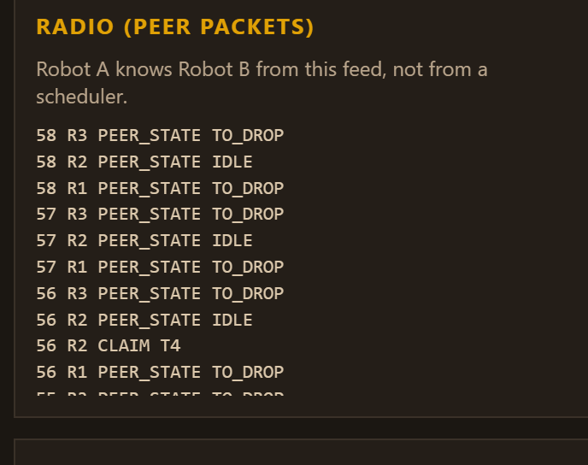
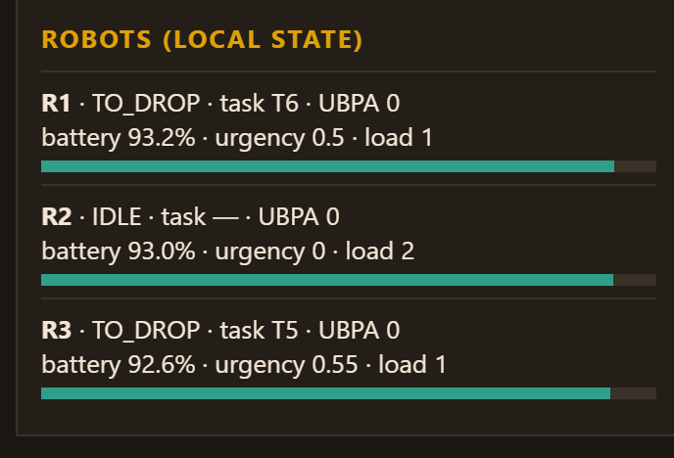
TECHNICAL APPROACH
«Team Name»
Technologies to be used (e.g. programming languages, frameworks, hardware)
Python 3.10+ standard library only — no pip install, no build step, no GPU, no cloud, no service to configure. Dashboard: vanilla HTML/CSS/JS on stdlib http.server. Storage: JSON (results/metrics.json). Radio: an in-process peer bus with drop probability and latency. Roadmap hardware: one Raspberry-Pi-class edge computer per AMR, radio becomes UDP multicast, and the same Robot.step() runs unchanged.
Methodology and process for implementation (Flow Charts/Images/ working prototype)
• Local planner: space-time A* on a 4-connected 25×11 grid; state (x, y, t); actions N/E/S/W/WAIT; peer planned_path cells become reservations; unknown future is held for HOLD_HORIZON = 4 ticks.
• Per robot, per tick: sense (SENSOR_RANGE 2) → receive broadcasts → update local peer table (stale dropped at 6) → auction / claim / release → detect conflict → UBPA negotiate → plan → emit ONE move intention → broadcast PeerState.
• Parameterised, not hardcoded: BID_WINDOW 3, LOOKAHEAD 6, STALEMATE_TICKS 8, YIELD_WAIT 6, RADIO_DELAY 1 tick, battery drain 0.18 per cell — all in simulation/config.py.
• Working prototype, measured: 3 AMRs · 6 tasks · 8 Hz · 3 experiments × 5/3 seeds · 9 unit tests · mean 0.09 ms per robot step.
THE LOOP — every robot, every tick at 8 Hz. No stage has a central caller.
SENSE
blocked cell
(range 2)
BROADCAST
PeerState
every tick
AUCTION
lowest valid
bid wins
DETECT
conflict vs
peer path
UBPA
who keeps
the aisle
REPLAN
space-time
A*
PROOF — the Radio (peer packets) panel: PEER_STATE, CLAIM and OBSTACLE traffic. This feed is the ONLY channel between robots; there is no dispatcher process.
Robot state: task, battery, status, workload — held locally by each AMR and broadcast as PeerState.
Messages on the wire: PEER_STATE · TASK_ANNOUNCE (a bulletin, never an assignment) · BID · CLAIM · RELEASE · OBSTACLE · YIELD_QUERY / YIELD_ACK / YIELD_NACK. All peer-to-peer.
Notes:
Technologies and method, all read from simulation/config.py and docs/methodology.md. Emphasise that there is no build step and no dependency: this is why it demos reliably in a room with bad Wi-Fi. The pipeline strip is the per-tick decide-act loop; the point to make out loud is that no stage has a central caller. The radio panel is the strongest single piece of evidence of decentralization: Robot A knows Robot B from that feed. 9 unit tests, 3 experiments, ~0.09 ms per robot step.

Slide 4
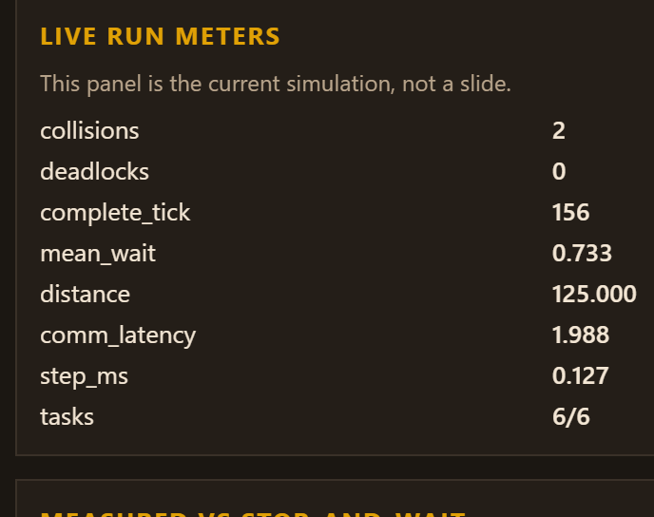
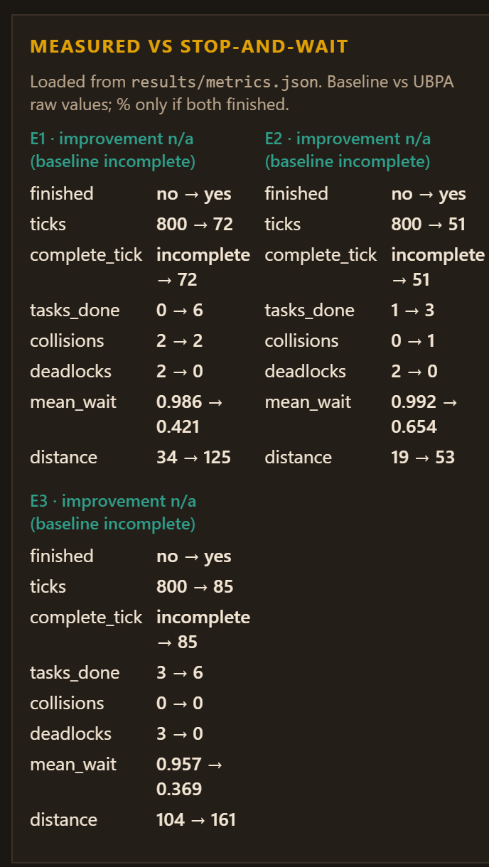
FEASIBILITY AND VIABILITY
«Team Name»
72 · 51 · 85
ticks to finish E1/E2/E3 under UBPA; stop-and-wait never finished (0/6, 1/3, 3/6 jobs inside 800 ticks).
0 deadlocks
UBPA in all three experiments. Baseline: 2 / 2 / 3 deadlocks, only 0/6 jobs done in E1.
0.09 ms
mean per-robot step time — a laptop-clock proxy for edge CPU, the only host-dependent field.
MEASURED VS STOP-AND-WAIT — read from results/metrics.json
Analysis of the feasibility of the idea
• Runs anywhere Python 3.10+ runs: no GPU, no cloud, no API key, no pip install — one command starts the clock and serves the dashboard.
• Every demo knob (policy, seed, robot count, packet loss, radio delay, live cell block) is a browser control, so one terminal can run the whole demo in a hostile room.
• Deterministic under fixed seeds: re-runs reproduce every decision metric exactly; only mean_robot_step_ms moves, because it is wall-clock.
• Edge-deployable by construction: each robot is a self-contained agent with local state and a local planner, so the laptop and the future per-AMR Pi share one code path.
Potential challenges and risks
• The radio, obstacle sensing, battery drain and edge CPU time are *simulated*: no real AMR, no Wi-Fi mesh, no on-robot inference is claimed; step time is a laptop-clock proxy.
• collision_count is 2 under BOTH policies in E1 (0 vs 1 in E2), so we claim no collision-safety win — the measured win is deadlock removal and completion.
• The failure mode is measured too: at 3 ticks of radio delay the fleet still never deadlocks, but only 3/6 E1 jobs finish and intention conflicts rise to 577 — PEER_STALE_TICKS = 6 still trusts a 3-tick-stale path. Roadmap fix: age-filter peer reservations.
• No percentage speed-up is published: the baseline never finished inside the 800-tick limit, so improvement is null and comparable is false. Tuning weights live in docs/methodology.md and are re-tuned per site.
Strategies for overcoming these challenges
• Realism ladder: swap the simulated bus for UDP multicast and the grid for a real map behind the same PEER_STATE schema, so the interface survives the hardware change.
• Deterministic safety net independent of the score: after STALEMATE_TICKS the lower robot_id yields, so stale state cannot freeze the aisle even if both peers are wrong.
• Measurements are regenerated, never typed, and the live panel shows collisions, deadlocks and complete_tick side by side with the measured baseline — including the unflattering numbers.
LIVE RUN METERS — the same simulation a judge will drive: 6/6 tasks, 0 deadlocks, finished at tick 156, 0.127 ms per robot step.
Note it also shows collisions = 2. We print the unflattering number rather than hide it.
Every value here is regenerated by python scripts/run_experiments.py — improvement is null, comparable is false.
Notes:
Feasibility and viability, including the parts we are not claiming. Be first to say that the radio, the obstacle sensing, battery drain and edge CPU time are simulated, that the kinematics is a grid, and that step_ms is a laptop clock proxy. Then the honest part that wins credibility: collisions are 2 under both policies in E1, and improvement is null because the baseline never finished - so we publish raw values and no percentage. The three cards are the only headline numbers in the deck: 72/51/85 ticks, 0 deadlocks, 0.09 ms. MEASURED panel values come from results/metrics.json; the LIVE panel is the current run in the browser and will differ tick for tick. For the radio sliders, results/degradation.json is the source: 40% loss still finishes 6/6 with no deadlock (93–125 ticks), while a 3-tick delay starves E1 to 3/6 without deadlocking - volunteer that number.

Slide 5
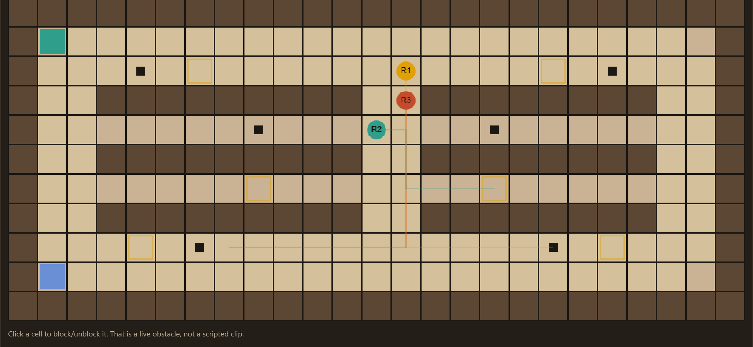
IMPACT AND BENEFITS
«Team Name»
Potential impact on the target audience
• Warehouse / 3PL operators running AMR fleets: the aisle keeps working when the fleet-management server, the Wi-Fi or one robot fails — the coordination lives inside the robots, so there is nothing central left to go down.
• Indian MSME warehouses, cold-chain and 3PL hubs (the target here is a Hyderabad 3PL floor): narrow rack aisles are exactly where a single occupancy model breaks, and where one 2-robot standoff costs a whole shift.
• Fleet integrators and AMR vendors: conflict resolution is one policy file behind the same broadcast schema, so UBPA drops into an existing stack without a dispatcher rewrite.
• The operator on the floor: click a cell or press BLOCK AISLE and the fleet re-plans around the real obstruction instead of waiting for a central map to be updated.
Benefits of the solution (social, economic, environmental, etc.)
• Economic — throughput: 6/6 tasks vs 0/6 in E1, and a blocked aisle recovered in 85 ticks instead of never. Deadlock is downtime, so removing it is the return.
• Economic — deployment: standard library only, no GPU, no cloud, no licence, no service to configure; one edge computer per robot.
• Operational — degradation is bounded and measured: at 40% packet loss the fleet still finishes 6/6 with 0 deadlocks (93–125 ticks vs 72), and at 3 ticks of delay it starves but still never deadlocks.
• Social — a safer floor: an explicit, explainable right-of-way rule plus a deterministic stalemate fallback replaces ad-hoc blocking, and every decision is visible on the peer radio feed.
• Environmental — indirect: less stalled idle running per completed task; total distance rises only because the baseline barely moves while UBPA actually finishes the work.
• Research value — the harness measures deadlocks, collisions, wait fraction, distance, communication latency and edge CPU time against a stop-and-wait baseline, so any future policy is judged on one scale.
UBPA — tick 44
STOP-AND-WAIT — tick 44
3 of 6 tasks done, 0 deadlocks, 0 stalemates. R1 and R3 met head-on and resolved it through a turnout.
0 of 6 tasks done, 2 deadlocks. R1 and R3 meet in the aisle and neither yields — the aisle is frozen.
Same seed, same map, same tick — only the conflict policy differs
• E1 throughput, 5 seeds: UBPA finishes at tick 72 with 6/6 tasks and 0 deadlocks; stop-and-wait hits the 800-tick limit with 0/6 tasks and 2 deadlocks.
• E3, aisle blocked at tick 16: UBPA recovers in 85 ticks with 6/6 tasks and 0 deadlocks; the baseline strands at 3/6 with 3 deadlocks.
• Disclosed, not hidden: collisions are 2 under both policies in E1 (0 vs 1 in E2). We claim deadlock removal and completion — not a collision-safety win.
Notes:
Impact and benefits. The side-by-side is the money shot: identical seed, identical map, identical tick - the only difference is the conflict policy. Left: 3/6 done, 0 deadlocks. Right: 0/6 done, 2 deadlocks, aisle frozen. Keep the language concrete: deadlock is downtime, so removing it is the return, and 6/6 vs 0/6 is the throughput statement. If a judge asks about distance rising for UBPA, answer it directly: the baseline's distance is low because it stops and never finishes the work. Then volunteer the collision caveat before they find it.

Slide 6
RESEARCH AND REFERENCES
«Team Name»
Details / Links of the reference and research work
• Problem statement SIH26123 — Edge-AI Based Distributed Fleet Coordination for Autonomous Mobile Robots in Smart Warehouses · Bharat Electronics Limited · Software · Theme: Robotics and Drones — sih.gov.in
• Stern, Sturtevant, Felner, Koenig, Ma, Walker, Li, Atzmon, Cohen, Kumar, Boyarski, Barták (2019), “Multi-Agent Pathfinding: Definitions, Variants, and Benchmarks”, arXiv:1906.08291 — the MAPF framing our planner sits in.
• Silver (2005), “Cooperative Pathfinding”, AIIDE-05, pp. 117–122 — the original decentralized conflict-resolution formulation our yield stage builds on.
• Sharon, Stern, Felner, Sturtevant (2015), “Conflict-Based Search for Optimal Multi-Agent Pathfinding”, Artificial Intelligence 219:40–66 — the centralized optimum we deliberately do NOT depend on.
• VDA 5050 — the industry interface standard (MQTT/JSON) between AMRs/AGVs and a master control system; it is the boundary our edge deployment would speak at, not the coordination we use.
• Warehouse AMR fleet practice — our own problem analysis of the central-dispatcher failure mode, and the Hyderabad 3PL layout (narrow rack aisles, two highways, depot and drop) used as the test floor.
Method, our own research artefacts, and how to reproduce every number
• Decentralization is enforced by test, not by promise: python -m unittest tests.test_mandatory runs 9 tests, including the two forbidden patterns — “no central scheduler” and “no hardcoded winner”.
• Every number in this deck is regenerated by python scripts/run_experiments.py into results/metrics.json (tick limit 800, fixed seeds, means across seeds). The dashboard only reads that file; no metric string is typed into the UI.
• Reproduce it: python scripts/run_demo.py (live 8 Hz, default http://127.0.0.1:8765/) · python scripts/run_experiments.py · python -m unittest tests.test_mandatory.
• Our artefacts: docs/architecture.md (what is centralized vs not), docs/methodology.md (planner, auction cost, UBPA weights, baseline), docs/evaluation.md (per-seed tables, known limitations), docs/mandatory_requirements.md (10 musts + 4 forbidden patterns).
• No improvement percentage is claimed: results/metrics.json carries improvement: null and comparable: false, because the baseline never finished inside the tick limit.
• Every screenshot in this deck is the running prototype at 127.0.0.1:8765 — no mock-ups and no re-drawn UI.
Notes:
References. Attribute the algorithms, not this deck. Stern et al. 2019 is the MAPF framing; Silver 2005 is the original decentralized conflict-resolution formulation; Sharon et al. 2015 (CBS) is the centralized optimum we deliberately do not depend on; VDA 5050 is the boundary standard our edge deployment would speak, not the coordination we use. The right column is the credibility line: anyone can rerun the experiments and the 9 tests and get the same numbers, and the two forbidden patterns are enforced by those tests.

