Slide 1
Application of Novel Metaheuristic algorithms for problem solving
Presented By
Shreya Dasgupta
UG/02/BCA/2023/015
Sayantan Golder
UG/02/BCA/2023/059
Debobrata Dutta
UG/02/BCA/2023/068
Sneha Bhowmick
UG/02/BCA/2023/070
Project Guide
Dr. Tamal Ghosh
Associate Professor, Adamas University
SCHOOL OF ENGINEERING AND TECHNOLOGY || ADAMAS UNIVERSITY || KOLKATA

Slide 2




Introduction
Optimization is the process of finding the best possible solution among feasible options while satisfying constraints. It focuses on improving efficiency, accuracy, and resource utilization, making it essential in real world problem solving. As a foundation of modern science and engineering, optimization is widely used to enhance performance, reduce costs, design efficient systems, and train Al models, aiming to achieve the most effective outcome.
Application
Optimization is widely used across many domains, it plays a crucial role in various aspects of our daily lives, impacting industries, services, and decision-making processes. Major applications of optimization through industrial revolution are:
Artificial Intelligence
& Machine Learning
Business
&
Management
Logistics
&
Transportation
Networking
&
Wireless Communication
Rise Of Nature Inspired Algorithms
Nature-Inspired Metaheuristics are optimization techniques developed to solve complex, non-linear, and high-dimensional problems where traditional methods fail. Inspired by natural phenomena like evolution, partical swarm optimization, chameleon hunting behavior, and dune formation in deserts, these algorithms are flexible and effective in finding near-optimal solutions.

Slide 3
Problem Statement
Limitation of Existing Algorithms:
Despite advancements, many traditional & nature inspired algorithms still face significant limitations. They often experience premature convergence, where the search process settles too quickly on suboptimal solutions. Over time, population diversity may decrease, reducing the algorithm’s ability to explore new regions of the search space. In addition, many methods struggle to adapt effectively in dynamic landscapes and fail to maintain a strong balance between exploration and exploitation.
Complexity of Modern Problem:
Modern optimization problems are highly complex due to high-dimensional spaces, non-linear and dynamic environment. The key challenge is to design and implement a novel metaheuristic algorithm that can overcome these issues and delivers strong performance. The algorithm must demonstrate robustness, stable convergence behavior, and the ability to escape local optima. Its overall performance must also be evaluated against well-established algorithms to assess its effectiveness.
Need for better Approach:
Limitations of existing methods demand adaptive optimization strategie. Our approach is to evalute the proposed algorithm to the CEC2017 benchmark functions and thoroughly analyze its performance. The evaluation includes testing across unimodal, multimodal, hybrid functions. The analysis focuses on convergence speed, stability, and adaptability across different levels of problem complexity.

Slide 4
Literature Review
Over the years, many optimization algorithms have been developed by studying animal behavior in nature. These animal-inspired methods use ideas like hunting, flocking, and adaptation to solve complex problems. This section briefly reviews the main approaches and their common limitations.
Category | Algorithm / Concept | Author & Year | Key Inspiration / Strategy
Swarm-Based | PSO, ACO, GWO, WOA | James Kennedy 1995, Marco Dorigo 1990, Seyedali Mirjalili 2014, Andrew Lewis 2016 | Collective intelligence and social behaviors like flocking or hunting in groups.
Predator-Prey | Lion, Cheetah, & Sharks Optimization | Seyedali Mirjalili 2015, Seyedali Mirjalili 2022, Mojtaba Yazdani 2012 | Mimicking the chase and interaction between hunters and targets.
Mimicry-Based | Cuckoo Search (CS), Firefly (FA) | Xin She Yang 2009, Xin She Yang 2008 | Animals copying others or using biological tricks to hide or attract.
Limitation Observed
Many existing metaheuristic algorithms have some common problems. They may not move steadily toward the best solution and can lose diversity in the population, which reduces exploration. They often get stuck in local optima and struggle to perform well in high-dimensional problems where the search space becomes more complex.

Slide 5
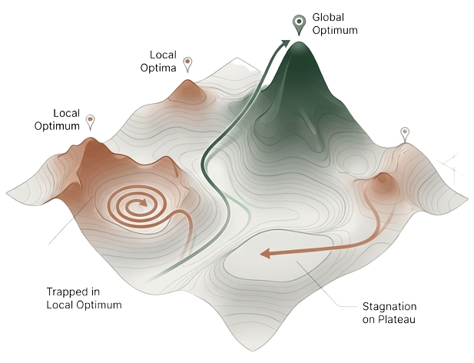



Challenges And Gaps In Current Research
Nature-inspired metaheuristics (PSO, GWO, GA) are essential for solving complex problems, mimicking effective animal behaviors like flocking and hunting.
The Challenge:
Despite their success, these "predators" often face critical challenges in complex search landscapes.
Premature Convergence
The algorithm settles on a "good enough" solution too early, losing the diversity needed to find the true global optimum.
Local Optima Stagnation
The search gets trapped in deceptive regions of the landscape, unable to escape and explore more promising areas.
Slow Adaptation
Many algorithms struggle to react when the optimal solution changes over time, a common scenario in dynamic, real-world problems.

Slide 6

The Camouflage Optimization Algorithm (COA): An Adaptive Toolkit
COA translates the biological principles of camouflage into a computational framework. Candidate solutions adjust their search behavior based on the "environment" of the optimization landscape, allowing them to blend with favorable regions and avoid poor ones.
1.Initialization (LHS)
5.Environmental
Adaptation Mechanism (EAM)
for dynamic landscapes.
2.Camouflage Density Function & Escape Risk
4.Predator Prey Co-Evolution For local Refinement
3.Dynamic Blending (Exploitation) & Escape (Exploration)

Slide 7
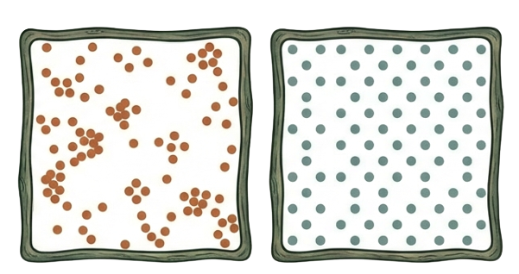

Methodology
Initialization using LHS
The algorithm starts by spreading a population of possible solutions across the entire search space. It uses Latin Hypercube Sampling (LHS) to ensure every part of the area is covered evenly from the very beginning.
Imagine people are looking for a hidden treasure in a giant park. Instead of everyone standing in one corner, LHS makes sure all team stands in a perfect grid so that no section of the park is left unsearched.
Random
Sampling.
Latin Hypercube
Sampling.
Camouflage Density Function & Escape Risk
The algorithm calculates a density score for each solution based on its distance to neighbors and its fitness. This determines the Escape Risk - how likely a solution is to be "seen" or stuck in a bad spot.
If the person is "blending in" well (high density), he stay put. If he is "standing out" too much or in a dangerous spot, the risk goes up, and he know it is time to move.
High Density
Low Density

Slide 8
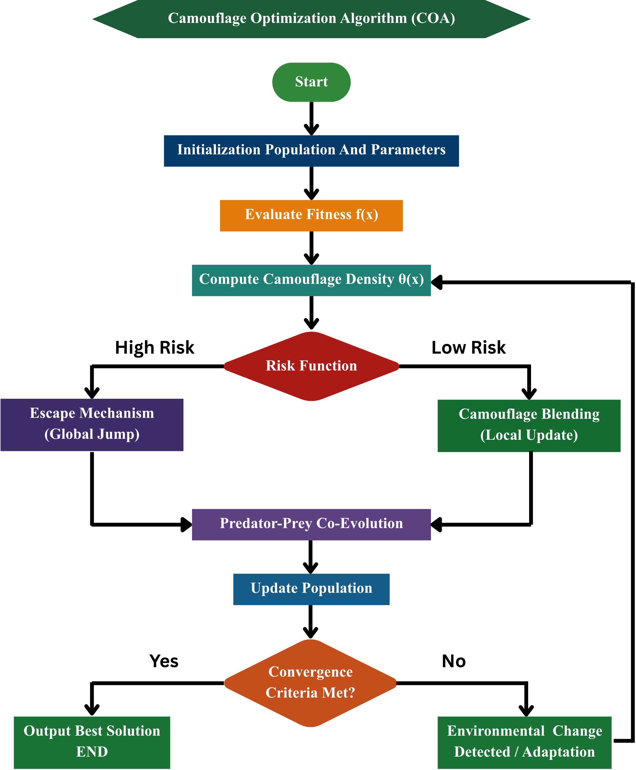
Branching Search Strategy
Based on the risk level, the algorithm chooses one of two behaviors:
High Risk (Global Jump): The solution "jumps" to a completely new part of the map to escape a trap
Low Risk (Local Update): The solution stays in the area but makes small moves to "blend" into the best nearby spot.
If a predator is about to catch the person, he sprint away to a new hiding spot (Global Jump). If he is safe then he just wiggle slightly to hide better (Local Update).
Predator-Prey Co-evolution
A small group of "predators" is added to chase the best solutions. This forces the solutions to keep improving their positions through a local search.
It is like a coach pushing an athlete to run faster. The "predator" (coach) makes sure the "prey" (athlete/solution) doesn't get lazy and keeps moving toward the finish line.

Slide 9
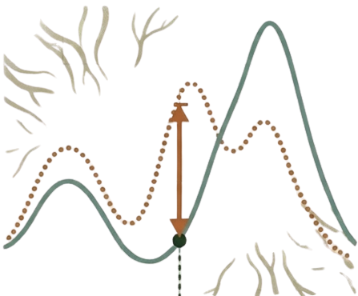
Environmental Adaptation Mechanism (EAM)
The algorithm constantly monitors the environment. If it detects that the best possible answer has moved or changed, it resets parts of the population to adapt to the new landscape.
If the park suddenly gets flooded or changed, the team doesn't keep using the old map. They look around, realize things are different, and change their strategy to fit the new ground.
New Environment
The Final Result
The Optimal Solution
Old Environment
After full operation over the iteration, we get the specific set of values (coordinates or parameters) that solve the problem with the highest accuracy.
This is the "score" of that solution, showing how close it got to the perfect answer (for example, the lowest error or highest efficiency).

Slide 10
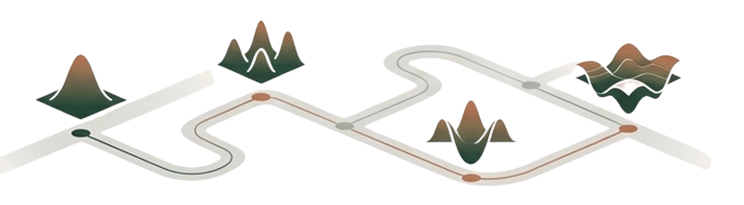
The Proving Ground
Benchmark Suite
The Competitors
Experimental Setup
The CEC 2017 test suite, a standard for evaluating optimization algorithms. (Made by Cheng et al. (2017))
COA was benchmarked against a field of seven established algorithms from different categories.
Dimension:
10
Population Size:
100
Max Iteration:
1000
Swarm Intelligence
Runs:
Function Types
10 independent runs per function
WSO, PSO, GWO, ACO
Includes unimodal, multimodal, hybrid, and composition functions to test robustness across diverse and deceptive landscapes.
Evolutionary
DE, GA
Physics Based
Usage
GSA
Functions C17-F1 to C17-F30 (excluding the unstable C17-F2).

Slide 11
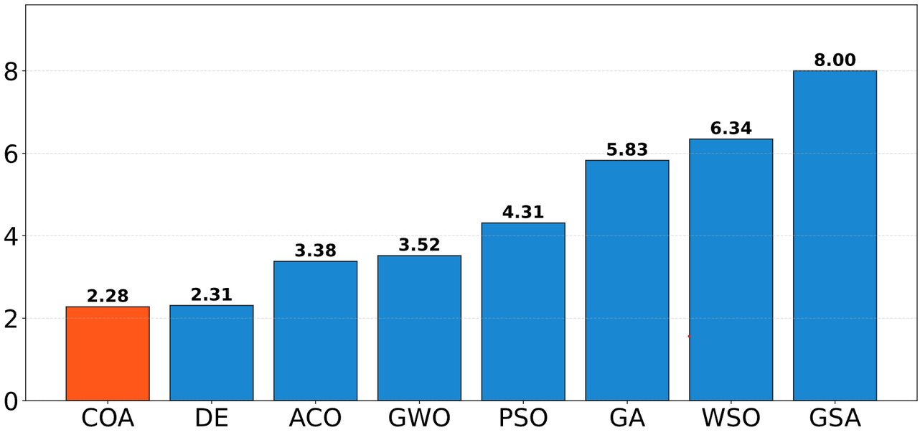
Result Analysis
Key Findings:
COA shows superior results in composition and hybrid functions.
Consistency: The algorithm achieved higher accuracy and stability compared to GA, PSO, and GWO
Note: C17-F2 was excluded from results due to unstable benchmark behavior.
Average rank
Algorithm

Slide 12
Conclusion
Powerful New Tool: The Camouflage Optimization Algorithm (COA) is a successful new method inspired by how animals change color to blend into their surroundings.
Better Performance: In extensive testing, COA consistently performed better than famous algorithms like Genetic Algorithms (GA) and Whale Swarm Optimization (WSO).
Reliable and Stable: It is very good at finding the best solution without getting "stuck" in local traps, making it a dependable choice for tough problems.
Phase 2 Plan
Rigorous Testing & Ablation Study: We will expand our evaluation to include more dimensions and a complete range of benchmark functions through F30 to analyze the specific contribution of each COA component.
Extended Dataset Scope: The project scope will be broadened to include the CEC 2014 dataset, providing a more comprehensive baseline for performance validation.
Real-world Testing: Apply the optimized COA to practical engineering problems beyond synthetic benchmark functions.
Implementation of Second Algorithm: Integrate the second planned metaheuristic algorithm for comparative analysis.

Slide 13
Reference
Cheng, G., et al. (2017). "Problem Definitions and Evaluation Criteria for the CEC 2017 Special Session and Competition on Single Objective Real-Parameter Numerical Optimization."
Grosche, T. (2008). "Foundations of Metaheuristics."
Shehab, M., et al. (2024). "Nature-inspired Metaheuristic Algorithms: A comprehensive review."
Joseph, R. (2000). "Chameleons and camouflage."
Escobar-Cuevas, et al. (2024). "Latin Hypercube Sampling for Initialization."
Joseph, R. (2000), "Chameleons and camouflage,".
Stuart-Fox, D., Moussalli, A. and Whiting, M. J. (2008), "Predator-specific camouflage in chameleons," Biology Letters, The Royal Society, Vol. 4 No. 4, pp. 326-329
Escobar-Cuevas, H., Cuevas, E., Avila, K. and Avalos, O. (2024), "An advanced initialization technique for metaheuristic optimization: a fusion of Latin hypercube sampling and evolutionary behaviors," Computational & Applied Mathematics.
J. Kennedy and R. C. Eberhart, “Particle Swarm Optimization,” in Proc., Australia, 1995, pp. 1942–1948.
Mirjalili, S., Mirjalili, S. M., & Lewis, A. (2014). Grey Wolf Optimizer. Advances in Engineering Software, 69, 46–61. doi:10.1016/j.advengsoft.2013.12.007
Dorigo, M., Maniezzo, V., & Colorni, A. (1991). Ant System: Optimization by a colony of cooperating agents. In E. S. (Ed.), Proceedings of the European Conference on Artificial Life (pp. 134–142). Elsevier.

Slide 14
Thank You

