Slide 1
Expected Values
CS231
Dianna Xu

Slide 2
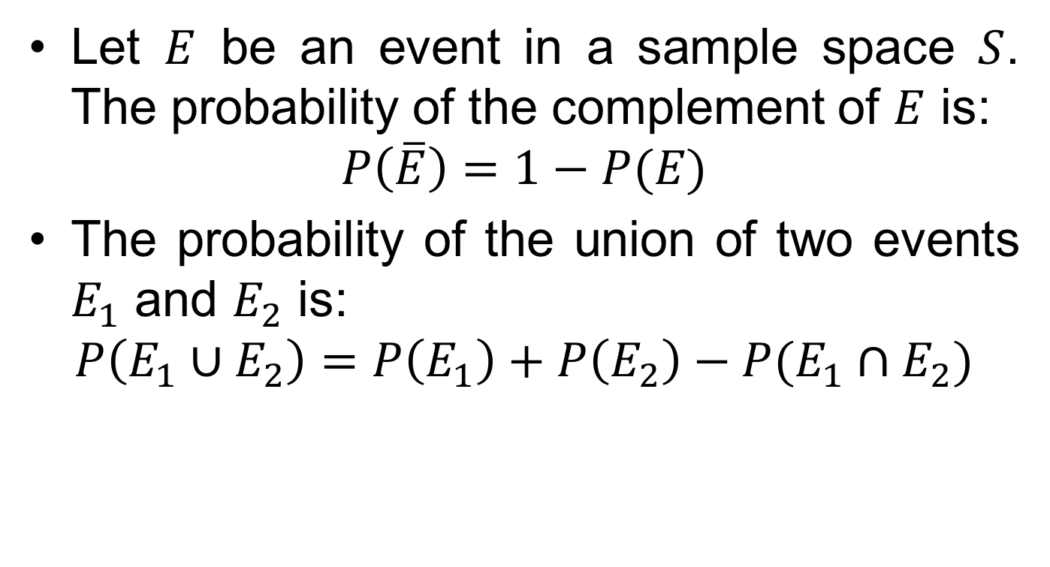
Probability Axioms
Let $E$ be an event in a sample space $S$. The probability of the complement of $E$ is:
$$P\left(\overline{E}\right)=1−P(E)$$
The probability of the union of two events $E_{1}$ and $E_{2}$ is:
$$P\left(E_{1}∪E_{2}\right)=P\left(E_{1}\right)+P\left(E_{2}\right)−P(E_{1}∩E_{2})$$

Slide 3
Example
If you choose a number between 1 and 100, what is the probability that it is divisible by 2 or 5 or both?
Let n be the number chosen
p(2|n) = 50/100 (all the even numbers)
p(5|n) = 20/100
p(2|n) and p(5|n) = p(10|n) = 10/100
p(2|n) or p(5|n) = p(2|n) + p(5|n) - p(10|n)
= 50/100 + 20/100 – 10/100
= 3/5

Slide 4
When is gambling worth it?
This is a statistical analysis, not a moral/ethical discussion
What if you gamble $1, and have a ½ probability to win $10?
What if you gamble $1 and have a 1/100 probability to win $10?
One way to determine if gambling is worth it:
probability of winning * payout ≥ amount spent per play

Slide 5
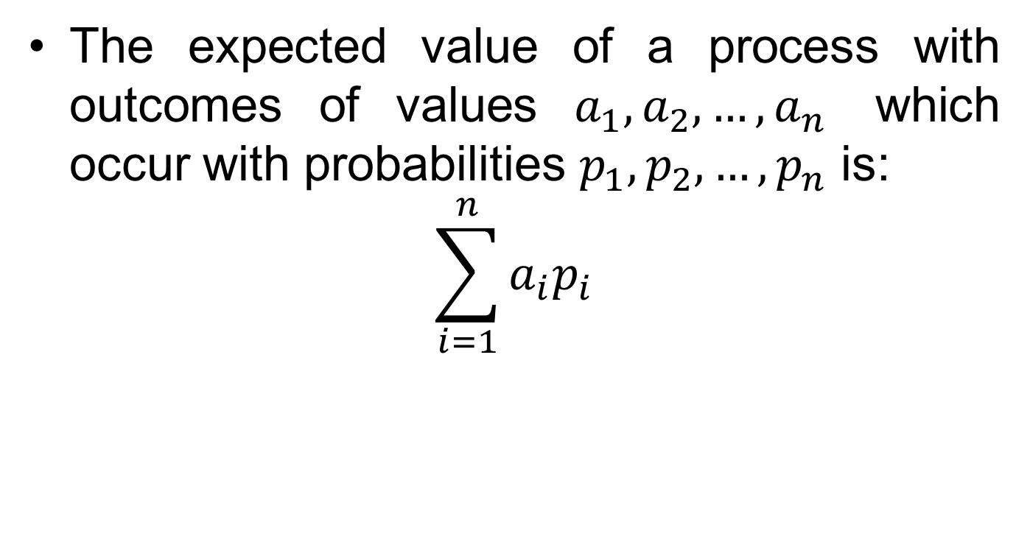
Expected Value
The expected value of a process with outcomes of values $a_{1}, a_{2}, …, a_{n}$ which occur with probabilities $p_{1}, p_{2}, …, p_{n}$ is:
$$\sum_{i=1}^{n}{a_{i}p_{i}}$$

Slide 6
Expected values of gambling
Gamble $1, and have a ½ probability to win $10
(10-1)*0.5+(-1)*0.5 = 4
Gamble $1 and have a 1/100 probability to win $10?
(10-1)*0.01+(-1)*0.99 = -0.9
Another way to determine if gambling is worth it: Expected value > 0
6

Slide 7
When is lotto worth it?
In many older lotto games (Pick-6) you have to choose 6 numbers from 1 to 48
Total possible choices (order does not matter) are C(48,6) = 12,271,512
Total possible winning numbers is C(6,6) = 1
Probability of winning is 0.0000000814
Or 1 in 12.3 million
If you invest $1 per ticket, it is only statistically worth it if the payout is > $12.3 million

Slide 8
Powerball lottery
Modern powerball lottery: you pick 5 numbers from 1-55
Total possibilities: C(55,5) = 3,478,761
You then pick one number from 1-42 (the powerball)
Total possibilities: C(42,1) = 42
You need to do both - apply the product rule,
Total possibilities are 3,478,761* 42 = 146,107,962
The probability for the jackpot is about 1 in 146 million
If you count in the other (sub)prizes, then you will “break even” if the jackpot is $121M

