Slide 1
Conditional Probability
CS231
Dianna Xu

Slide 2
Boy or Girl?
A couple has two children, one of them is a girl. What is the probability that the other one is also a girl? Assuming 50/50 chances of conceiving boys and girls.

Slide 3
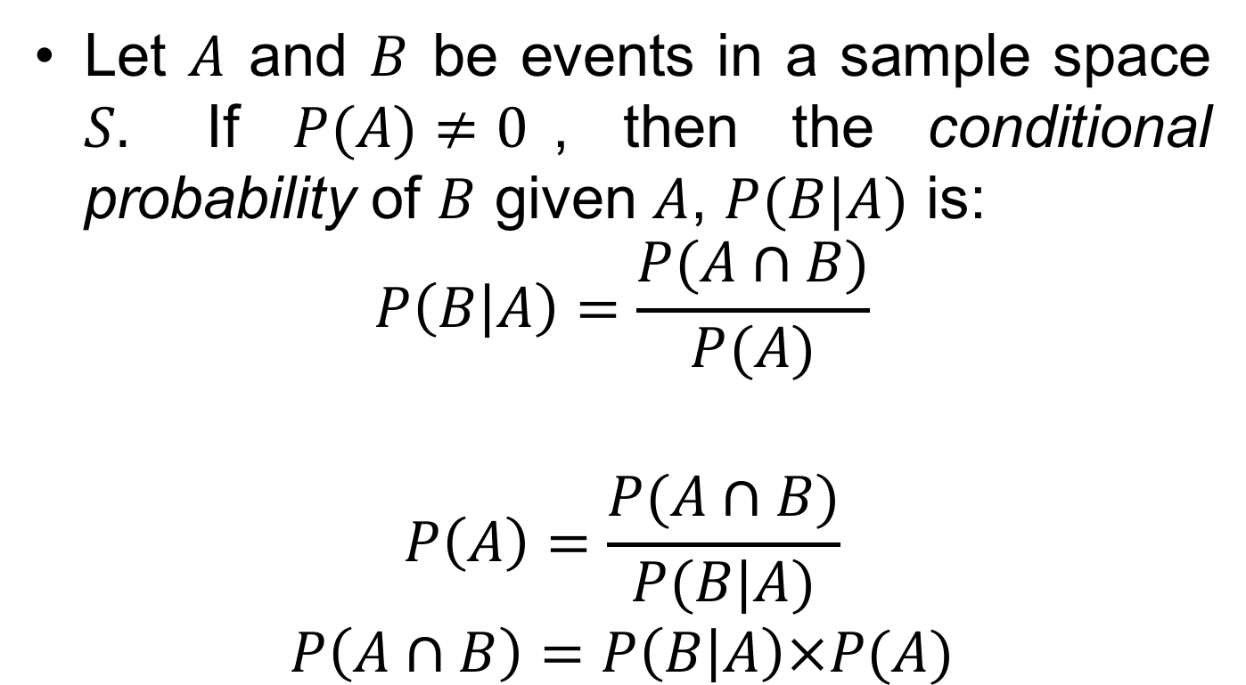
Conditional Probability
Let $A$ and $B$ be events in a sample space $S.$ If $P(A)≠0$, then the conditional probability of $B$ given $A$, $P(B|A)$ is:
$$P\left(B | A\right)=\frac{P(A∩B)}{P(A)}$$
$$P\left(A\right)=\frac{P(A∩B)}{P(B|A)}$$
$$P\left(A∩B\right)=P\left(B | A\right)×P(A)$$

Slide 4
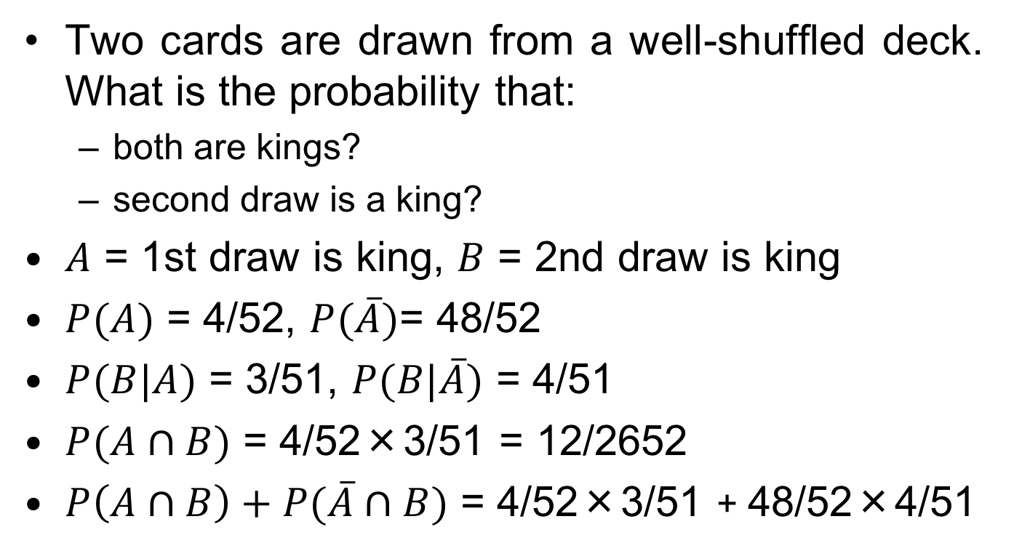
Example
Two cards are drawn from a well-shuffled deck. What is the probability that:
both are kings?
second draw is a king?
$A$ = 1st draw is king, $B$ = 2nd draw is king
$P(A)$ = 4/52, $P(\overline{A})$= 48/52
$P(B|A)$ = 3/51, $P(B|\overline{A})$ = 4/51
$P(A∩B)$ = 4/52×3/51 = 12/2652
$P\left(A∩B\right)+P(\overline{A}∩B)$ = 4/52×3/51 + 48/52×4/51

Slide 5
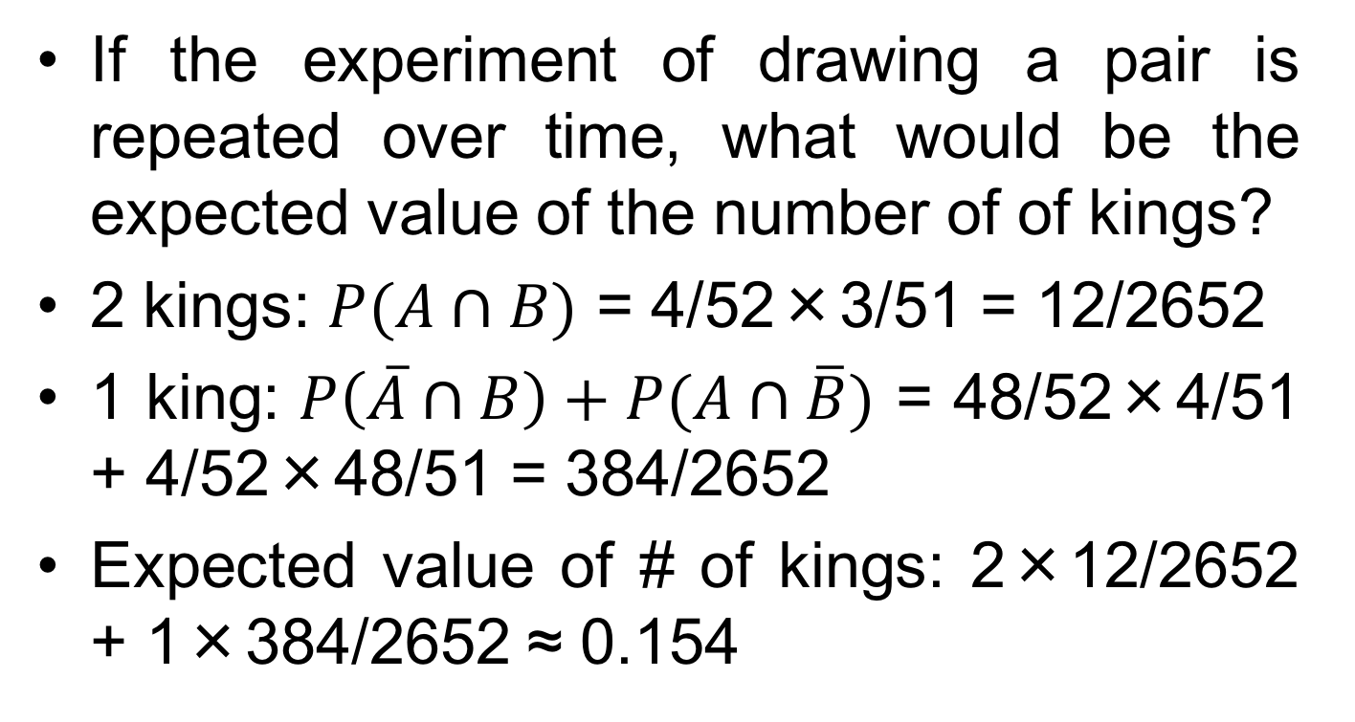
Example
If the experiment of drawing a pair is repeated over time, what would be the expected value of the number of of kings?
2 kings: $P(A∩B)$ = 4/52×3/51 = 12/2652
1 king: $P\left(\overline{A}∩B\right)+P(A∩\overline{B})$ = 48/52×4/51 + 4/52×48/51 = 384/2652
Expected value of # of kings: 2×12/2652 + 1×384/2652 ≈ 0.154

Slide 6
Example
5% of manufactured components are defective in general.
The method for screening out defective items is not totally reliable. The test rejects good parts as defective in 1% of the cases and accepts defective parts as good ones in 10% of the cases.
Given that the test indicates that an item is good, what is the probability that this item is, in fact, defective?

Slide 7
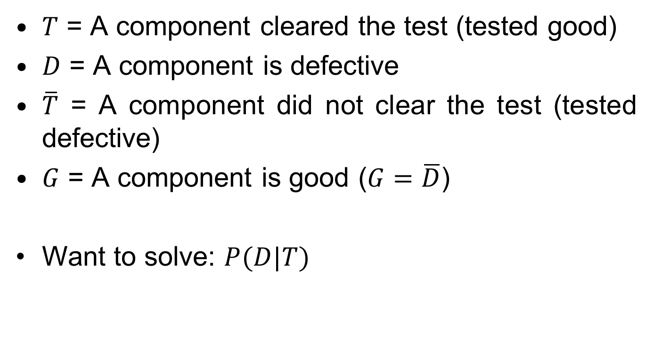
Definitions
$T$ = A component cleared the test (tested good)
$D$ = A component is defective
$\overline{T}$ = A component did not clear the test (tested defective)
$G$ = A component is good ($G=\overline{D}$)
Want to solve: $P(D|T)$

Slide 8

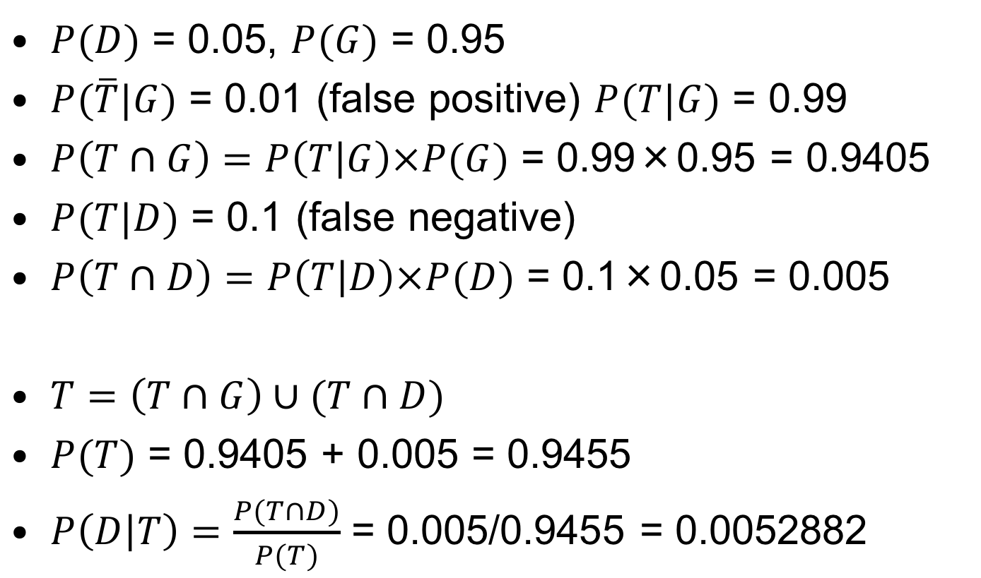
$$P(D|T)$$
$P(D)$ = 0.05, $P(G)$ = 0.95
$P(\overline{T}|G)$ = 0.01 (false positive) $P(T|G)$ = 0.99
$P\left(T∩G\right)=P\left(T | G\right)×P(G)$ = 0.99×0.95 = 0.9405
$P(T|D)$ = 0.1 (false negative)
$P\left(T∩D\right)=P\left(T | D\right)×P(D)$ = 0.1×0.05 = 0.005
$T=\left(T∩G\right)∪(T∩D)$
$P(T)$ = 0.9405 + 0.005 = 0.9455
$P\left(D | T\right)=\frac{P(T∩D)}{P(T)}$ = 0.005/0.9455 = 0.0052882

Slide 9
Medical Screening
1% of population suffer from a certain disease.
The method for screening is not totally reliable. The test reports false positive in 5% of the cases and false negative in 10% of the cases.
Given that a person has a negative test result, what is the probability that this person is, in fact, sick?
Given that a person has a positive test result, what is the probability that this person is, in fact, sick?

Slide 10
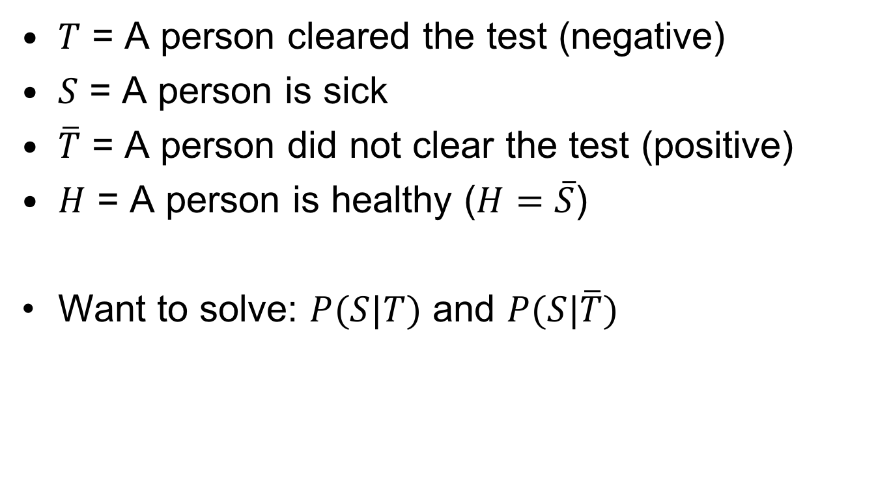
Definitions
$T$ = A person cleared the test (negative)
$S$ = A person is sick
$\overline{T}$ = A person did not clear the test (positive)
$H$ = A person is healthy ($H=\overline{S}$)
Want to solve: $P(S|T)$ and $P(S|\overline{T})$

Slide 11

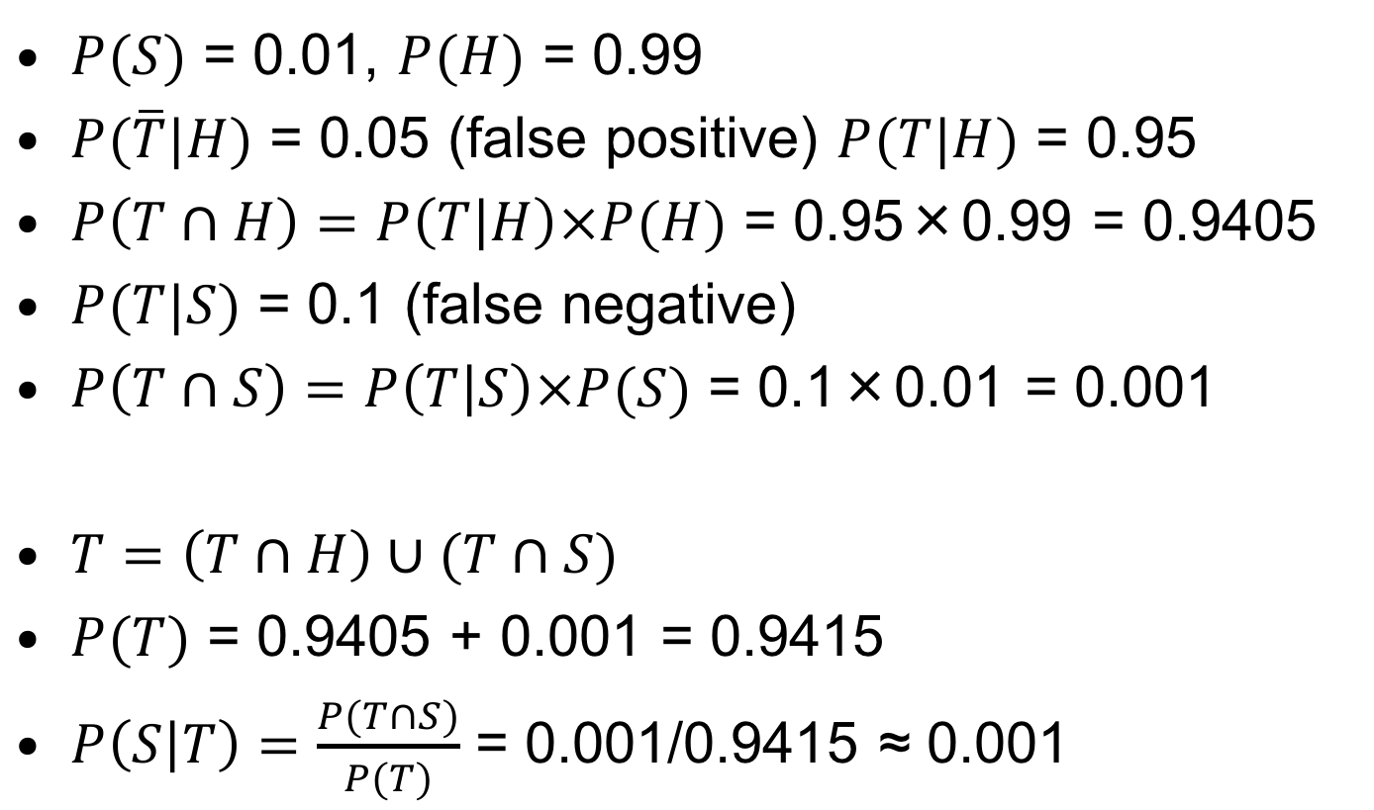
$$P(S|T)$$
$P(S)$ = 0.01, $P(H)$ = 0.99
$P(\overline{T}|H)$ = 0.05 (false positive) $P(T|H)$ = 0.95
$P\left(T∩H\right)=P\left(T | H\right)×P(H)$ = 0.95×0.99 = 0.9405
$P(T|S)$ = 0.1 (false negative)
$P\left(T∩S\right)=P\left(T | S\right)×P(S)$ = 0.1×0.01 = 0.001
$T=\left(T∩H\right)∪(T∩S)$
$P(T)$ = 0.9405 + 0.001 = 0.9415
$P\left(S | T\right)=\frac{P(T∩S)}{P(T)}$ = 0.001/0.9415 ≈ 0.001

Slide 12
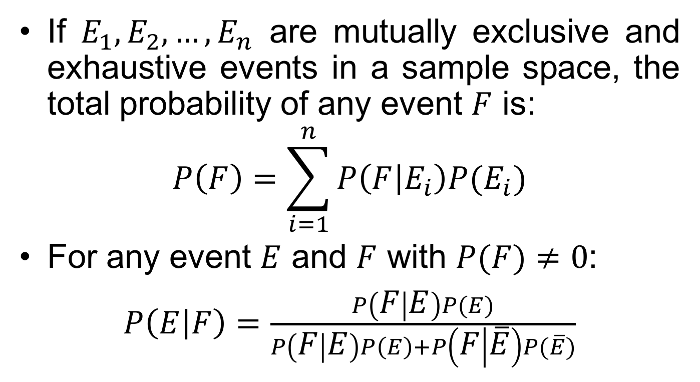
Bayes’ Theorem
If $E_{1}, E_{2}, …, E_{n}$ are mutually exclusive and exhaustive events in a sample space, the total probability of any event $F$ is:
$$P\left(F\right)=\sum_{i=1}^{n}{P\left(F | E_{i}\right)P(E_{i})}$$
For any event $E$ and $F$ with $P(F)≠0$:
$P\left(E | F\right)=\frac{P\left(F | E\right)P(E)}{P\left(F | E\right)P\left(E\right)+P\left(F | \overline{E}\right)P(\overline{E})}$

Slide 13

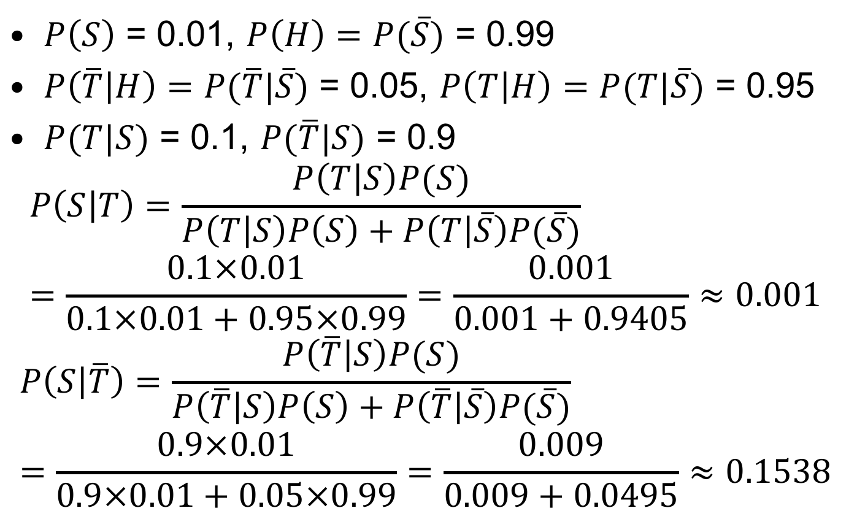
$P(S|T)$ and $P(S|\overline{T})$ with Bayes’
$P\left(S\right)$ = 0.01, $P\left(H\right)=P(\overline{S})$ = 0.99
$P\left(\overline{T} | H\right)=P(\overline{T}|\overline{S})$ = 0.05, $P\left(T | H\right)=P(T|\overline{S})$ = 0.95
$P(T|S)$ = 0.1, $P(\overline{T}|S)$ = 0.9
$$P\left(S | T\right)=\frac{P\left(T | S\right)P(S)}{P\left(T | S\right)P\left(S\right)+P\left(T | \overline{S}\right)P(\overline{S})}=\frac{0.1×0.01}{0.1×0.01+0.95×0.99}=\frac{0.001}{0.001+0.9405}≈0.001$$
$$P\left(S | \overline{T}\right)=\frac{P\left(\overline{T} | S\right)P(S)}{P\left(\overline{T} | S\right)P\left(S\right)+P\left(\overline{T} | \overline{S}\right)P(\overline{S})}=\frac{0.9×0.01}{0.9×0.01+0.05×0.99}=\frac{0.009}{0.009+0.0495}≈0.1538$$

Slide 14
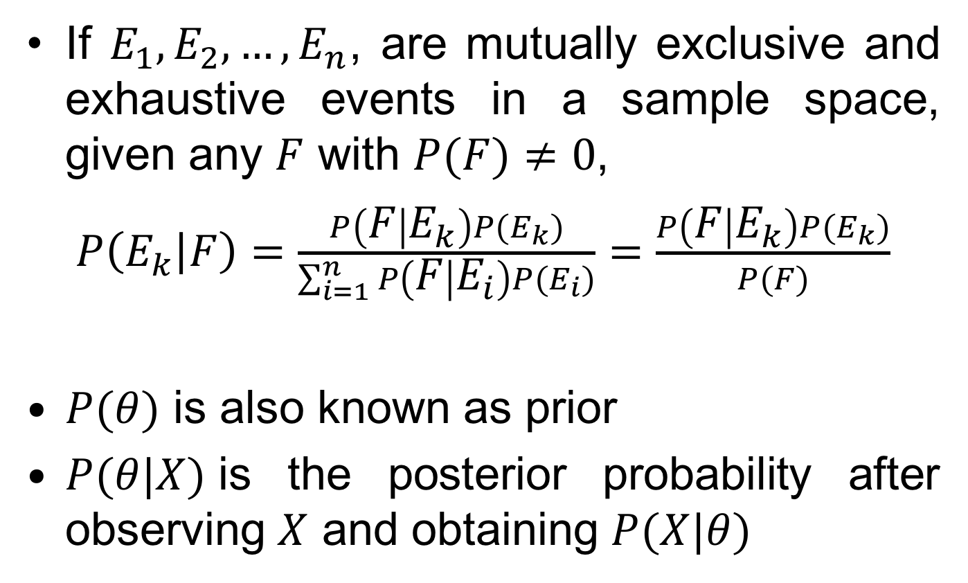
Bayes’ Theorem
If $E_{1}, E_{2}, …, E_{n}$, are mutually exclusive and exhaustive events in a sample space, given any $F$ with $P(F)≠0$,
$P\left(E_{k} | F\right)=\frac{P\left(F | E_{k}\right)P(E_{k})}{\sum_{i=1}^{n}{P\left(F | E_{i}\right)P(E_{i})}}=\frac{P\left(F | E_{k}\right)P(E_{k})}{P(F)}$
$P(θ)$ is also known as prior
$P(θ|X)$is the posterior probability after observing $X$ and obtaining $P(X|θ)$

Slide 15
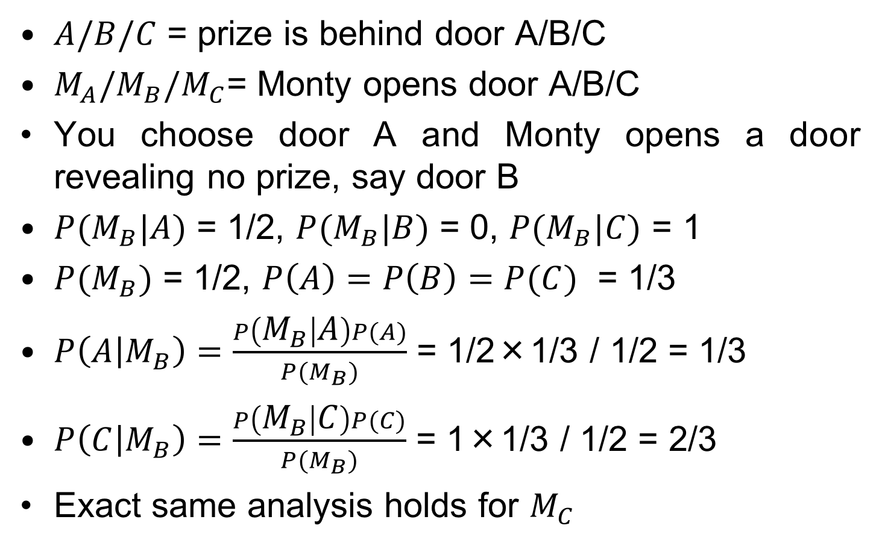
Monty Hall Revisited
$A/B/C$ = prize is behind door A/B/C
$M_{A}{/M}_{B}{/M}_{C}$= Monty opens door A/B/C
You choose door A and Monty opens a door revealing no prize, say door B
$P(M_{B}|A)$ = 1/2, $P(M_{B}|B)$ = 0, $P(M_{B}|C)$ = 1
$P(M_{B})$ = 1/2, $P\left(A\right)=P\left(B\right)=P(C)$ = 1/3
$P\left(A | M_{B}\right)=\frac{P\left(M_{B} | A\right)P(A)}{P(M_{B})}$ = 1/2×1/3 / 1/2 = 1/3
$P\left(C | M_{B}\right)=\frac{P\left(M_{B} | C\right)P(C)}{P(M_{B})}$ = 1×1/3 / 1/2 = 2/3
Exact same analysis holds for $M_{C}$

Slide 16
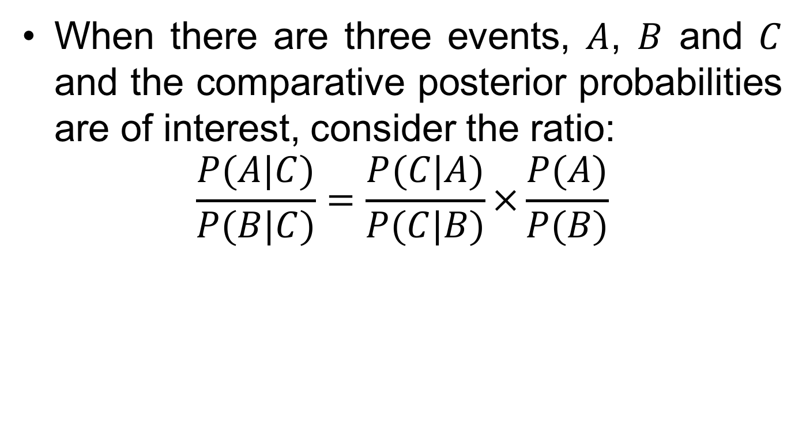
Bayes’ Ratio
When there are three events, $A$, $B$ and $C$ and the comparative posterior probabilities are of interest, consider the ratio:
$$\frac{P(A|C)}{P(B|C)}=\frac{P(C|A)}{P(C|B)}×\frac{P(A)}{P(B)}$$

Slide 17
Example
Two bags, one contains 70 red and 30 blue balls, and the other 30 red and 70 blue balls.
Choose one bag randomly and draw with replacement.
8 red and 4 blue balls are drawn in 12 tries.
What is the probability that it was the predominantly red bag that was chosen?

Slide 18
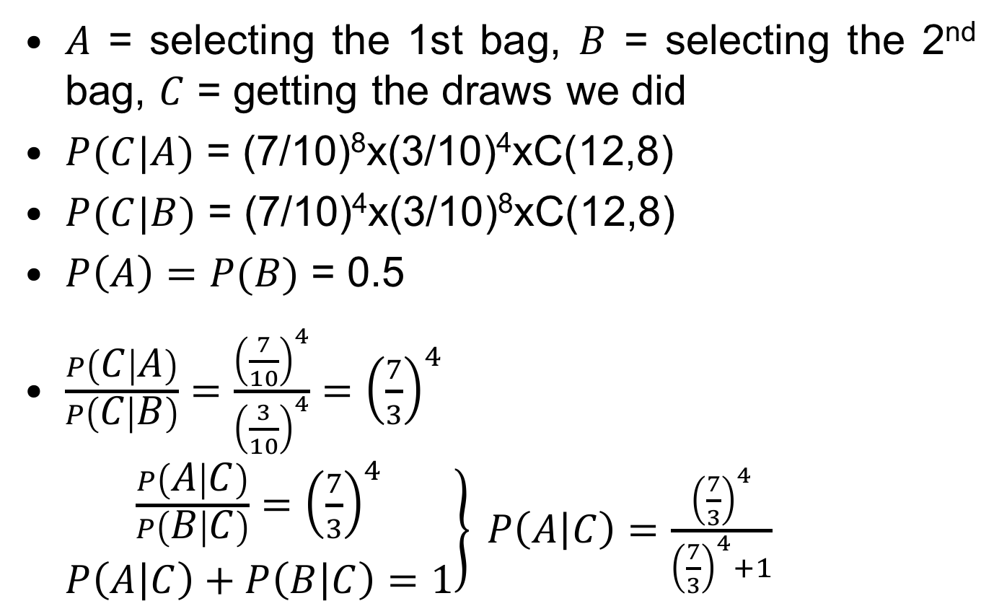
Solution
$A$ = selecting the 1st bag, $B$ = selecting the 2nd bag, $C$ = getting the draws we did
$P(C|A)$ = (7/10)⁸x(3/10)⁴xC(12,8)
$P(C|B)$ = (7/10)⁴x(3/10)⁸xC(12,8)
$P\left(A\right)=P(B)$ = 0.5
$\frac{P\left(C | A\right)}{P\left(C | B\right)}=\frac{{\left(\frac{7}{10}\right)}^{4}}{{\left(\frac{3}{10}\right)}^{4}}={\left(\frac{7}{3}\right)}^{4}$ $\left.\begin{matrix}\frac{P\left(A | C\right)}{P\left(B | C\right)}={\left(\frac{7}{3}\right)}^{4} \\ P\left(A | C\right)+P\left(B | C\right)=1\end{matrix}\right\} P\left(A | C\right)=\frac{{\left(\frac{7}{3}\right)}^{4}}{{\left(\frac{7}{3}\right)}^{4}+1}$

Slide 19
Dramatic Taxicab
A cab was involved in a hit-and-run at night.
Two cab companies operate in the city, with green and blue cabs, respectively.
85% of the cabs are green.
A witness identified the cab as blue.
The witness correctly identified the two colors 80% of the time under night-time testing.
What is the probability that the witness was right?

Slide 20
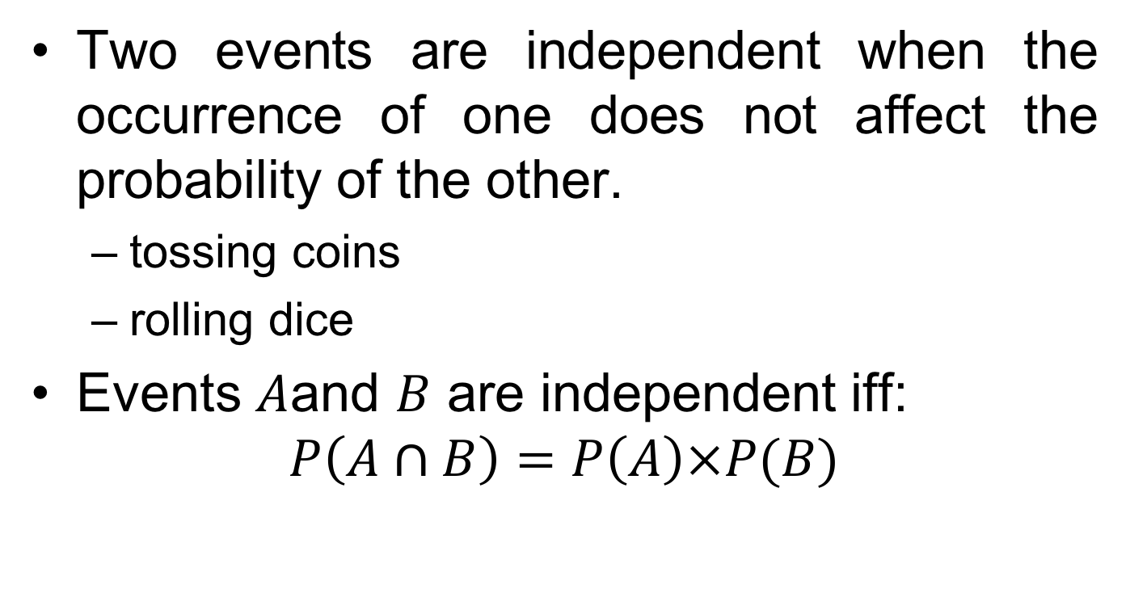
Independent Events
Two events are independent when the occurrence of one does not affect the probability of the other.
tossing coins
rolling dice
Events $A$and $B$ are independent iff:
$$P\left(A∩B\right)=P\left(A\right)×P(B)$$

Slide 21

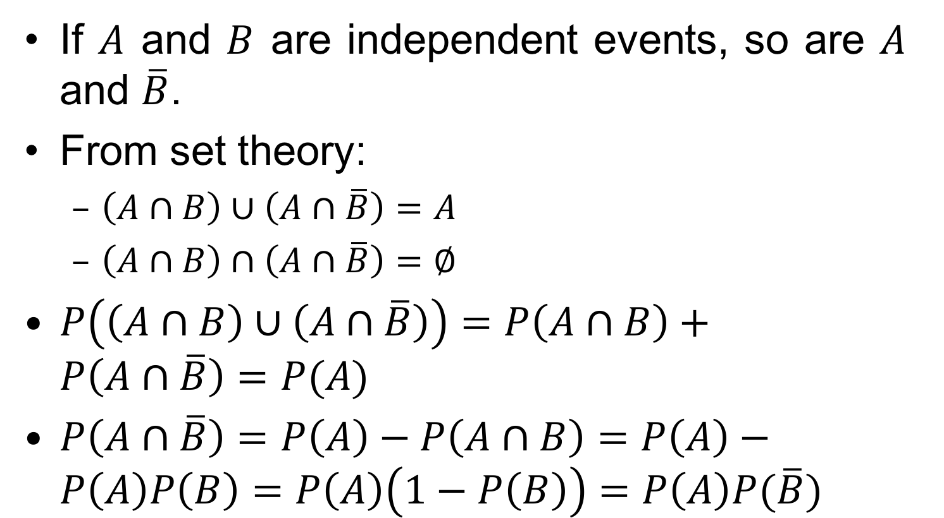
$$P(A∩\overline{B})$$
If $A$ and $B$ are independent events, so are $A$ and $\overline{B}$.
From set theory:
$\left(A∩B\right)∪\left(A∩\overline{B}\right)=A$
$\left(A∩B\right)∩\left(A∩\overline{B}\right)=∅$
$P\left(\left(A∩B\right)∪\left(A∩\overline{B}\right)\right)=P\left(A∩B\right)+P\left(A∩\overline{B}\right)=P(A)$
$P\left(A∩\overline{B}\right)=P\left(A\right)−P\left(A∩B\right)=P\left(A\right)−P\left(A\right)P\left(B\right)=P\left(A\right)\left(1−P\left(B\right)\right)=P\left(A\right)P(\overline{B})$

Slide 22
Loaded Coin
A coin is loaded so that the probability of heads is 0.6. After 10 tosses, what is the probability of obtaining 8 heads?
Consider HHHHHHHHTT
P(HHHHHHHHTT) = 0.6⁸×0.4²
How many ways can you get 8 heads with 10 tosses? – C(10, 8)
P(8 heads) = C(10, 8)×0.6⁸×0.4² ≈ 0.12

