Slide 1

Coding with
Command-line interface
CLI

Slide 2
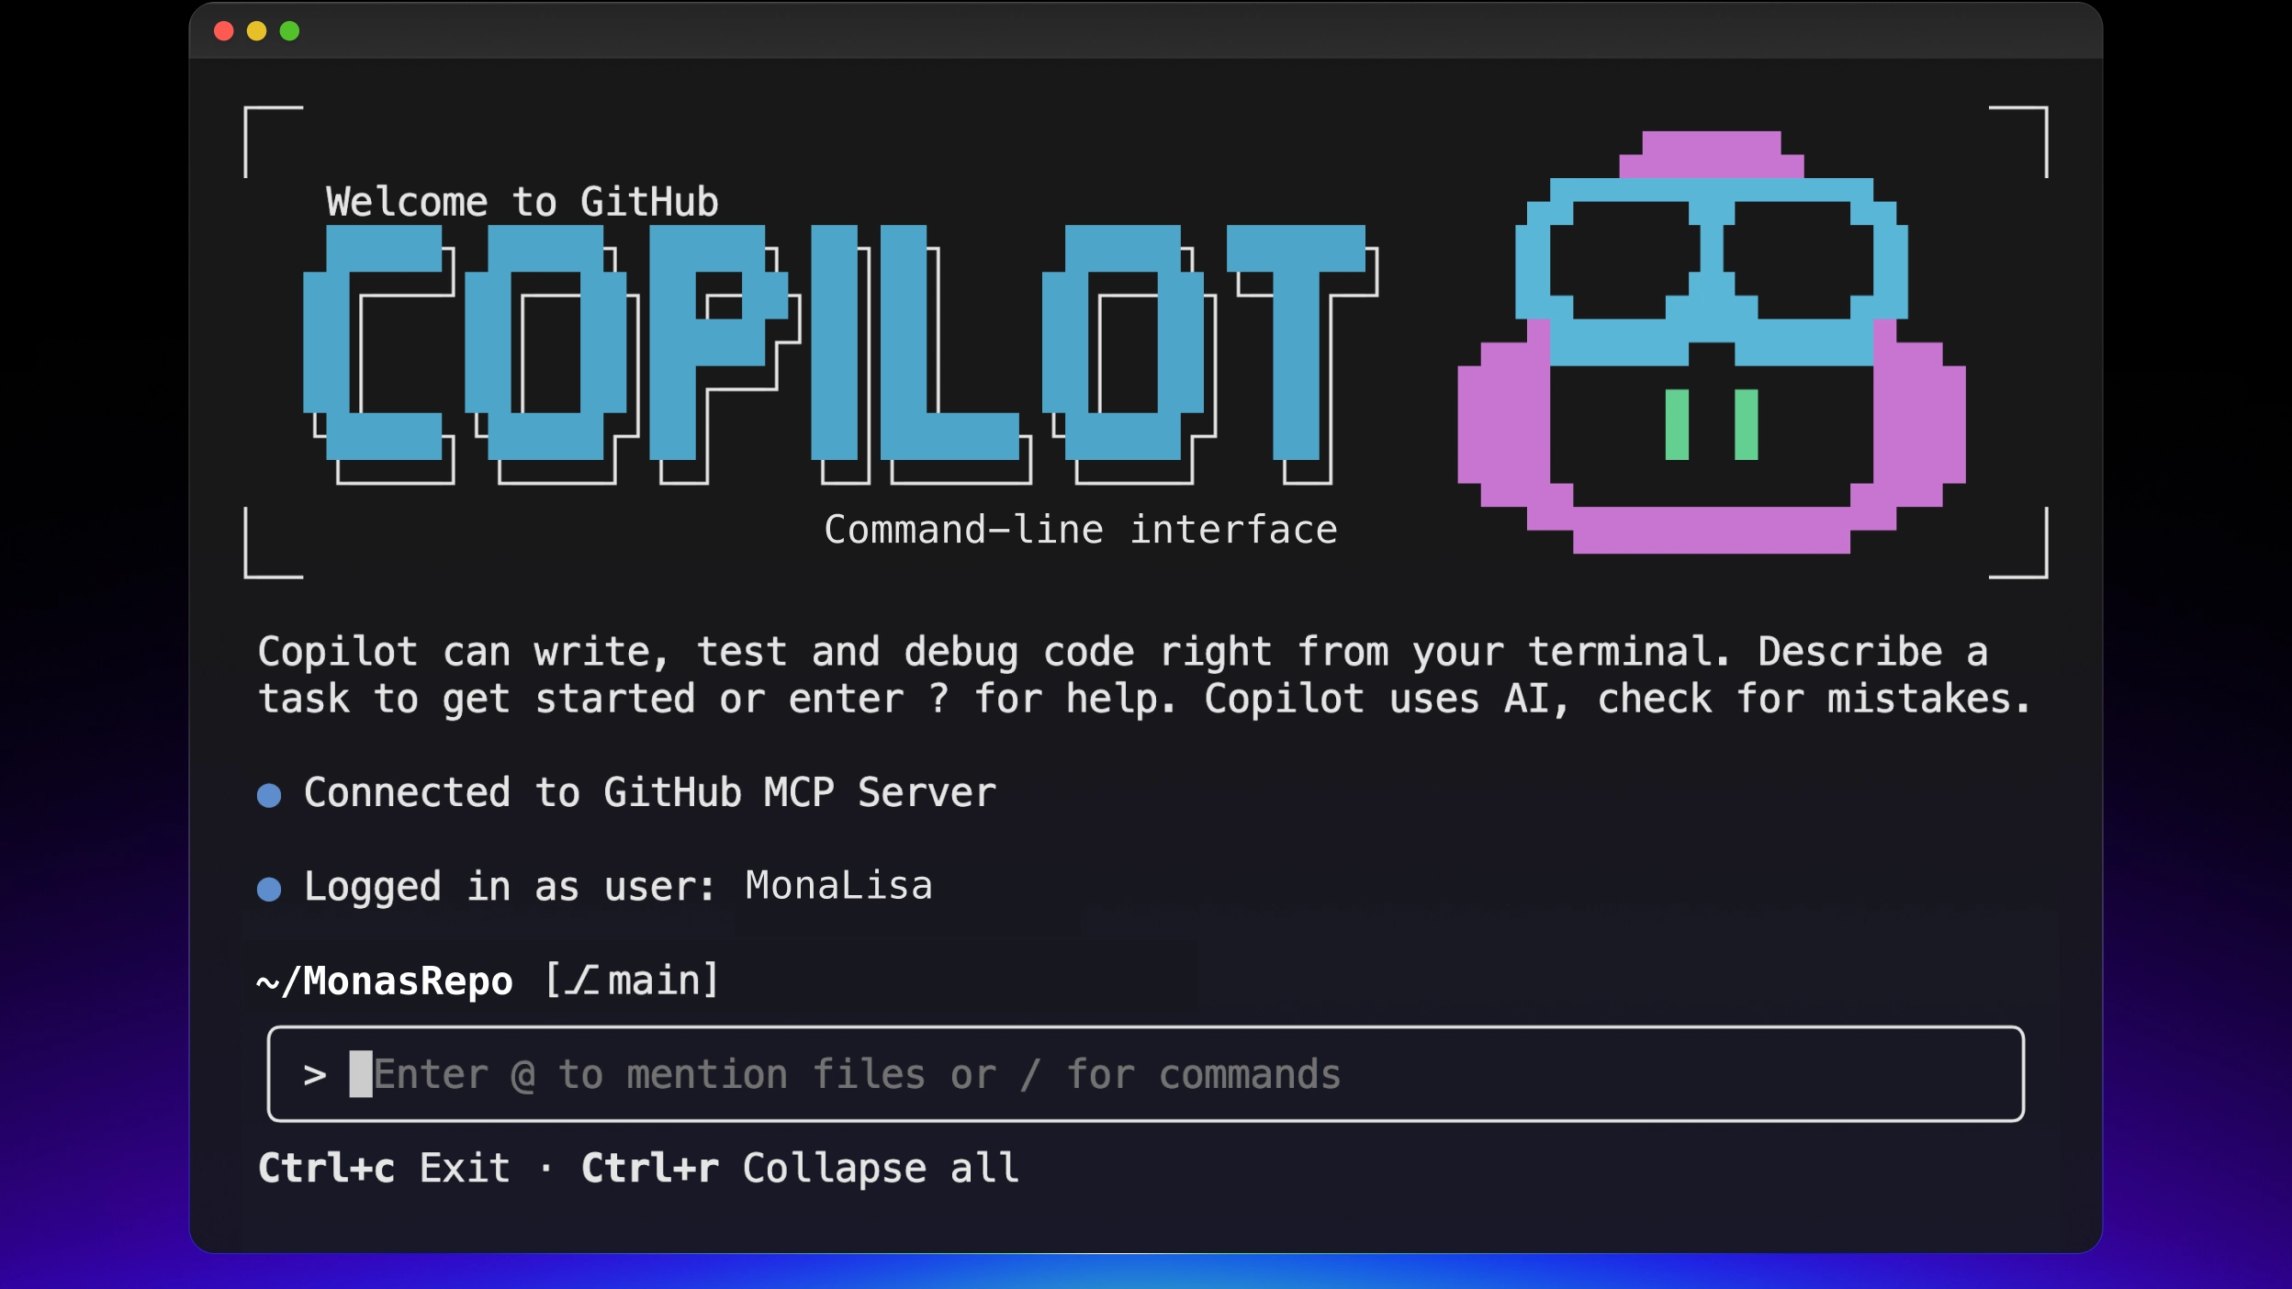




Copilot CLI
New Tab
ChatGPT
Claude
Google Gemini
GitHub
How many of you have AI open in your browser right now ?
Copilot, ChatGPT, Claude, Copilot, Gemini, chances are there's an AI tab open somewhere.
And if you're coding, you probably have a dozen other tabs open too.

Slide 3
The problem with AI in the browser
You copy your code in every single time
You explain your file structure every single time
You paste the answer back into your editor
You switch windows constantly
It never actually knows your project

Slide 4
What if your AI already knew your project?
You copy your code in every single time
You explain your file structure every single time
You paste the answer back into your editor
You switch windows constantly
It never actually knows your project

Slide 5




What is GitHub Copilot CLI?
Runs in your terminal
Plain English prompts
No browser, no editor plugin (just your terminal)
Describe what you want (no commands to memorize)
Knows your project
Built by GitHub
Reads your files, structure, and database automatically
Part of Microsoft (free to start with a GitHub account)

Slide 6
How it works
1
2
3
4
You type a prompt
Copilot reads your project
AI generates a response
You review and apply
→
→
→
Plain English, in your terminal
Files, structure, database — all of it
Code, commands, or documentation
Approve, edit, or ask again

Slide 7






What can you do with it?
Query databases
Build apps
Generate docs
Connect and explore in plain English
Scaffold, wire up, and run projects
README, CHANGELOG, SECURITY files
Write tests
Security audits
Fix & refactor
Unit tests for your existing code
Spot vulnerabilities instantly
Debug and improve your codebase
AND MORE

Slide 8
You're in control
Claude Sonnet 4.5
GPT-4.1
Claude Opus
Your own model
Default
Powerful
Premium
Custom
> /model — switch AI model at any time during your session
CUSTOMIZATION
Custom instructions
MCP servers
Give Copilot context about your project once — not every session
Connect Copilot to your own data sources and tools
Custom agents
Copilot Memory
Specialized versions of Copilot for specific tasks
Remembers your conventions and preferences across sessions

Slide 9
TODAY'S WORKSHOP
Connect → Build → Document
Connect → Build → Document
Using nothing but plain English prompts, we will connect to a real database,
build a working web app and generate documentation.
Real database
Working web app
Full documentation
Chinook SQLite
ASP.NET Razor Pages
README + security audit

Slide 10
Four tutorials, one complete project
0
1
2
3
Setup
Connect
Build
Document
Install GitHub Copilot CLI and get your environment ready.
Connect to the Chinook SQLite database and explore its data.
Build a full CRUD web app using ASP.NET Razor Pages.
Generate docs, run a security audit, and plan version 2.
→
→
→

Slide 11
Tutorial 1 — Connect
The Chinook database
A sample digital music store — 11 tables of real data.
chinook.sqlite — schema
Artist
Album
Track
Genre
MediaType
Playlist
PlaylistTrack
Customer
Employee
Invoice
InvoiceLine
> Connect to the Chinook.sqlite database using DataSource=Chinook.sqlite;Cache=Shared;

Slide 12
Tutorial 2 — Build
What we'll build
A working ASP.NET Razor Pages web app — built entirely with prompts.
1
Create the project
A new ASP.NET Razor Pages app with .NET 10
2
Connect the database
Entity Framework Core wired to Chinook.sqlite
3
Scaffold CRUD pages
Add, edit, delete, and list genres from the database
4
Apply a theme
Bootswatch Sketchy — hand-drawn, fun, unique
4 prompts. A working app.

Slide 13
Tutorial 3 — Documentation
The app is built. Now let Copilot document it.
Audit it. And plan what's next.
1
Generate fake data
Insert 10 sample genres directly into the database
2
Generate a README
Full project documentation with setup instructions
3
Run a security audit
Spot vulnerabilities — saved to SECURITY.md
4
Plan version 2
Ask Copilot what to build next and how long it would take
> Review the project for security vulnerabilities and document findings in SECURITY.md

Slide 14
BONUS DEMO
Squad
Squad
What happens when Copilot isn't just one agent?
Specialized agents
Each agent has a defined role — Lead, Backend, Frontend, Testing, DevOps
They collaborate
Agents hand off tasks, wait on each other, and review each other's work
You just prompt once
Ask for a feature — Squad figures out who does what
Autopilot mode
Let it run autonomously until completion, then review the result
Experimental — but a glimpse of where development is going.

Slide 15
Let's get started.
Let's get started.
Open your terminal. Type copilot. Start prompting.
resources
Workshop repo → github.com/goldfish047/copilot_cli_workshop
Copilot CLI docs→ docs.github.com/en/copilot
Squad repo → github.com/bradygaster/squad
Connect → Build → Document

Slide 17
Copilot can write, test and debug code right from your termina. Describe a task to get started or enter ? for help. Copilot uses AI, check for mistakes.
Connected to GitHub MCP Server

Slide 18
Copilot CLI
New Tab
ChatGPT
Claude
Google Gemini
GitHub

