Slide 1
Open Hardware Design for
BusKill Cord
Presented at DEFCON32 Demo Lab by Melanie Allen AKA @goldfishlaser
CC-BY-SA

Slide 2


Who is ?
Founder
Michael Altfield <michaelaltfield.net>
Contributors
Sam <youtube.com/@samxplogs>
Steven Johnson <linkedin.com/in/sj2019/>
Jacob Neplokh <jacobneplokh.com/>
François Marier <fmarier.org/>
Cyberkryption <github.com/cyberkryption>
Links
@BusKill@mastodon.social
https://docs.buskill.in

Slide 3
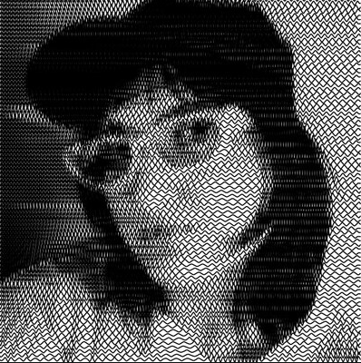
Who am I?
Ex-BusKill Lead 3D-Printing Developer (Volunteer)
@goldfishlaser
Melanie Allen <mnallen.net>

Slide 4
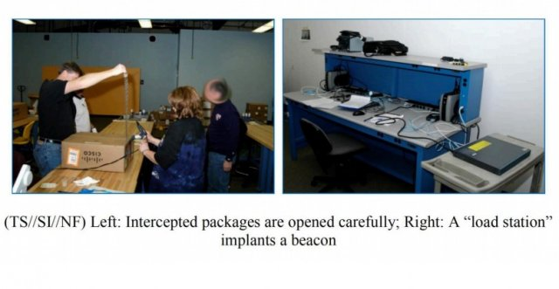
Project Goal
Create a design for BusKill that is suitable for decentralized, home lab manufacture using 3D printing and easily sourced parts to avoid interdiction for high risk individuals such as journalists, activists, and whistleblowers.
In 2013, TAO infected 85,000 computers/routers, and they were targeting to increase that to millions
(Source)

Slide 5
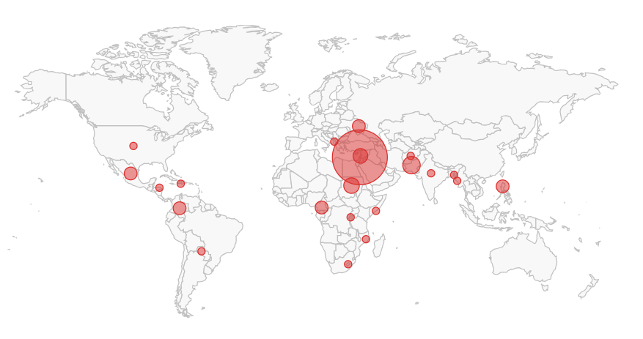
Project Goal
140 Journalists and Media Workers killed between 2023 and 2024 / Motive Confirmed or Unconfirmed
(Source)

Slide 6
Purpose
Allow high risk individuals a method to quickly secure sensitive information when separated from their laptops

Slide 7
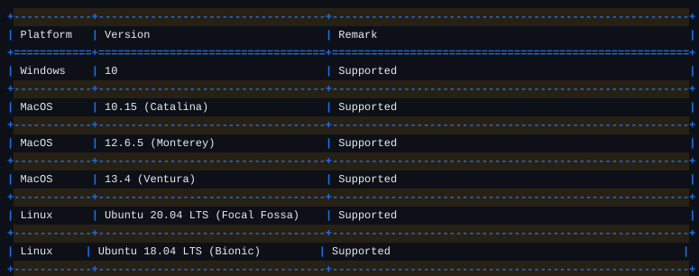
BusKill Software Capabilities
Lock screen and soft shutdown works in Windows, Mac, and Linux
Self destruct works in Linux only

Slide 8
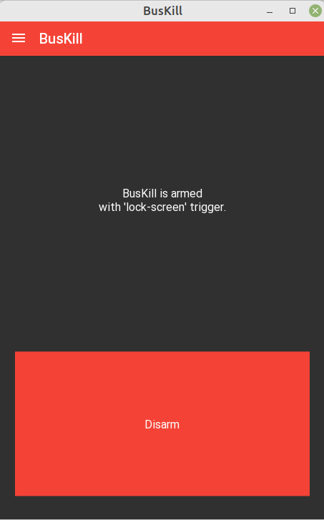
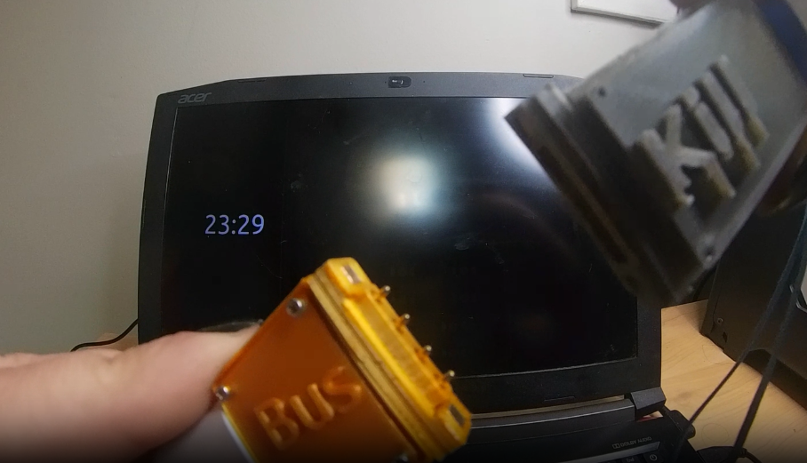
BusKill Software Capabilities
Lock the computer

Slide 9
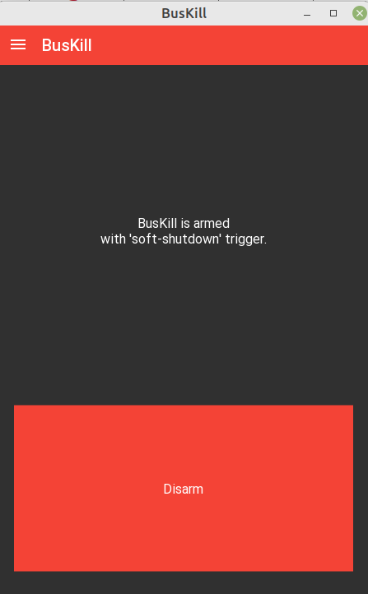
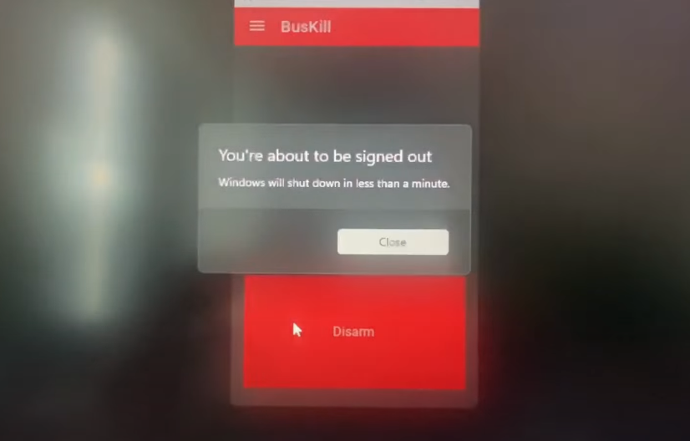
BusKill Software Capabilities
Shut down the computer

Slide 10
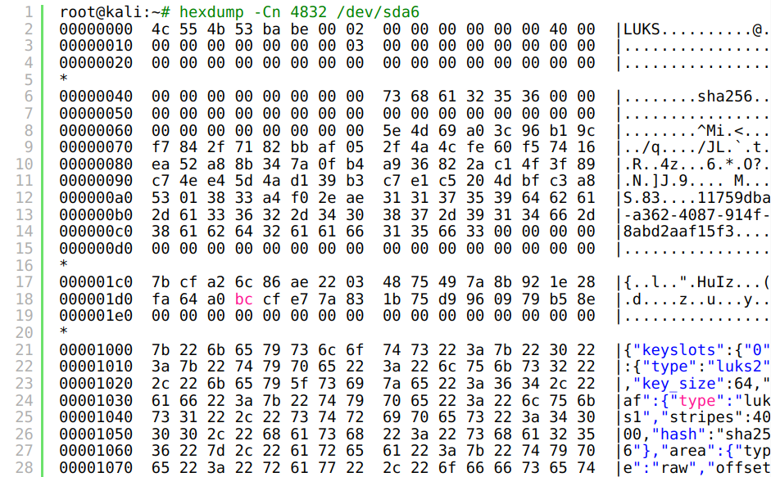

BusKill Software Capabilities
Shred your keys

Slide 11
Qubes
BusKill was originally designed to work for Qubes and works with a simple udev command
There’s no GUI for Qubes OS but there’s an installation guide in this article.

Slide 12
BusKill Hardware Requirements
Suitable for home manufacture
Can disassemble and inspect
Doesn’t block other USB ports
Separates easily, yet not have false positives

Slide 13
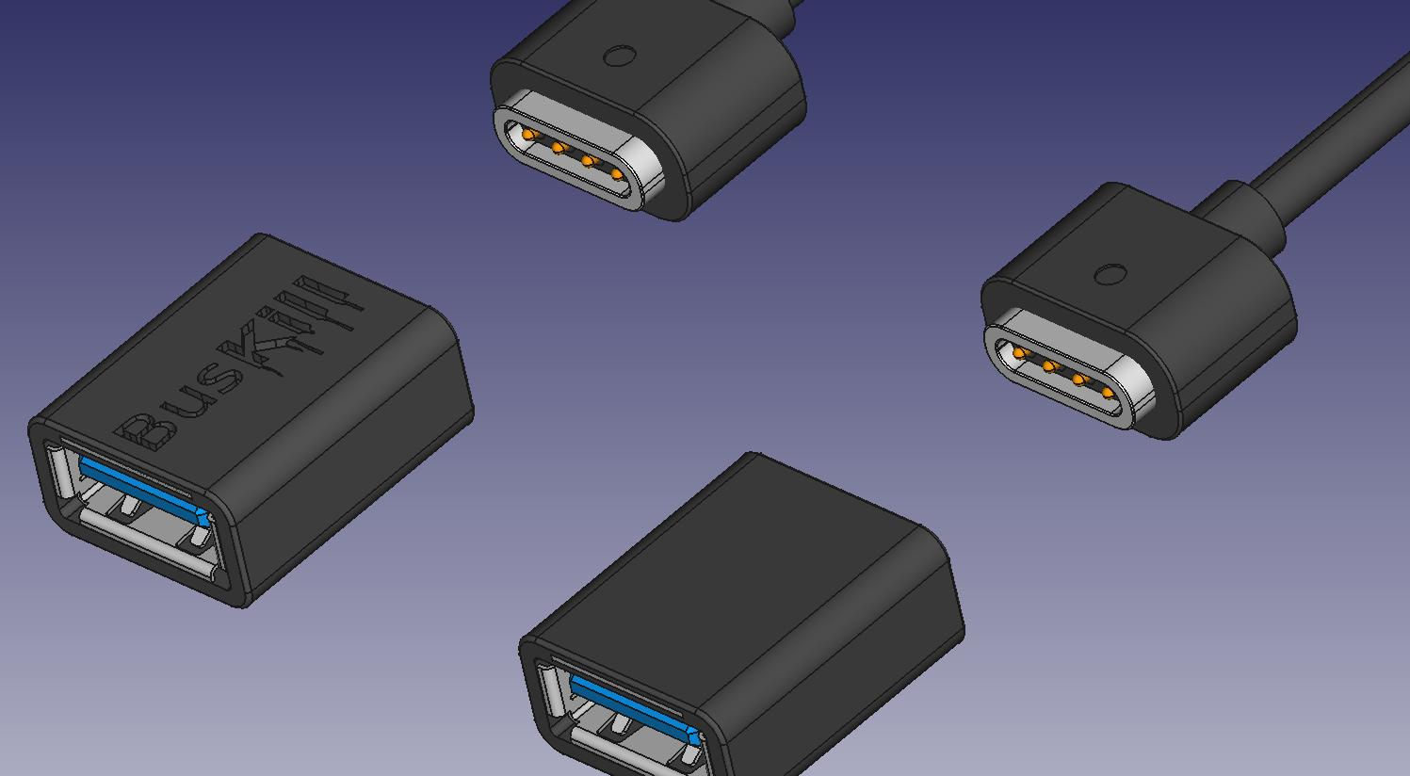
Manufactured Version
Engineering drawings available on github
For purchase on buskill.in

Slide 14
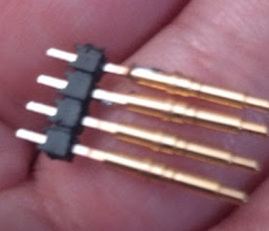
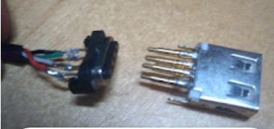
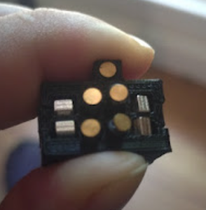
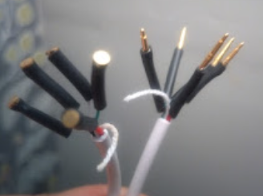
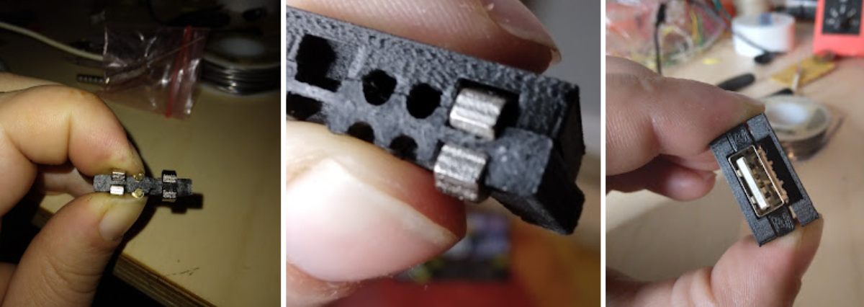
Hardware Development History
How do we do this?!

Slide 15
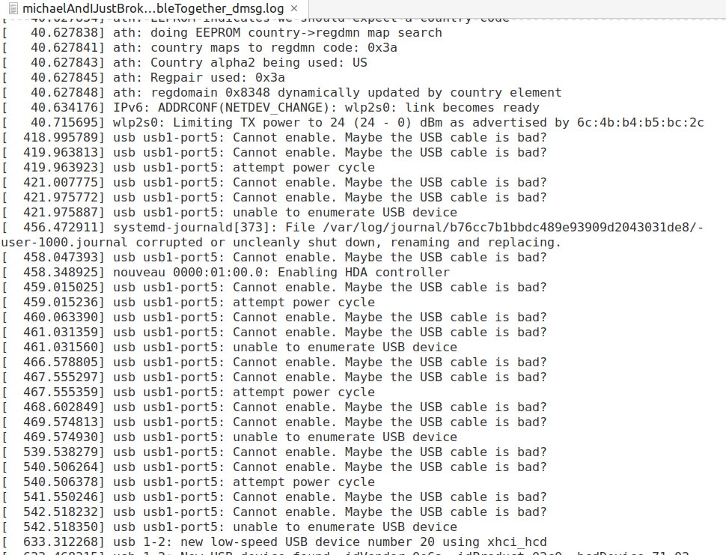
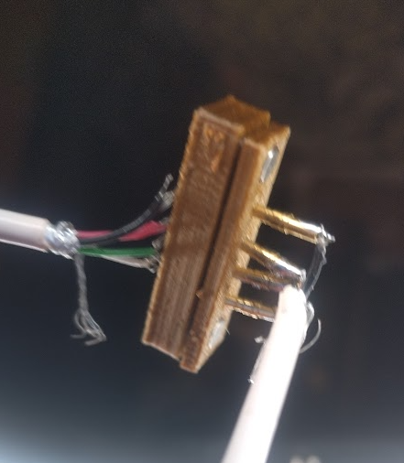
Hardware Development History
That time we killed a USB drive

Slide 16
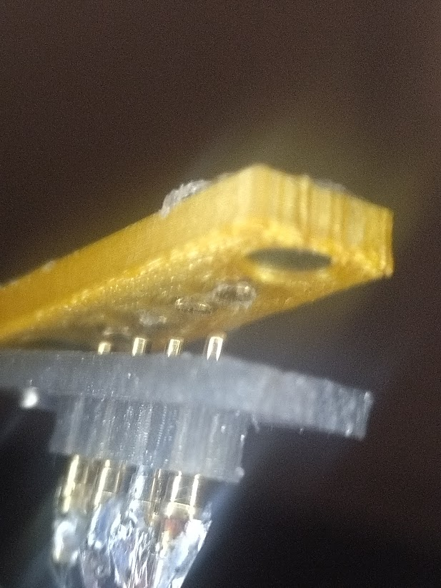
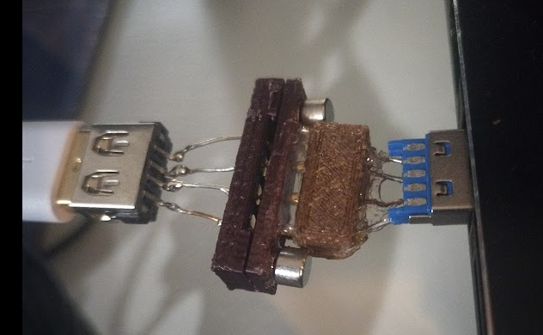
Hardware Development History
Magnets, how do they work?

Slide 17
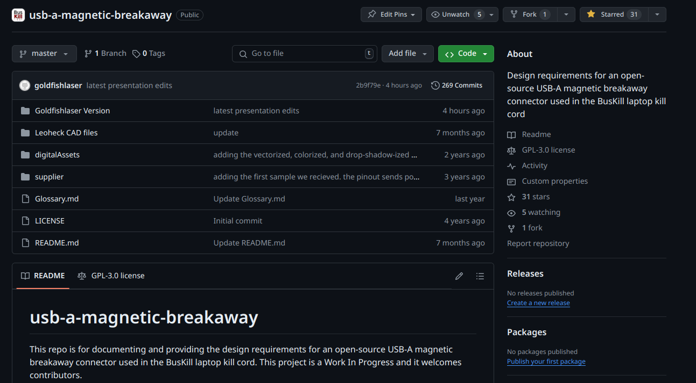
3D-Printed “Goldfishlaser Version”
BusKill repo has older files and history documented on Issue#2

Slide 18
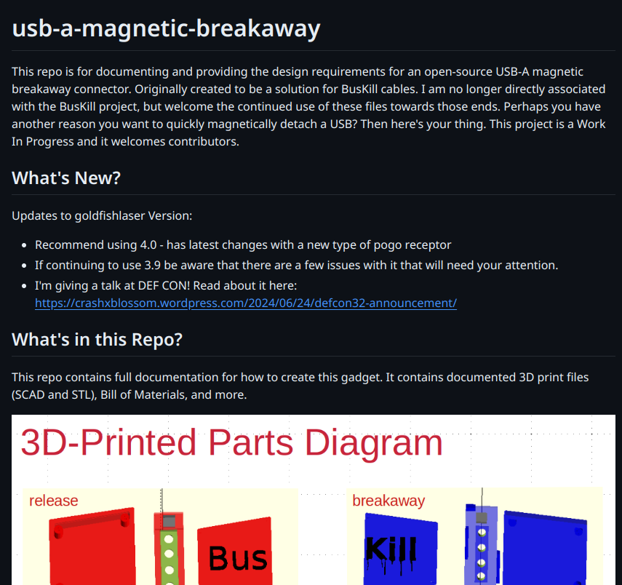
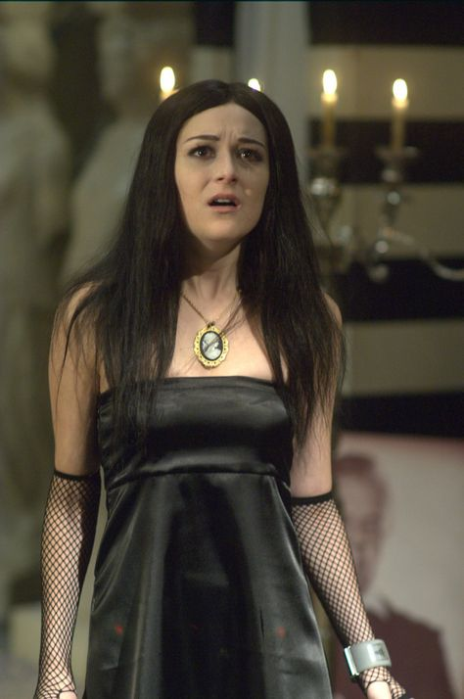
Repo! The Generic Opera
Since I’m no longer affiliated with BusKill, latest files are here:
https://github.com/goldfishlaser/usb-a-magnetic-breakaway/tree/master

Slide 19
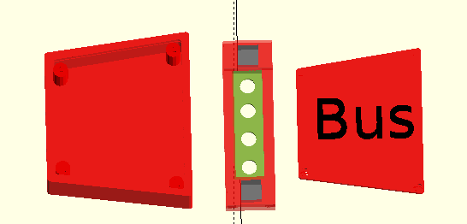
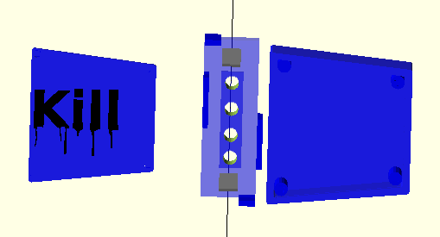
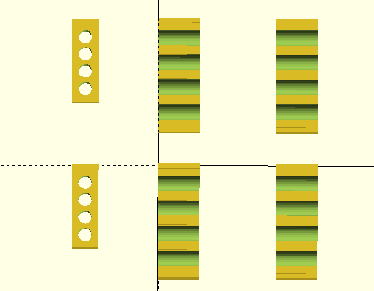
3D-Printed Parts Diagram
release
breakaway
body
face
lid
lid
face
body
Wire jigs

Slide 20
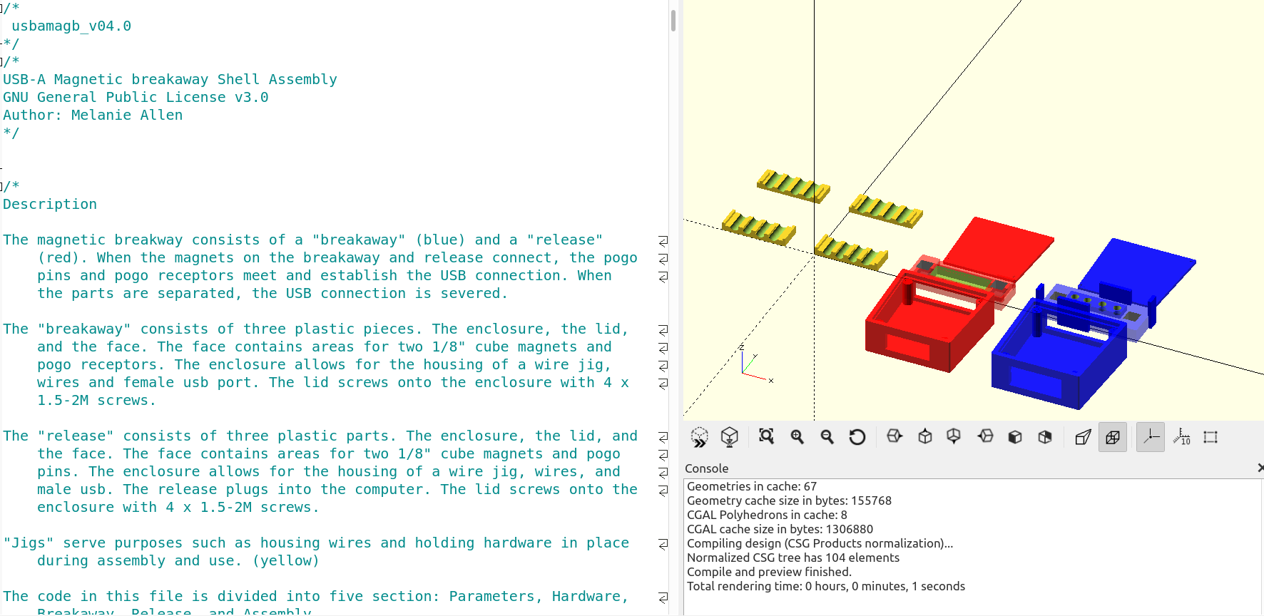
OpenSCAD Code Tour
Built in OpenScad

Slide 21
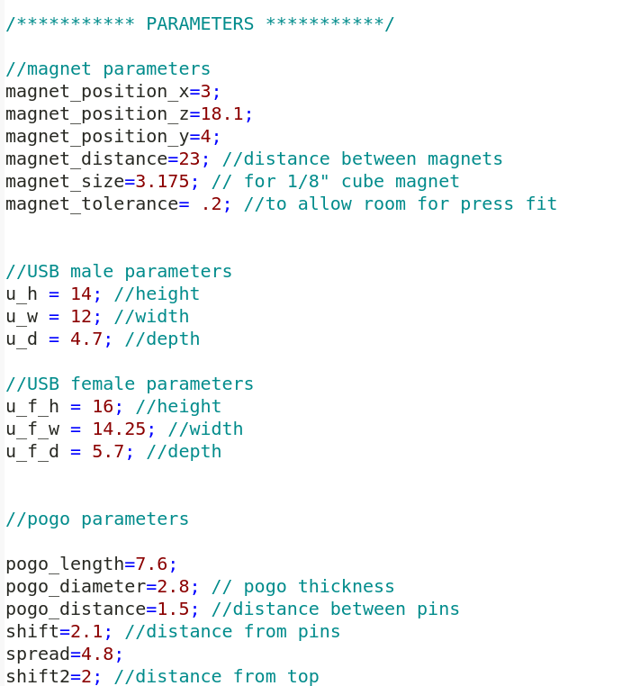
OpenSCAD Code Tour
Parameters and hardware sections for editing components and wire jigs

Slide 22
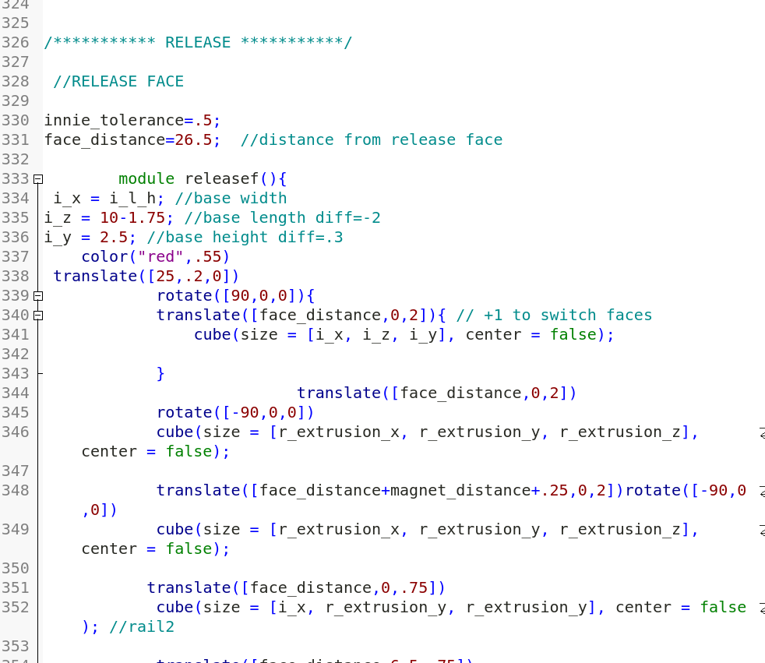
OpenSCAD Code Tour
Release section for everything related to the Release

Slide 23
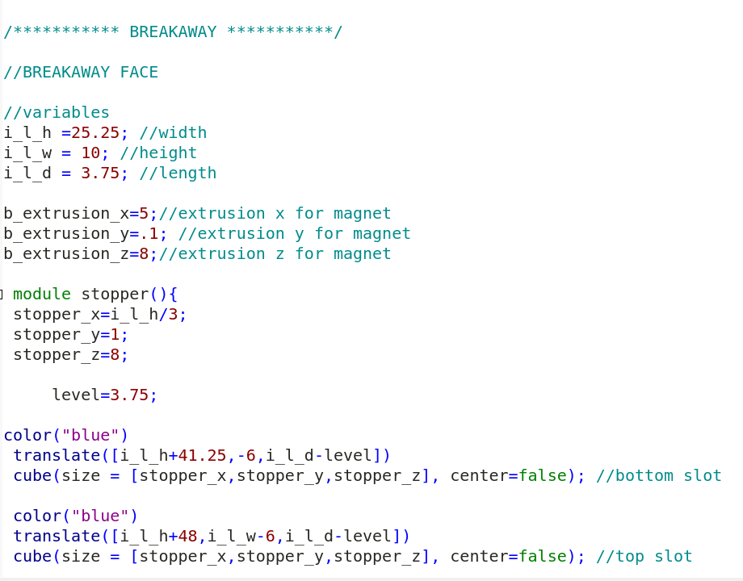
OpenSCAD Code Tour
Breakaway section for everything related to the Breakaway

Slide 24
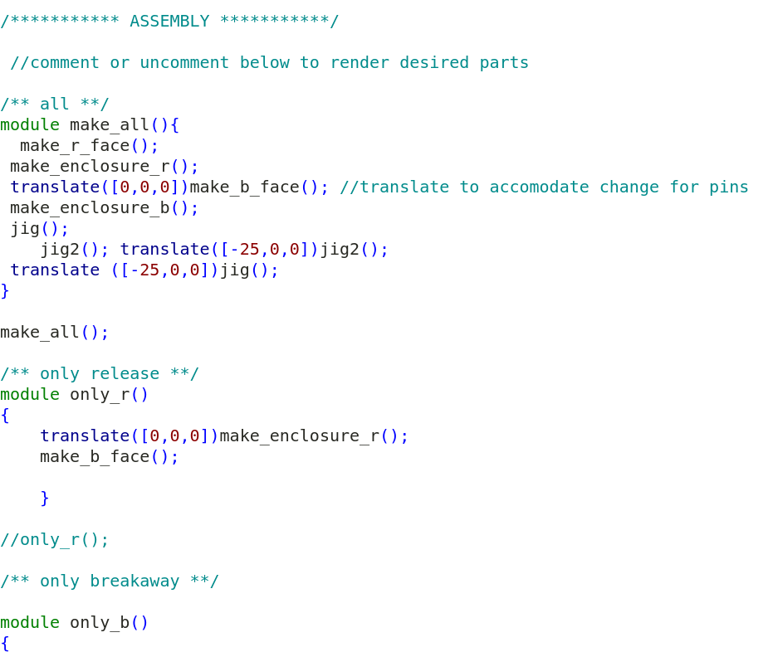
OpenSCAD Code Tour
Assembly section for actually generating the parts.

Slide 25
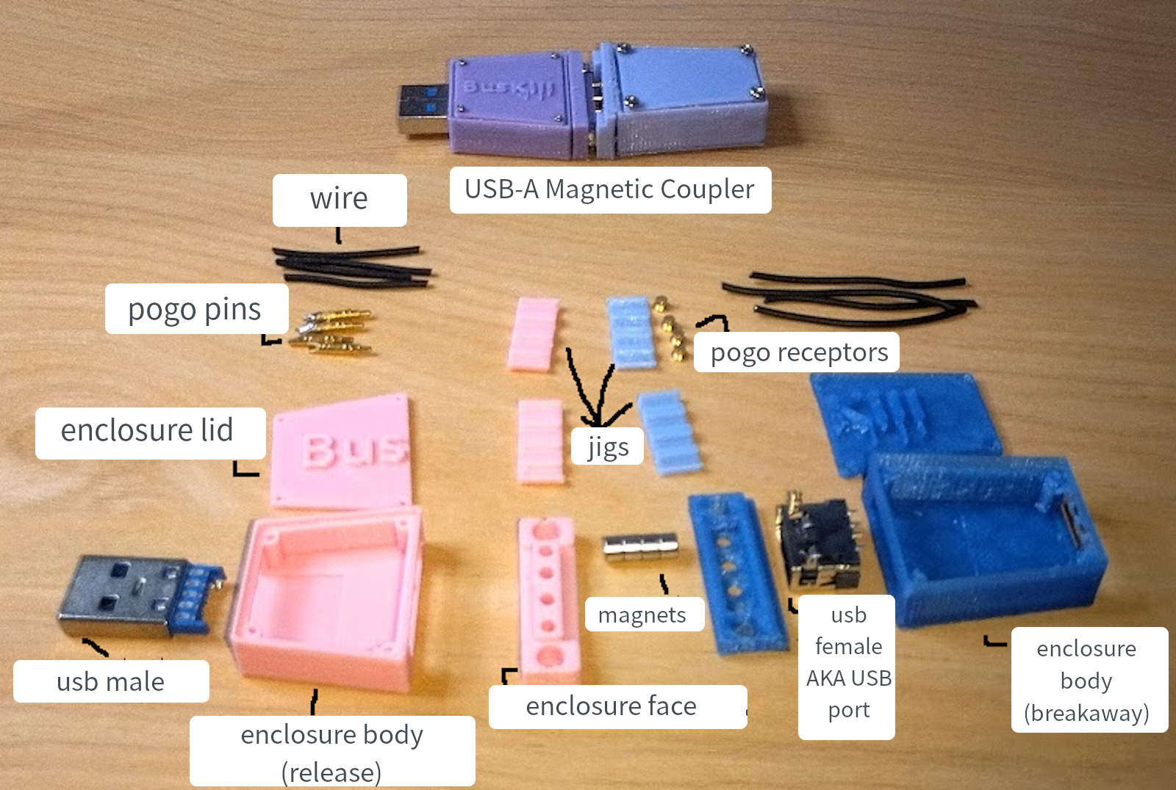
3D-Printed BusKill Assembly Diagram
To be updated

Slide 26
How you can help – 3D-printing
Make one
Improve it
  The more compact the design, the better
  The cheaper the design, the better
  The more parametric the design, the better

Slide 27
How you can help – BusKill Software
Develop more self-destruct triggers:
  Veracrypt
  FileVault
  Bitlocker

Slide 28
BusKill Links
What is BusKill?
BusKill web site
BusKill docs
BusKill software repo
BusKill USB-A repo
BusKill YouTube
BusKill Crowdsupply
BusKill Open Collective
Qubes article
LUKS shredder article
Tails article

Slide 29
My Links
Blog: https://crashxblossom.wordpress.com/category/project-updates/buskill/
YouTube: https://www.youtube.com/channel/UCI8joA75A7_ZTAoWluCX7dA

Slide 30
Questions? Comments?

