Slide 1
CTE Registration System Workshop
http://london.spsu.edu

Slide 2
Objectives
By the end of this workshop you will:
Tour the CTE registration system using an Admin account
Create, edit, and manage Programs
Create, edit, and manage Topics and Workshops
Approve workshops and upload presenter content
View the Calendar
Cancel workshop registrations with Manage User Events
Generate Sign-In sheets with Reports
Mark participants as attended with Manage User Events
View and print Transcripts and Certificates

Slide 3
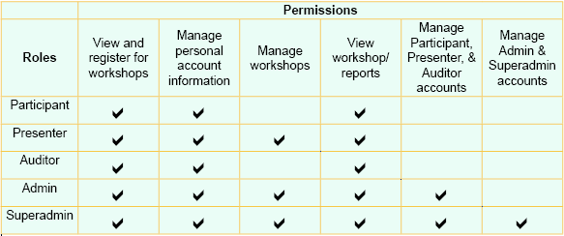
What are the roles?
The admin and super admin roles have the highest number of privileges.
Both the Superadmin and Admin role allow the user the following privileges:
Creating, editing, and deleting of participant, presenter, and auditor accounts,
Editing account details, departments, workshops, and workshop details, approving and disapproving workshop requests.
Only the Superadmin can create Admin and Superadmin accounts.
Notes:
The system supports the roles of Participant, Presenter, Auditor, Admin, and Superadmin.
The default role for a newly registered user is Participant, which allows viewing and registering for workshops.
NOTE: This semester there will only be participants and admins registered in the system.

Slide 4

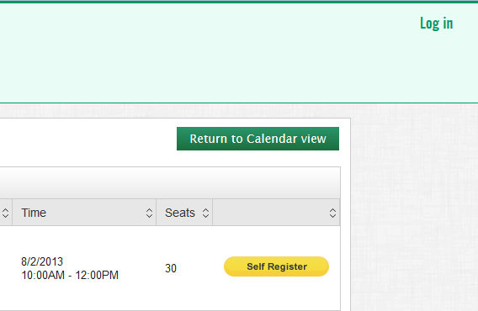
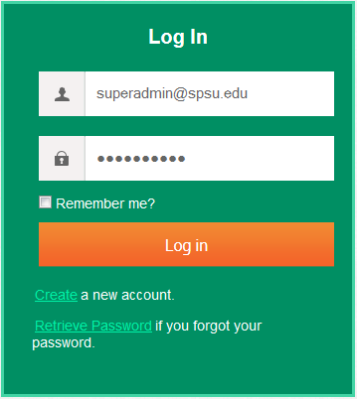
Logging in
Type http://london.spsu.edu into your browser’s navigation bar.
Click on the Log In link.
Type your user ID into the first field.
Type your password into the second field.
Click the Log in button.
1
2
3
4
5

Slide 5
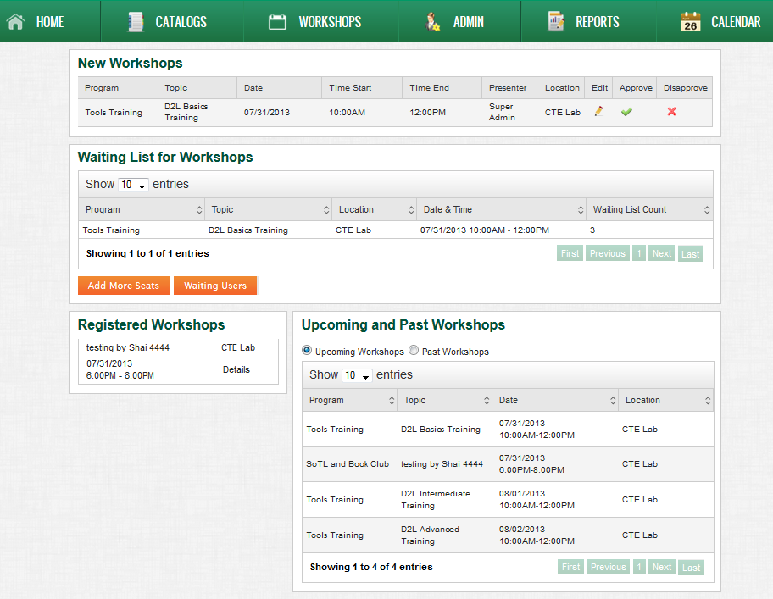
Home Page
Use this panel to edit, approve, or disapprove new workshops.
Use this panel to manage workshops with waiting lists by adding seats or approving participants.
Use this panel to view all the workshops currently in the system.
Use this panel to see your registrations.

Slide 6
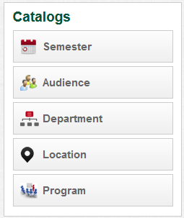
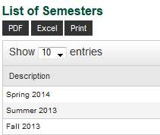
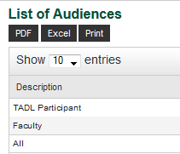
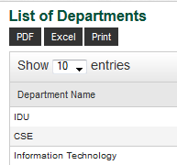
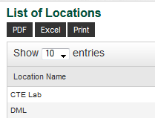
What are Catalogs?

Slide 7
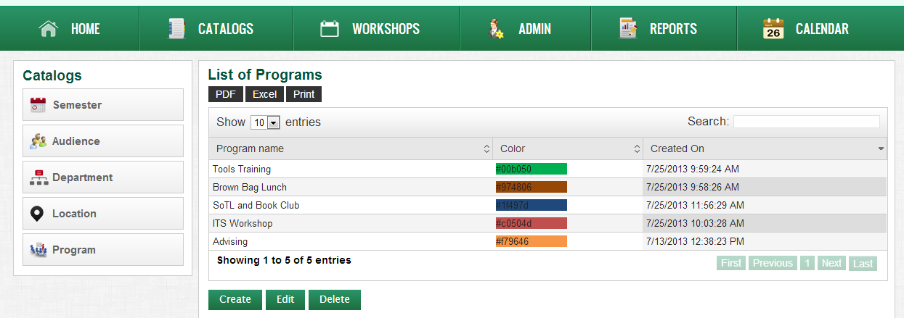
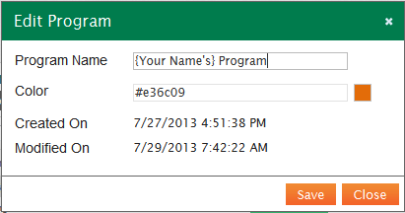
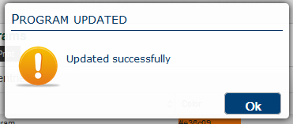
Adding Programs
1
Click CATALOGS from the main menu.
Click Program from the left-hand menu.
Click the Create button.
Enter the title into the Program Name field.
Click the colored square to select a color.
Click the Save button.
Click Ok in the prompt.
2
3
4
NOTE: Workshops cannot share the same color.
5
6
7
Notes:
Instruct them to create the program as their name’s practice program.

Slide 8
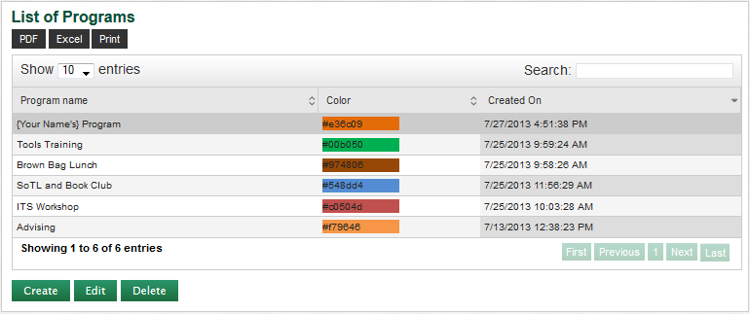
Editing Programs
Select the Program you want to edit.
Click the Edit button.
1
2

Slide 9
Deleting Programs
Select the Program from the list.
Click the Delete button.
1
2

Slide 10
Workshops
A workshop is an event within a program on a topic that faculty can register for and attend to earn PDU points.
Programs
Admins create programs on behalf of departments.
Topics
Admins create the Topics that belong to the Programs.
Workshops
Admins assign Presenters Workshop offerings for a Topic at specific days and times.
Figure 1: Relationship of Programs, Topics, and Workshops

Slide 11
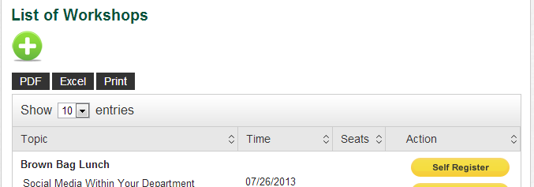
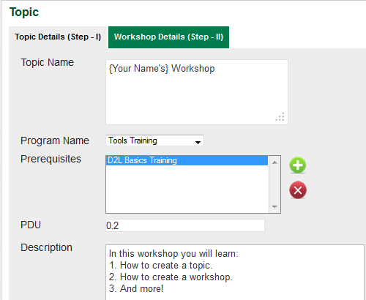

Creating a Topic
1
Click WORKSHOPS from the main menu.
Click on the + icon below List of Workshops.
Enter the topic’s name in the Topic Name field. Use a title like “Shah’s New Workshop”, using your own last name.
Select Tools Training from the Program Name drop-down menu.
Enter 0.2 into the PDU field.
2
3
4
5
Continued…

Slide 12
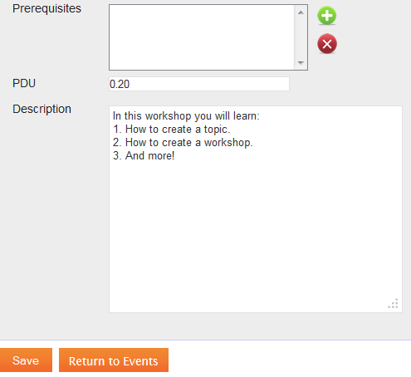
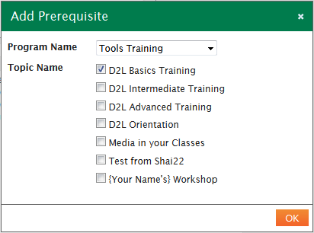
Creating a Topic (cont.)
6
Click on the + icon.
In the Add Prerequisites pop-up window, select D2L Basics from the Program Name drop-down list.
Select the check boxes for prerequisites to add.
Click the OK button.
Enter the description of the workshop in the Description field.
Click the Save button.
7
8
9
11
10

Slide 13
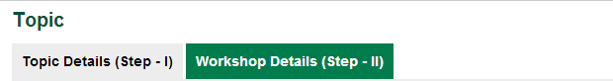
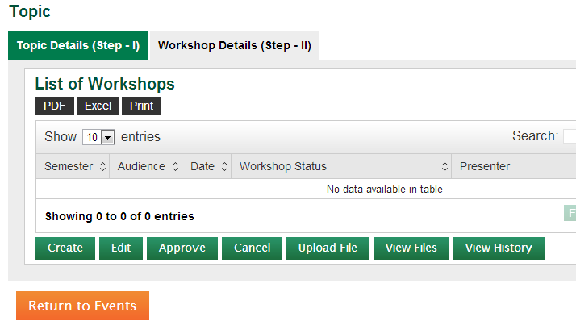
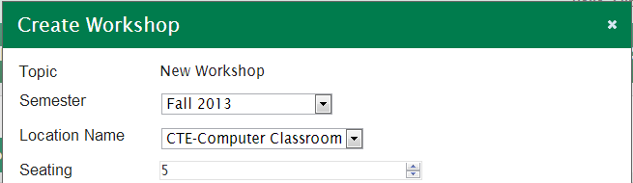
Creating a Workshop
Click Workshop Detail (Step – II) tab from the top of the screen.
Click the Create button.
Select the Fall 2013 from the Semester drop-down menu.
Select the CTE-Computer Classroom from the Location drop-down menu.
Enter 5 into the Seating field.
1
2
3
4
5
Continued…

Slide 14
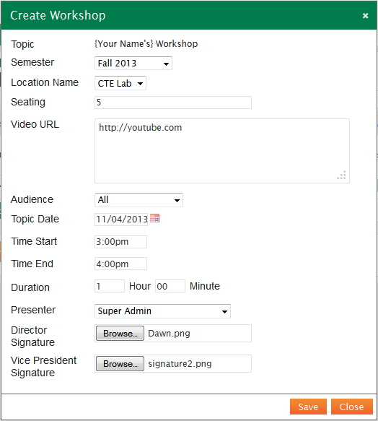
Creating a Workshop (cont.)
Enter http://www.youtube.com in the Video URL field.
Select All from the Audience drop-down menu.
Enter your birthday as the date in the Topic Date field.
Select 3 PM from the Time Start drop-down menu.
Select 4:00pm in the Time End drop-down menu.
Select your name from the Presenter drop-down list.
Upload the Director and Vice President signatures.
Click Save.
6
7
8
9
10
11
12
13

Slide 15
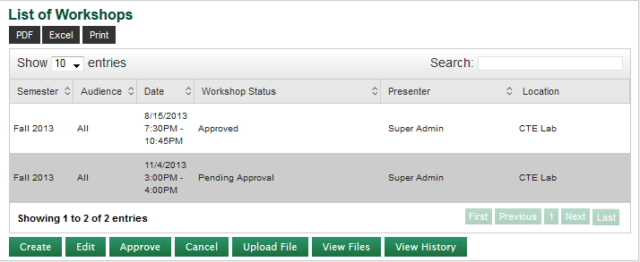
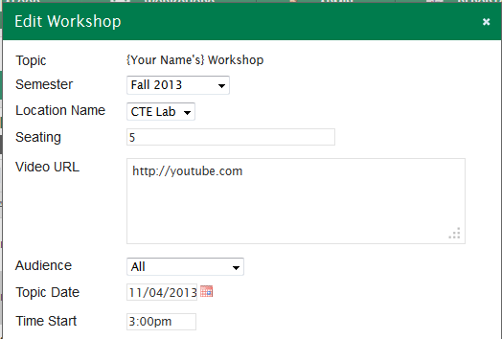
Editing a Workshop
Click the row with the workshop detail to edit.
Click the Edit button.
You are ready to edit the topic.
1
2
3

Slide 16
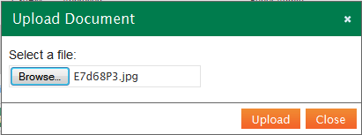
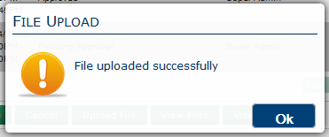
Uploading Content to a Workshop
Select the workshop from the List of Workshops.
Click the Upload File button.
Click the Browse button. Select the file on your computer and click OK.
Click the Upload button.
Click the Ok button in the prompt.
1
2
3
4
5

Slide 17
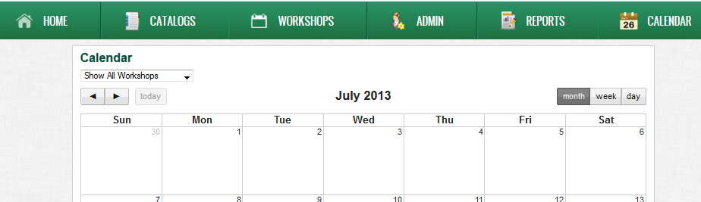
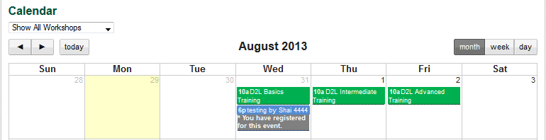
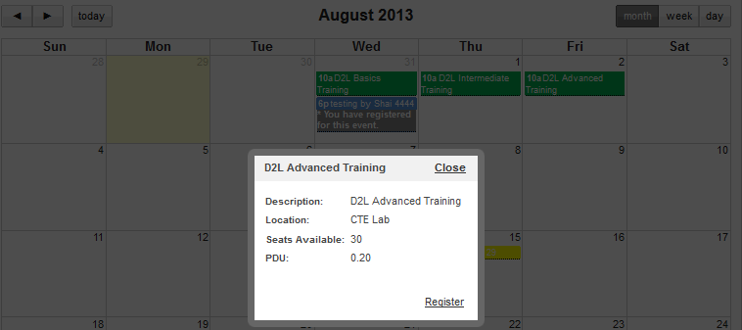
Viewing the event on the Calendar
Click Calendar from the main menu.
Click the arrows to navigate to the date of your workshop (your birthday).
Click on the event.
View the details.
Click Close.
2
1
3
5
4

Slide 18
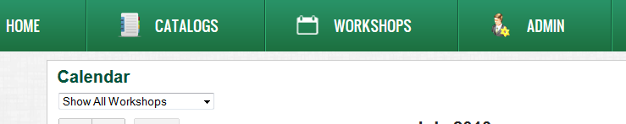
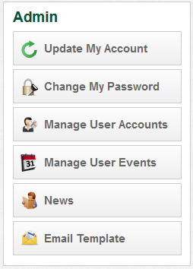
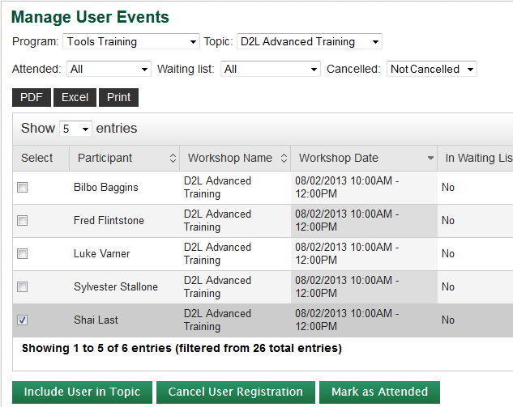
Cancelling Registration by Admin
Click ADMIN from the main menu.
Click Manage User Events from the Admin menu.
Choose Tools Training from the Program drop-down menu.
Choose D2L Advanced Training from the Topic drop-down menu.
Choose Not Cancelled from the Cancelled drop-down menu.
1
2
3
4
5
Continued…

Slide 19
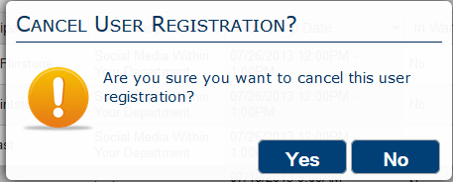
Cancelling Registration by Admin (cont.)
Select the checkbox for a user.
Click the Cancel User Registration button.
Click Yes in the prompt.
6
7
8

Slide 20
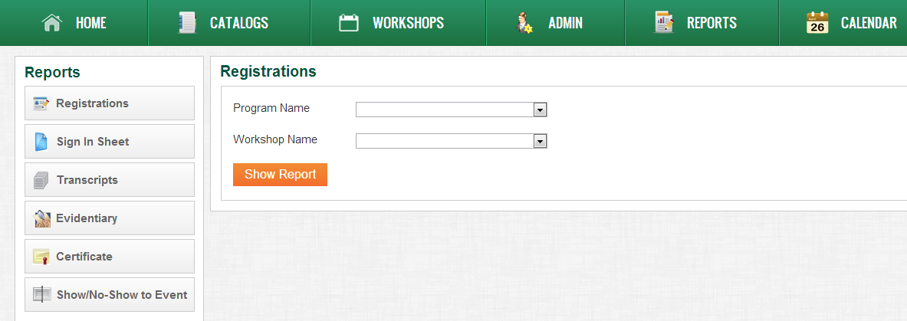
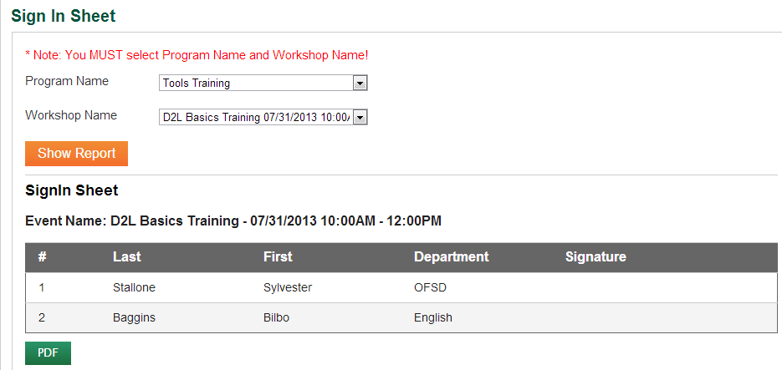
Viewing and Printing Sign In Sheet
Click REPORTS from the main menu.
Select Sign In Sheet from the Reports menu.
Select Tools Training from the Program Name drop-down list.
Select D2L Basics… from the Workshop Name drop-down list.
Click the Show Report button.
Click the PDF button.
Go to your browser’s action bar and select File > Print.
2
1
3
4
5
6

Slide 21
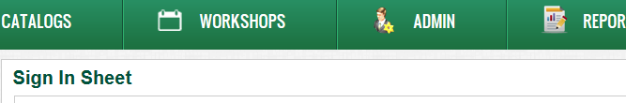
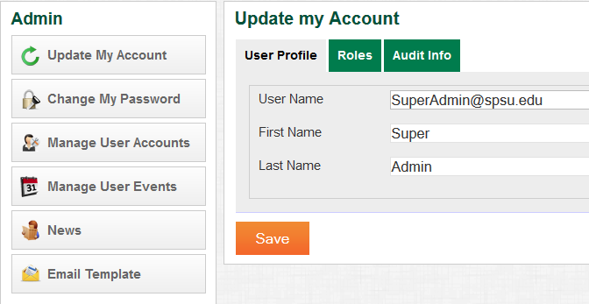
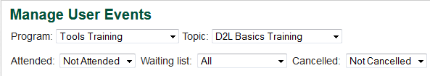
Marking User Attendance
Click ADMIN from the main menu.
Click on Manage User Events from the Admin menu.
Select {Get Name} from the Program drop-down menu.
Select D2L Basics from the Topic drop-down menu.
Select Not attended from the Attended drop-down menu.
Select All from the Waiting List drop-down menu.
Select Not Cancelled from the Cancelled drop-down menu.
1
2
3
4
7
5
6
Continued…

Slide 22
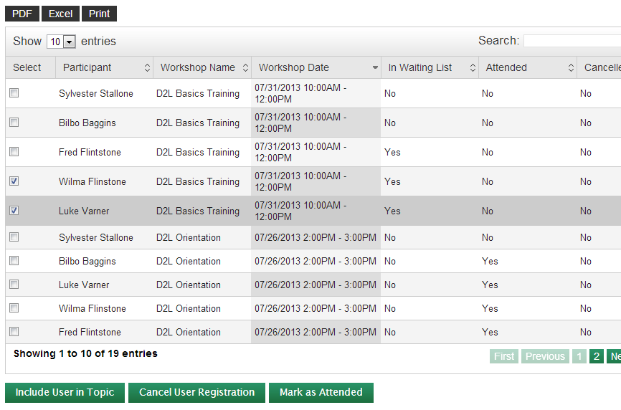
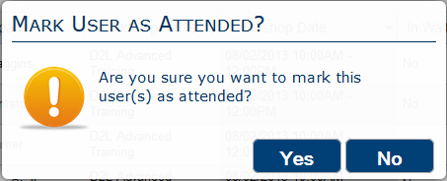
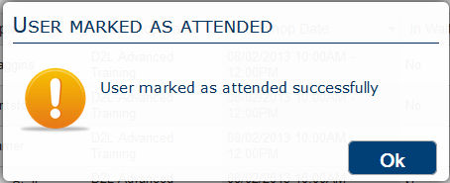
Marking Users Attendance (cont.)
Select the checkbox for the user(s) you want to mark as attended.
Click the Mark as Attended button.
Click the Yes button in the prompt.
Click Ok in the confirmation message window.
8
9
10
11

Slide 23
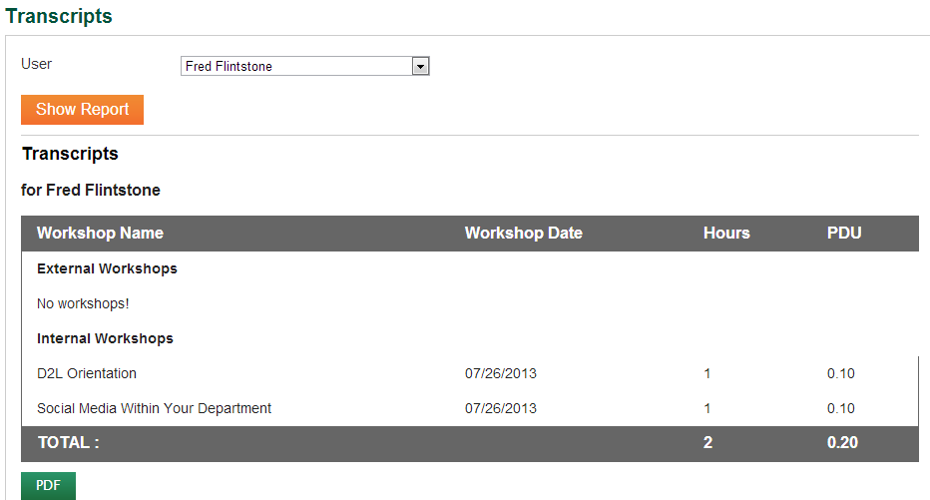
Viewing and Printing Transcripts
Click REPORTS from the main menu.
Select Transcripts from the Reports menu.
Select Fred Flintstone from the User drop-down list.
Click the Show Report button.
Click the PDF button.
Go to your browser’s action bar and select File > Print.
1
2
3
4
5
Notes:
Transcript should be lots of stuff and correct

Slide 24
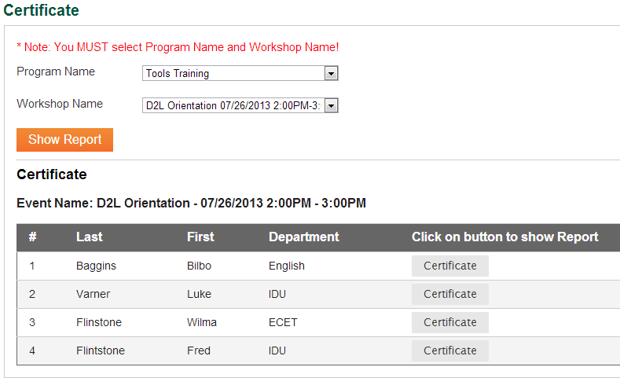
Viewing and Printing Certificates
Click Certificate from the Reports menu.
Choose Tools Training from the Program Name menu.
Choose D2L Orientation … from the Workshop Name menu.
Click the Show Report button.
Click the Certificate button for Fred Flintstone.
Go to your browser’s action bar and select File > Print.
1
2
4
3
5

