Slide 1
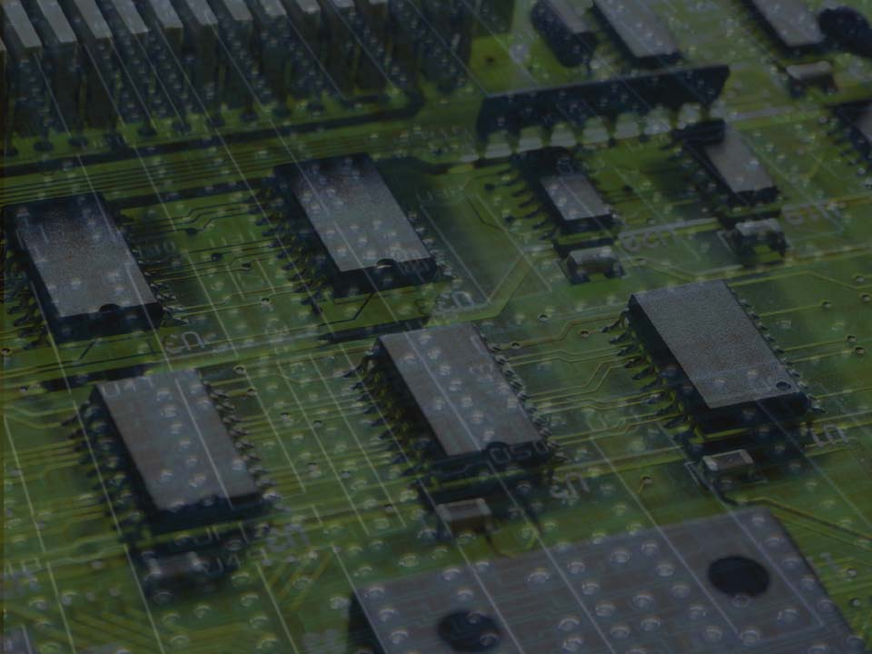
Transmeta Crusoe
Group 23
Todd Goldfinger
Josh Martin
Tom Schneider
Daniel Wilhelm
February 8, 2001

Slide 2
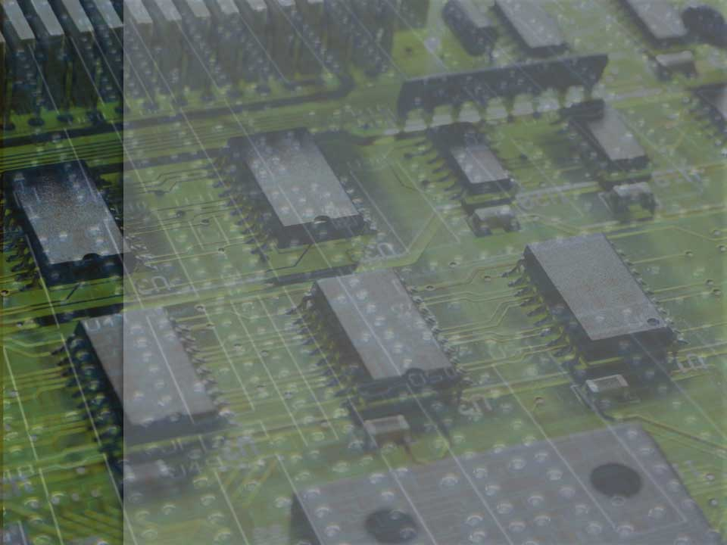
The Idea
Dynamic binary recompilation
VLIW engine
Software emulates hardware

Slide 3
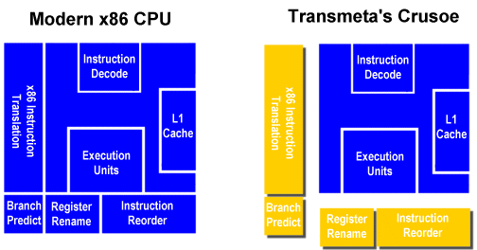
Software Emulates Hardware
Decoding and scheduling
Smaller die size

Slide 4
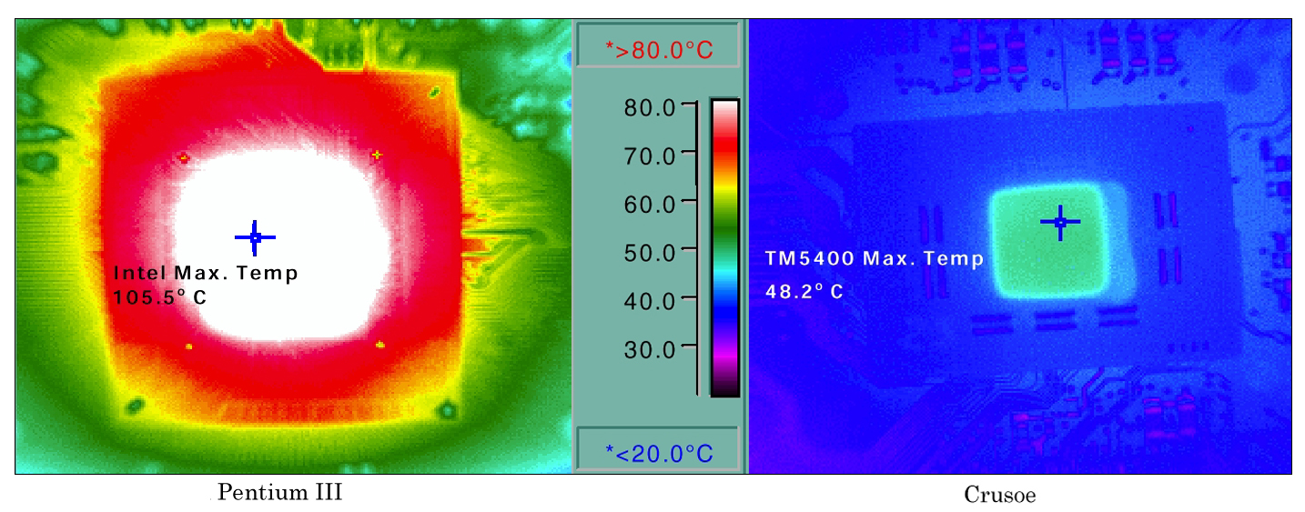
Heat Comparison

Slide 5
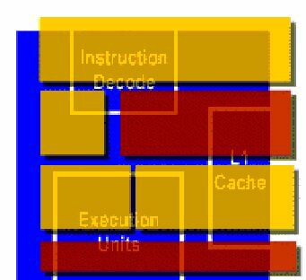
Emulation Overhead
25% loss in performance
33-100% increase in code

Slide 6
Hardware
Registers
  64 general purpose (32 bits)
  32 floating point (80 bits)
  Shadow registers
Code morphing ROM

Slide 7
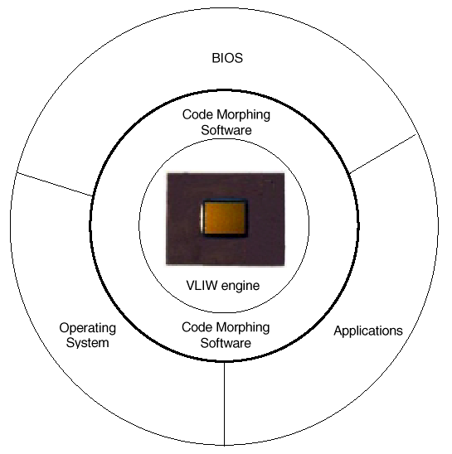
Changeable ISA
Java analogy

Slide 8
Code Morphing Software
Filtering
90 – 10 rule
Translation

Slide 9
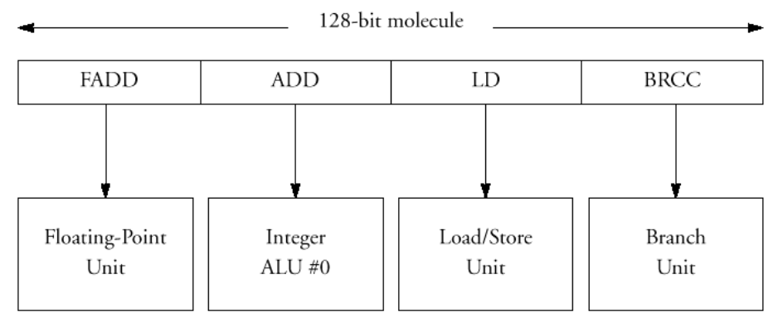
Atoms and Molecules

Slide 10
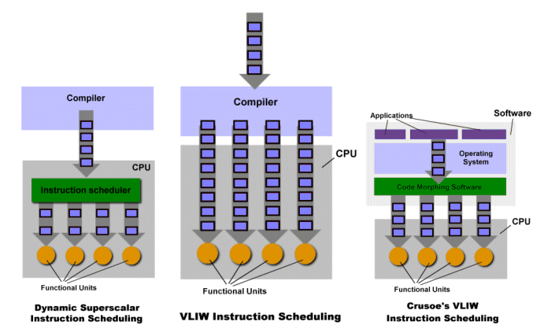
Approaches Towards Parallelism

Slide 11
Hardware Support
Exceptions and scheduling
Out of order instructions
Optimizing memory operations
Self-modifying code

Slide 12
Code Example
x86
Ld %r30, [%esp]
Add.c %eax, %eax, %r30
Ld %r31, [%esp]
Add.c %ebx, %ebx, %r31
Ld %esi, [%ebp]
Sub.c %ecx, %ecx, 5
Crusoe
1) Ld %r30, [%esp];
Sub.c %ecx, %ecx, 5
2) Ld %esi, [%ebp];
Add %eax, %eax, %r30;
Add %ebx, %ebx, %r30

Slide 13
Analysis – Pros
Less/simpler hardware
Low power
Better branch prediction
Runtime optimization
Recompile fixes bugs
Can work with any architecture

Slide 14
Analysis - Cons
Slower than x86
Difficult exception handling
“Code-bloat”

Slide 15
Questions?

