Slide 1
OPENGL

Slide 2
What is OpenGL
OpenGL (Open Graphics Library)is a cross-language, multi-platform application programming interface (API) for rendering 2D and 3D vector graphics. The API is typically used to interact with a graphics processing unit (GPU), to achieve hardware-accelerated rendering.

Slide 3
Install OpenGL
OpenGL 4.5
Release Date: August 11, 2014
https://www.opengl.org/wiki/Getting_Started#Downloading_OpenGL
GLUT(OpenGL Utility Toolkit)
https://www.opengl.org/resources/libraries/glut/glut_downloads.php
GLUT(just dll file and lib file)
https://www.opengl.org/resources/libraries/glut/glutdlls37beta.zip

Slide 4
Install OpenGL(2) in Windows
Put dll file in the folder C:\windows\system32 C:\Windows\SysWOW64 Or put dll file in your project execute folder var:$(OutDir)$(TargetName)$(TargetExt)
Put lib file in the folder example: E:\software\visual_studio\VC\lib You can see path in project property(Next Page) var:$(VC_LibraryPath_x86)

Slide 5
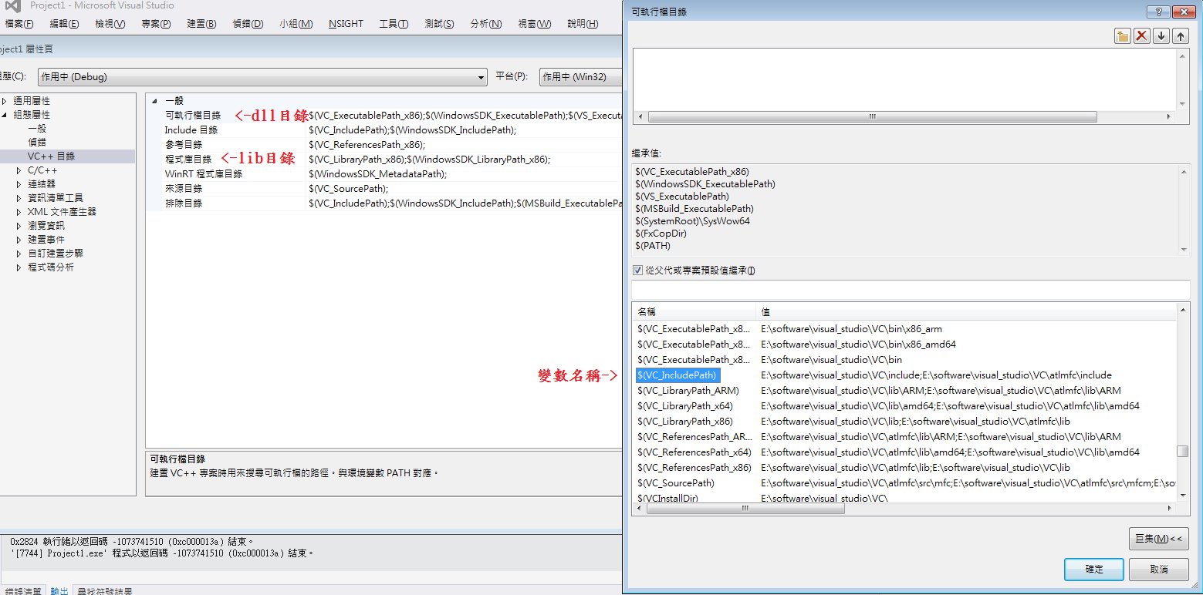

Slide 6
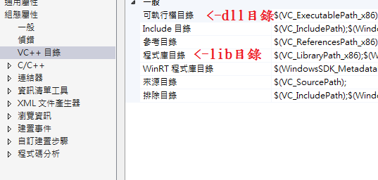

Slide 7


Slide 8
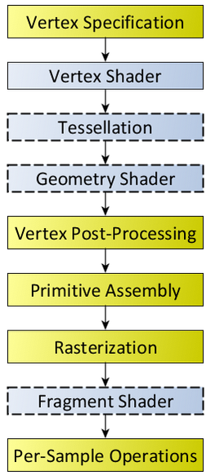
OpenGL pipeline
Diagram of the Rendering Pipeline.
The blue boxes are programmable shader stages.

Slide 9
Vertex Specification
The process of vertex specification is where the application sets up an ordered list of vertices to send to the pipeline. These vertices define the boundaries of a primitive.
This part of the pipeline deals with a number of objects like Vertex Array Objects and Vertex Buffer Objects. Vertex Array Objects define what data each vertex has, while Vertex Buffer Objects store the actual vertex data itself.

Slide 10
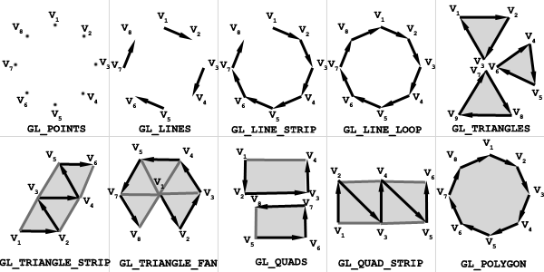
Type of Primitives

Slide 11
Geometry Shader
Geometry shaders are user-defined programs that process each incoming primitive, returning zero or more output primitives.
The input primitives for geometry shaders are the output primitives from a subset of the Primitive Assembly process. So if you send a triangle strip as a single primitive, what the geometry shader will see is a series of triangles.
Geometry shaders are optional.

Slide 12
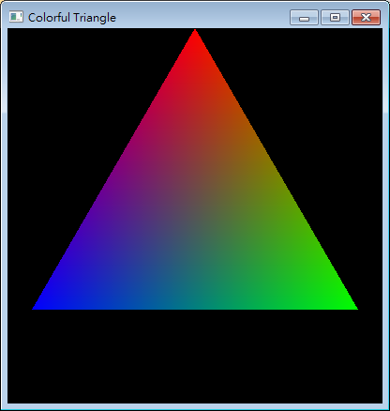
Example
glBegin(GL_TRIANGLES);// 開始劃三角形
glColor3f(1.0f, 0.0f, 0.0f);// 設定顏色為紅色
glVertex2f(0.0f, 1.0f);//(x1,y1)=(0, 1)
glColor3f(0.0f, 1.0f, 0.0f);// 設定顏色為綠色
glVertex2f(1.0f, -0.5f);//(x2,y2)=(1.0,-0.5)
glColor3f(0.0f, 0.0f, 1.0f);// 設定顏色為藍色
glVertex2f(-1.0f, -0.5f);//(x3,y3)=(-1.0,-0.5)
glEnd();// 結束劃三角形
glutSwapBuffers();//將buffer換至螢幕

Slide 13
Vertex post-processing
Transform Feedback
The outputs of the geometry shader or primitive assembly are written to a series of buffer objects that have been setup for this purpose. This is called transform feedback mode; it allows the user to do transform data via vertex and geometry shaders, then hold on to that data for use later.
The data output into the transform feedback buffer is the data from each primitive emitted by this step.

Slide 14
Vertex post-processing
Clipping
The primitives are then clipped. Clipping means that primitives that lie on the boundary between the inside of the viewing volume and the outside are split into several primitives, such that the entire primitive lies in the volume. Also, the last Vertex Processing shader stage can specify user-defined clipping operations, on a per-vertex basis.

Slide 15
Primitive assembly
Primitive assembly is the process of collecting a run of vertex data output from the prior stages and composing it into a sequence of primitives. The type of primitive the user rendered with determines how this process works.
The output of this process is an ordered sequence of simple primitives (lines, points, or triangles). If the input is a triangle strip primitive containing 12 vertices, for example, the output of this process will be 10 triangles.
The rendering pipeline can also be aborted at this stage. This allows the use of Transform Feedback operations, without having to actually render something.

Slide 16
Primitive assembly
Face culling
Triangle primitives can be culled (ie: discarded without rendering) based on the triangle's facing in window space. This allows you to avoid rendering triangles facing away from the viewer. For closed surfaces, such triangles would naturally be covered up by triangles facing the user, so there is never any need to render them. Face culling is a way to avoid rendering such primitives.

Slide 17
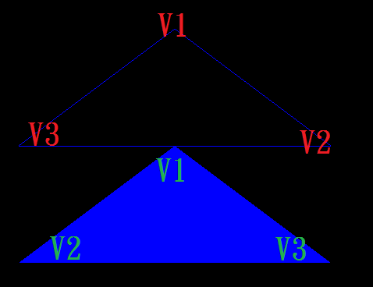
Cull Face Example
GL_CW and GL_CCW
glEnable(GL_CULL_FACE);
glCullFace(GL_BACK);
//GL_BACK、GL_FRONT
//GL_FRONT_AND_BACK
glFrontFace(GL_CCW);
//GL_CW、GL_CCW

Slide 18
Fragment Processing
The data for each fragment from the rasterization stage is processed by a fragment shader. The output from a fragment shader is a list of colors for each of the color buffers being written to, a depth value, and a stencil value. Fragment shaders are not able to set the stencil data for a fragment, but they do have control over the color and depth values.
Fragment shaders are optional. If you render without a fragment shader, the depth (and stencil) values of the fragment get their usual values. But the value of all of the colors that a fragment could have are undefined. Rendering without a fragment shader is useful when rendering only a primitive's default depth information to the depth buffer, such as when performing Occlusion Query tests.

Slide 19
Per-Sample Operations
Stencil Test: When enabled, the test fails if the stencil value provided by the test does not compare as the user specifies against the stencil value from the underlying sample in the stencil buffer. Note that the stencil value in the framebuffer can still be modified even if the stencil test fails (and even if the depth test fails).
Depth Test: When enabled, the test fails if the fragment's depth does not compare as the user specifies against the depth value from the underlying sample in the depth buffer.
Stencil Test is early than Depth Test

Slide 20
Initialize
glutInit(&argc, argv);//須在其它glut function前使用
glutInitDisplayMode(GLUT_RGB | GLUT_DOUBLE);
GLUT_RGB / GLUT_RGBA / GLUT_INDEX
GLUT_SINGLE / GLUT_DOUBLE
GLUT_DEPTH / GLUT_STENCIL / GLUT_ACCUM
glutInitWindowPosition(100, 50); // 設定視窗位置
glutInitWindowSize(800, 600); // 設定視窗大小
glutCreateWindow(“HELLO WORLD");//建立視窗並打上標題

Slide 21
Main Loop Function
glutReshapeFunc(WindowSize);//當視窗改變大小時會獲取新的視窗長寬
glutKeyboardFunc(Keyboard);//獲取鍵盤輸入訊息
glutDisplayFunc(Display);//負責描繪
glutIdleFunc(idle);//畫完時重覆進idle
glutMainLoop();//進入主迴圈

Slide 22
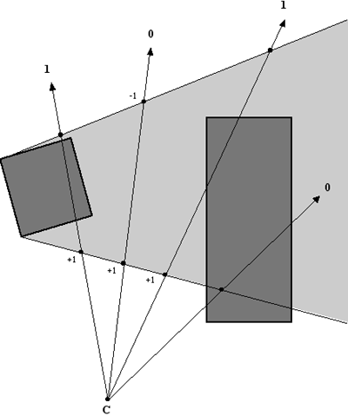
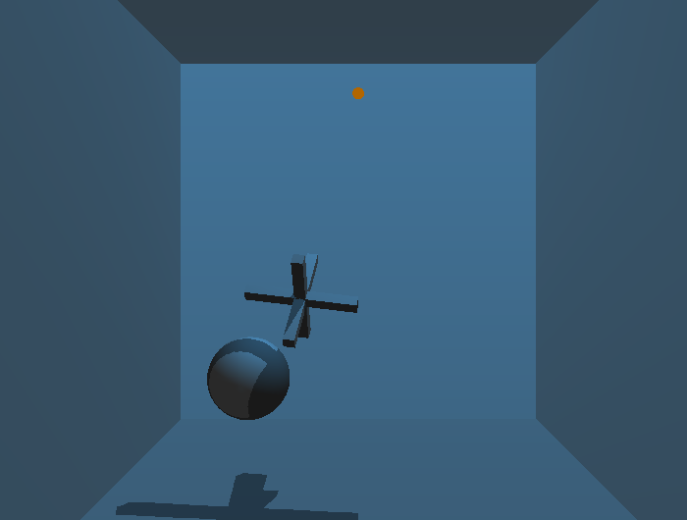
Stencil Test

Slide 23
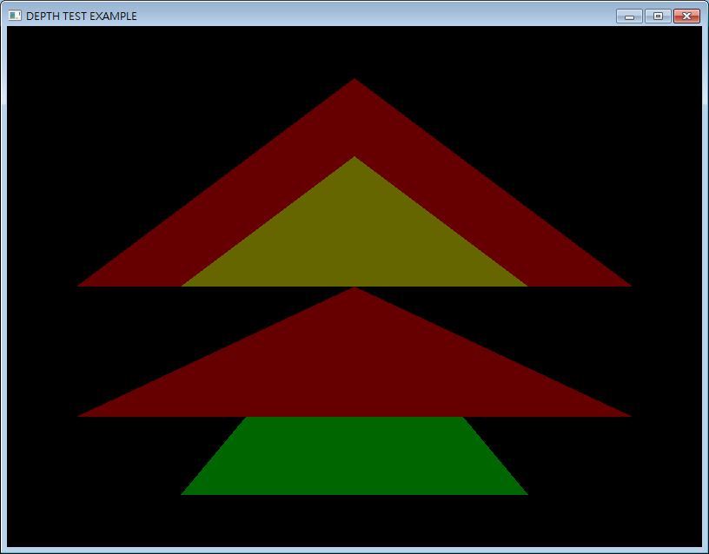
Depth Test
GL_NEVER, GL_LESS, GL_EQUAL, GL_LEQUAL, GL_GREATER, GL_NOTEQUAL, GL_GEQUAL, and GL_ALWAYS
GL_NEVER, GL_LESS, GL_EQUAL, GL_LEQUAL, GL_GREATER, GL_NOTEQUAL, GL_GEQUAL, and GL_ALWAYS
glutInitDisplayMode(GLUT_RGB | GLUT_DOUBLE | GLUT_DEPTH);
glEnable(GL_DEPTH_TEST);
glDepthFunc(GL_LESS);
GL_NEVER GL_LESS GL_EQUAL GL_LEQUAL GL_GREATER GL_NOTEQUAL GL_GEQUAL GL_ALWAYS

Slide 24
Basic Transformations
glTranslate(T x, T y, T z)
Translates an object by given x, y, and z.
glRotate(T angle, T x, T y, T z)
Rotates an object by given angle (in degrees) counterclockwise around the given vector(x, y, z).
glScale(T x, T y, T z)
Scales an object by given x, y, and z. ▪ Note: this will mess up normals, so you must enable GL_NORMALIZE to counter it.

Slide 25
Basic Transformations
glMatrixMode( GL_MODELVIEW ); // set current matrix
glLoadIdentity(); // Clears the matrix
glTranslatef( 0.0f, 0.0f, -2.0f );
glRotatef( 45.0f, 0.0f, 0.0f, 1.0f );
glScalef( 2.0f, 2.0f, 2.0f );
draw_object(); // our own drawing function

Slide 26
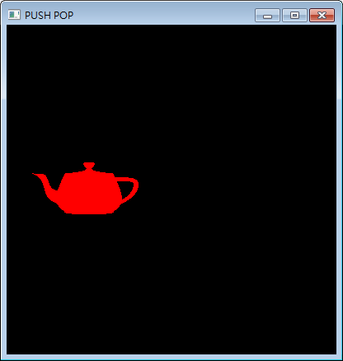
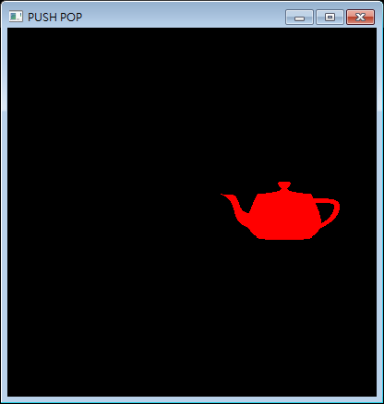
Translate and Rotate Example
glRotated(180.0, 0.0, 1.0, 0.0);
glTranslated(5.0, 0.0, 0.0);
glutSolidTeapot(2.0);
glTranslated(5.0, 0.0, 0.0);
glRotated(180.0, 0.0, 1.0, 0.0);
glutSolidTeapot(2.0);

Slide 27
Push and Pop Matrix
You may wish to save and reload the current matrix using a stack.
glPushMatrix()
glPopMatrix()
This is particularly useful when thinking about object hierarchies.

Slide 28

Push and Pop Matrix
glPushMatrix();
transform_body();
glPushMatrix();
transform_left_arm();
draw_left_arm();
glPopMatrix();
glPushMatrix();
transform_right_arm();
draw_right_arm();
glPopMatrix();
draw_body();
glPopMatrix();

Slide 29

Push and Pop Matrix
glPushMatrix();
transform_body();
glPushMatrix();
transform_left_arm();
draw_left_arm();
glPopMatrix();
glPushMatrix();
transform_right_arm();
draw_right_arm();
glPopMatrix();
draw_body();
glPopMatrix();

Slide 30
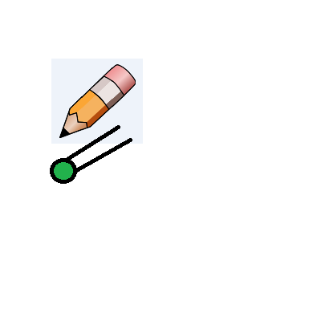
Push and Pop Matrix
glPushMatrix();
transform_body();
glPushMatrix();
transform_left_arm();
draw_left_arm();
glPopMatrix();
glPushMatrix();
transform_right_arm();
draw_right_arm();
glPopMatrix();
draw_body();
glPopMatrix();

Slide 31

Push and Pop Matrix
glPushMatrix();
transform_body();
glPushMatrix();
transform_left_arm();
draw_left_arm();
glPopMatrix();
glPushMatrix();
transform_right_arm();
draw_right_arm();
glPopMatrix();
draw_body();
glPopMatrix();

Slide 32
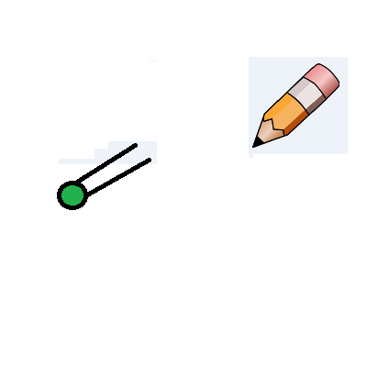
Push and Pop Matrix
glPushMatrix();
transform_body();
glPushMatrix();
transform_left_arm();
draw_left_arm();
glPopMatrix();
glPushMatrix();
transform_right_arm();
draw_right_arm();
glPopMatrix();
draw_body();
glPopMatrix();

Slide 33
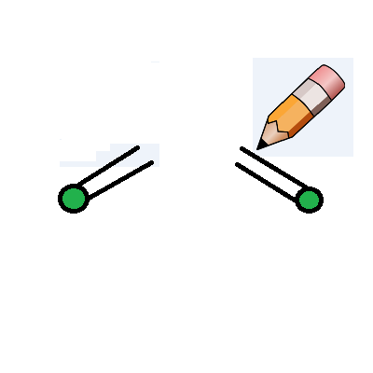
Push and Pop Matrix
glPushMatrix();
transform_body();
glPushMatrix();
transform_left_arm();
draw_left_arm();
glPopMatrix();
glPushMatrix();
transform_right_arm();
draw_right_arm();
glPopMatrix();
draw_body();
glPopMatrix();

Slide 34

Push and Pop Matrix
glPushMatrix();
transform_body();
glPushMatrix();
transform_left_arm();
draw_left_arm();
glPopMatrix();
glPushMatrix();
transform_right_arm();
draw_right_arm();
glPopMatrix();
draw_body();
glPopMatrix();

Slide 35

Push and Pop Matrix
glPushMatrix();
transform_body();
glPushMatrix();
transform_left_arm();
draw_left_arm();
glPopMatrix();
glPushMatrix();
transform_right_arm();
draw_right_arm();
glPopMatrix();
draw_body();
glPopMatrix();

Slide 36
View
gluLookAt( GLdouble e_x, GLdouble e_y, GLdouble e_z, GLdouble c_x, GLdouble c_y, GLdouble c_z, GLdouble u_x, GLdouble u_y, GLdouble u_z )
e_x, e_y, e_z specify the desired viewpoint
c_x, c_y, c_z specify some point along the desired line of sight
u_x, u_y, u_z define the up vector of our camera

Slide 37
Projection
Matrix mode use is similar:
glMatrixMode(GL_PROJECTION)
We are really concerned with only two types of projection transformations:
Orthographic projection：Our viewing volume is rectangular and all objects appear the same size no matter the distance
Perspective projection：Uses perspective to give a sense of depth. Our viewing volume is conical or pyramidal in shape.

Slide 38
Orthographic Projection
glOrtho( GLdouble left, GLdouble right, GLdouble bottom, GLdouble top, GLdouble near, GLdouble far)
left, right, top, and bottom define the boundaries of the near/far clipping planes
near and far specify how far from the viewpoint the near and far clipping planes are

Slide 39
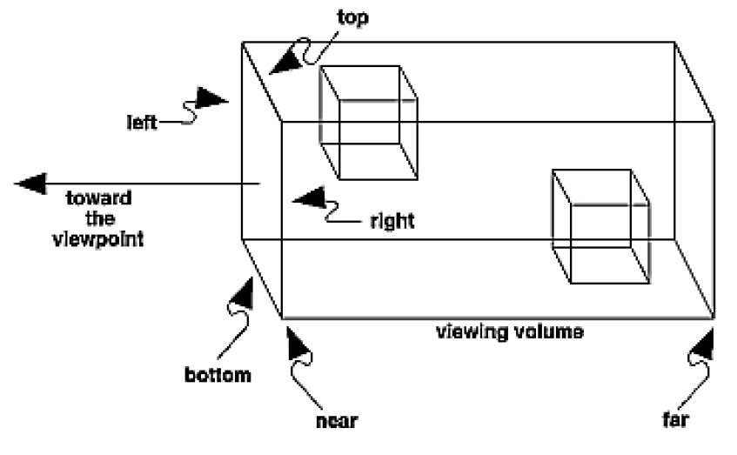
Orthographic Projection

Slide 40
Perspective Projection
gluPerspective( Gldouble fovy, Gldouble aspect, Gldouble near, Gldouble far )
fovyis the angle in the field of view (in range from [0.0, 180]
aspectis the aspect ratio of the frustrum(width of window over height of window)
near and farare the values between viewpoint and the near/far clipping planes

Slide 41
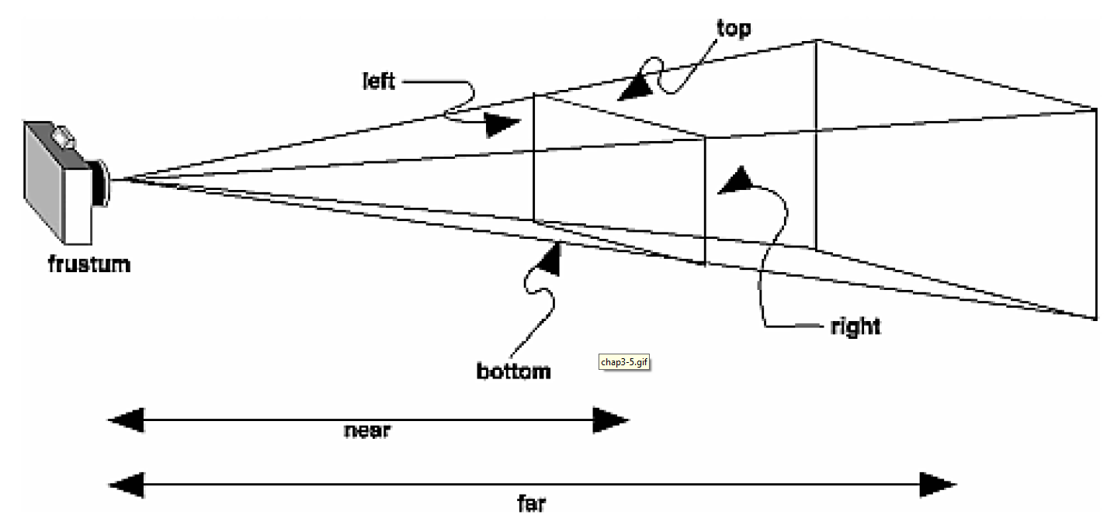
Perspective Projection

Slide 42


Ambient Light
The result of multiple interactions between (large) light sources and the objects in the environment.

Slide 43

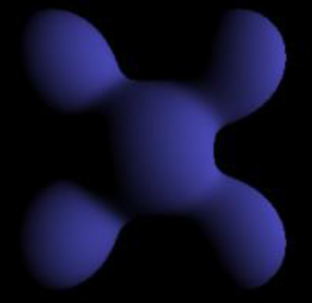
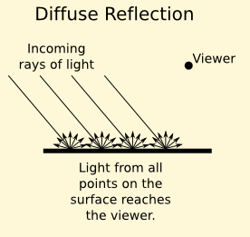
Diffuse Reflection
Light scattered equally in all directions
Reflected intensities vary with the direction of the light.

Slide 44
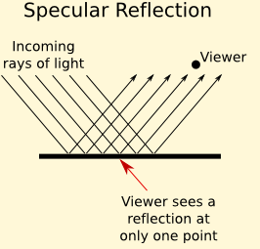
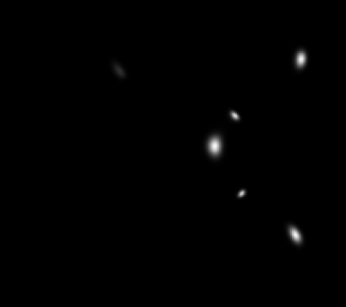
Specular Reflections

Slide 45
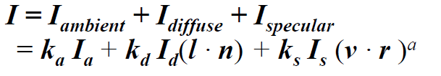
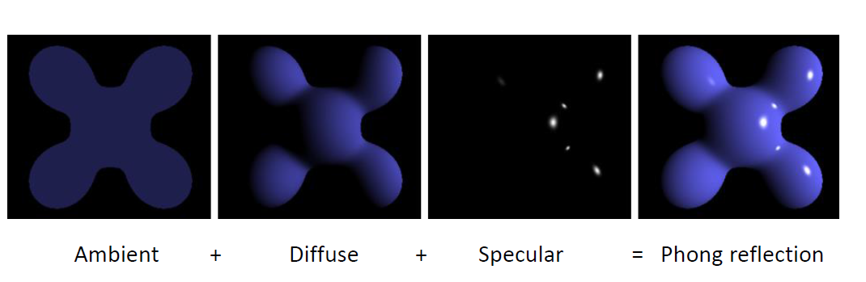
Light

Slide 46
Light
float LightPos[] = {0.0f,1.0f,3.0f};//X Y Z
float LightAmb[] = { 0.1f, 0.1f, 0.3f };// Ambient Light Values
float LightDif[] = { 0.8f, 0.8f, 1.0f };// Diffuse Light Values
float LightSpc[] = { 0.5f, 0.5f, 0.5f };// Specular Light Values

Slide 47
Light
glEnable(GL_LIGHT1);// Enable Light1
glEnable(GL_LIGHTING);// Enable Lighting
glLightfv(GL_LIGHT1, GL_POSITION, LightPos);// Set Light1 Position
glLightfv(GL_LIGHT1, GL_AMBIENT, LightAmb);// Set Light1 Ambience
glLightfv(GL_LIGHT1, GL_DIFFUSE, LightDif);// Set Light1 Diffuse
glLightfv(GL_LIGHT1, GL_SPECULAR, LightSpc);// Set Light1 Specular

Slide 48
Material Properties
glMaterialfv(GL_FRONT, GL_AMBIENT, MatAmb);
// Set Material Ambience
glMaterialfv(GL_FRONT, GL_DIFFUSE, MatDif);
// Set Material Diffuse
glMaterialfv(GL_FRONT, GL_SPECULAR, MatSpc);
// Set Material Specular
glMaterialfv(GL_FRONT, GL_SHININESS, MatShn);
// Set Material Shininess

Slide 49
Reference
Wikipedia, https://en.wikipedia.org/wiki/OpenGL
Hello World code, http://www.cc.ntu.edu.tw/chinese/epaper/0024/20130320_2410.html
https://www.opengl.org/wiki/Rendering_Pipeline_Overview
http://www.cs.cmu.edu/afs/cs/academic/class/15462-s15/www/lec_slides/lec02.pdf

