Slide 1
OpenGL2

Slide 2
Overview
Introduction
ColorMask
DepthTest, DepthMask, Depthfunc
StencilTest, StencilMask, StencilFunc, StencilOp

Slide 3
Introduction
Color, Depth and Stencil buffers are pixel-based. You can think of buffers as texture.
All functions (blending, depthfunc, stencilfunc…) define how or what to write in buffers.

Slide 4
ColorMask
glColorMask(Glboolean red, Glboolean green Glboolean blue, GL Boolean alpha)
Specify whether red, green, blue, and alpha can or cannot be written into the frame buffer.
Example1:
glColorMask(ture,true,true,true)
Draw blue triangle
Example2:
glColorMask(false,false,false,false)
Draw blue triangle
Both Ex1 and Ex2 will write value in
Detph buffer and Stencil buffer.
Frame Buffer
Example2
Example1

Slide 5
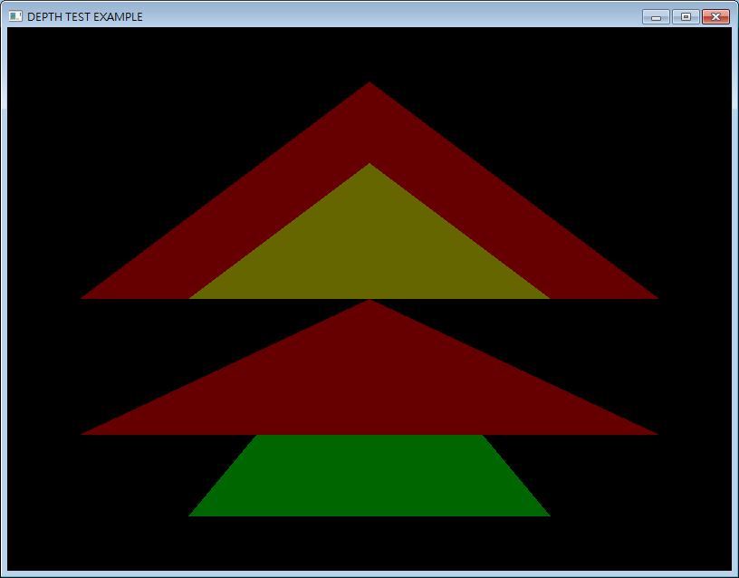
Depth Test
DepthMask(true);//initial value
Depthfunc(GL_LESS);//initial value
Example:
Red is more close to camera( red is less value)
If you draw green then draw red, it works.(example1 next page)
If you draw red then draw green, depth test failed. Green is not drawn.(example2 next page)

Slide 6
Depth Test
Define red’s depth is 1 , green’s depth is 2. DepthFunc(GL_LESS)
Depth Buffer
Depth Buffer
Example1(Depth test pass)
Example2(Depth test fail)

Slide 7
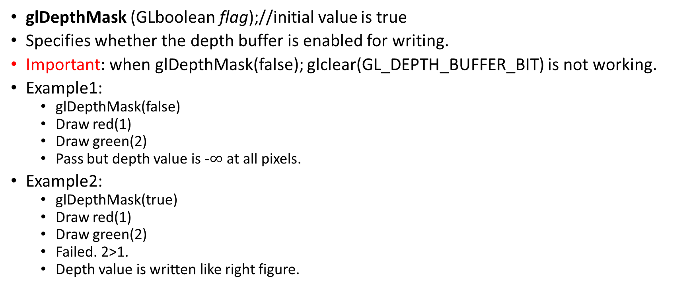
Depth Test
glDepthMask (GLboolean flag);//initial value is true
Specifies whether the depth buffer is enabled for writing.
Important: when glDepthMask(false); glclear(GL_DEPTH_BUFFER_BIT) is not working.
Example1:
glDepthMask(false)
Draw red(1)
Draw green(2)
Pass but depth value is -$∞$ at all pixels.
Example2:
glDepthMask(true)
Draw red(1)
Draw green(2)
Failed. 2>1.
Depth value is written like right figure.
Depth Buffer
Example2(Depth test fail)
2
1

Slide 8
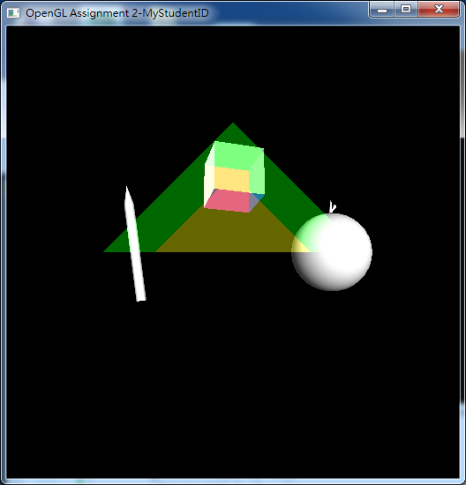
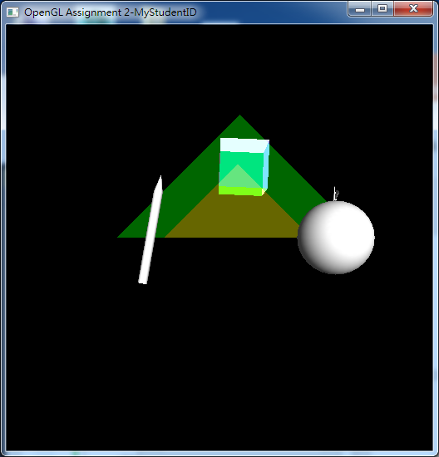
Depth Test
Example1
Example2
Example1:
glDepthMask(true);
Draw_PPAP();
gldepthMask(false);
Draw two traingles();
Example2:
glEnable(GL_DEPTH_TEST);
Draw_PPAP();
glDisable(GL_DEPTH_TEST);
Draw two traingles();

Slide 9
Depth Test
DepthFunc(func)
Specifies the depth comparison function.
Func: GL_NEVER, GL_LESS, GL_EQUAL, GL_LEQUAL, GL_GREATER, GL_NOTEQUAL, GL_GEQUAL, and GL_ALWAYS
GL_LESS: Pass if incoming value is LESS than stored value.

Slide 10
Stencil Test
A stencil buffer is an extra buffer, in addition to the color buffer and depth buffer (z-buffering) found on modern graphics hardware.(from wiki)
The buffer is per pixel.
Stencil value is integer.
Stencil value is zero initially.

Slide 11
Stencil Test
glStencilFunc(func,ref,mask)
Func:GL_NEVER, GL_LESS, GL_LEQUAL, GL_GREATER, GL_GEQUAL, GL_EQUAL, GL_NOTEQUAL, GL_ALWAYS. The initial value is GL_ALWAYS.
pass if ( ref & mask ) func ( stencil & mask )
Example:
glStencilFunc(GL_EQUAL, 0x00000001, 0x00000001)
If stencil value in this pixel is 1 (1&1) == (1&1), pass

Slide 12
Stencil Test
glStencilOp(sfail,dpfail,dppass)
Sfail:stencil test fail
Dpfail:stencil test pass but depth test fail
Dppass:stencil test pass and depth test pass
GL_KEEP, GL_DECR, GL_INCR

Slide 13
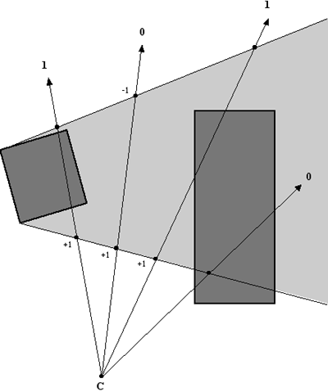
Stencil Test
Example: shadow volume
PASS1:increase stencil value if front face and pass depth test
PASS2:decrease stencil value if back face and pass depth test
PASS3:draw shadow if stencil value not equal to 0

Slide 14
Pass 1
Mask color buffer and depth buffer
Use glColorMask and glDepthMask
Enable back face culling
glCullFace(GL_BACK);
Increase stencil value if depth test is passed
Draw shadow polygons
Stencil value = 1
Stencil value = 0

Slide 15
Pass 2
Mask color buffer and depth buffer
Enable front face culling
glCullFace(GL_FRONT);
Decrease stencil value if depth test is passed
Draw shadow polygons
Stencil value = +1 -1 = 0
Stencil value = +1

Slide 16
Pass 3
Set stencil pass condition
NotEqual to zero
Render shadow
(There are many ways to combine color.)
Camera
0
Screen
0
1
0
Blended with shadow

Slide 17
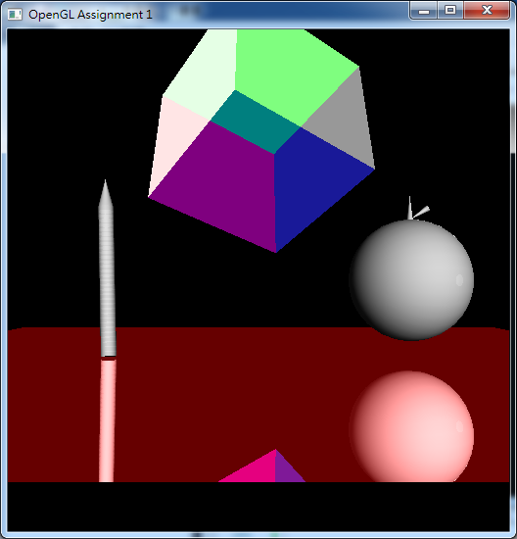
Stencil Test
Example: mirror scene

Slide 18
PASS1
Mask color buffer and depth buffer
Use glColorMask and glDepthMask
Increase stencil value if depth test is passed
Draw mirror polygons

Slide 19
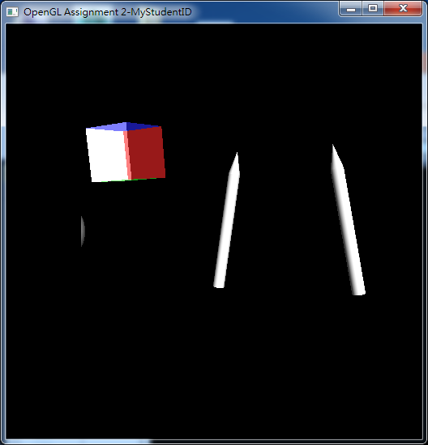
PASS2
Set stencil pass condition
NotEqual to zero
Render mirror Scene

Slide 20
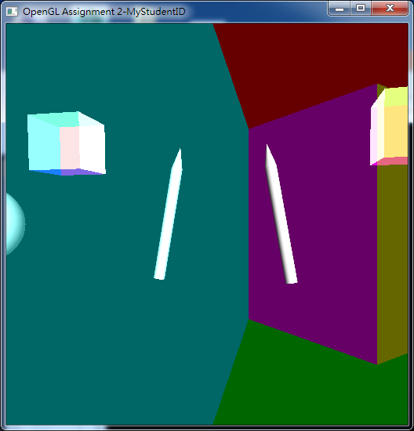
PASS3
Draw mirror and blending

