Slide 1
Lab 0.Warm-Up
DL-TA
鍾嘉峻

Slide 2
規則
請準時寫完作業，並準時交到E3上
請勿抄襲，作業請自己加油
有用我們提供機器的人請勿拿去挖礦
善用TA不要怕 <3 咱們都蠻好的，大膽的跟我們聯絡吧

Slide 3
規則

Slide 4
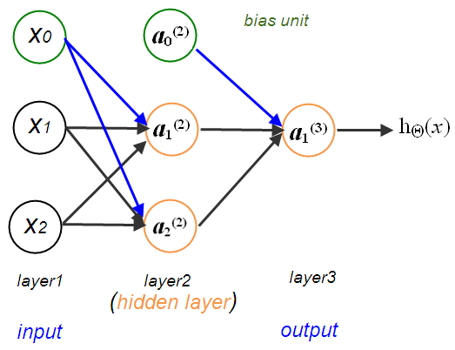
Lab: Warn-up

Slide 5
Lab: Warn-up
Requirements:
Implement a simple neural networks with one hidden layer
You must use “backpropagation” in this neural network
only can use Numpy and other python standard library
DL/ML framework is not allowed in this lab.
Tensorflow
Pytorch
….
DEADLINE:
2018/3/20 23:59:59

Slide 6
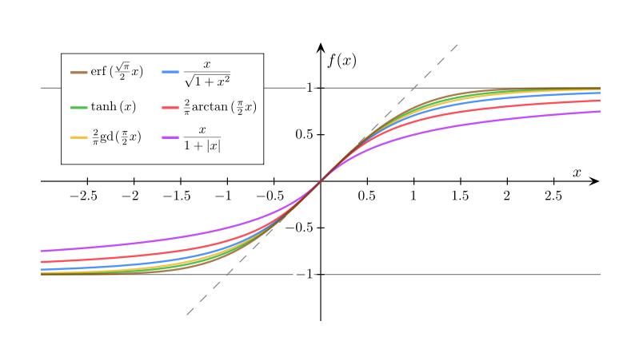
Sigmoid functions
Check the WIKI

Slide 7
Sigmoid functions
def sigmoid(x):
return 1.0/(1.0 + np.exp(-x))

Slide 8
Input
X = np.array([[0, 0],
[0, 1],
[1, 0],
[1, 1]])
Y = np.array([0, 1, 1, 0])

Slide 9
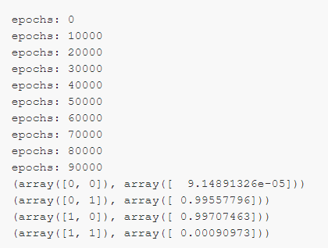
Output

Slide 10
參考資料
Python Standard Library:
https://docs.python.org/3/library/index.html
Logical regression:
http://www.bogotobogo.com/python/scikit-learn/logistic_regression.php
Python tutorial:
https://docs.python.org/3/tutorial/
Numpy tutorial:
https://www.tutorialspoint.com/numpy/index.htm
Example for AND gate:
https://gist.github.com/annanay25/b6a94ab7e399f75411b2

Slide 11
Bonus
Change the model into two hidden layers (5%)
超賺

Slide 12
Report Spec
1.Introduction (15%)
2.Experiment setups:
A.Sigmoid functions (10%)
B.Neural network(10%)
C.backpropagation(10%)
3.Results:
A.Results of your testing (30%)
(1).screenshot
(2).anything you want to present
4.Discussion (25%)
A.Anything you want to share(5%)

