Slide 1

BridgeWatch AI
Exploratory data analysis and modeling approach
Predicting which bridges' condition ratings will drop by their next inspection
139,079
7
6
3
bridges (2025)
states
years of inspections
data sources
Edmund L. Goldsberry · UMBC DATA 606 Capstone
Notes:
Introduce the project: BridgeWatch AI uses federal bridge inspection records, weather, and state spending data to predict which bridges are likely to see their condition rating drop by the next inspection. Today covers the data, how it was cleaned and selected, what the exploratory analysis found, and how the first model was chosen and trained.

Slide 2
THE PROBLEM
Why predict bridge deterioration?
Every U.S. highway bridge is inspected every 12 to 24 months, and the results go to FHWA's National Bridge Inventory. Budgets are limited, so states cannot fix or re-inspect every bridge every year.
1
Can we predict it?
Will a bridge's rating drop by its next inspection, using only what is known today?
2
What drives it?
A model that flags bridges likely to decline before the next inspection helps planners focus limited inspection and repair resources where they are needed most.
Which factors matter most: age, traffic, material, scour risk, condition?
3
Does climate matter?
Do weather conditions add information beyond the bridge's own attributes?
4
Does spending matter?
Is a state's bridge repair spending related to how fast its bridges decline?
BridgeWatch AI · UMBC DATA 606
2
Notes:
The motivation is resource allocation. The four research questions on the right guide the whole project. Questions 3 and 4 are why two extra data sources, weather and state spending, were added to the bridge records.

Slide 3



DATA SELECTION
Three public data sources
Bridge inspections
Weather
State bridge spending
FHWA National Bridge Inventory
NOAA nClimGrid-Daily
FHWA Highway Statistics, Table SF-12A
42 files: 7 states × 6 years (2020 to 2025)
123 columns, one row per bridge
824,312 bridge-year records
Age, design, traffic, condition ratings
Daily temperature and precipitation on a ~5 km grid
72 monthly files, about 4.6 GB
Each bridge matched to its nearest grid cell
Summarized to one row per bridge per year
What each state spent on bridge replacement and repair
5 yearly workbooks × 14 sheets
Summed to 35 state-years (2020 to 2024)
Thousands of dollars
BridgeWatch AI · UMBC DATA 606
3
Notes:
The core dataset is the National Bridge Inventory. Weather was added to test research question 3, and state spending to test research question 4. All three are free, official government sources. The weather files were far too large to keep, so a script downloads them, summarizes them to one row per bridge per year, and deletes the raw grids.

Slide 4
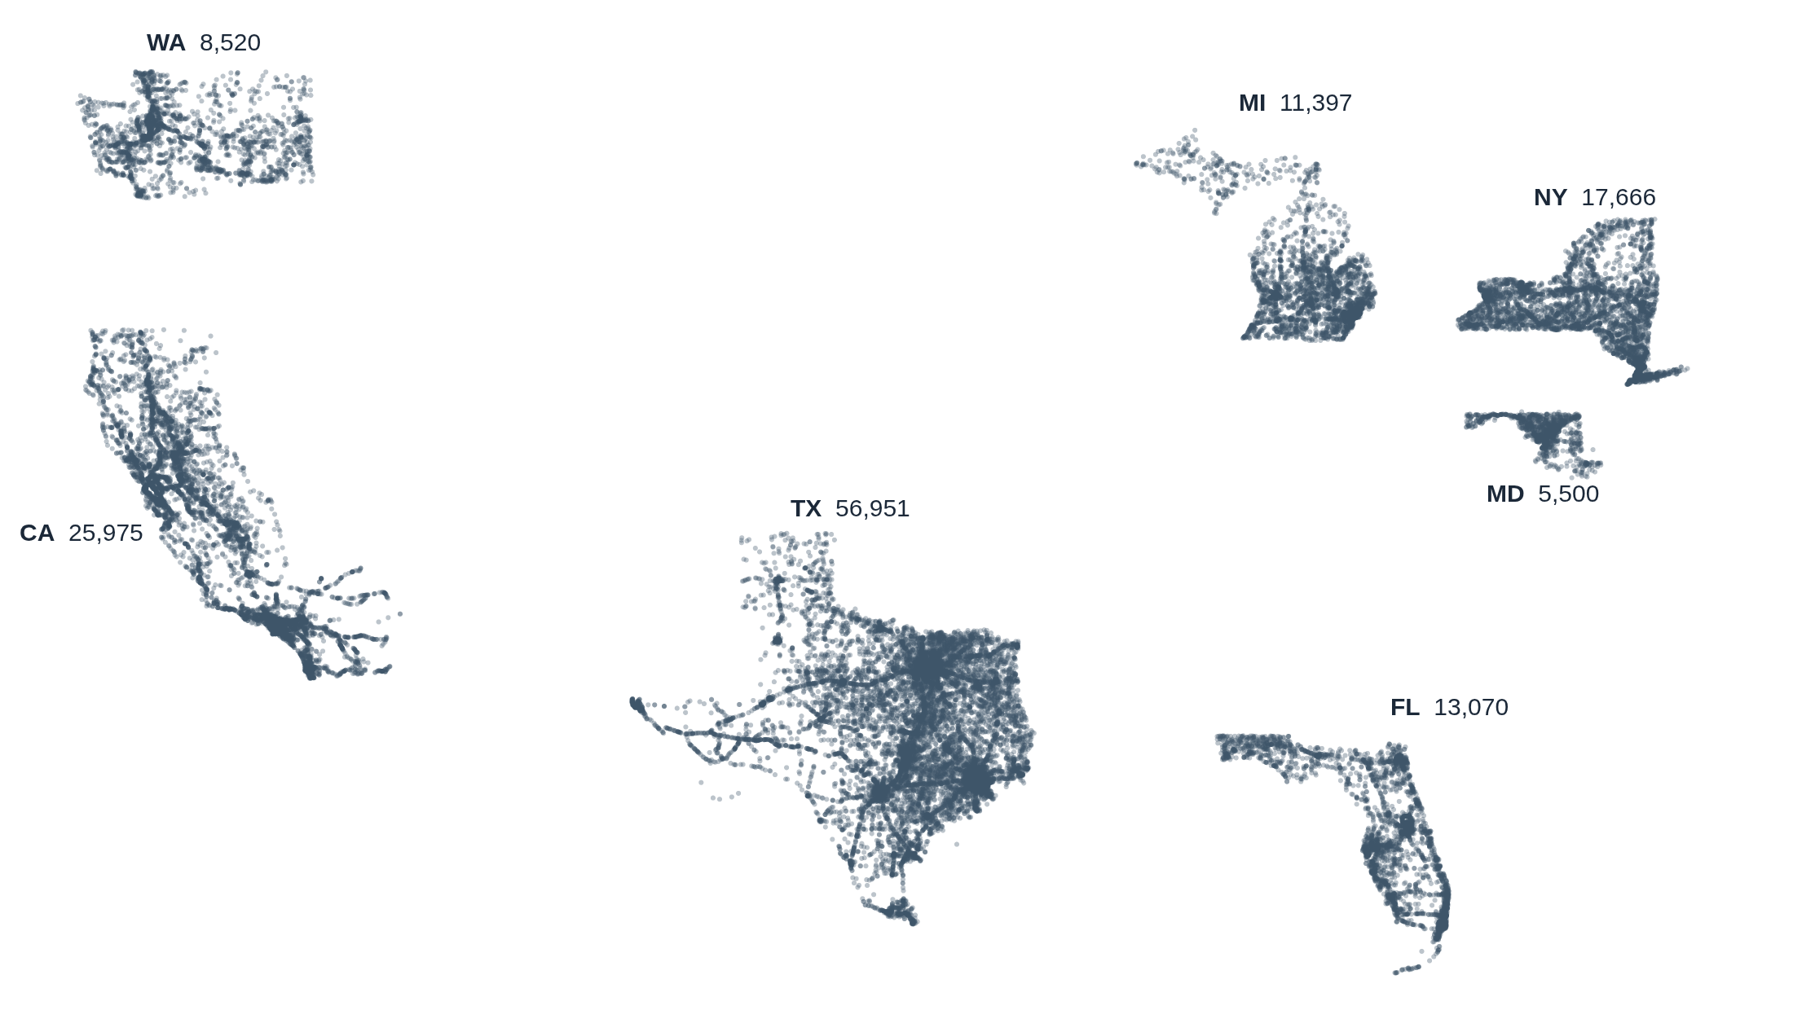
DATA SELECTION
Seven states, chosen for geographic and climate diversity
Why these states
Cold winters: Michigan, New York
Hot and humid: Florida, Texas
West Coast: California, Washington
Mid-Atlantic: Maryland
Texas alone holds 41% of the bridges; Maryland has the fewest (5,500).
Bridge locations, 2025 (sample of 40,000 points)
BridgeWatch AI · UMBC DATA 606
4
Notes:
The seven states give a wide range of climates, which matters for the weather question. The map is drawn from the decoded bridge coordinates, and the clean state outlines are a sanity check that the coordinate decoding worked. Texas dominates the bridge count, which is worth keeping in mind for any overall statistic.

Slide 5
BUILDING THE TARGET
What the model predicts
2020
2021
2022
2023
2024
2025
Each bridge's record in one year is paired with its record the next year: 5 year-to-year transitions per bridge.
681,841
deteriorated_next_period
= 1 if the bridge's LOWEST_RATING next year is lower than this year
= 0 if it stayed the same or improved
LOWEST_RATING is FHWA's minimum of the deck, superstructure, substructure, and culvert ratings (0 = failed, 9 = excellent). It is never missing.
bridge transitions in the model dataset
4.34%
deteriorated (29,583 transitions): a 22 to 1 imbalance
BridgeWatch AI · UMBC DATA 606
5
Notes:
The target is built by pairing each bridge with itself one year later. Only about 4 in 100 transitions are a drop, so this is a heavily imbalanced problem. That imbalance shapes how the model is trained and evaluated later: accuracy is not a useful measure here.

Slide 6




DATA CLEANING
Checking the raw files before trusting them
Same columns in every file
Duplicates removed
All 42 files share one identical 123-column layout, so they can be stacked and joined safely even though FHWA was changing its coding standard in this period.
2 rows dropped: an exact duplicate in Texas 2022, and two different California bridges that were given the same ID in 2021.
Join key is reliable
Suspicious values flagged
Over 99% of bridges carry the same ID from one year to the next in every state, so bridges can be followed over time.
5 ages over 200 years and 684 bridges (0.49%) reporting zero daily traffic were checked and kept, since they are rare and plausible.
BridgeWatch AI · UMBC DATA 606
6
Notes:
These are the basic integrity checks. The schema check came first because the whole approach depends on joining files across years. Only 2 rows needed removing. The zero-traffic and very old bridges are rare enough that they were kept rather than guessed at.

Slide 7
DATA CLEANING
Decoding and validating bridge locations
Problems found (2025 snapshot)
The raw format
Latitude and longitude are stored as packed integers with no decimal point or sign.
10
blank coordinates
Raw LAT_016
40454199
370
stored in a nonstandard signed decimal format (0.27%)
Read as
40° 45′ 41.99″
146
decode fine but land outside their state, e.g. placeholder codes 00000000 and 99999999
Decoded
40.7617
Longitudes are made negative, since every bridge here is in the western hemisphere.
Decision: set these to missing rather than guess. Only 156 of 139,079 bridges (0.11%) lose their location, and a wrong location is worse than none on a risk map.
BridgeWatch AI · UMBC DATA 606
7
Notes:
Location needed the most careful cleaning. Two separate checks were used: whether the value is a plain digit string, and whether the decoded point falls inside the state's boundary box. The out-of-bounds values are mostly placeholder codes in Maryland, not real GPS errors. Masking them affects only the map, not model training.

Slide 8



DATA CLEANING
Missing values: mostly small, and some are by design
Missing by design
Culverts only have a culvert rating; other bridges only have deck, superstructure, and substructure ratings. So the target uses LOWEST_RATING, which covers both.
Weather gaps are coastal
About 1.4% of bridges sit next to a grid cell just offshore, so they get no temperature values.
How gaps are filled
Inside the model: numbers get the median, categories get the most common value. Learned from training data only.
Every other feature is 0% missing.
BridgeWatch AI · UMBC DATA 606
8
Notes:
Missing data was small across the board. The important insight is that the component condition ratings look very incomplete, but that's structural: a culvert and a regular bridge are rated on different fields. That is why the target is built on LOWEST_RATING instead of any single component rating. Remaining gaps are filled inside the model pipeline, fit on the training data only.

Slide 9
FEATURE SELECTION
What goes into the model, and what stays out
26 features kept
Left out, and why
Current condition: LOWEST_RATING, deck / superstructure / substructure / culvert ratings
Age and design: age, material, structure type, deck type, spans, length, width
Use: daily traffic, truck share, lanes, inspection interval
Risk and ownership: scour rating, owner, state
Location: latitude, longitude
Weather: max / min / average temperature, precipitation, freeze and thaw days
Bridge ID
an identifier, not a predictor
Year built
replaced by age, which is more directly useful
Overall condition (G/F/P)
a coarse summary of the same ratings
Year columns
used only to split train and test
Spending per bridge
tested, then dropped (see results)
BridgeWatch AI · UMBC DATA 606
9
Notes:
Features were chosen to cover the bridge's condition, age, design, use, and environment, using only information known at the time of an inspection. Current condition ratings are legitimate predictors, not leakage: they describe this year, while the label is about next year. Spending was included in the first model and then removed after testing, which is covered in the results.

Slide 10
EXPLORATORY ANALYSIS
What the bridge inventory looks like (2025)
50 yrs
median bridge age (oldest listed: 225)
3,400
median vehicles per day (range 0 to 810,110)
4.3%
of bridges rated Poor overall (46.7% Good, 49.0% Fair)
BridgeWatch AI · UMBC DATA 606
10
Notes:
A quick profile of the inventory. The typical bridge is about 50 years old. Traffic is extremely skewed, from zero to over 800,000 vehicles a day, so it was plotted on a log scale in the notebook. Michigan and New York have by far the largest share of bridges in poor condition, which previews the deterioration results on the next slide. By material, wood and steel bridges are most often rated poor.

Slide 11
EXPLORATORY ANALYSIS
How often do ratings drop?
Michigan and New York deteriorate at more than twice Maryland's rate. Year to year, the overall rate stays in a narrow 3.9% to 4.7% band.
BridgeWatch AI · UMBC DATA 606
11
Notes:
The deterioration rate varies a lot between states: Michigan and New York stand out, both states with harsh winters, which is what motivated adding weather data. Across years the rate is stable, which is good news for a time-based train and test split: the test year is not unusual.

Slide 12
KEY FINDING
Top-rated bridges are the most likely to drop
Why?
A bridge rated 9 can only stay at 9 or go down, and new or freshly repaired bridges tend to settle from 9 to 8 as normal wear appears.
What it means
The label counts any one-point drop: 9 to 8 counts the same as 4 to 3. So the model predicts the chance of a rating drop, not the chance of a bridge becoming unsafe.
BridgeWatch AI · UMBC DATA 606
12
Notes:
This was the most surprising result of the analysis. Bridges in the best condition drop the most often, 22% of 9-rated bridges versus 2 to 3% in the middle of the scale. It changes how the model's output should be described, and it suggests future work: a label that weighs drops by how serious they are. Ratings 0 and 1 are left off the chart because there are only a few hundred of them.

Slide 13

EXPLORATORY ANALYSIS: WEATHER
Climate differs sharply across the seven states
How it was built
Each bridge was matched to its nearest ~5 km grid cell; daily values were summarized per year into 5 features.
How it joins
On bridge ID and year. 98.5% of model rows get a weather match.
Why it matters
A freeze and thaw day (above 0°C by day, below at night) lets water in cracks freeze and expand, a known cause of deck damage.
BridgeWatch AI · UMBC DATA 606
13
Notes:
New York and Michigan average around 90 freeze and thaw days a year, while Florida has about 3. That's the same pattern as the deterioration rates, which is why weather was a promising addition for research question 3.

Slide 14
EXPLORATORY ANALYSIS: SPENDING
More spending goes with more deterioration, across states
State | Repair $ per bridge (thousands) | Deterioration rate
MI | 56.1 | 7.07%
NY | 50.5 | 6.71%
WA | 45.9 | 2.94%
FL | 36.2 | 4.35%
MD | 29.5 | 2.75%
TX | 18.3 | 3.44%
CA | 11.3 | 4.24%
+0.60
correlation across states: high spenders have more deterioration
−0.13
correlation within a state over time: a weak link, in the other direction
Most likely explanation: states spend where bridges are already in poor shape. Spending follows condition; it does not cause decline.
State averages, 2020 to 2024. Spending divided by each state's bridge count, since raw totals mostly reflect state size.
BridgeWatch AI · UMBC DATA 606
14
Notes:
For research question 4, spending was converted to dollars per bridge so large and small states could be compared. The two correlations tell different stories. Across states the link is positive, most likely because money goes where it is needed. Within a state over time it is weak. With only 35 state-year values, this was flagged as a risky feature before modeling even started.

Slide 15




MODEL SELECTION
Why Logistic Regression?
Interpretable
Handles imbalance
Fast at this scale
A strong baseline
Each coefficient says how much a feature pushes risk up or down, so the app can explain every bridge's score.
class_weight = "balanced" weights the rare deteriorated cases more heavily, without resampling.
Trains quickly on over half a million rows, so different versions can be compared easily.
A standard first model. Anything more complex has to beat it to justify the added complexity.
More flexible models (random forests, gradient boosting) can capture more complex patterns but are harder to explain. They are the planned comparison, not the starting point.
BridgeWatch AI · UMBC DATA 606
15
Notes:
Interpretability was the deciding factor, because the end product is an app that has to explain why a bridge was flagged. Logistic Regression also deals with the class imbalance directly and trains fast enough to run the data source comparison. A more flexible model, like gradient boosting, is a natural next step to compare against this baseline.

Slide 16
TRAINING
How the model was trained
26 features
Fill gaps
Scale + encode
Logistic Regression
bridge + weather
median / most common
numbers scaled, categories one-hot: 154 columns
balanced class weights
One scikit-learn pipeline, fit on training data only, so nothing about the test year leaks into preprocessing.
Time-based train / test split
Train: transitions ending 2021 to 2024 · 543,921 rows
Test: 2025 · 137,920
Mirrors real use: learn from past years, then forecast a year the model has never seen. The same bridge can appear in both sets, but its 2025 outcome is never used in training.
BridgeWatch AI · UMBC DATA 606
16
Notes:
Preprocessing and the model are wrapped in one pipeline so the exact same steps run in training, testing, and later in the app. The split is by time rather than random: the model learns from transitions ending 2021 to 2024 and is tested on 2025. A random split would mix years and give an overly optimistic score.

Slide 17
RESULTS
How well does it work on 2025?
0.722
ROC AUC (0.5 = random guessing)
0.118
average precision, 2.6× the 0.045 a random ranking would score
Accuracy is misleading here: always predicting "no drop" is 95% accurate and catches nothing.
BridgeWatch AI · UMBC DATA 606
17
Notes:
The headline number for this use case is the capture rate. If inspectors worked down the model's list, the riskiest 20% of bridges contain almost half of all the 2025 rating drops, about 2.4 times better than checking at random. ROC AUC of 0.72 is a solid but not exceptional score, which is expected for a first, simple model.

Slide 18
TESTING THE NEW DATA
Each data source had to earn its place
Bridge only
+ Weather
+ Spending
0.7215
0.7224
0.7164
test ROC AUC
test ROC AUC
test ROC AUC
Baseline
Small but real gain: kept
Made it worse: dropped
Same model, same rows, only the features change. A bootstrap check (200 redraws of the test set) showed both differences are real, not luck.
Why spending failed: in 2020 to 2023, years with extra spending had slightly more deterioration, so the model learned "more spending = more risk." In 2024 that flipped: New York cut spending the most and its deterioration jumped over 5 points. With only 35 state-year values, the pattern was not stable.
BridgeWatch AI · UMBC DATA 606
18
Notes:
This slide answers research questions 3 and 4. Weather gives a small but reliable improvement, so it stays. Spending made the forecast worse, and the notebook traces exactly why. Dropping it is itself a finding: adding data does not guarantee a better model, and each source has to be tested on data the model hasn't seen. The spending analysis is still kept in the EDA and can appear in the app as background.

Slide 19


INTERPRETING THE MODEL
What drives a bridge's risk score?
Condition comes first
Components already in poor shape raise risk sharply: a culvert rated 3 (serious) has about 24× the odds of a further drop.
Then age
Every 25 or so years of age raises the odds of a drop by about 25%.
Traffic barely matters
Once condition and age are known, how busy a bridge is adds almost nothing.
BridgeWatch AI · UMBC DATA 606
19
Notes:
Research question 2. The Logistic Regression coefficients are turned into odds multipliers for a typical change in each feature. The current condition rating dominates, then age. Individual weather coefficients point in mixed directions because the temperature measures are 93 to 98% correlated with each other, so weather is judged as a group, which is what the with and without comparison did. For the app, each bridge's score can be split exactly into these contributions to explain it.

Slide 20
LIMITATIONS AND NEXT STEPS
Where the project goes from here
Limitations
Next steps
Any one-point drop counts, whether 9 to 8 or 4 to 3
Only six years and seven states of data
Spending is state-level only: 35 values in total
About 1.4% of bridges lack temperature data; 0.11% lack a location
Save the final bridge + weather model
Build the Streamlit app: bridge lookup with explained risk scores, and a state risk map
Compare against a more flexible model, such as gradient boosting
Try a label that weighs drops by how serious they are
Questions?
Notes:
Close with the honest limitations, especially that the label treats every one-point drop the same. Next steps are saving the model and building the app, then testing whether a more flexible model or a severity-weighted label improves on this baseline.

