Slide 1
FreeMind
For what do we need
Open-Source mind mapping?

Slide 2
Contents
Introduction
Use Cases
Timeline
Motivation
For what do we need Open-Source mind mapping?

Slide 3
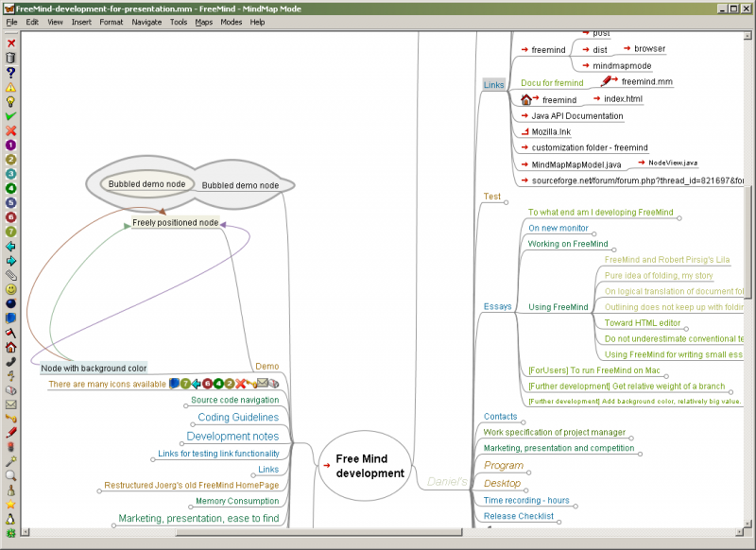
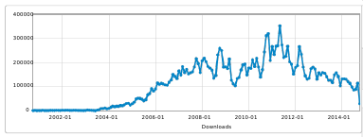
Introduction
FreeMind is an open-source mind mapping application
  Home is http://freemind.sourceforge.net/
  Since 2000: 19 million downloads
  Licensed under Gnu Public License
    Private and commercial use allowed
  Currently version 1.0.1
  Directors
    Jörg Müller (founder)
    Daniel Polansky
    Christian Foltin
  Team: currently 1 person

Slide 4
Use cases
Structure
  Concepts, documents, thoughts
  Used in an early phase
  Later normally replaced by presentations, documents, papers, …
Database for useful information
  Hyperlinks (www and local)
  Office swiss army knife (calendar, ...)
Exotic use cases
  house hunting

Slide 5

Timeline
History
2000: (0.1-0.6)
  Bare mind mapping application
  Folding
2004 (0.7)
  Clouds, Arrow links, Plugins
  Icons
2005 & 2008 (0.8)
  Undo
  Import/Exports
  Automatic coloring
  Encrypted nodes/maps
  Notes
2011 (0.9)
  Filters + Attributes
  Timer support
  Pattern editor
  Scripting

Slide 6
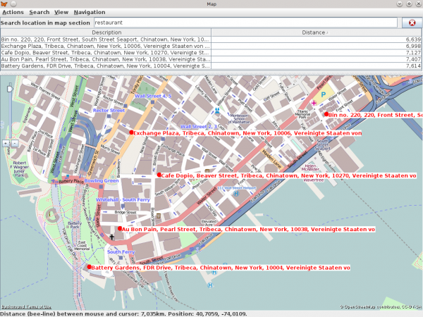
Timeline
Today
Version 1.0: Advanced features
  „Clones“: exact copies of nodes
    Synchronized trees
  Mind mapping over the network
    Working together on the same map
  Association of geographical positions to nodes
    Integrated geo-map application (based on open street maps)
    Examples: associate customers, restaurants, ... with their location

Slide 7
Timeline
Future
Android Application for Smart Phones
  Text based?
FreeMind Map Server application
  Serving multiple maps
  Concurrent edits
More flexible GUI
  Format dialog with preview

Slide 8
Timeline
Limitations
FreeMind wouldn't have
(unless some developers do it)
  More ex-/import to other mind mapping tools
  Close integrations into Windows applications
  Support for project planning
  Exotic layouts (e.g. fish bone)
"Old fashioned" look and feel
  Like Emacs ;-)

Slide 9
Motivation
FreeMind in every day usage
  Easy to use
    Keyboard shortcuts
    Automatic layout (don't try to improve it!)
  Focus on data/structure
    Few distractions
Development of demanding features
  Clones
  Network sharing
  Android

Slide 10
For what do we need
Open Source Mind Mapping?
Free to use
  For Schools
  Test of mind mapping method
  Without business interests
Object for studies
  Universities
Experiments/Innovation

