Slide 1
General polygon Boolean operations based on binary space partitioning tree
Gyu Jin Choi
2023.04.05

Slide 2
references
Bernstein G, Fussell D. Fast, exact, linear booleans[C]//Computer Graphics Forum. Blackwell Publishing Ltd, 2009, 28(5): 1269-1278.
Naylor B, Amanatides J, Thibault W. Merging BSP trees yields polyhedral set operations[C]//ACM SIGGRAPH Computer Graphics. ACM, 1990, 24(4): 115-124.
Thibault W C, Naylor B F. Set operations on polyhedra using binary space partitioning trees[C]//ACM SIGGRAPH computer graphics. ACM, 1987, 21(4): 153-162.
Thibault W C. Application of binary space partitioning trees to geometric modeling and ray-tracing[J]. Ph.D. Dissertation, Georgia Institute of Technology, Atlanta, Georgia, 1987.

Slide 3
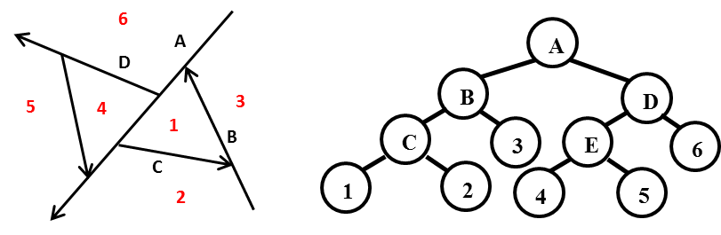
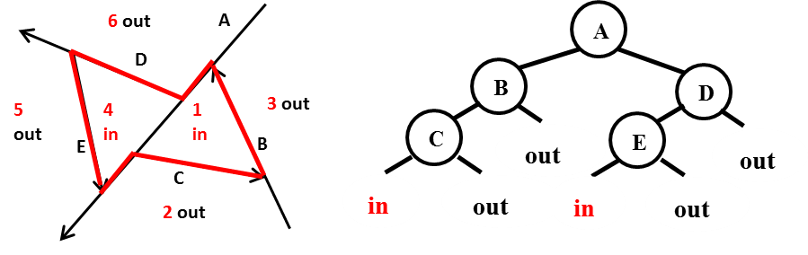
Intro: BspTree
h+
P
Each node represents a region.
If the node is not a leaf node, the node also contains a partition.
p
h-
h+
h-
a.区域r和r中的一个划分p
b. a中对应的BspTree
Bsptree介绍
a.区域的空间分割 b.用BspTree表示各个区域
a. Target simple polygon (red border) b. BspTree representation of the target simple polygon area in a
Use BspTree to express simple polygon area
用BspTree表示空间区域

Slide 4
Merge two BspTree
When performing Merge operation on two BspTree (for A and B), select one as the split BspTree and one as the split BspTree. A is the split BspTree, B is the split BspTree.
Tree A
Tree B
a
1
b
c
2
3
d
e
f
g
4
5
6
7
h
…
…
…
…
B_Left
B_Right
2
1
4
5
…
3
…
…
6
7
…
…
Notes:
多边形的bool运算通过BspTree的merge来完成

Slide 5
Merge two BspTree
When one of A or B is found to be a leaf node, the leaf merging algorithm is used, and different Boolean operations are processed accordingly.
There is an error in the Merging BSP trees yields polyhedral set operations article.
Merge_Tree_With_Cell:(A,B:BspTree) -> BspTree
::=
VAL :=
IF A.is_an_InCell
THEN
CASE operation
Union -> A
Intersection -> B
Difference ->Complement_BspTree(B)
END
ELSE IF A.is_an_OutCell
THEN
CASE operation
Union -> B
Intersection -> A
Difference -> A
END
ELSE IF B.is_an_InCell
THEN
CASE operation
Union -> B
Intersection -> A
Difference -> OutCell
END
ELSE
THEN
CASE operation
Union -> A
Intersection -> B
Difference -> A
END
END Merge_Tree_With_Cell

Slide 6
How to partition a BspTree
Tree A
Tree B
a
1
b
c
2
3
d
e
f
g
4
5
6
7
h
…
…
…
…
Split each node from top to bottom
B_Left
B_Right
2
1
4
5
…
3
…
…
6
7
…
…
Each time a node is divided, it is necessary to judge the positional relationship between the node partition in A and the node partition in B within the area represented by the node in B.

Slide 7
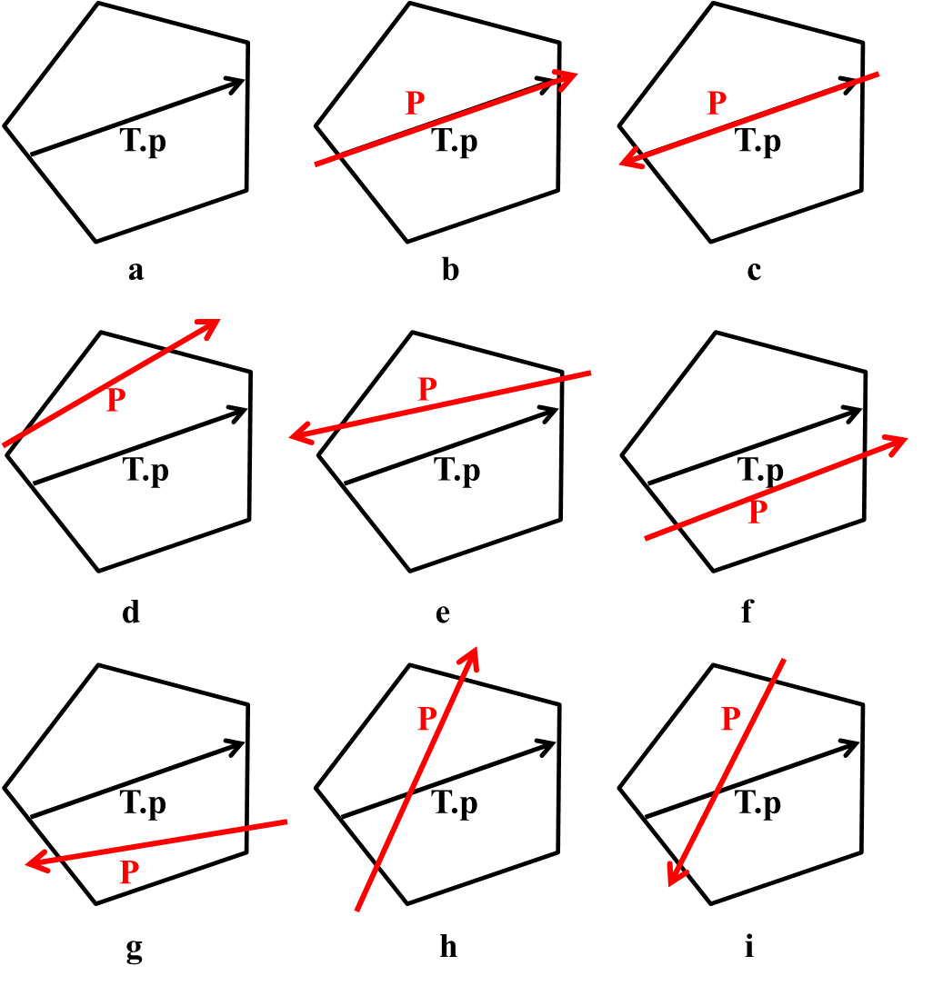
How to partition a BspTree
T.p represents the partition of the split node
(Node in B)
P represents the partition of the split node
(Node in A)
Let the split node be node1,
The process of splitting node1 is actually
The process of splitting the left and right child nodes of node1
Therefore, it is necessary to judge the positional relationship between T.p and P.
To determine the segmentation strategy for the left and right children of node1
Step by step recursion from B root node to leaf node

Slide 8
Generate polygon edges
The previous process has actually completed the Boolean operation task of BspTree, but this assignment
The sides of the polygon need to be displayed, so the sides of the polygon need to be extracted from the BspTree.
Thibault W C. Application of binary space partitioning trees to geometric modeling and ray-tracing[J]. Ph.D. Dissertation, Georgia Institute of Technology, Atlanta, Georgia, 1987.
Any edge of the resulting polygon must be the dividing line between the interior and exterior of the polygon.
So if an edge is both an edge of an inner region and an edge of an outer region, then this edge belongs to the boundary of the resulting polygon.
Notes:
论文中提到了这篇文章。

Slide 9

Complexity Analysis
Merge
简单实现: O($N^{3}$)
作者利用arrangements of hyperplanes技术 ϴ($N^{2}$)
优化merge过程：O($N^{2}$)
Generate polygon edges
$O(N^{2})$和$O(N^{2}logN)$之间

Slide 10
Others
合法性检查（利用了BspTree的区域划分）
环：
方向；
环内部除相邻边顶点重合外其他任何交点都非法。
区域：
环都合法；
内环都在外环内部；
内环之间区域重合面积应等于0；
环之间除顶点重合外，出现任何交点都非法。
多边形：
多边形：区域都合法；
区域之间区域重合面积应等于0；
区域之间除顶点重合外，出现任何交点都非法。
内存管理：容器记录，统一释放

Slide 11
E&Q

