Slide 1
基于Kinect手势交互的自平衡小车 A Kinect-based Self-Balancing Scooter
2017现代电子系统设计课程 · 分组创新实验
刘江（2015011xxx）
孙竟耀（2015011504）
金帆（2015011506）

Slide 2
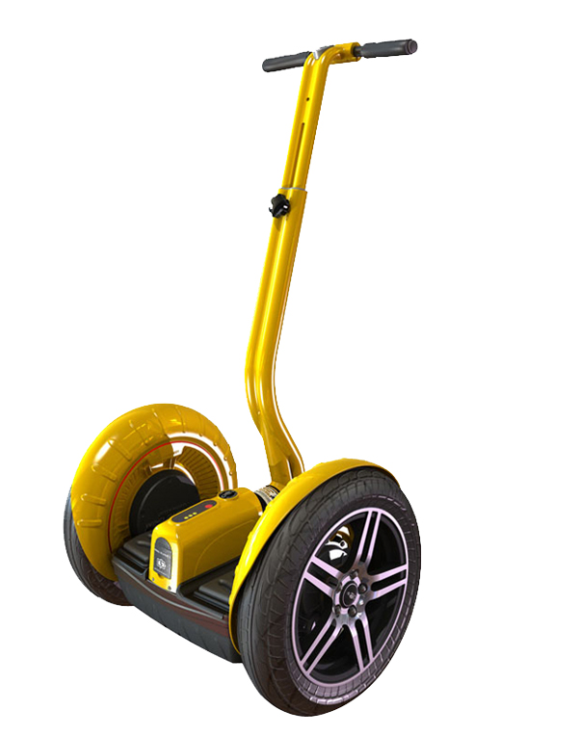
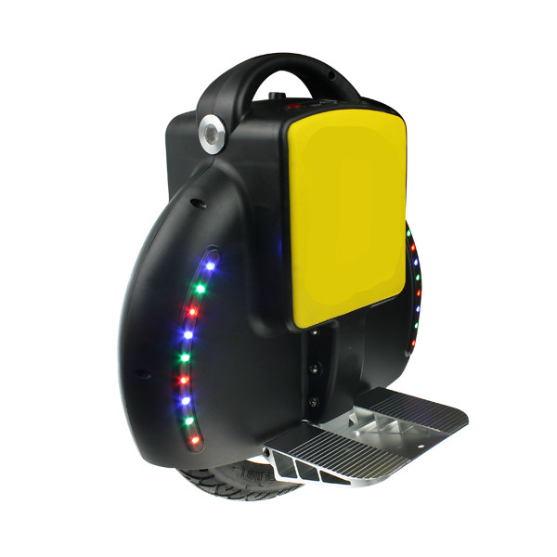
A dream of standing balance with two wheels, even fewer…
A 2 wheel (axis-inline) powered vehicle that balances both rider and itself based on rider's leaning action
自平衡车是一种轴向直列的两轮车，通过
How does it balance?
–Sensors measure the pitching angle and rate
–Signals are sent to motors to drive them accordingly

Slide 3
System Block Diagram

