Slide 1
Developing a
Digital Synthesizer in C++

Slide 2
What is a Synthesizer?

Slide 3
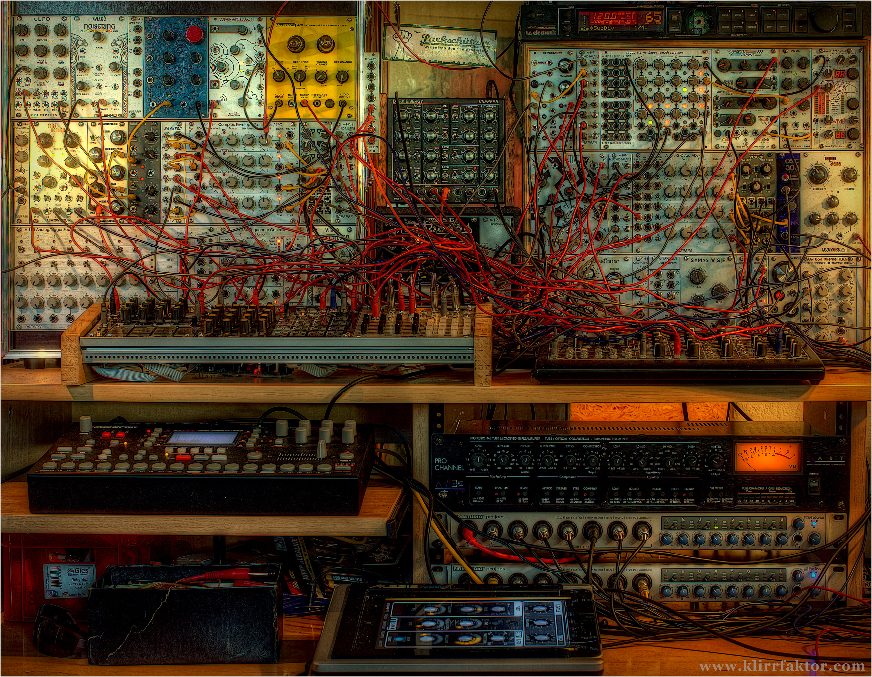
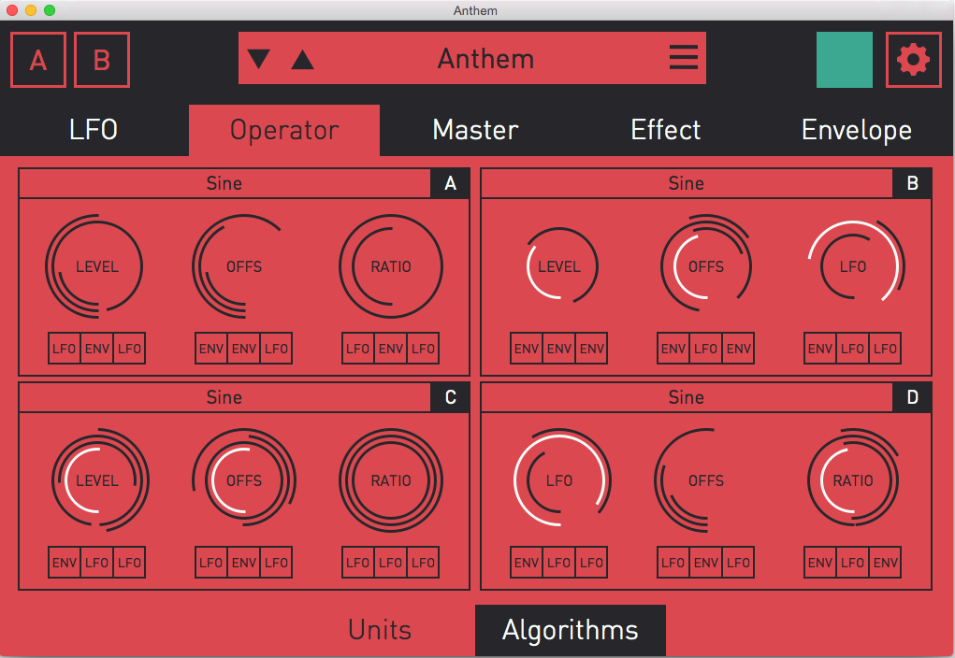
Source: http://devsound.se/2013/sjs-one-modular-expander
Analog
Digital

Slide 4
Recipe for a Digital Synthesizer:
The Generation of Sound
The Synthesis of Sound
The Modulation of Sound

Slide 5
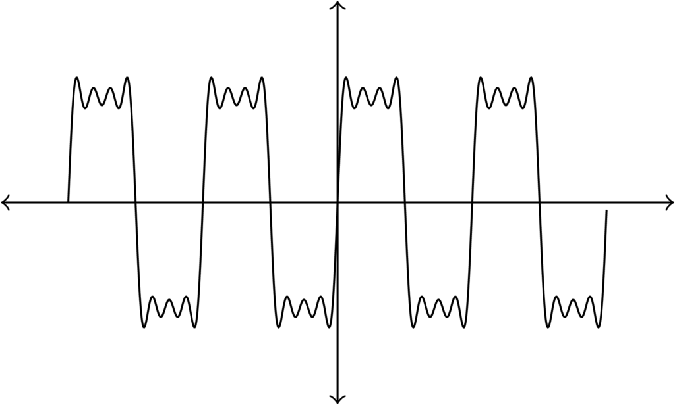
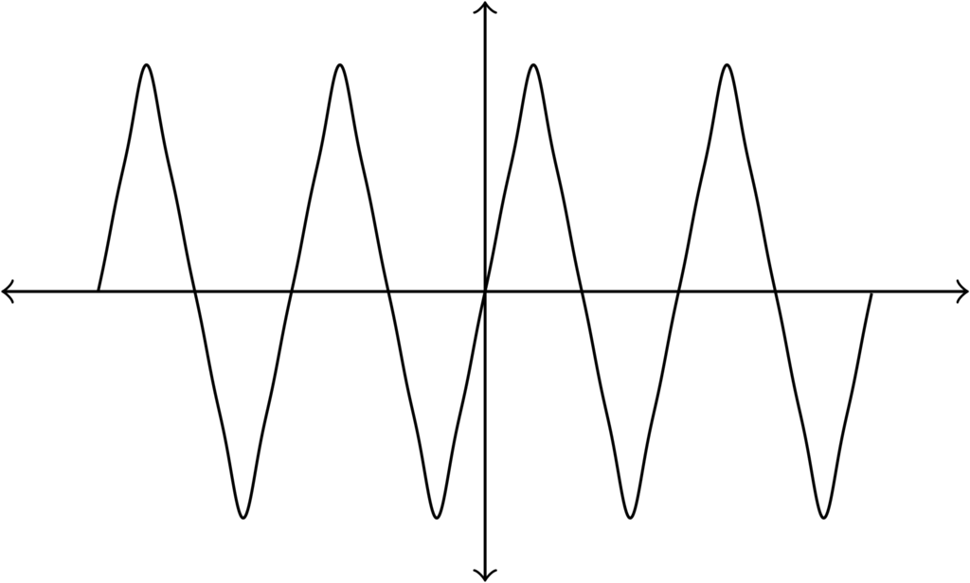
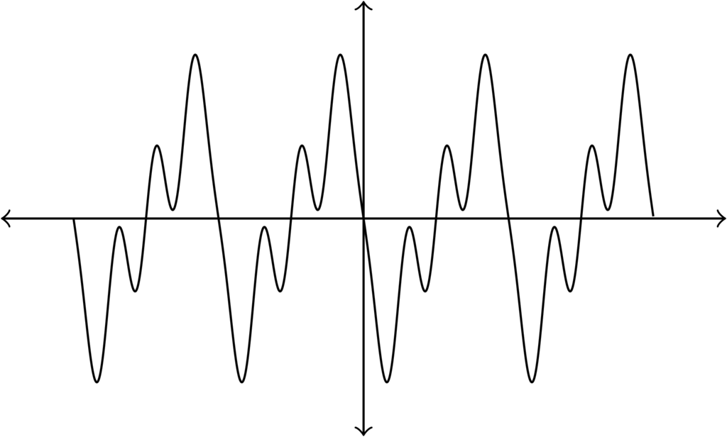
I. The Generation of Sound
Waveforms:
The basic building blocks of sound

Slide 6
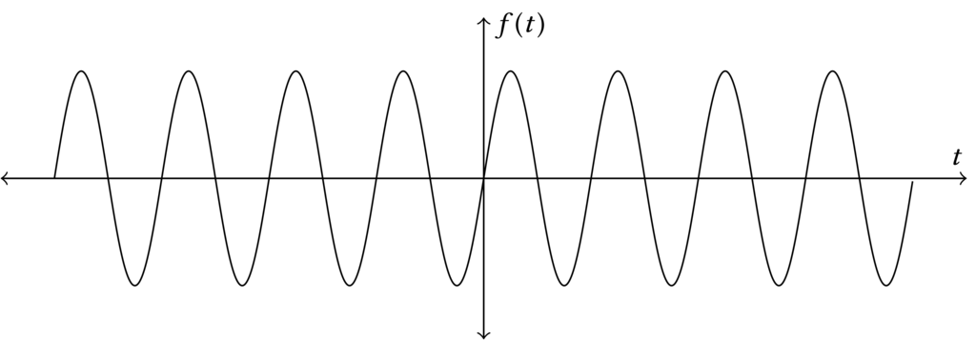
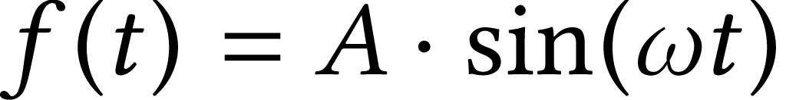
I. The Generation of Sound
Sine wave

Slide 7
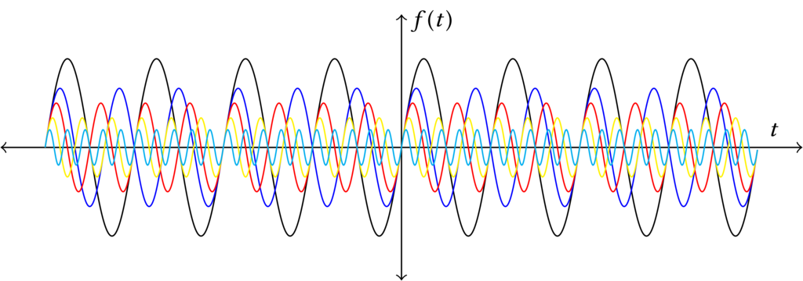
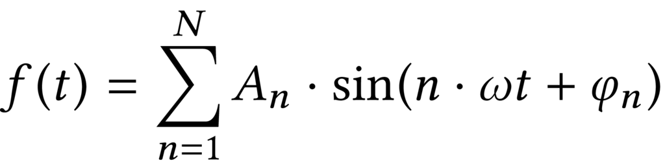
I. The Generation of Sound
Complex Waveforms: Additive Synthesis

Slide 8
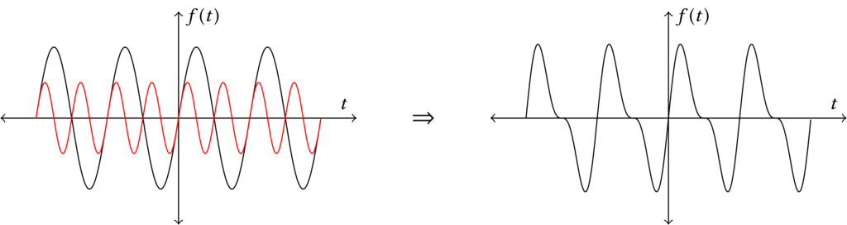
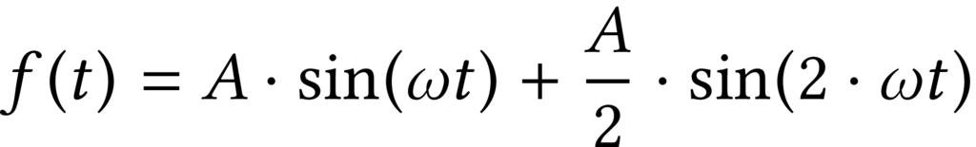
I. The Generation of Sound
Sawtooth Wave: 2 Partials

Slide 9
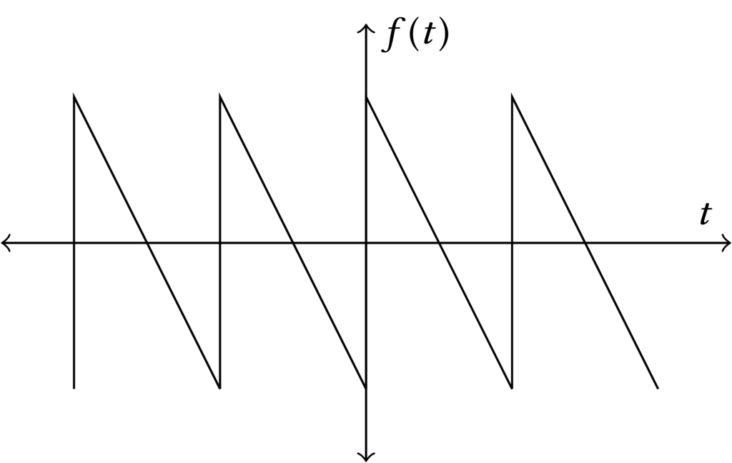
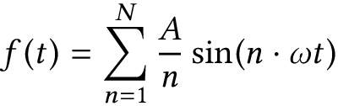
I. The Generation of Sound
Sawtooth Wave: Partials

Slide 10
II. The Synthesis of Sound
Frequency Modulation Synthesis

Slide 11
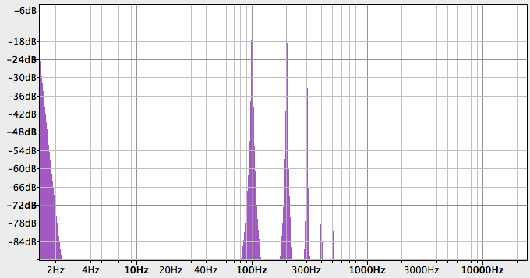
II. The Synthesis of Sound
C : M Ratio

Slide 12
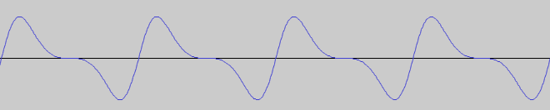
II. The Synthesis of Sound
C:M Ratio of 1:1 → Sawtooth wave

Slide 13
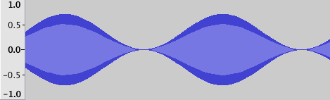
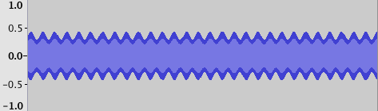
III. The Modulation of Sound
Low Frequency Oscillators

Slide 14
The Generation of Sound
The Synthesis of Sound
The Modulation of Sound

Slide 15
Thank you

