Slide 1

Computer Networks Fall 2020 Final Presentation
Team 3:
Muhammad Dahab
Software (Computer Science and Engineering)
2017314461
Moon Wonjun
Software (Computer Science and Engineering)
2017315482

Slide 2
#01 Background #02 Project Concept #03 HW Implementation #04 SW Implementation 1: HSV Detection Using OpenCV #05 SW Implementation 2: Socket Programming #06 SW Implementation 3: Full Integration and Moving Algorithm

Slide 3




Problem Formulation
IV Drip Stand
Oxygen Therapy Kit
Tiring and Inconvenient
Burden for Old Patients
#01
Background

Slide 4

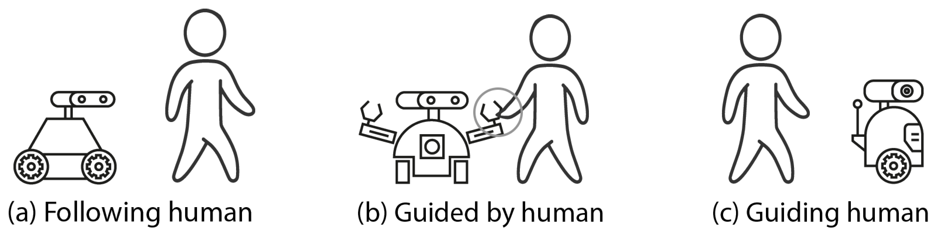
Project Idea
A robot that follows a specific color tag.
Users have to stick the tags on their back (yellow in the figure).
Keeps a fixed distance from the leader object.
Stops in case of an obstacle.
#02
Project Concept

Slide 5
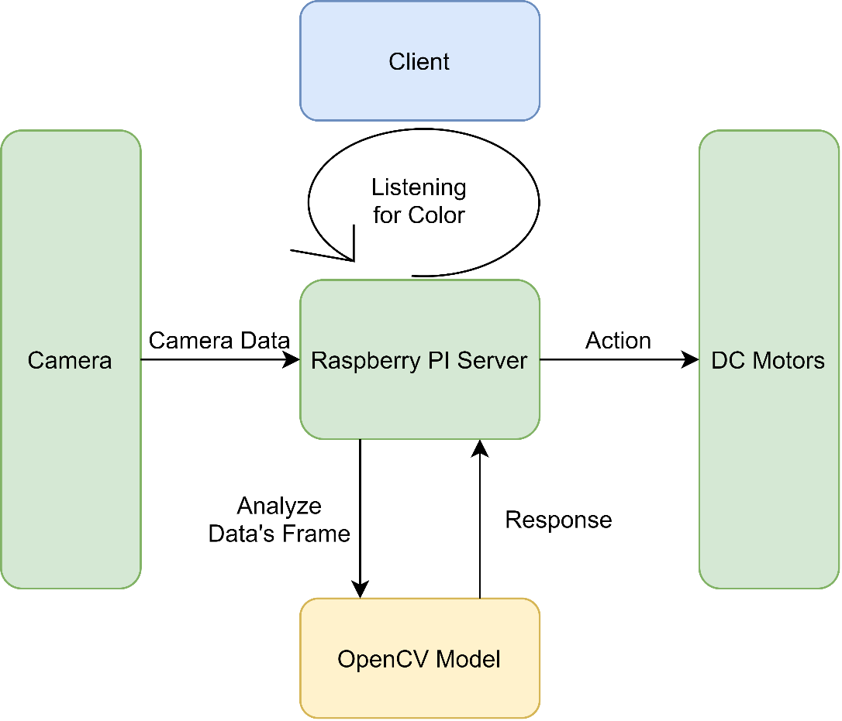

Architecture Diagram
Tag Detection
#02
Project Concept

Slide 6
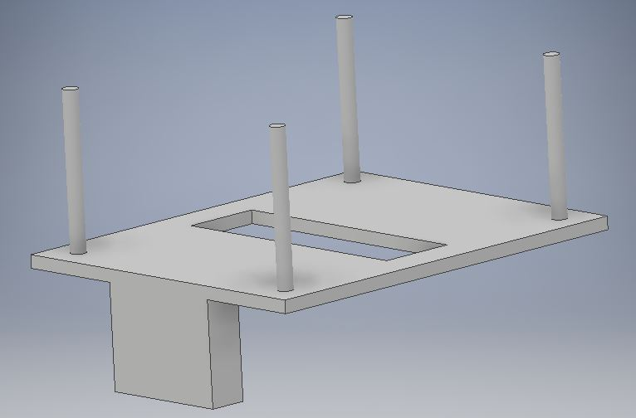
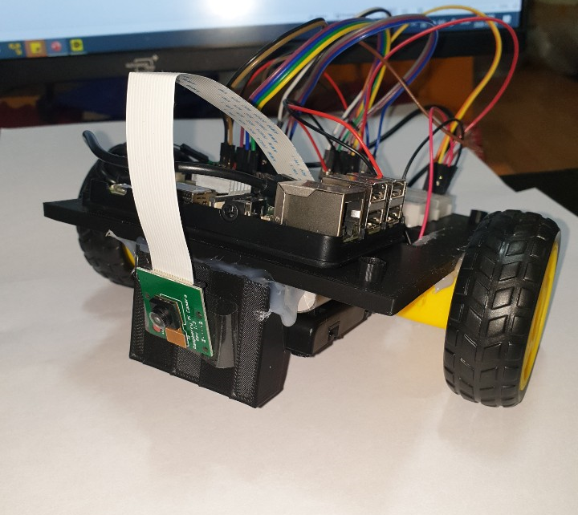
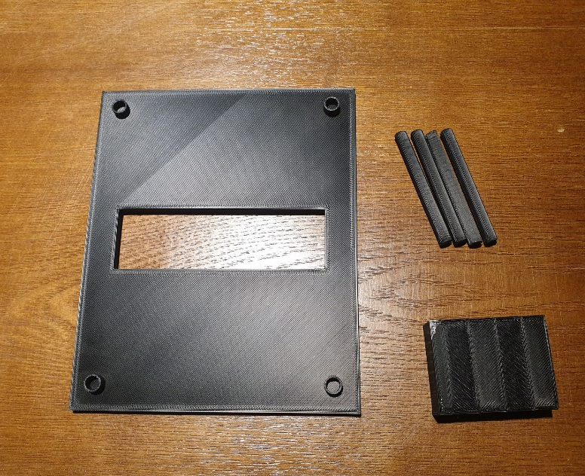
Hardware Assembly
Made everything from scratch ,3D printed and assembled the chassis.
#03
HW Implementation
Notes:
Change the dates here (Anythiing is fine)

Slide 7
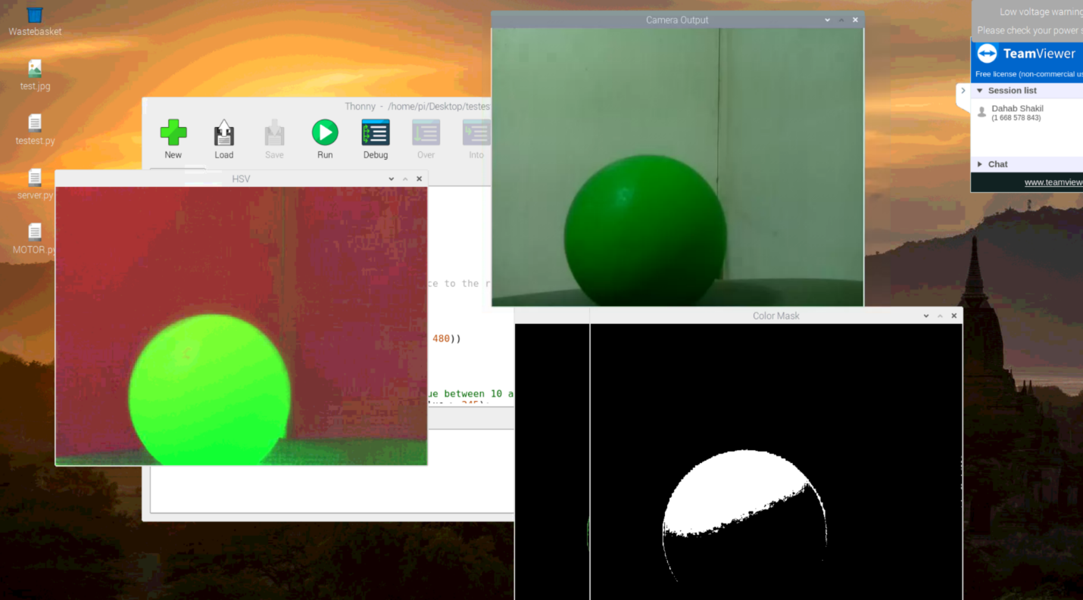
Using OpenCV’s APIs: 1
(3)
(1)
(2)
(1)
Using cvtColor() RGB is changed to HSV
Using inRange() we apply a threshold to remove all colors but a single hue and create a mask (white area).
Goal achieved: separated the test ball based on color from the background
#04
SW Implementation
Notes:
Change the dates here (Anythiing is fine)

Slide 8
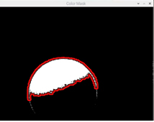
Using OpenCV’s APIs: 2
findContours()
Using findContours() we were able to find:
Boundaries.
Area.
Position_x.
Position_y.
#04
SW Implementation
Notes:
Change the dates here (Anythiing is fine)

Slide 9
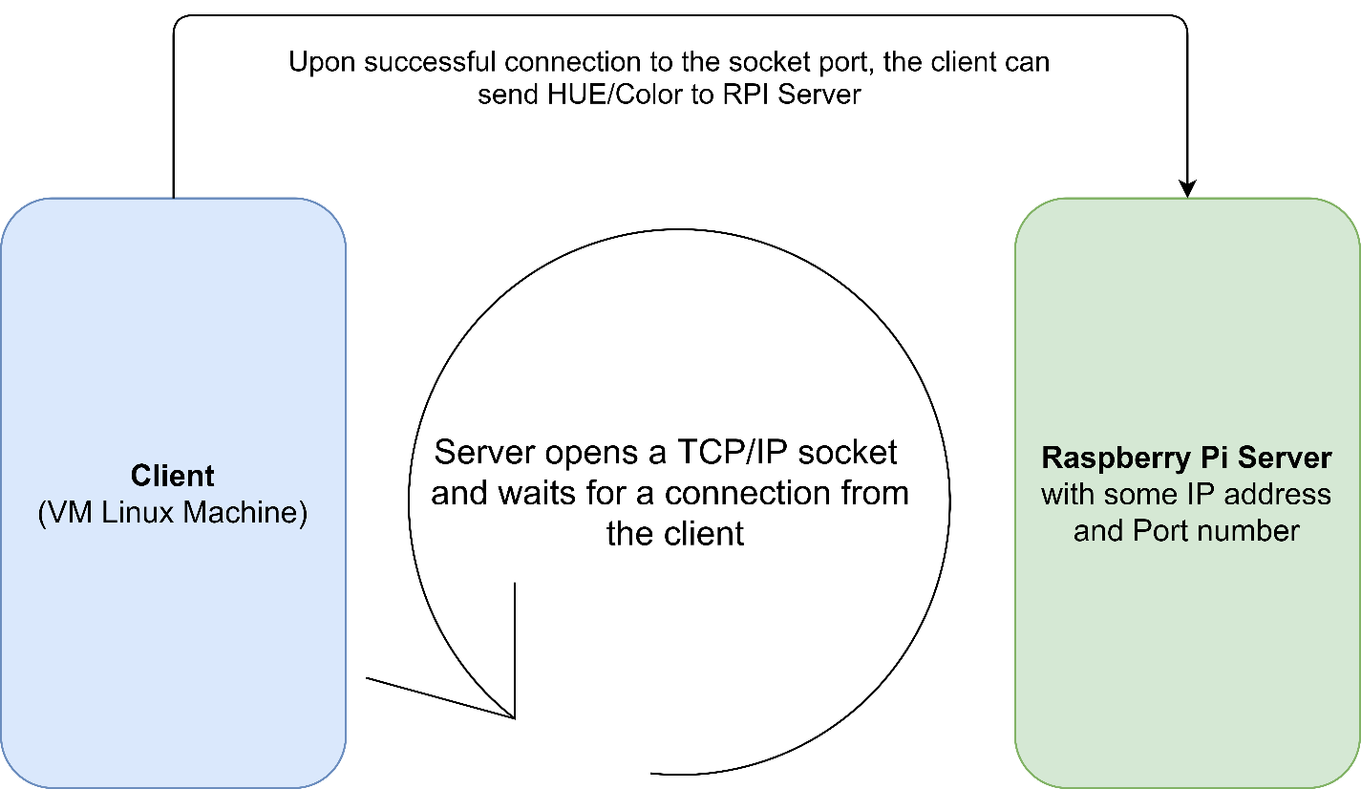
TCP/IP Sockets
#05
SW Implementation
Notes:
Change the dates here (Anythiing is fine)

Slide 10
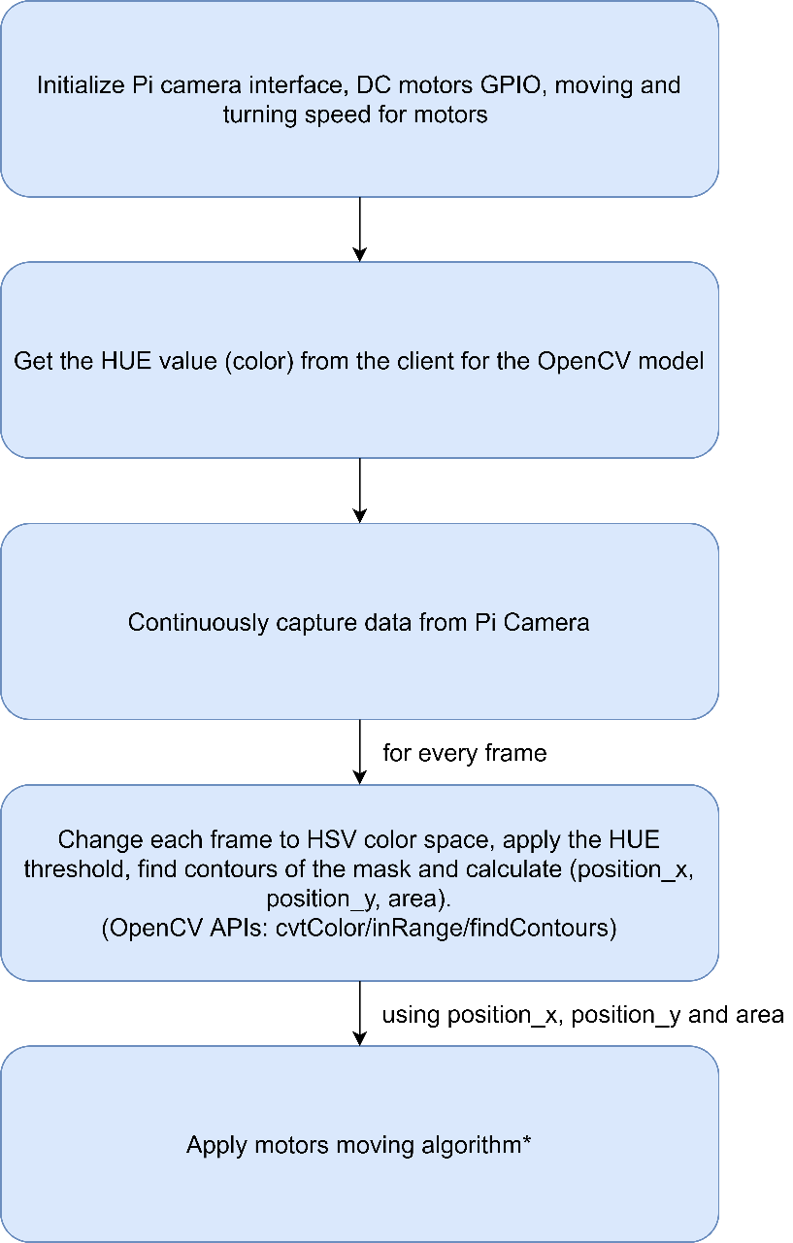
Full Integration
#06
SW Implementation
Notes:
Change the dates here (Anythiing is fine)

Slide 11
Moving Algorithm: 2 Parameters
Using (position_x, position_y,area), FAR decides its movement based on 2 parameters:
Threshold_Area:
If area >= Threshold_Area then the object is close and the robot stops.
position_y’s location:
Based on what section the Y coordinate lies in, the robot moves in that direction.
#06
SW Implementation
Notes:
Change the dates here (Anythiing is fine)

