Slide 1

Mobile App Programming Lab
Final Project
Team #11

Slide 2
Content
01
Motivation & Goals
02
Implementation
03
Team Members’ Roles
04
Completeness

Slide 3
Part 1
Motivation & Goals

Slide 4





Motivation

Slide 5
Goals
Our group’s purpose is to make a platform where refugees and those in need can get help. In addition to build a base for community service and voluntary work.

Slide 6

What is WITH YOU ?
Refugees
Volunteers
An android application to provide information and support to refugees and volunteers in real time when any natural disaster happens.

Slide 7

Existing Tech.
No Smartphone Application
Only Medical Services Provided
volunteer-based emergency medical services (EMS) organization based in Jerusalem, Israel.

Slide 8




Architecture Diagram
Sign Up
Activity
Arduino
Activity
Splash
Activity
Sign In
Activity
Main
Activity
Notice
Activity
Volunteer
Refugee
Google Login API
Donation
Activity

Slide 9
Part 2
Implementation

Slide 10
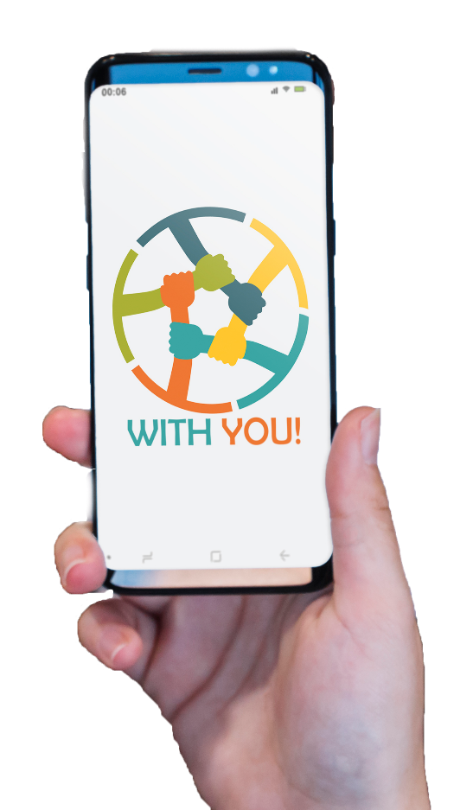


Key Features
Feature 1: Login

Slide 11


Key Features
Feature 2: Arduino

Slide 12

Key Features
Feature 3: Map

Slide 13


Key Features
Feature 4: Donate

Slide 14

Key Algorithms
Shortest Path- Google Route
A* Algorithm

Slide 15
Part 3
Team Members’ Roles

Slide 16
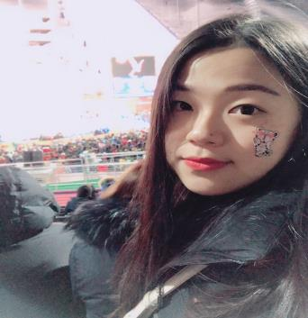
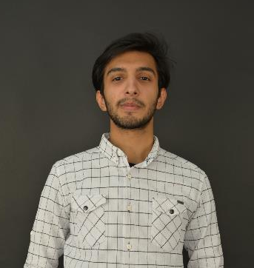
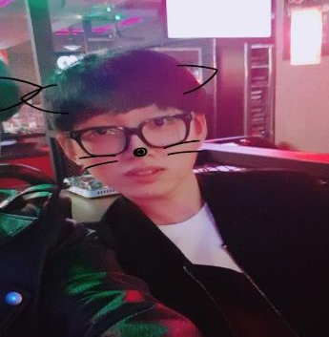
Team members’ role
Young Min Ok
Muhammad Shakeel
Kyung Deok Shin
Frontend Developer
Integration Developer
Presentation Designer
Backend Developer
Arduino Developer
Integration Developer
API Developer
DataBase Developer
Integration Developer

Slide 17
Part 4
Completeness

Slide 18
Proposal & Product
Function | Splash Activity | Gmail Log In | Facebook Log In | Alarm Locally (Button) | Alarm & FB | Get Volunteer Location | Provide Volunteer Location | Short Route
Proposal |  | O | O | O |  | O | O
Actual Project | O | O |  | O | O | O | O | O

Slide 19
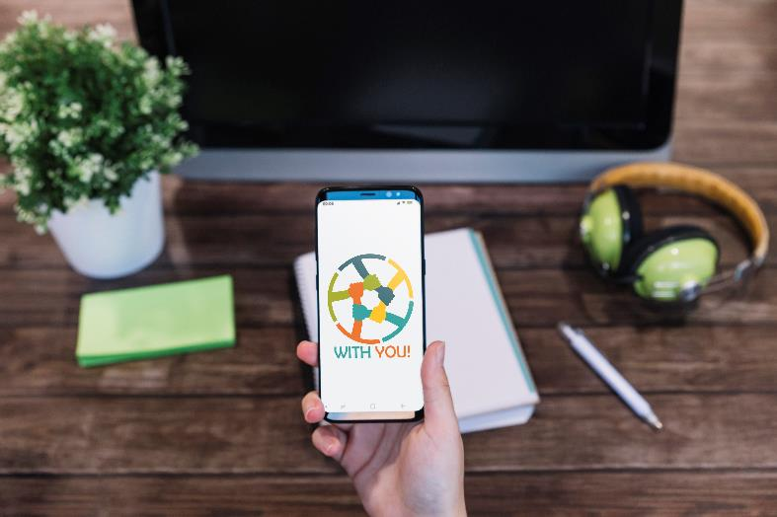
Bugs and Limitations
- Design (node.js/vue.js/ionic)
- Does not work in Korea (API)
- Multi-route complexity .
- Using Tomcat/eclipse rather than loading the webpage to firebase.

Slide 20
Thank You
QnA

