Slide 1

Modern Backends for Mobile Apps
Sasha Goldshtein
CTO, Sela Group
@goldshtn

Slide 3
Azure Mobile is a backend for your mobile apps … that has a free tier … and cloud scale … and support for all mobile platforms

Slide 4
Why Azure Mobile Services?
It is the only holistic MBaaS solution backed by a major cloud provider
If properly designed, it can be detached from Azure and migrated elsewhere (including on-prem)
Parse was acquired by Facebook and discontinued in early 2016
Standalone Parse Server can be hosted on AWS, Azure, etc.
There are numerous products solving a smaller problem (e.g. Urban Airship for push notifications)

Slide 5
Platforms and Features
Platforms (client libraries)
iOS
Android
Windows Phone
Universal Windows Platform
HTML/JavaScript
PhoneGap
Xamarin
Features
Data and queries
Push notifications
Authentication
Server-side scripts
Custom API
Offline sync
Mass push
Git integration

Slide 6
System Diagram
Microsoft Azure
Google Cloud Messaging
Table storage
Server scripts
SQL database
Apple Push Notification Service
Node + Express backend
Mongo DB
Facebook Auth Provider
Custom API
.NET backend
Twitter Auth Provider

Slide 7
Demo: Portal walkthrough

Slide 8
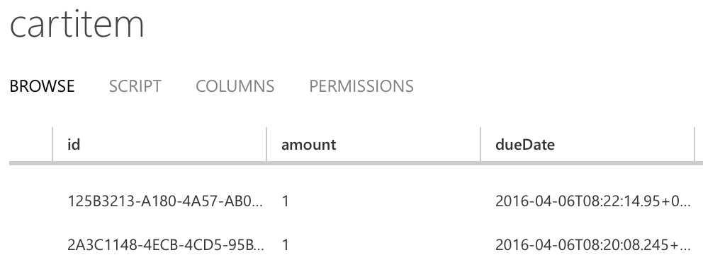
Data Access at a Glance
Futures.addCallback( table.where() .startsWith("title", filter) .orderBy("dueDate").execute(), new FutureCallback<MobileServiceList<CartItem>>() { @Override public void onSuccess(MobileServiceList<CartItem> result) {} @Override public void onFailure(Throwable t) {} } );

Slide 9
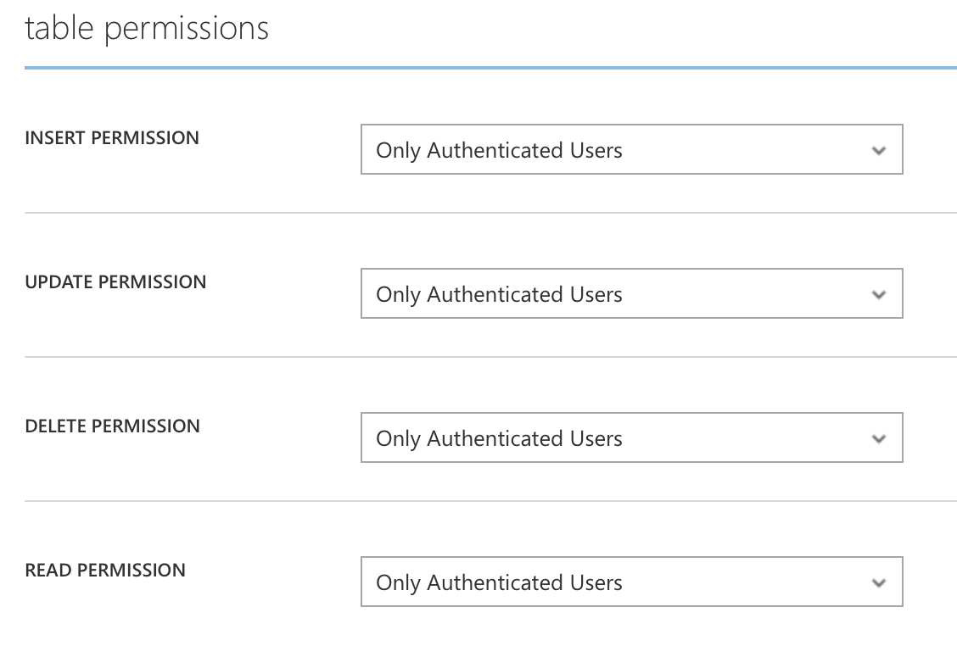
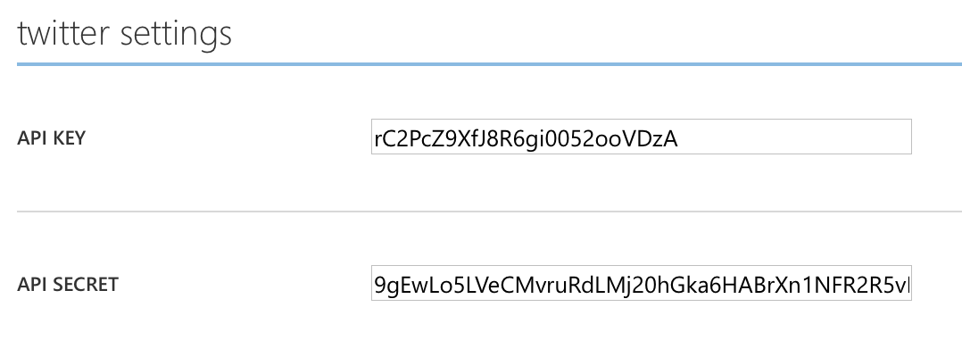
Authentication at a Glance
Futures.addCallback( mobileServiceClient.login( MobileServiceAuthenticationProvider.Twitter), new FutureCallback<MobileServiceUser>() { @Override public void onSuccess(...) {} @Override public void onFailure(...) {} } );

Slide 10
Demo: Data access and login

Slide 11
Typical Push System Diagram
Platform Push Provider
App
Your Web Service
Database

Slide 12
Notification Hub Push Architecture
Microsoft Azure
Google Cloud Messaging
Notification Hub Service
Apple Push Notification Service
Node + Express backend
Tag | URIs/Tokens | Templates
sports | [ ab…, 5a…, …] | alert: … <toast…> data: …
news | [ bc…, 5a…, …]
123456 | [ 5a… ]
Windows Notification Service
Server scripts
Microsoft Push Notification Service
SQL Database

Slide 13
Registration | Template | Channel URI / Device Token | Device Type
12345678… | {"aps":{"alert":"$(breakingnews)"}} | abcd 12f0 … | iOS
45678901… | {"data":{"message":"$(breakingnews)"}} | 556a432f… | Android
78901234… | <?xml version="1.0" encoding="utf-8"?><wp:Notification xmlns:wp="WPNotification"><wp:Toast><wp:Text1>Breaking news</wp:Text1><wp:Text2>$(breakingnews)</wp:Text2></wp:Toast></wp:Notification> | https://live... | Windows Phone
34567890… | <toast><visual><binding template="ToastText02"><text id="1">Breaking news</text><text id="2">$(breakingnews)</text</visual></toast> | https://live... | Windows 10

Slide 14
Demo: Push

Slide 15
Thank you! App: https://s.sashag.net/shoppy16 Code: https://s.sashag.net/shoppy16src
Sasha Goldshtein
CTO, Sela Group
@goldshtn

