Slide 1
Fuel Cells as Viable Electrical Sources
Eric Rees
Department of Materials Science
Cambridge University
ejr36@cam.ac.uk
www.msm.cam.ac.uk/corrosion
Nov 2006
2 ml
360 ml
0.6 ml
0.4 ml
0.2 ml
Hydrogen –
uncompressed gas
Liquid
Hydrogen
Methanol
Li-ion
Battery
Hydrogen
from
Chemical
Hydride

Slide 2
Outline
Fuel cells 1839 – present. Invented by Nasa?
Cell Physics
Existing applications – light energy storage
Advantages over combustion
H₂/O₂ prototypes and challenges
Direct methanol-air cells
Economical components for mass-production…

Slide 3
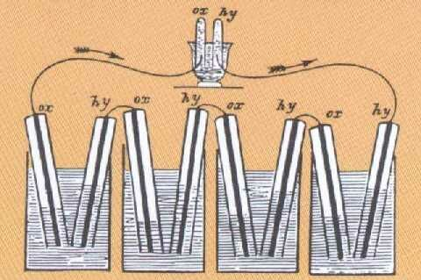
Background 1/2
1) 1839: First publication by William Grove, not long after the first metallic battery (Alessandro Volta’s zinc-silver ‘Voltaic pile’ in 1800).
Alternating H₂ and O₂ electrodes in a ‘gas battery’ – W. Grove, Philos. Mag., Ser. 3, 1839, 14, 127

Slide 4
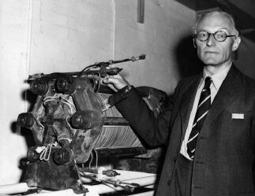

Background 2/2
2) Pressurised, hot alkali fuel cells were developed during the 1950’s, and generated useful power conversion – notably the Bacon cell which was bought by Nasa for the Apollo program…
1959: 5 kW alkaline cell
3) Present day: Honda, GM, etc. have prototype fuel cell vehicles (FCVs) ~ 50 kW
2005: Honda FCV

Slide 5

Prototype hydrogen-burning machine

Slide 6
Cell Physics 1/3
ZINC BATTERY:
Zinc Dissolves to Zn ²⁺ plus electrons
Electrons discharge into an ion slush at a lower energy than they started on the zinc.
2H⁺ + 2e⁻ = H₂
Energy difference can be extracted as a voltage across the cell terminals
Zinc
charge
load
H⁺ ions

Slide 7
Cell Physics 2/3
ZINC CELL
H₂ / O₂ FUEL CELL
electron potential
ZINC
1.5 V
HYDROGEN
HYDROGEN
1.2 V
H₂O

Slide 8
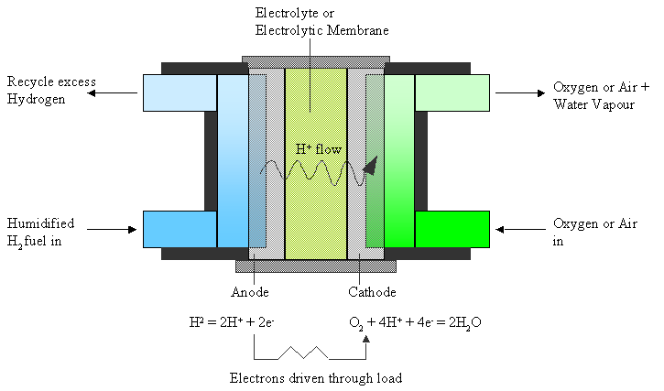
Cell Physics 3/3
Metallic cells use reactive metals as a source of weakly bound electrons – a fuel like hydrogen is a cheaper and lighter source of electrons than a refined metal.

Slide 9
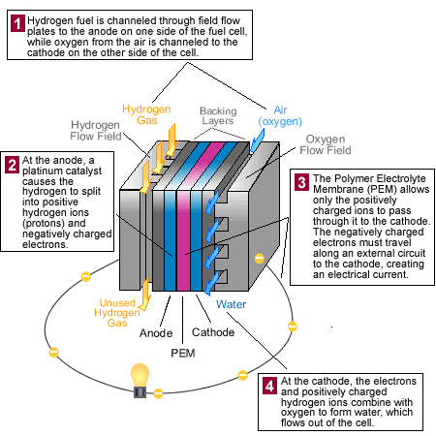
Fuel Cell schematic
(fueleconomy.gov)

Slide 10
Fuel Volume, per Watt hour
360 ml
2 ml
0.6 ml
0.2 ml
0.4 ml
Hydrogen –
uncompressed gas
Liquid
Hydrogen
Hydrogen
from
Chemical
Hydride
Methanol
Li-ion
Battery

Slide 11
Fuel Mass
Watt hours / kg
Fuel Cells
Methanol 6050 liquid
Hydrogen 32630 gas (or cryogenic liquid)
LiBH₄ 2400 chemically stored solid H₂
C₁₀H₁₈ 2400 as liquid hydrogen source
Batteries
Lead acid 30
Ni / Cd 40
Ni / MH 60
Li - ion 130 (now quoted 280)
(Source: Scientific American, July 1999)

Slide 12
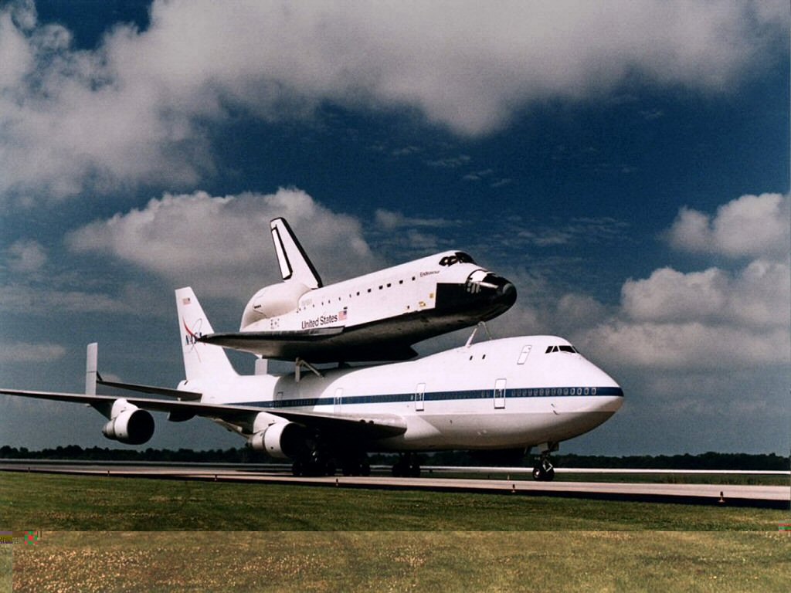
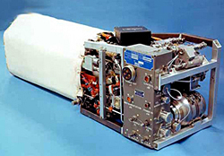
Fuel Cells – Space Shuttle
3 pressurised alkaline FCs run at ~90 ºC, each generating:
2 kW (32.5 V, 61.5 A) at 70 % thermal efficiency, or
12 kW peak output (27.5 V, 436 A) at 60 % efficiency.
Cell Size: 116 kg, 102 cm x 38 cm x 36 cm
(Source: Nasa)

Slide 13

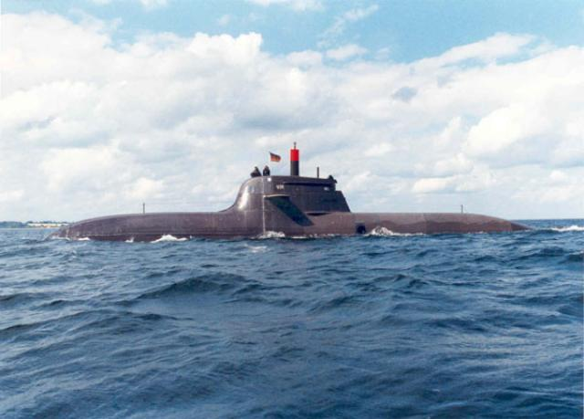
Fuel Cells – U212 Submarine
Nine 30 – 40 kW H₂/O₂ cells.
Uses PEM cells – the preferred design for high power density uses a proton conducting polymer membrane to improve fuel/oxygen contact.
First pair commissioned 19th October 2005, Germany.
56m x 7m x 6m.

Slide 14
FC Advantages
Gravimetric Energy Density (energy stored / mass)
Energy Security (secondary fuel, various sources)
Zero Local Emissions (H₂/O₂ to H₂O vapour)
High Thermal Efficiency! (% fuel energy converted to electricity)

Slide 15
Hydrogen cells – possible applications
Transport
Auxiliary electrical power
Backup electrical supplies
Negligible emissions and efficient fuel use
High density energy storage
No moving parts
Hydrogen Ion Cells?
Probably not suitable for portable use, due to weight of pressurised, chemical, or cryogenic storage systems.
Futuristic Batteries might use hydrogen ions migrating through a crystal lattice as a replacement for today’s lithium ion cells.

Slide 16
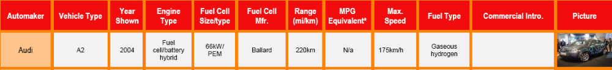
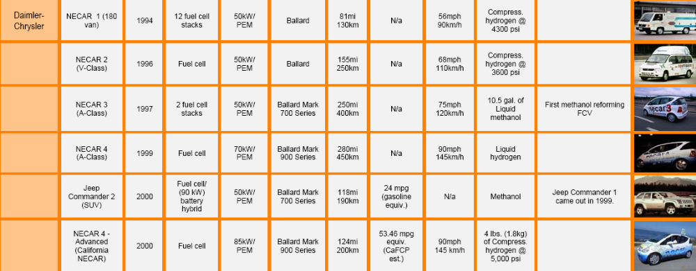
Zero Emission Vehicles
…
(US fuel cells council.)

Slide 17
Thermal Efficiency
Thermal engines are rated by the fraction, η, of heat converted to mechanical energy
Thermodynamic limits on heat recovery…. Internal combustion engine efficiency < 30%*, gas turbines ~ 50%.
Cells convert Free Energy (ΔG) not heat (ΔH). Then H₂/O₂ has a limit of 83%, methanol 97%.
Cells have no theoretical limit except energy conservation – on paper a H₂/O₂ cell can convert the entire Free Energy of the hydrogen oxidation. This corresponds to a cell voltage of 1.22 V.
(
Actual Cell Voltage
)
Real H₂/O₂ fuel cell efficiency =
X 83 %
1.22 V

Slide 18
Losses affecting efficiency 1/2
Activation – increases with log (current)
- most cells lose ~ 0.4 V to bring currents up to the working range
- use a good electrode catalyst (platinum)
Ohmic – increases linearly with cell current
- resistance controls losses at high current
- use a thin electrode structure – low resistance

Slide 19
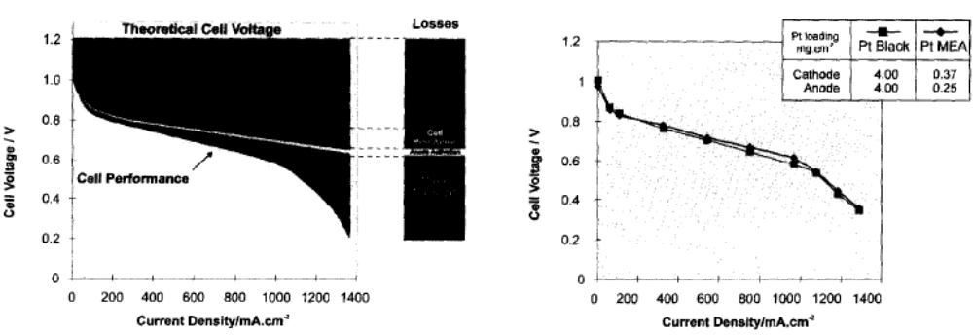
Losses and Typical Efficiency 2/2
e.g. at 0.7 V, 750 mA/cm², thermal efficiency is 48%.
(G.J.K. Acres et al. Catalysis Today, 38, 1997, 393-400.)

Slide 20
Other Contribution to Energy Footprint
HYDROGEN
Manufacture by:
Gas Shift
Biomass and Gas Shift
Electrolysis
Storage by:
Pressurisation
Liquefaction
Methanol for conversion to H₂
Slush stored in polymer foam?
METHANOL
Manufacture by:
Cultivation of biomass, or extraction from oil
Refining

Slide 21
Energy Footprint, Hydrogen Manufacture
GAS SHIFT CH₃OH + (n)H₂O
(2+n)H₂ + CO₂/CO
300 ºC,
NiO / ZnO / Pt cat.
Converts 60 % of fuel energy (C. Chamberlin, 2004, practical)
Or 79 % (Genesis Fueltech, claimed)
ELECTROLYSIS
1 kg hydrogen is equivalent to 1 gallon of petrol, in energy content (33 kW hours, or 118 MJ). Energy price varies – at 4 pence / kW hr, cost of H2 is £1.32 / gge (gallon gasoline equivalent), although conversion efficiency and overheads may double this.

Slide 22
Energy Footprint, Hydrogen Storage
Endurance
50kW, 50% efficiency
Energy
overhead
100 litre tank
PRESSURISED GAS
200 ATM 5.5 % 1.6 kg 32 mins
300 ATM 6 % 2.4 kg 48 mins
360 ATM 6.2 % 2.9 kg 57 mins
LIQUID HYDROGEN
22 K (-251 ºC) 30 % to 40 % 7.0 kg 2.3 hours
(practical)
REFORM METHANOL
Ambient 60% 79.2 kg 2.9 hours
FOAM / H₂ SLUSH
6 wt% H₂ (40 wt% in nanotubes?)
??? ?? Unproven

Slide 23
Energy Footprint, Petroleum
Extraction
Ratio of 50 (energy content of oil: energy for extraction) for accessible oil.
New sources (shale oil, tar sand) are estimated to have ratios of between 2 and 5 (present technology), hence consider the overhead as 20% to 100% extra fuel required compared to the amount consumed.
Refining
Additional overhead depending on grade of oil – will only get worse.

Slide 24
Hydrogen cells – challenges
Miniaturisation!
Reduce Cost - target is < £30 / kW installed system (£600 prototypes)
- reduce cost of components (platinum, cell membranes)
Hydrogen - reduce hydrogen supply cost to < £2 / kg (currently ~6)
- develop storage system for ~ 300 km range
Durability - cell lifetime > 5000 operating hours without degradation for transport, > 100 000 hours for standby generators.
        - (needs electrodes to resist carbon contamination)
(US Department of Energy, summarised)

Slide 25
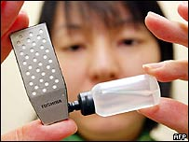

Direct Methanol cells
Mobile Cell. 100 mW power, volume: 22 mm x 56 mm x 5mm. 2 cc fuel, lifetime 20 hours? Toshiba.
Laptop Cell. Volume ~ 1 litre, powers one laptop. 10 hours fuel supply. Toshiba.

Slide 26
Methanol Reaction schematic
CH₃OH
CH₂OH
CHOH
COH
CH₂OOH
CHOOH
COOH
CH
C
CO₂ + H₂O
Multi-step process
Several toxic organics
Complex hence sluggish reaction compared to hydrogen

Slide 27

Methanol cells – challenges
Avoid toxicity! - toxic vapour from air-breathing cells! - scrub output lines with more catalysts?
Control flammable vapour - highly rugged technology
Methanol infrastructure - non-rechargeable cells!
Avoid cell degradation - carbon soot from MeOH is likely to snarl up the cell
Applications…
Remote long-term power supply?
e.g. Alaskan weather stations
C. Chamberlin 2004 (Schatz Energy Research Centre):

Slide 28
Materials Science – Miniaturisation and cost reduction…
Reduce Platinum loading…
Platinum nanoparticles on graphite
Platinum alloys – Pt₃Co
Platinum surfacing onto lattice-matched particles of base material
Reduce membrane electrolyte cost…
Mass production
Expiry of patents…
Replace Platinum entirely!
Base materials: tungsten carbide, tantalum carbide
Embedded nickel
Metal organic compounds

Slide 29
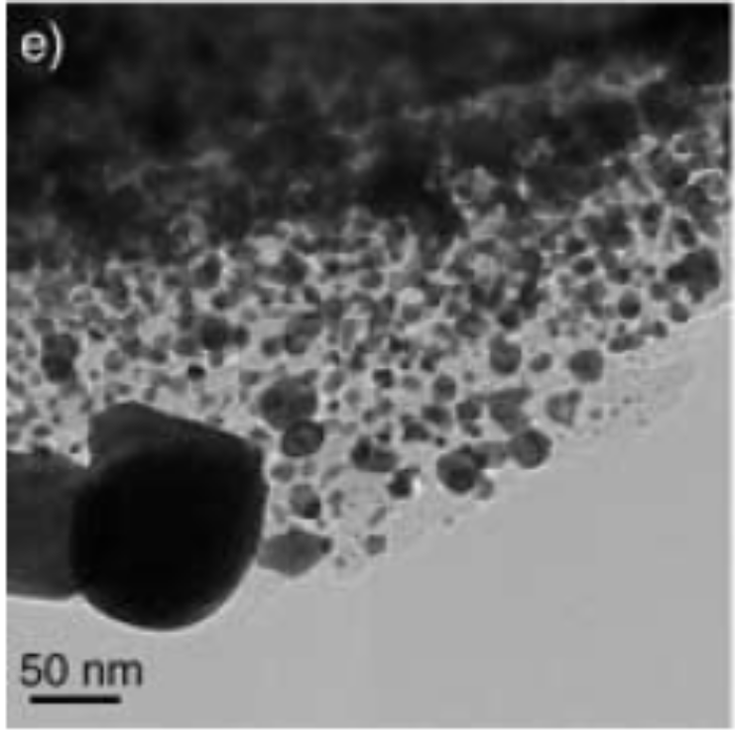
Platinum Nanoparticles
Economising on platinum by coating onto a carbide micro-sphere
(Ganesan, Lee, Angew. Chem. Int. Ed. 2005, 44, 6557 –6560)

Slide 30
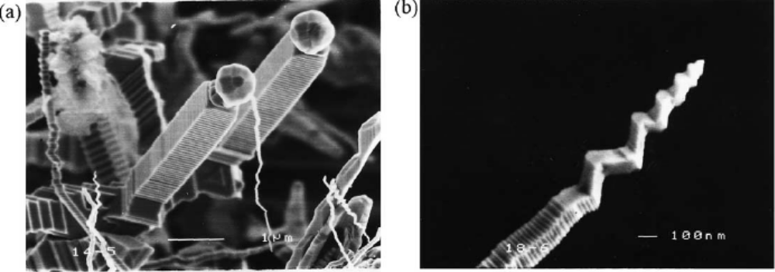
Platinum Replacements 1/2
Nickel Tantalum Carbide.
Resists corrosion
Catalytic, depending on Nickel content
(Y.-J. Chen et al. / Materials Letters 280 56 (2002) 279–283)

Slide 31
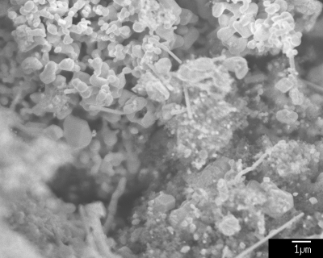
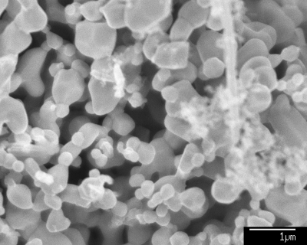
Platinum Replacements 1/2
Tungsten Carbide, Eric Rees, 23 Oct 06
Some catalysis – 30 mA/cm² as an electrolyser, only 2 mA as a cell, both at 150 mV from equilibrium.

