Slide 1
Electric Longboard motors

Slide 2
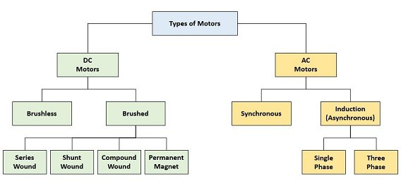
Electric motors
There are many different types of electric motors and almost all of them operate via using electromagnetisim via an induced magnetic field, to spin a rotor.
However, only one type of electric motor is used in electric longboards namely: DC brushless (BLDC) motors and therefore a discussion of the other types would be superfluous (not to mention I have had only 1 class, mechatronics, that went over motors so if you want explanations that are more likely to be accurate, you should just do some research on your own).

Slide 3
DC Motor Characteristics
When power is initially switched to the armature, if it is not spinning, the resistance between the power and ground of the battery, is solely the inductance and resistance (collectively impedance). Since the resistance of the armature is generally <1Ω, DC motors starting from a dead stop, draw large amounts of current.
As the rotor begins to spin, an electric current is induced in the armatures conductors by that is opposite the direction of the applied voltage from the battery. This is known as the counter or back EMF and its magnitude is proportional to the rotation speed of the armature, while the shape of the waveform depends on the shape of the windings. As the rotor spins faster, the counter-EMF grows larger and the effective resistance of the armature increases. The eventual result of this is that a DC motor under no-load moving at its full speed draws very little current.
While for relatively small motors, such as the ones we will be using, starting from a dead-stop is possible, for large motors a starter motor is required because the current draw for the motor starting from a dead-stop would likely destroy motor components (many DC motors were originally started manually until technology evolved and start up motors could be created).
Torque is directly proportional to the armature current times the field flux, so torque is at a maximum for a DC motor starting from a dead stop (this is another reason why large motors have starter motors: to reduce the torque within safe limits), and at a minimum for a DC motor rotating at full speed with no load. This also means that current control enables acceleration control.
Imposing a minimum speed requirement on the longboard to engage the motor means we can have a lower peak current rating of the battery pack, motor, and wires.
For a DC motor with a constant load, rotational speed is directly proportional to the voltage applied to the armature and with a constant voltage, speed is inversely proportional to load

Slide 4
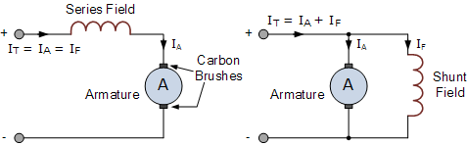
BLDC motor setups
Series connection DC Motor
Armature and field windings are connected in series with battery.
Motor speed is a non-linear function of load torque and armature current so speed regulation is not great.
Has very high startup torque
Should not be started without a load because speeds would be high enough to damage the motor
Shunt Connection DC Motor
Armature and field wingdings connected in parallel with a common D.C power source.
Good speed control even with a varying load.
Lacks high starting torque of series connected DC motor
series connected (left) shunt connected(right)

Slide 5
BLDC motors require controller
The polarity of the magnetic fields through the coils must be flipped at specific times in order to allow for a continuous forward movement of the motor. In a brushed DC motor, this is accomplished automatically via brushes on the commutator.
In a BLDC, this is accomplished via electrical control of an inverter. There are three main types of control schemes employed for three-phase (means that there are 3 stator phases positioned at 120 degree intervals around the axis of rotation), BLDC motors (which is the vast majority of BLDC motors), with their effectiveness dependent on the shape of the generated counter-EMF. The control schemes are Trapezoidal, sinusoidal, and Field-Oriented Control (FOC).
All control methods require knowledge of rotor position although the degree of precision varies.
The optimum goal of the controls is to obtain maximum torque, through adjustment of the current in the stator windings in order to obtain a stator field that is completely orthogonal to the rotor field. Non-quadrature components of the stator field increase stress on the rotor bearings as well as generates waste heat without providing any torque.

Slide 6
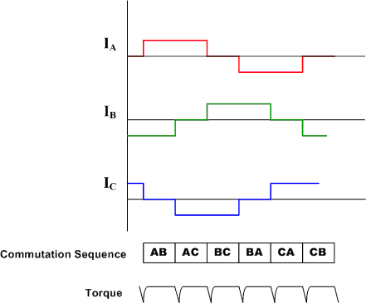
Trapezoidal control
The simplest control method is Trapizoidal control.
At all times during motor operation, one stator winding is connected to the positive supply, one winding is connected to ground and acts as a return path, and one winding is unconnected. During the course of a single mechanical rotation, which winding is in which state changes such that in one full rotation each coil has been in every state. This means that at any point in time, the coils can be in one of six states, which is why Trapezoidal control is also known as six-step commutation.
This method of control only requires a rough approximation of where the rotor location is and thus a sensored motor need only have 3 hall effect sensors spaced 60 degrees part.
The abrupt switching (commutation) every 60 degrees of rotation means that this method of control is prone to torque ripple and limits the smoothness and precision of motor control especially at low speeds. This is because, while on average the current space vector is in quadrature with the rotor field, the instantaneous net stator field can lead or lag by as much as 30 degrees.
It is most efficient if the EMF is Trapezoidal in nature.

Slide 7
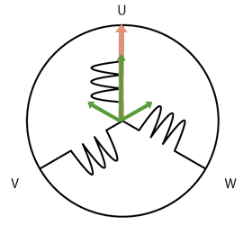
Sinusoidal control
This method of control involves driving the windings with 3 different currents that vary sinusoidal as the motor rotates. The phases of the currents are chosen such that the result is a current space vector that has a constant magnitude and is always orthogonal to the rotor.
This method if done properly, largely eliminates the torque ripple and commutation spikes associated with Trapezoidal control.
Requires current sensing circuitry as well as much more precise knowledge of rotor precision than trapezoidal control, which in turn necessitate the use of a rotary encoder or resolver in sensored BLDC designs.
Most effective if back-EMF is sinusoidal in nature and motor is rotating at low speeds.
At higher speeds, PI controllers have more difficulty tracking the higher frequency sinusoidal current signals. This along with the need to overcome an back-EMF of increasingly high amplitude and frequency causes lead and lag errors, with higher speeds causing higher errors. These errors make the current space vector change direction with respect to the rotor.
Above a certain speed, current motor phase shift crosses 90 degrees, making the torque zero and operation of the motor impossible.
Gif depicting current space vector with sinusoidal control.

Slide 8
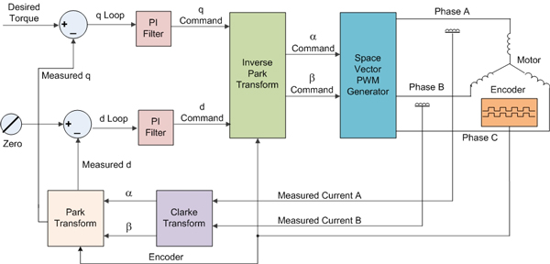
FOC or vector control
In FOC, the sensed stator currents are translated into rotor direct (D) and quadrature (Q) components by a transform function. The D and Q currents are then compared, respectively, with zero and the torque requested by the application. The resulting error signals are input to two PI blocks, which then generate signals in the D-Q reference plane. Subsequently, these signals are transformed into the stator domain, This allows for the maintenance of a constant stator field in quadrature with the rotor field irrespective of any bandwidth limitations of the PI controllers.
This method allows for both high efficiency over the full speed range, quick acceleration and acceleration allowing fast response to dynamic loads, and minimizes power consumption and torque ripple.
Requires computational intensive and rapid mathematical computations as well as precise knowledge of rotor location, necessitating either a rotary encoder or a resolver in sensored motor designs
Can be implemented using either hardware or software e.g., build an IC device whose input is the Clarke transform of the output vs. writing a software function.
Control diagram depicting FOC algorithm

Slide 9
Sensorless BLDC motors
The most common type of BLDC motors are sensored motors with the 3 hall effect sensors.
If knowledge of rotor position to a much higher degree of precision is required, there are BLDC motors with either encoders or resolvers.
Alternative to sensored motors are sensorless motors, which are attractive due to increased robustness and compactness.
Rotor position in sensorless is determined by monitoring the counter EMF generated in one or more the stator coils.
Because EMF is zero when the motor is not rotating, sensorless motors at a dead stop, startup in an open loop configuration with a predetermined sequence. While inefficient, this will allow the motor rotate until it has reached a high enough speed that the generated EMF is large enough to switch to efficient, closed-loop operation.
As a result of this, applications of BLDC that require low speeds generally use motors with sensors.

Slide 10
ESCs
There are a wide variety of electronic speed controls (ESCs) for electronic skateboards.
Most of them are capable of implementing both trapezoidal and vector control.
They can be either dual or single motor drives.
Many of them can work with both sensored and sensor-less motors.
A common one is called VESC and it is an open-source design, with electrical schematics as well electrical BOM freely available.

Slide 11
Belt vs hub motors
Belt | Hub
Difficult to use without electric power higher maintenance issues less durable and weatherproof Much higher torque, so better acceleration Substantial number of wheel options heat dissipation isn’t a big issue less efficient noisey many more DIY off the shelf choices They weigh significantly more and are bulkier | Can be used as a regular skateboard less maintenance issues higher durability and greater weatherproofing less torque heat dissipation due to enclosure is a significant issue near 100% efficiency more compact and less weight. A given motor generally has a choice of only one or two specifically designed wheels.

Slide 12
Types of Hub Motors
In a direct drive motor, the outer shell of the hub is part of the motor and the shafted is fixed in place. When the motor runs, it spins the hub, and thus the wheels directly.
In a geared hub motor, the motor is outer hub is connected to the motor shaft via gearing.
Direct Drive | Geared
Simpler Quieter Lower torque Heavier and larger Less maintenance Few suppliers Less efficient due to higher wattage needed to produce a given torque. | Decreased longevity Much higher torque Smaller and lighter Louder More common type of hub motor Heavier loads have a higher impact on efficiency. More efficient due to lower wattage needed to produce a given torque.

