Slide 1
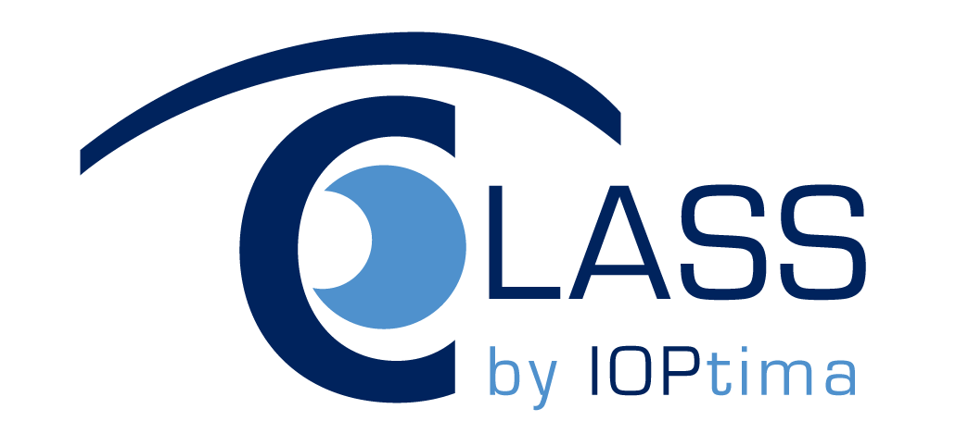


Are you diagnosed with Glaucoma?
Would you like to maintain your sight?
Are you tired of applying medications?
If yes is the answer, then you are a perfect candidate for a CLASS procedure
CLASS™ by IOPtima Better & Safer Glaucoma Surgery

Slide 2


IOPtiMate – a first CLASS for your Glaucoma treatment
Glaucoma is caused by an increase in pressure within the eye as a result of blockage of the flow of the intraocular fluid (also known as aqueous humor). Blockage of the aqueous humor flow causes increased pressure that if unrelieved causes vision impairment.
IOPtima’s Solution
IOPtima Ltd. has developed the IOPtiMate, a unique, minimally invasive CO₂ laser-assisted system for the treatment of Glaucoma.
In utilizing the particular properties of the CO₂ laser, CLASS procedure thins the white part of the eye (the sclera wall) by ablating surges at the natural drainage area (the Schlemm’s Canal) without penetrating into the eye. The use of the CO₂ laser facilitates adequate, functional percolation of intra-ocular fluid from the eye through the remaining membrane in a simple, highly controlled and specific manner.
CLASS™ by IOPtima Better & Safer Glaucoma Surgery

Slide 3


Don’t lose sight of those precious
moments in life
Glaucoma is a group of eye disorders characterized by progressive loss of nerve tissue, often leading to blindness. It is the second leading cause of vision loss in the world. As is the case with most eye diseases, the elderly are most affected by Glaucoma with incidence of the disease growing as age advances.
Normal Vision Glaucoma

Slide 4
“The system transforms complex and highly risky glaucoma surgery into a safe, elegant and precise laser-assisted procedure.”
Prof. Ehud Assia, MD
Safe, minimally-invasive laser procedure
Unlike other surgical solutions, the CLASS procedure is non-penetrating and doesn’t involve foreign bodies
Low post-operation complications rate
CLASS procedure reduced complication rates in comparison with other current surgical solutions
Significant long-term reduction of IOP, stable over time
One-time procedure reduces the need for medications
Consult your eye physician for a first CLASS laser treatment for Glaucoma or visit us at www.IOPtima.co.il
CLASS™ by IOPtima Better & Safer Glaucoma Surgery

