Slide 1
Tanks
Matthew Goldstein, Savanah Many, and Joseph Chouinard

Slide 2
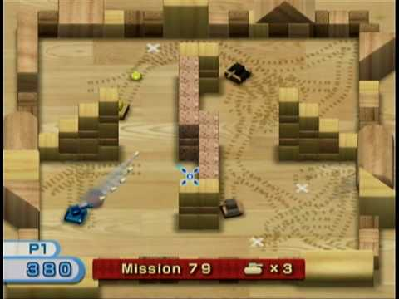
The Game - Tanks
A Windows rendition of the WiiPlay game “Tanks”

Slide 3
Controls
W – move forward
A – rotate left
S – move backward
D – rotate right
Space – place mine
Move mouse – aim gun
Mouse Left Click – fire gun

Slide 4
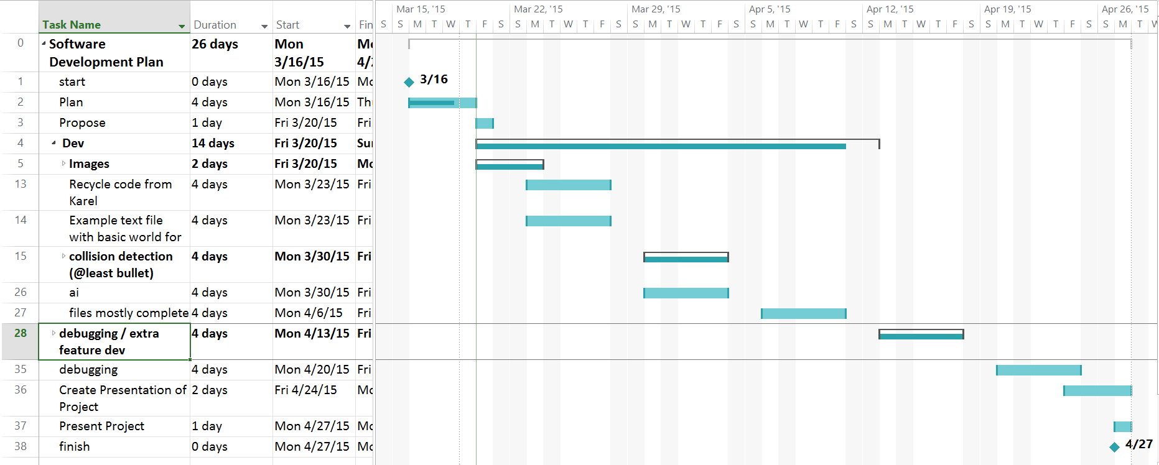
Project Management
Microsoft Project Gantt Chart

Slide 5
Work Breakdown
Joe – World Management / Drawing objects, Walls, & Collision Detection
Matt – AI, ReadFile, TanksObject, & Collision Detection
Savanah – Tanks, Bullets, & Mines
All - Images

Slide 6
Structure
Arrows
Show Inheritance

Slide 7





We Aren’t Graphic Designers

Slide 8
Set-backs
Collision Detection
ReadFile not properly opening a file
Rotating Images
Can’t use custom pointer because it breaks ReadFile (Windows.h)
Can’t return template arrays

Slide 9
Things We’ve Learned
Matt hates making games
Learned a lot about collision detection
Planning ahead helped us keep on track
Nothing goes as well as you plan

Slide 10
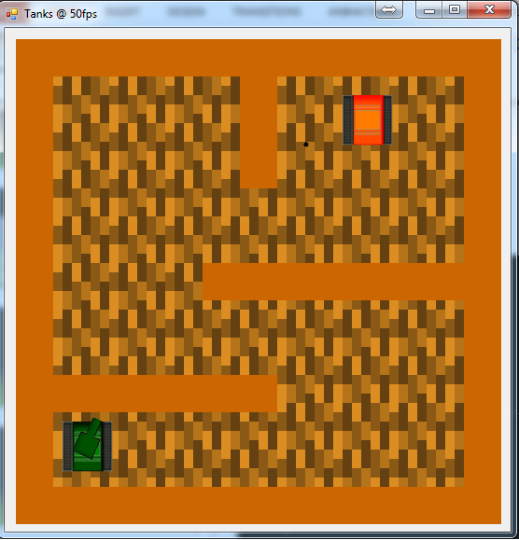
Screenshot

Slide 11
Game Demonstration

Slide 12
Any Questions?

