Slide 1
Tanks
Matthew Goldstein, Savanah Many, and Joseph Chouinard
Notes:
FULL NAMES

Slide 2
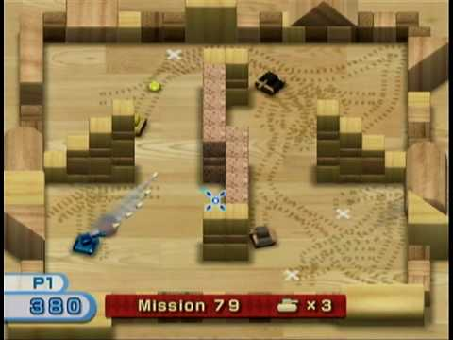
The Game - Tanks
A Windows rendition of the WiiPlay game “Tanks”
Notes:
Savanah: Game objective

Slide 3
Controls
W – move forward
A – rotate left
S – move backward
D – rotate right
P – pause / un-pause
R - restart
Space – place mine
Move mouse – aim gun
Mouse Left Click – fire gun
Notes:
Joe: controls

Slide 4
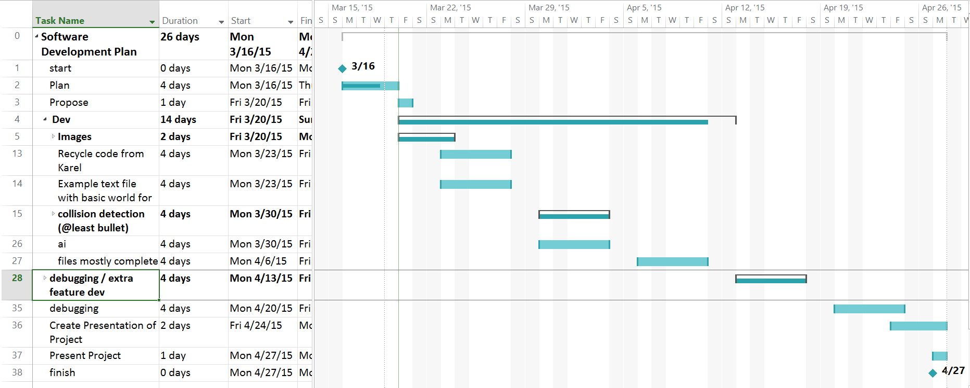
Project Management
Microsoft Project Gantt Chart
Notes:
Matt: Gantt Chart that helped us to keep focused on what needed to be done

Slide 5
Work Breakdown
Joe – World Management / Drawing objects, Walls, & Collision Detection
Matt – AI, ReadFile, TanksObject, & Collision Detection
Savanah – Tanks, Bullets, & Mines
All - Images
Notes:
Joe: Explain roles
Savanah: Explain roles
Matt: Explain roles
Joe: Everyone worked on images

Slide 6
Structure
Arrows
Show Inheritance
Notes:
Matt: Class structure breakdown. Arrows show inheritance.
TanksObject Superclass

Slide 7






We Aren’t Graphic Designers
Notes:
Savanah: Explain the different images
(from top left to right then bottom left to right) Player tank
Enemy tank
Mines
Walls
Pointer (didn’t get to use…explained later)
Floor (tileable)

Slide 8
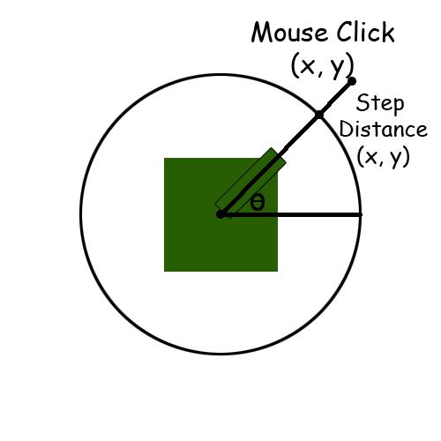
Bullet Mechanics
Notes:
Joe: explain mechanics of bullet travel
If you have a circle of a specified radius around the center of the tank, you can calculate the angle between the mouse-click and the horizontal line, and use trigonometry to determine where this intersects the circle. Can then use this point to determine step distances for bullet.

Slide 9
Notes:
Code to accompany previous slide

Slide 10
Set-backs
Collision Detection
ReadFile not properly opening a file
Rotating Images
Can’t use custom pointer because it breaks ReadFile (Windows.h)
Can’t return template arrays
Notes:
Joe: Collision Detection (many redesigns) and Rotating images (was very difficult and time consuming to figure out)
Matt: Readfile issue (filename defined after opening file—compiler didn’t catch), custom pointer (w/o drastically reducing speed or using a graphics API, need to use Windows.h which destroys our ability to use file input class, thus destroying our ability to draw the world), template arrays (can’t return them, workaround)

Slide 11
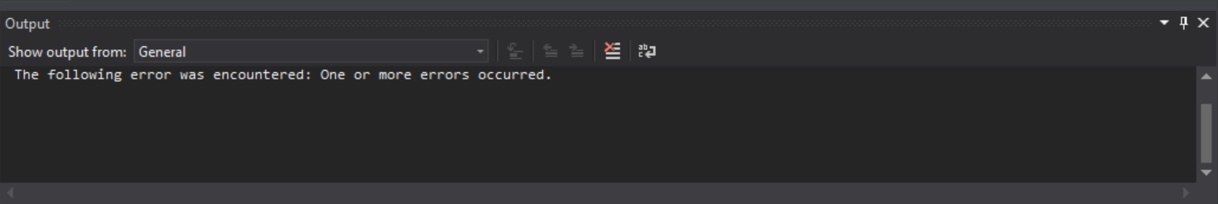
Things We’ve Learned
Matt hates making games
Learned the logic behind collision detection
Planning ahead helped us keep on track (mostly)
Nothing goes as well as you plan
Notes:
Matt: I hate making games
Learned how collision detection works and the logic behind writing collision detection
Planning ahead helped stay focused but issues drove us off course
Could get this ambiguous error: “One or more errors occurred.”

Slide 12
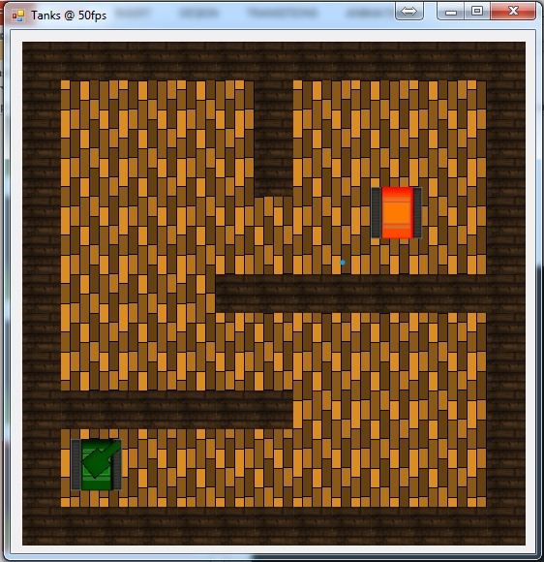
Screenshots
Notes:
Savanah: This shows gameplay

Slide 13
Notes:
Savanah: (Left) player wins…shot tank
(right) Player loses… shot by ai

Slide 14
Notes:
Savanah: Player can place a mine (right) ai dies when hit mine – player wins

Slide 15
Notes:
Savanah: Game is pause-able. Everything stops and all that can be done is un-pause or restart

Slide 16
If we had more time…
Animations
Sound Effects
More levels
More sophisticated AI enemies
Multiplayer
Score
Notes:
Matt: We were a little ambitious in our plans
Animations (explosions)
Sound effects (explosions, collisions)
More levels (different amounts of enemies and configurations)
More Sophisticated AI (different types of enemies that work differently)
Multiplayer
Scoring

Slide 17
Game Demonstration
Notes:
HOPEFULLY THERE IS TIME :D

Slide 18
Overall
Playable game
Demonstrates ability
Very Satisfied
Notes:
Joe: Overall, we have a playable game with double-buffered graphics, collision detection, and a fully functioning Artificial Intelligence enemy. This shows our ability as programmers, and we are very satisfied with our progress and outcome.

Slide 19
Any Questions?
Notes:
I sure hope not…

